Slide 1
Emergency Preparedness for Opioid Use Disorder Treatment
Tiffany Y. Lu, MD MS FASAM
Associate Director of Addiction Services, NYC H+H/Jacobi Behavioral Health Services Associate Professor of Medicine & Psychiatry, Albert Einstein College of Medicine

Slide 2
Key Questions
What is opioid use disorder in the context of overdose crisis?
How is opioid use disorder treatment delivered?
How is treatment access changing to address overdose crisis?
How can hospitals help with OUD treatment during emergencies?

Slide 3
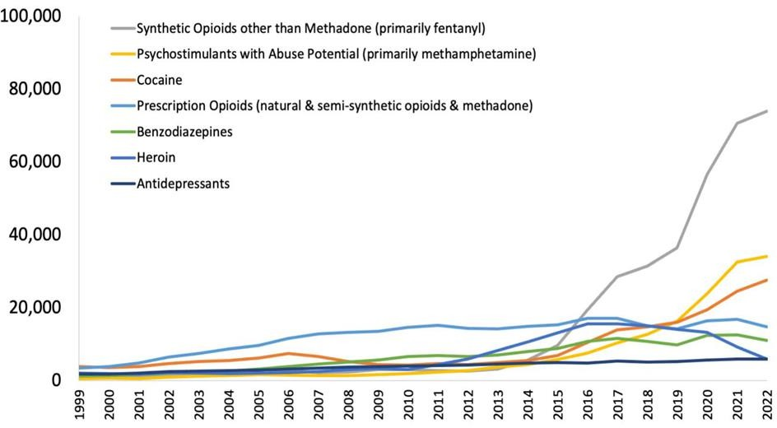
US Crisis: A Decade of Rising Overdose Deaths
National Center for Health Statistics, Centers for Disease Control and Prevention. Released 4/2024.
https://nida.nih.gov/research-topics/trends-statistics/overdose-death-rates#Fig2

Slide 4
Ongoing overdose crisis in New York City
In 2023, 1 person died of a drug overdose every 3 hours
83% overdose deaths involved opioids, mostly fentanyl
59% overdose involved cocaine
NYC Epi Data Brief October 2024. No. 142.
|

Slide 5
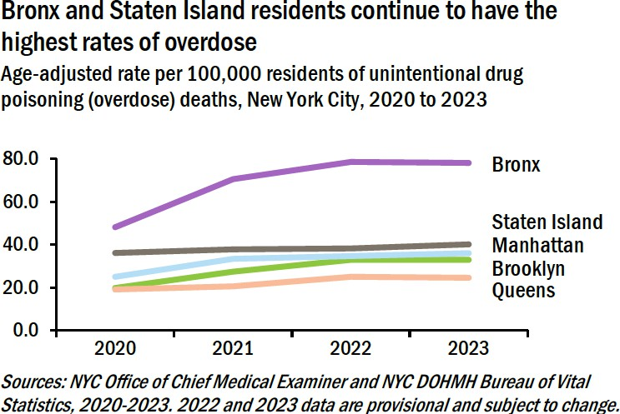
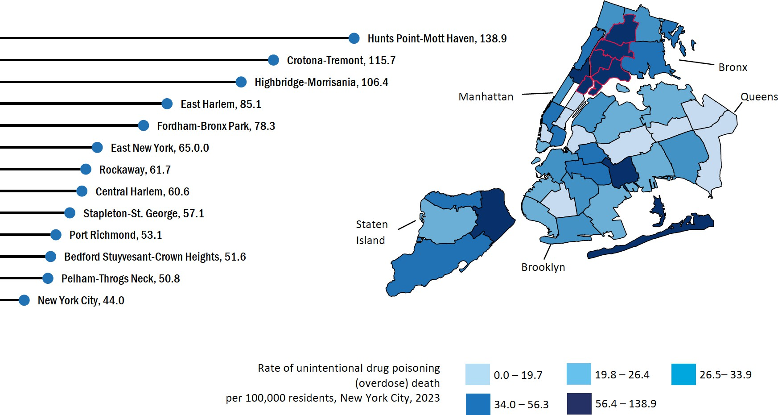
Overdose Disparities by Borough
NYC Epi Data Brief October 2024. No. 142.

Slide 6
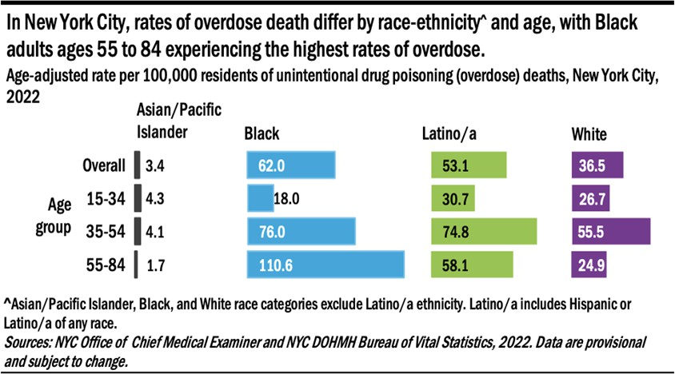
Overdose Disparities by Age and Race
NYC Epi Data Brief Sept 2023. No. 137

Slide 7
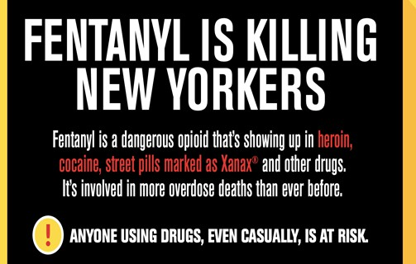
Unregulated Opioids Rapidly Changing
High potency synthetic opioids, not heroin
Fentanyl & fentanyl analogues (30-50x heroin, 100x morphine)
Nitazines (up to 20x fentanyl)
Lipophilic, easily crosses blood-brain barrier → increased overdose risk
Alpha 2 agonist sedatives as adulterants
Xylazine is not an opioid → sedation effects
not reversed by naloxone
Peripheral vasoconstrictive effects → skin ulceration and necrosis
Informational Bulletin June 21, 2024:
Co-occurring substance use
Stimulant use on the rise to help counter sedating effects of fentanyl → stimulant related medical/psychiatric complications
-Carfentanil (HPSO) identified in NYC
-Medetomidine/dexmedetomidine (alpha 2 agonist) observed in several states

Slide 8
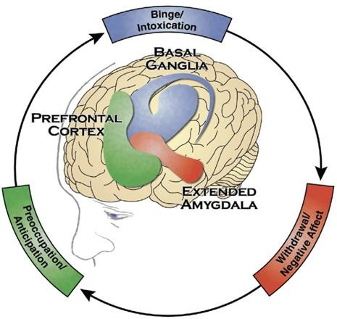
Overdose risk is highest for people with opioid use disorder
Chronic opioid use results in disrupted dopamine & glutamate signaling in brain’s reward circuits & stress- control systems
Neuro-adaptations manifest in behavioral changes, such as compulsion to use opioids despite negative consequences
Not everyone who uses opioids develop problems: Individual susceptibility to addiction is shaped by biological, social and environmental factors
Olsen. Med Clin N Am. 2022.

Slide 9
Clinical diagnosis of Opioid Use Disorder (OUD)
DSM-V Diagnostic Criteria:
Presence of 2 or more criteria below within a 12-month period
Physical dependence
Tolerance*
Withdrawal symptoms*
Loss of control
Severity defined by # criteria met: 2-3=Mild
4-5=Moderate
>6=Severe
Cravings
Unsuccessful attempts to stop or cut down
Using longer/larger amount than intended
Large amount of time/effort obtaining or recovering from opioids
Negative consequences
Unable to fulfill roles (work, parenting)
Negative impact on relationships
Hazardous conditions (DUI)
Negative physical or psychosocial consequences
Social/recreational activities given up
*Tolerance and withdrawal are not applicable if taking opioids soley as prescribed

Slide 10
Key Questions
What is opioid use disorder in the context of overdose crisis?
How is opioid use disorder treatment delivered?
How is treatment access changing to address overdose crisis?
How can hospitals help with OUD treatment during emergencies?

Slide 11
Evidence-Based Care for Opioid Use Disorder
Medication
Methadone Buprenorphine Naltrexone
Harm Reduction
Harm Reduction
Recovery Support
Mutual support groups, peer recovery coaches, housing, case management, etc
Psychosocial Counseling
Cognitive behavioral therapy, contingency management, etc

Slide 12
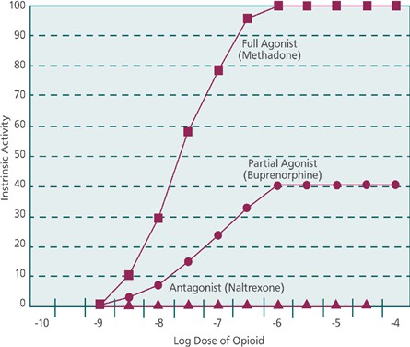
Medications for OUD are highly effective
3 FDA approved medications:
Methadone – full opioid agonist
Buprenorphine – partial opioid agonist
Naltrexone-ER – opioid antagonist
“Detox” is just the first step to
stabilization/remission:
Short-term opioid withdrawal management with medication taper is not effective compared to long-term maintenance therapy
Medications for OUD Treatment act differently on the body’s mu opioid receptors
Sees et al. JAMA 2000. Fiellin et al. JAMA Intern Med 2014.

Slide 13
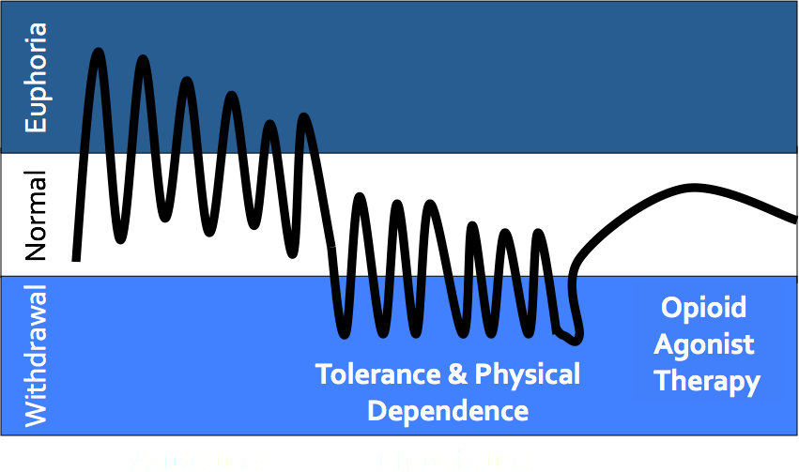
OUD treatment improves physical and psychosocial functioning
Goals of opioid agonist therapy: restore brain structure and function, reduce or eliminate compulsive opioid use, promote treatment retention, improve psychosocial functioning

Slide 14
Effectiveness of medications for OUD
 | Methadone | Buprenorphine | Naltrexone-XR
All cause mortality | ↓ | ↓ | ----
Non-prescribed opioid use | ↓ | ↓ | ↓
Retention in treatment | ↑↑ | ↑↑ | ↑
HIV or HCV transmission | ↓ | ↓ | ----
Legal involvement | ↓ | ↓ | ↓
Mattick et al. Cochrane Database Syst Rev 2014; Sordo et al. BMJ 2017; Jarvis et al. Addiction 2018

Slide 15
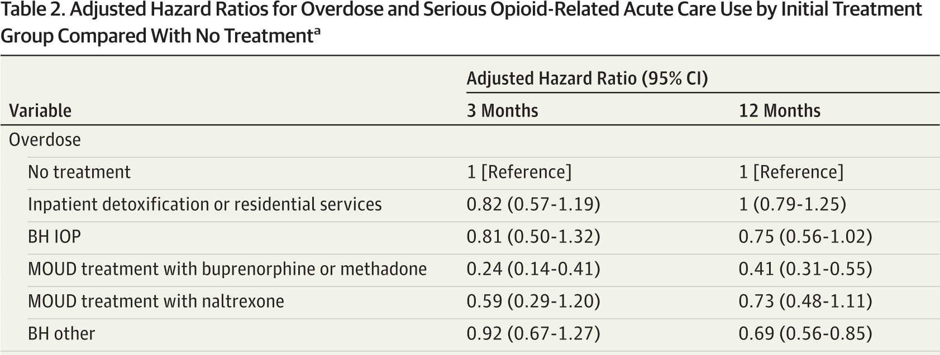
Buprenorphine and methadone treatment for OUD save lives
Among 40,855 insured US adults with OUD between 2015-17:
Buprenorphine or methadone is associated with 76% reduction in overdose at 3 months and 59% reduction in overdose at 12 months compared to no treatment
Wakeman et al. JAMA Network Open. 2020. BH = Behavioral Health

Slide 16
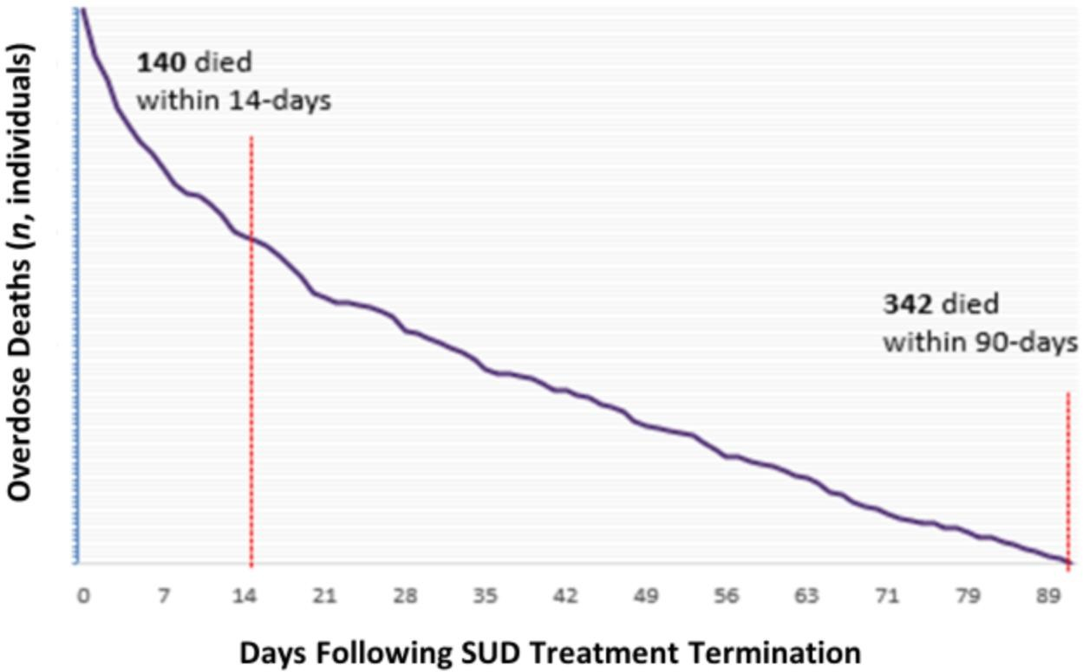
Mortality Risk Without OUD Treatment
Among 51,170 NYC residents with OUD who received NYC- based OUD treatment (between
Jan 2016-June 2019),
342
persons died from an overdose
within 90 days following treatment
termination
. 14 of the 342
overdose deaths (41%) occurred within 14 days.
NYS Office of Addiction Services and Supports, Addiction Data Bulletin (No. 2024-03); June. 2024.

Slide 17
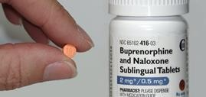
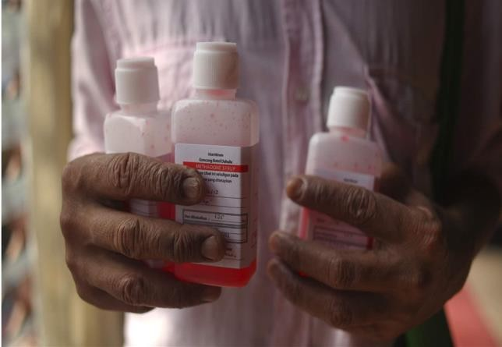
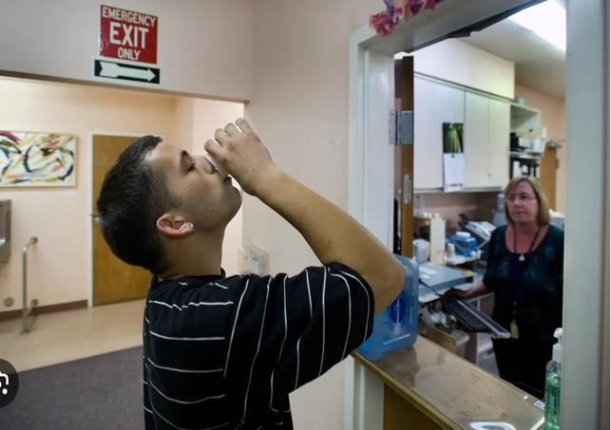
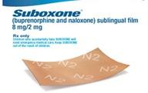
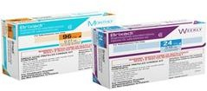
Opioid agonist medications for OUD
Methadone –
Liquid Dose Observed in Opioid Treatment Program (OTP) or Dispensed as Take-Home Bottles
Buprenorphine –
Sublingual Tablets/Films Prescribed to Pharmacy or Weekly/Monthly Injections Administered in Clinic

Slide 18
How is OUD treatment delivered?
 | Methadone | Buprenorphine | Naltrexone
DEA Regulation | High-level regulations (Schedule II) | Some regulations (Schedule III) | Not regulated as controlled rx
Location | Licensed opioid treatment program (OTP) | Anywhere, including primary care and mental health clinics | Anywhere
Provider | MD, DO, NP, PA enrolled as OTP provider | MD, DO, NP, PA with DEA license | Any prescriber
Dispensing | At OTP | Pharmacy | Pharmacy
Counseling | Regulated | Ability to refer | --
Visits | Regulated | -- | --
Urine drug tests | Regulated | -- | --
Dosing | Regulated | -- | --

Slide 19
OUD Treatment Access in NYS
In 2022, there were an estimated 2.8 million New Yorkers aged 12+ who had a substance use disorder in the past year.
100,177 persons enrolled in licensed SUD treatment services
•
57,734 (57%) enrolled in licensed treatment programs for
problems related to heroin/other opioids
40,781 enrolled in opioid treatment programs (OTPs)
14,784 enrolled in outpatient programs
Numbers do not include New Yorkers who access medication treatment
for OUD through primary care/mental health clinics

Slide 20
Most people with OUD do not receive evidence-based life-saving treatment!
6.1 million people > age 12 with past year OUD in US
18%
82%
Did not receive
Received treatment
2022 NSDUH (SAMHSA)

Slide 21
Fragmented Systems of Addiction Care
Harm reduction services
Addiction treatment
Mainstream healthcare (hospitals, clinics)
Mental health treatment
Siloed by different regulations, payors, providers and practices

Slide 22
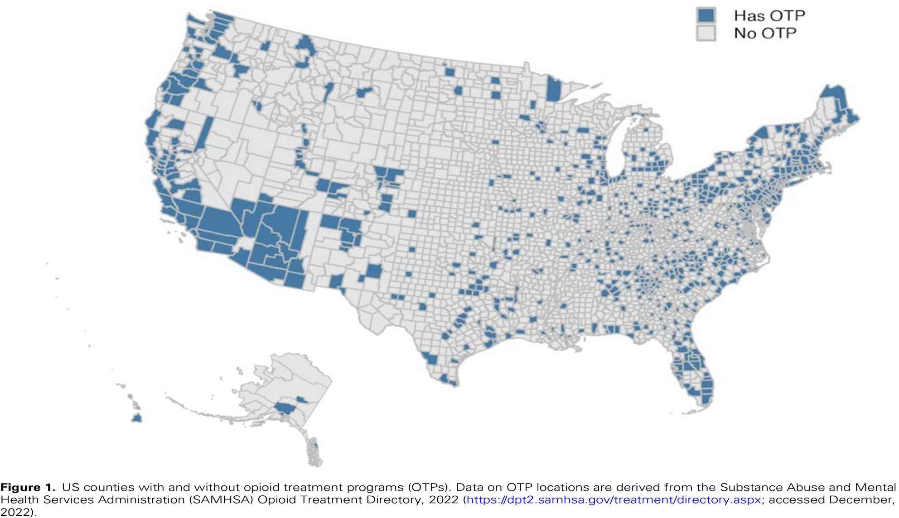
Methadone access varies across US
Only 20% of US Counties have methadone access through federally certified opioid treatment programs (OTPs)
Krawczyk N et al. Health Affairs Scholar, 2023, 1(1), 1–4

Slide 23
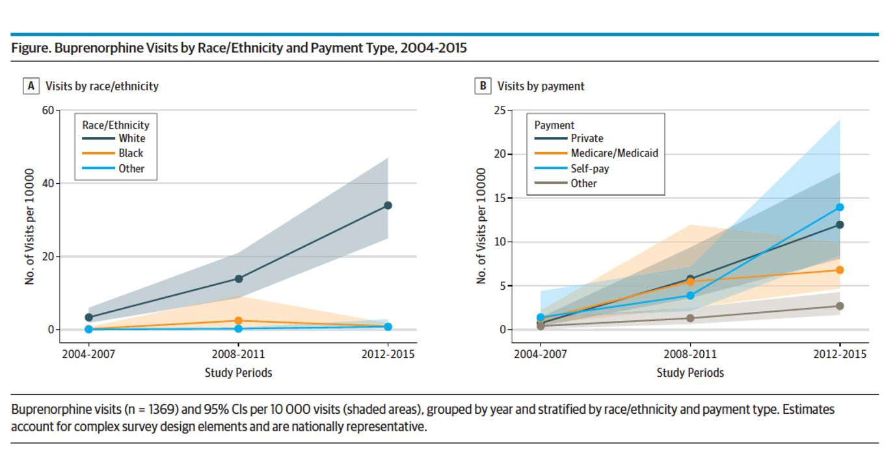
Buprenorphine treatment differs by insurance and race
White Americans and privately insured/self-pay individuals more likely to access buprenorphine treatment than non- White and publicly insured
Lagisetty P et al JAMA Psychiatry 2019

Slide 24
Key Questions
What is opioid use disorder in the context of overdose crisis?
How is opioid use disorder treatment delivered?
How is treatment access changing to address overdose crisis?
How can hospitals help with OUD treatment during emergencies?

Slide 25
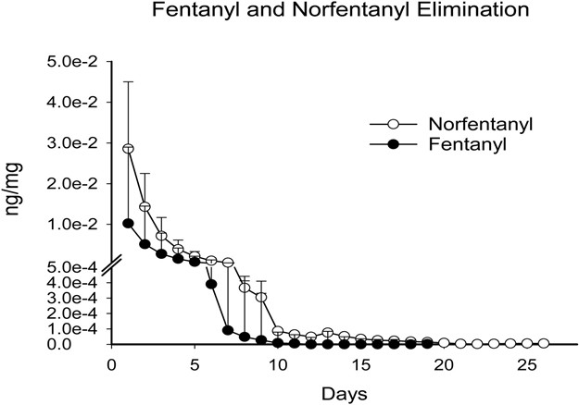
Fentanyl Specific Challenges to OUD Treatment
Frequent cycling thru intoxication and withdrawal
Rapid on but rapid off
Chronic use leads to fentanyl
accumulation in fat tissue
Variable and extended fentanyl metabolism between patients with opioid use disorder
Huhn et al. Drug and alcohol dependence. 2020 Sep 1;214:108147.

Slide 26
Common patient concerns in the fentanyl era
“I would rather have methadone”
Patient are unable to tolerate withdrawal long enough to start buprenorphine with traditional dosing strategies
“Suboxone makes me sick”
Patient reports precipitated withdrawal with buprenorphine
“Suboxone doesn’t work for me”
Withdrawal and cravings persist despite buprenorphine initiation
“I need more methadone”
Patient reports inadequate relief of opioid withdrawal and cravings on typical initiation doses of =< 40mg

Slide 27
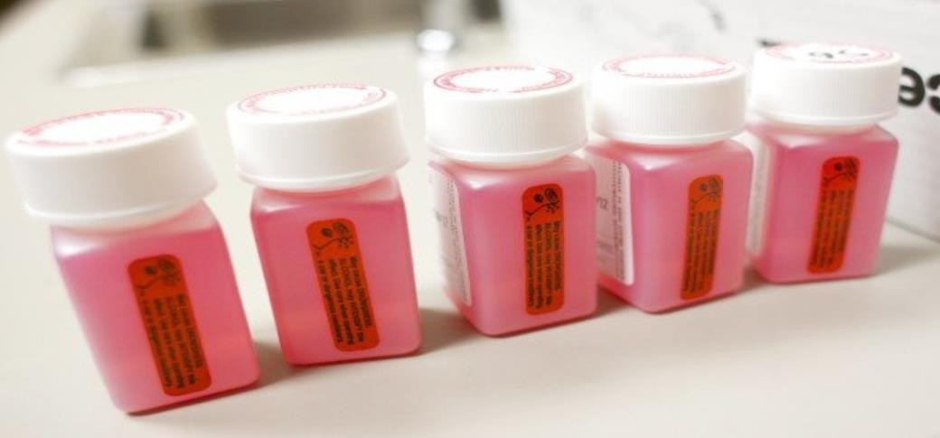
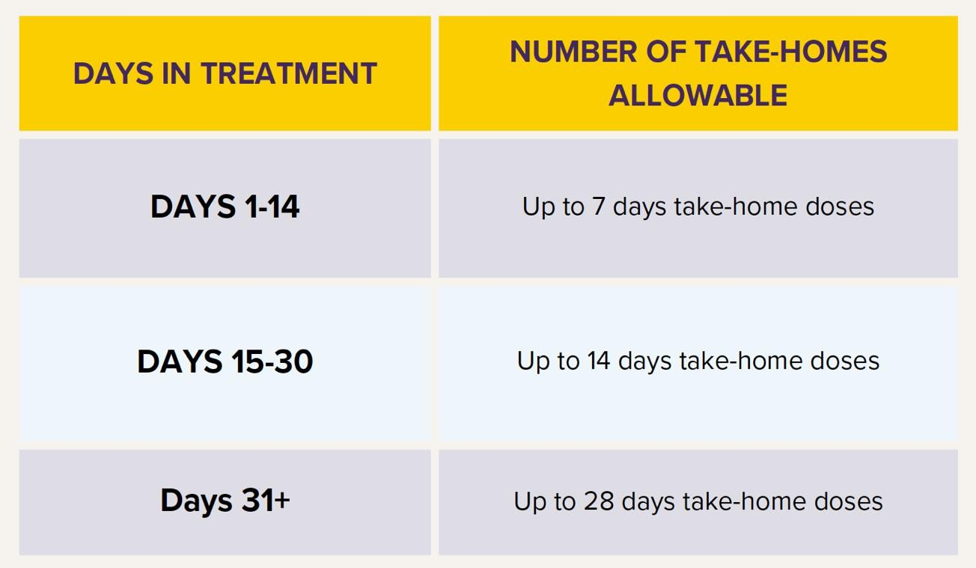
Federal regulation updates to promote methadone treatment
Methadone treatment no longer requires daily visits, number of take-home bottles based on individualized clinical assessments
Methadone starting dose increased to 50mg, higher if clinically justified

Slide 28
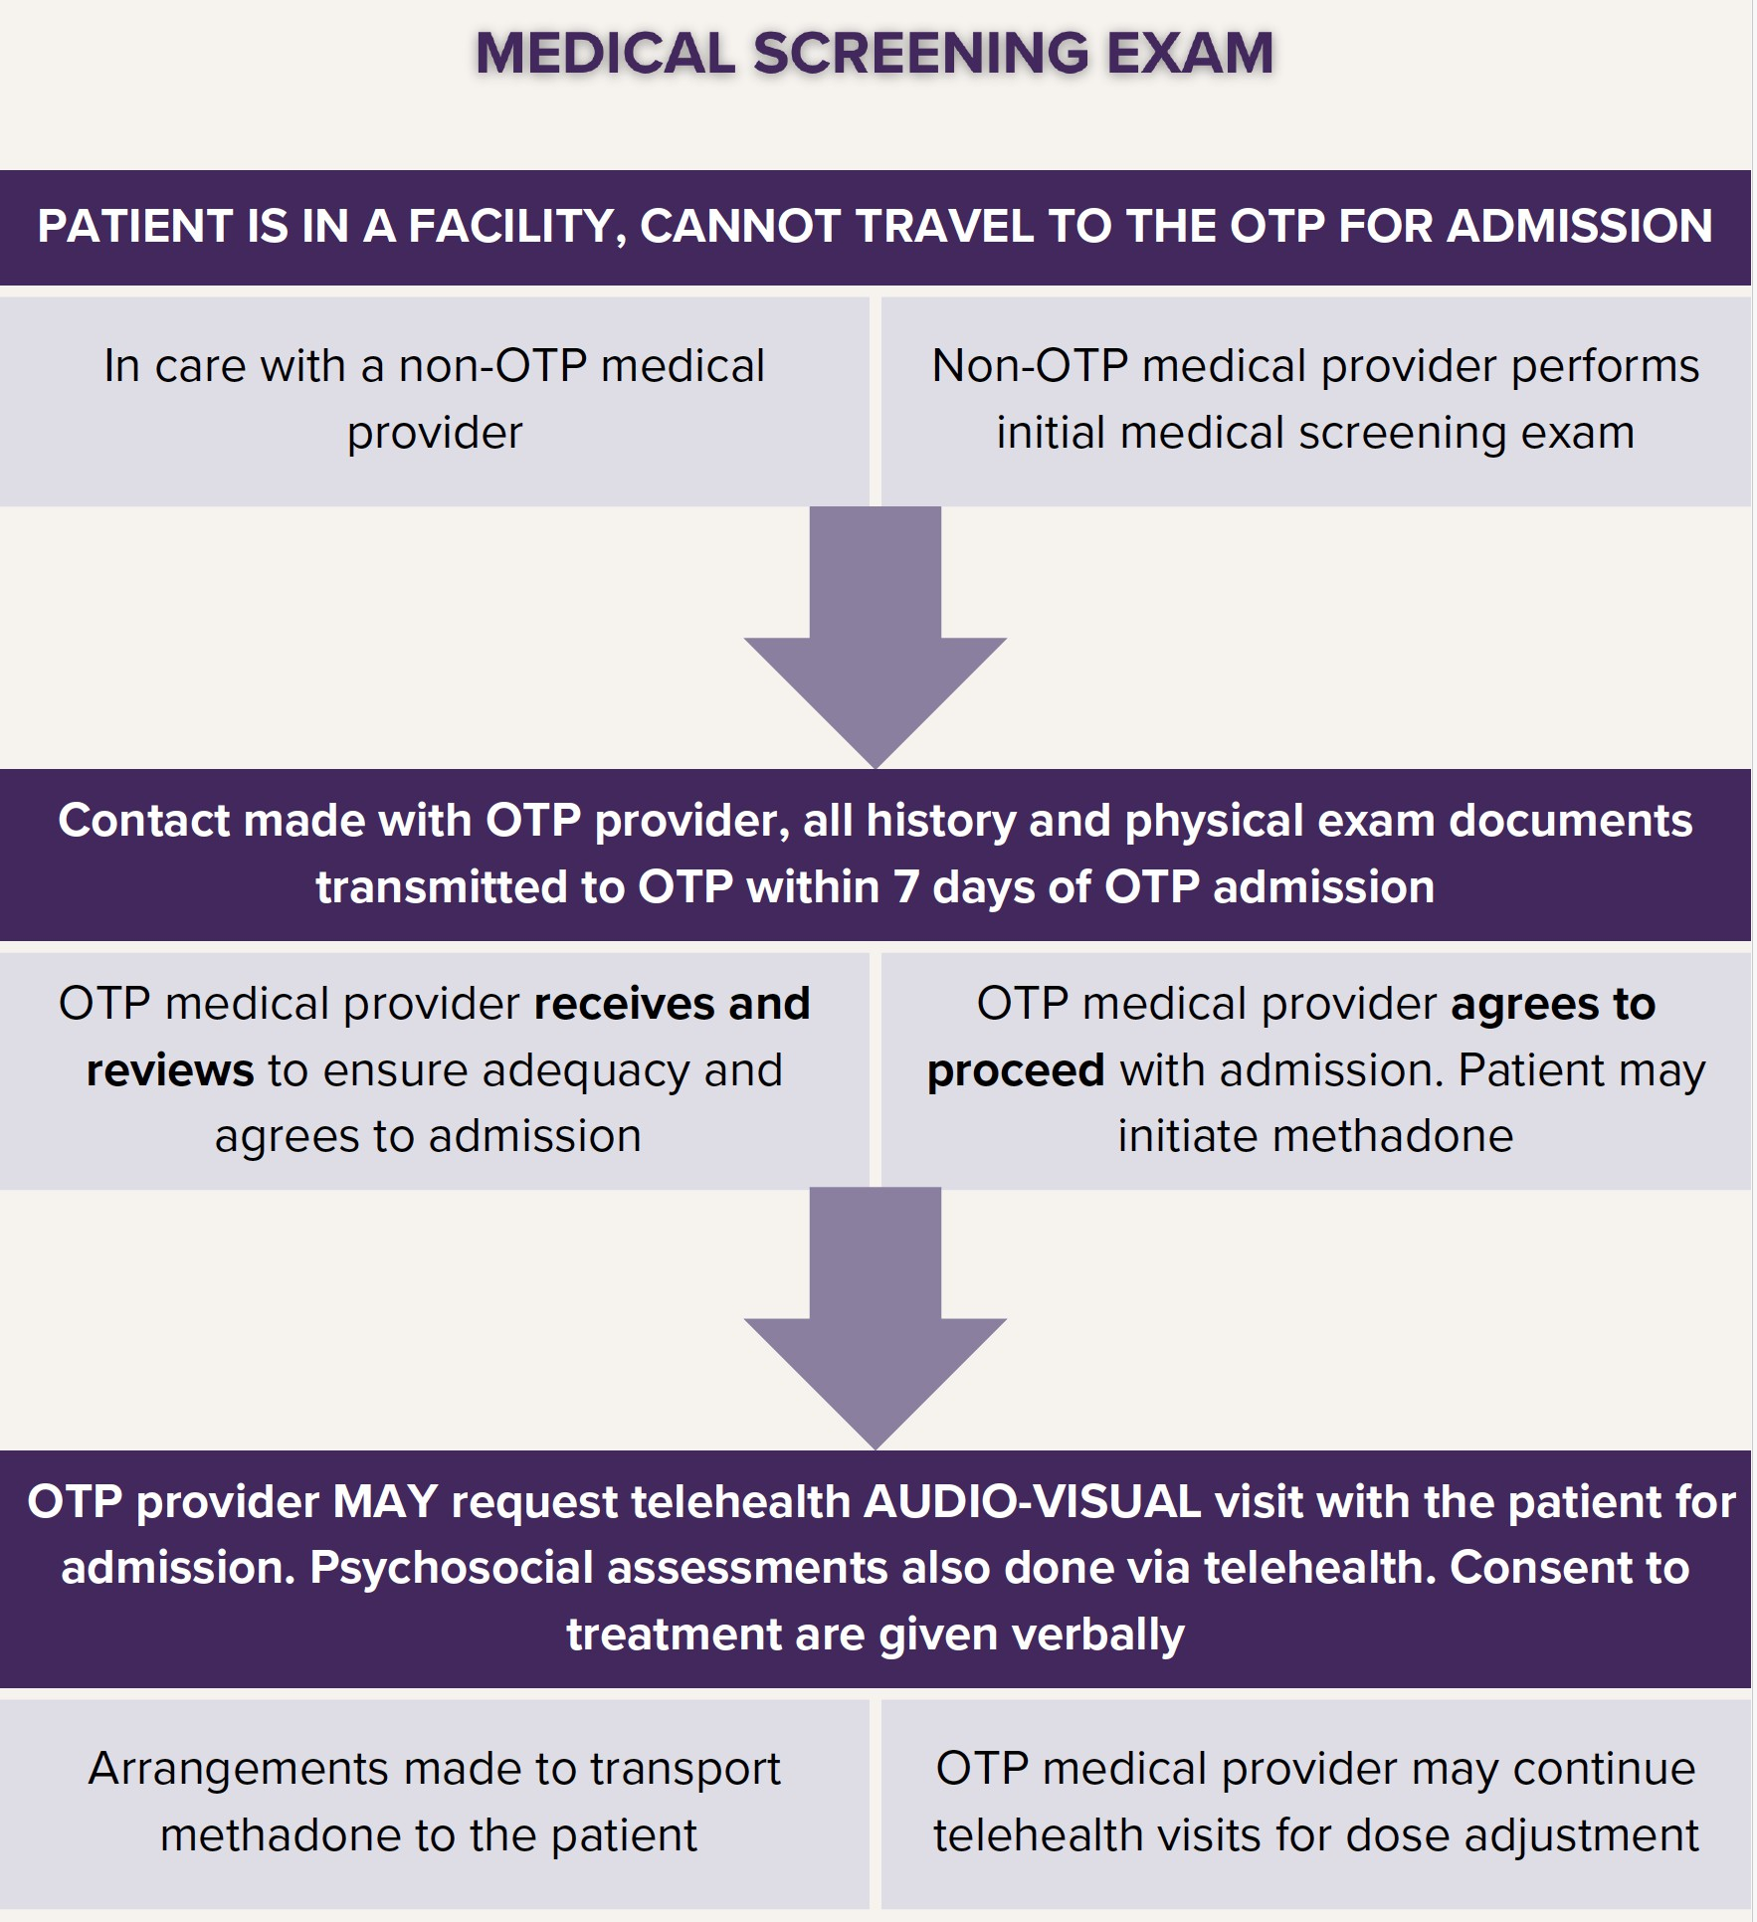
Opioid treatment program admissions can be done over audio-visual telehealth visits

Slide 29
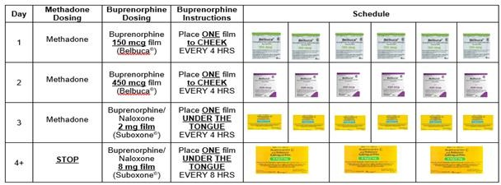
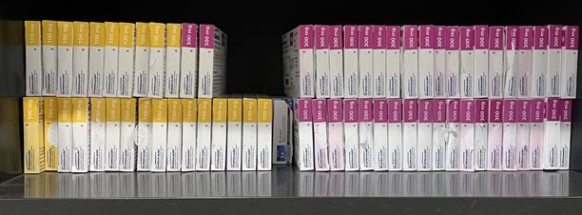
Regulation and practice updates to promote buprenorphine treatment
Buprenorphine treatment can be initiated through tele- health visits
New clinical protocols of starting buprenorphine to minimize having to wait for onset of opioid withdrawal
Expanded access to long- acting buprenorphine injections to reduce visits to the pharmacy and daily medication dosing
Top: 4-day protocol for low-dose buprenorphine initiation Bottom: Number of injectable buprenorphine medication doses
administered at Jacobi Outpatient Addiction Clinic April-Nov 2024

Slide 30
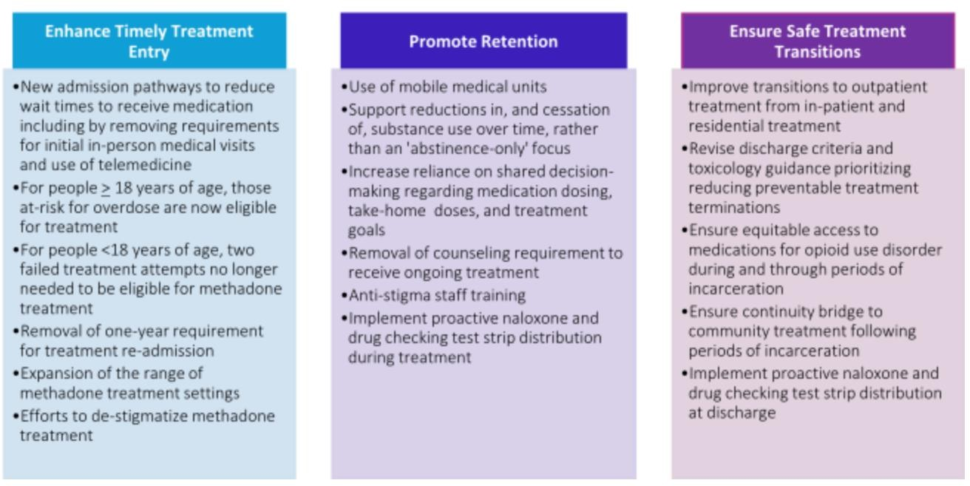
Statewide emphasis on treatment access, retention, and transitions
NYS Office of Addiction Services and Supports, Addiction Data Bulletin (No. 2024-03); June. 2024.

Slide 31
Key Questions
What is opioid use disorder in the context of overdose crisis?
How is opioid use disorder treatment delivered?
How is treatment access changing to address overdose crisis?
How can hospitals help with OUD treatment during emergencies?

Slide 32
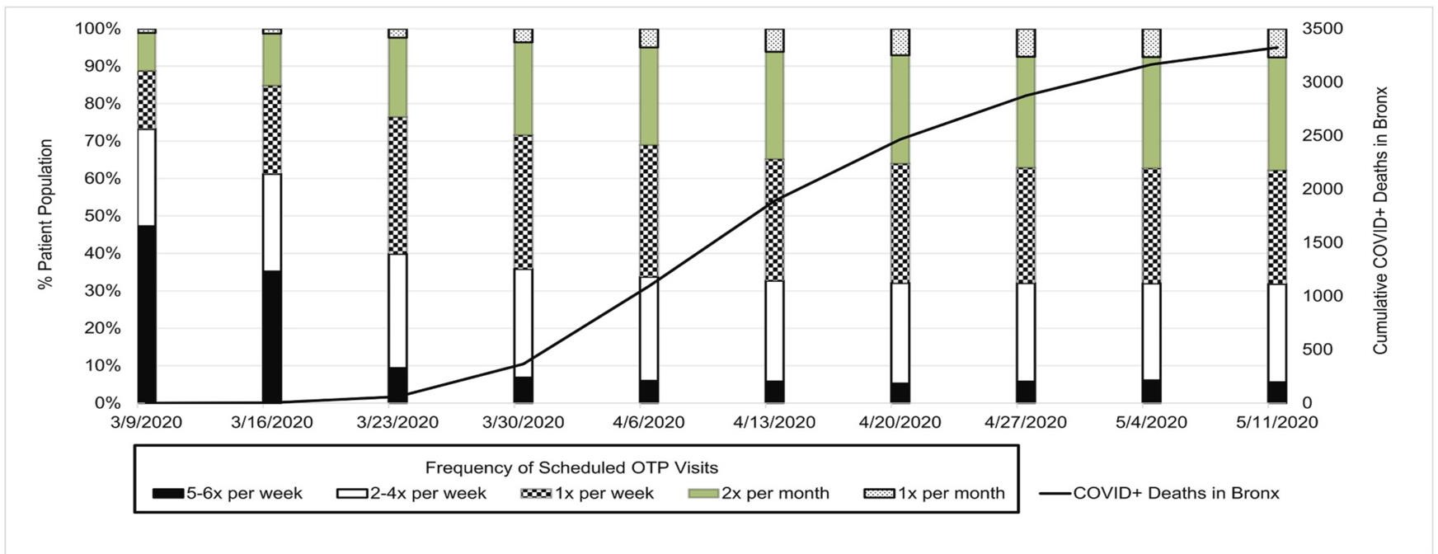
Emergency preparedness for addiction treatment
Opioid treatment programs (OTPs) already plan ahead by:
Providing take-home medications to minimize in-person visits
Remaining operational even during emergencies
Allowing medication dispensing to designated surrogates if patients
not able to travel
Changes in Bronx OTP Scheduled OTP
Visits during COVID-Pandemic
*Solid line represents COVID deaths reported in Bronx, NY
Joseph et al. Journal of Substance use and Addiction Treatment 2021.

Slide 33
ED/Hospitals are a critical touchpoint for people with substance use disorders
More than half of patients hospitalized with substance use disorders have had 3 and more ED visits as well as hospitalizations in the past 3 years
Alcohol use disorder is most common SUD type among patients who are hospitalized
Opioid use disorder is most common SUD type among patients who are seen by hospital addiction consult service
Trowbridge et al. JSAT 2017
Wakeman et al. JGIM 2017
McNeeley et al. JAMA Internal Medicine 2024

Slide 34
ED/Hospitals can help improve SUD treatment access
SUD treatment uptake post-discharge is typically <10%
However, at ED/hospitals with addiction consult service:
Receipt of medication treatment for AUD & OUD (8x higher odds) Increased 30-day engagement rate (7x higher odds)
Englander et al., JGIM 2022 Singh-Tan et al. JGIM 2023 Jakubowski et al. JGIM 2024
McNeeley et al. JAMA Internal Medicine 2024

Slide 35
Talk to me about your methadone…
“Are you currently enrolled in an Opioid Treatment Program (OTP, aka methadone program)? If so, what is the name of the program and if you have contact info or a bottle, that would be great…”
“What is your most recent
dose?”
“When did you last take
methadone?”
“How often do you visit the OTP? When did you start treatment there?”
“Is your dose adequate?
When was the last time you used heroin or another non- prescribed opioid?”

Slide 36
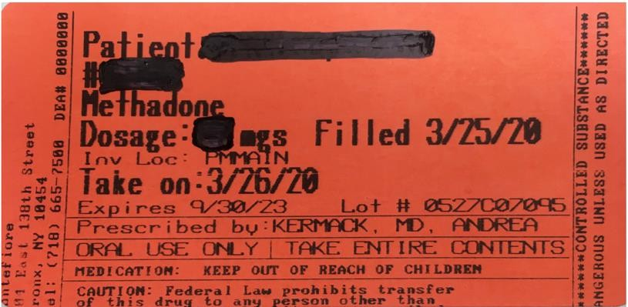
Clinical Pearls: Dose verification
CALL EARLY! Many OTPs close by noon, earlier on Saturdays
Not all programs have on-call provider to verify
doses when closed
Ask if the patient has a program ID or methadone take-home bottle for program contact and dose information (on the bottle label)
Dose is almost always the same as patient report but sometimes date of last medication is not as patient recalls
If you are not able to reach the program, you can still give methadone – usually 30-40mg as first dose, up to 50mg on first day

Slide 37
Unless sedated or other contraindication, start with (verified) outpatient dose in within 4 days. If >4 days ago, consider decreased dose.
If dose >150mg daily or active cardiac issue, check ECG for QT interval
Inpatient methadone dosing
If unable to verify or patient is not enrolled in a program can give up to 40mg first dose with an additional 10mg on first day
Titrate methadone dose to patient comfort, increasing by up to 10mg daily every few days; consider addiction consult if available
Close monitoring for sedation while titrating dose

Slide 38
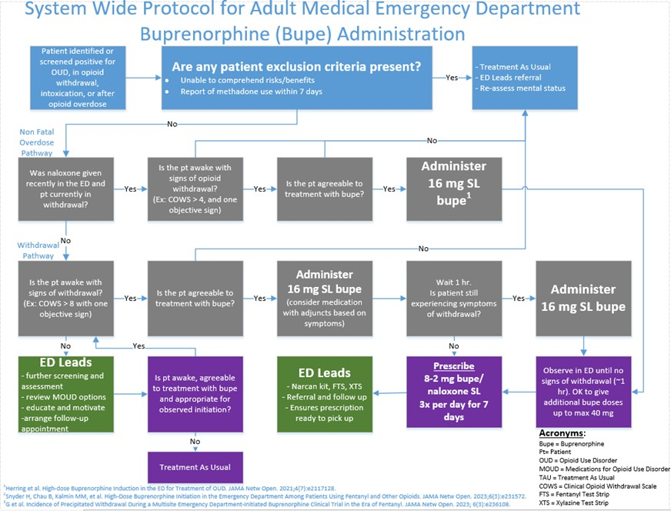

Slide 39
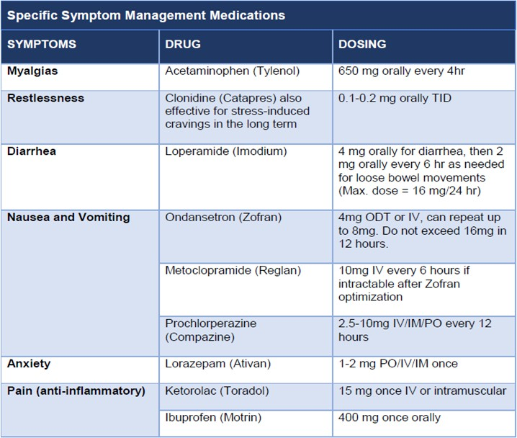
Adjunctive Medications for Opioid Withdrawal

Slide 40
Overdose Prevention Counseling
Test your drugs with fentanyl and xylazine test strips
If positive, consider not using.
If you do plan to use, start with a small amount and go slowly.
Avoid using alone and take turns
If you do use alone, call the Never Use Alone hotline (877) 696-1996
Avoid mixing drugs and alcohol
Overdose risk is high when mixing opioids with cocaine, benzos, or alcohol.
Space out your use.
Take care if you have not used in a while
Have naloxone (“Narcan”) ready and on hand

Slide 41
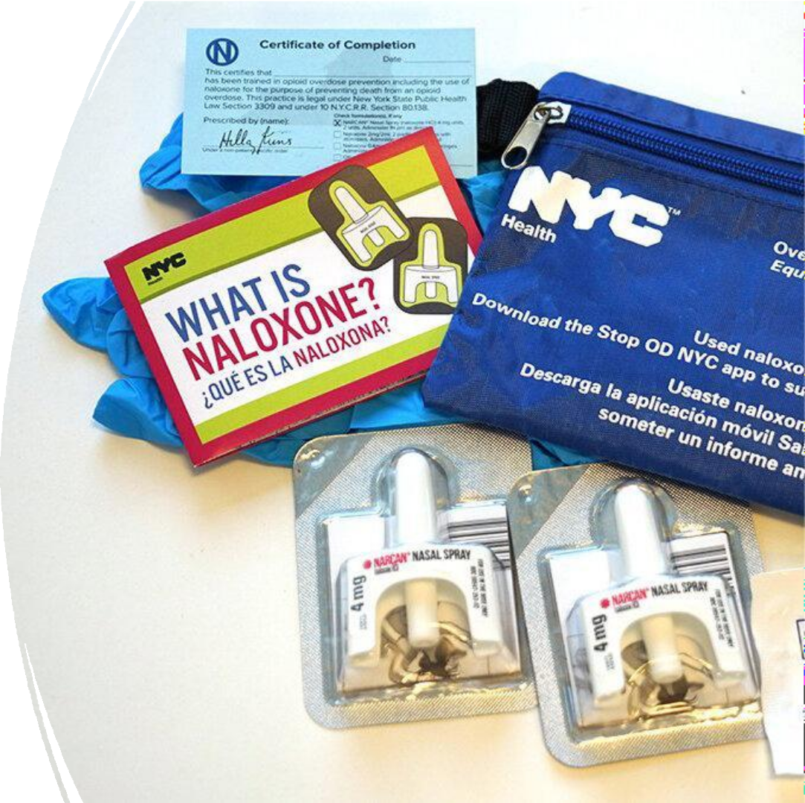
How to dispense naloxone kits
Supply is ordered from NYS/NYC
DOHMH and partnering orgs
Hospital pharmacies may stock these in ED, inpatient satellites and outpatient pharmacies
Each kit contains:
2 doses of Narcan® 4mg/0.1ml nasal spray
Face mask, alcohol wipes, gloves
Brochure reviewing overdose response steps

Slide 42
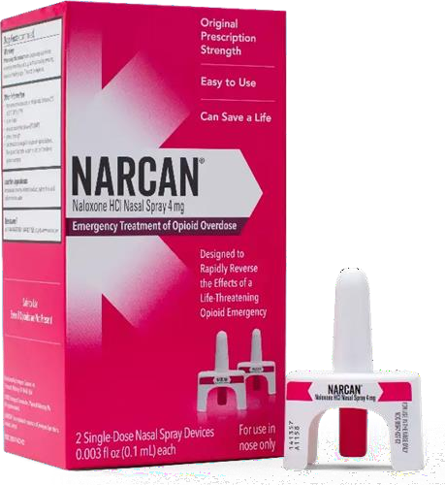
How to prescribe naloxone
Naloxone (Narcan®) 4mg/0.1ml is a single-step nasal spray
Each rx is dispensed as box with two doses of naloxone
Covered by Medicaid
Up to $40 OTC

Slide 43
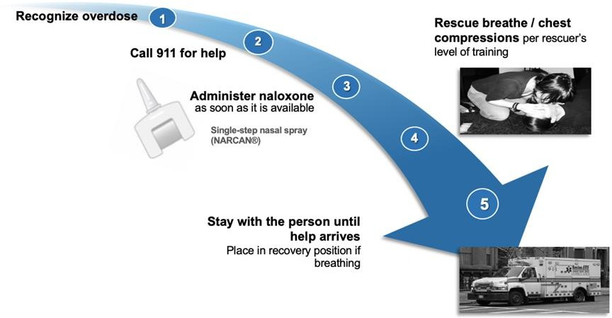
Overdose rescue with naloxone
Steps to teach patients, family, friends, caregivers

Slide 44
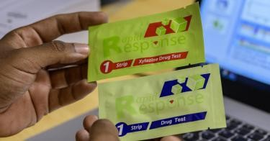
Drug Testing as Harm Reduction
Fentanyl (Blue) and Xylazine (Red) Test Strips

Slide 45
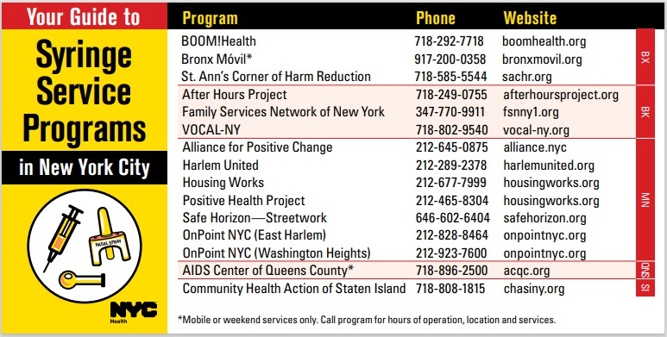

Slide 46
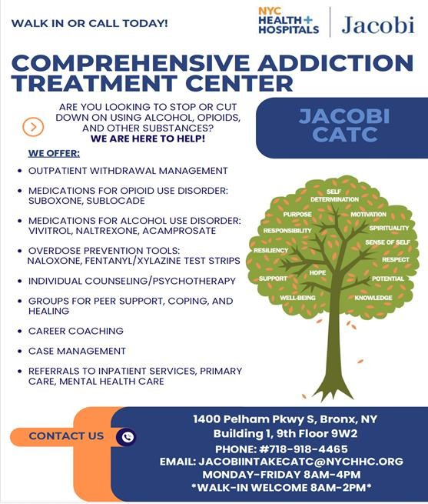
SUD Walk-In Clinic at NYC H+H
Most NYC H+H Hospitals operate SUD Walk-In Clinics
Provides triage and referrals
Same-day access to withdrawal management and stabilization
EPIC integrated “Ambulatory Referral to Psychiatry Chemical Dependency”

Slide 47
Words Matter: Optimizing the Care Environment
Instead of Saying This… | Say This…
Substance abuse | Substance use vs substance use disorder (based on assessment and diagnosis)
Addict, Abuser, Junkie | Person who uses drugs or alcohol, substance use disorder
Relapse | Return to use, recurrence of use
Dirty | Positive drug screen
Clean | Not currently or actively using substances In remission or recovery Negative drug screen
Medication assisted treatment Opioid substitution therapy | Medication treatment for opioid use disorder Medications for addiction treatment
|

Slide 48
Questions?
Email: Tiffany Lu, MD MS at lut7@nychhc.org

Slide 50
Budget Period 1
Update For Coalition Partners

Slide 51
March 2025
Coalition Meeting #3
Queens Coalition Co-Host
March 25 (10 AM – 1 PM)
CUNY School of Law, 2 Court Sq
Queens Coalition Presentations
Citywide Response to Radiological Dispersion Device (RDD), Radiation Injuries, Acute Radiation Syndrome
New Coalition Educational Series
Coalition, Coalition Adjacent Partners
March Date TBD, 12 Noon (1 Hour)
Calendar Item to Follow
Please contact Summer with ideas for future speakers
swilliams15@health.nyc.gov

Slide 52
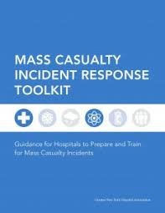
Transfer Center
Emergency Operations Plan
Surge Annex
Rapid Patient Discharge Plan
Year Of
The Snake
Year Of
The MRSE!

Slide 53
Thank You
Al Villacara, DMD
Executive Director, Healthcare System Readiness
Office: (347) 396-2948
Cell: (929) 996-8222
Email: avillacara@health.nyc.gov

Slide 54
2025 NYC Medical Response to Surge Exercise
NYC Healthcare Coalition Meeting February 11, 2025

Slide 55
Background
Medical Response to Surge Exercise (MRSE) is a HHS ASPR required activity
(previously Coalition Surge Exercise or SurgEx)
Collaborative Planning Effort
DOHMH, GNYHA, NYCEM, FDNY, NYSDOH
Hospital Planning Team

Slide 56
MRSE Coalition Objectives
Demonstrate and educate hospitals and partners on the initial response for ESF-8 and hospital notification
Examine effectiveness of inter-hospital coordination, including transfer needs and load-balancing strategies through the Hospital Coordination Call
Socialize and codify process for convening and coordinating with acute care hospitals during crisis and patient surges

Slide 57
ASPR Required Objectives
Healthcare Coalitions must:
Engage health care partners and their executives to participate in the exercise and the After-Action Review within the HPP budget period;
Notify coalition health care partners of an incident and facilitate ongoing information sharing during a community-wide emergency or disaster;
Demonstrate their ability to assess and meet critical resource needs (personnel, supplies, equipment, etc.) to manage patient surge during a community-wide emergency or disaster by the end of the MRSE; and
Demonstrate their ability to reduce patient morbidity and mortality through appropriate patient placement during a large patient surge by assisting with the identification and coordination of available patient care resources by the end of the MRSE.

Slide 58
Key Dates and Gameplay
March 19th
9:30am to 10:00am Part 1
ESF-8 Command Element Call
Exercise Briefing
---
Triage, Disposition, Load Balance, Survey (over following six days)
March 26th
9:30am to 11:30am Part 2 Hospital Operations Coordination Call (virtual)
Post-Exercise
After-Exercise Part 3
Survey
After-Action Review

Slide 59
Part 1: March 19 to March 25
Key Tasks
Evaluate Census and Rapid Discharge Patients in Anticipation of Surge
Receive, Triage, and Disposition Surge of ED Patients (local)
Determine transfer needs or excess capacity availability
Outputs of Part 1
Completed Survey with bed capacity, needs for transfers, and bed availability
Game Time: November 2nd 2025, 12:15pm
Real Time Activity: March 19, 9:30am via Zoom (30 minutes)
ESF-8 Command Element Call
Exercise Briefing
Asynchronous, internal gameplay: 6 days to accomplish tasks
Notes:
Hospitals to receive Patient Manifest

Slide 60
Exercise Scenario
NYC Marathon November 2nd, 2025
55,000 runners from over 150 countries
12:00pm – Reports of explosions near the starting line
Four coordinated explosions across the marathon route

Slide 61
Scenario
Four Simultaneously Coordinated Explosions
Staten Island
Brooklyn
Queens
Bronx

Slide 62
Key Dates and Gameplay
March 19th
9:30am to 10:00am Part 1
ESF-8 Command Element Call
Exercise Briefing
---
Triage, Disposition, Load Balance, Survey (over following six days)
March 26th
9:30am to 11:30am Part 2 Hospital Operations Coordination Call (virtual)
Post-Exercise
After-Exercise Part 3
Survey
After-Action Review

Slide 63
Part 1: March 19 to March 25
Key Tasks
Evaluate Census and Rapid Discharge Patients in Anticipation of Surge
Receive, Triage, and Disposition Surge of ED Patients
Outputs of Part 1
Understanding of transfer needs/ available capacity (submission through survey)
Game Time: November 2nd 2025, 12:15pm
Real Time Activity: March 19, 9:30am via Zoom (30 minutes)
ESF-8 Command Element Call
Exercise Briefing
Asynchronous, internal gameplay
Notes:
Hospitals to receive Patient Manifest

Slide 64
Patient Surge
Four incident locations with paitents:
Specific Populations
Pregnant 30+ weeks (0.50%) – 8 total patients
Deaf or ASL (1%) – 15 total patients
Language Barriers (19%) – 285 total patients
Pediatrics (10%) – 150 total patients
Staten Island | Brooklyn | Queens | Bronx | Total
450 pts | 300 pts | 300 pts | 450 pts | 1500 pts
Each incident location receives triaged patients: 5% red, 15% yellow, 25% yellow, 55% green

Slide 65
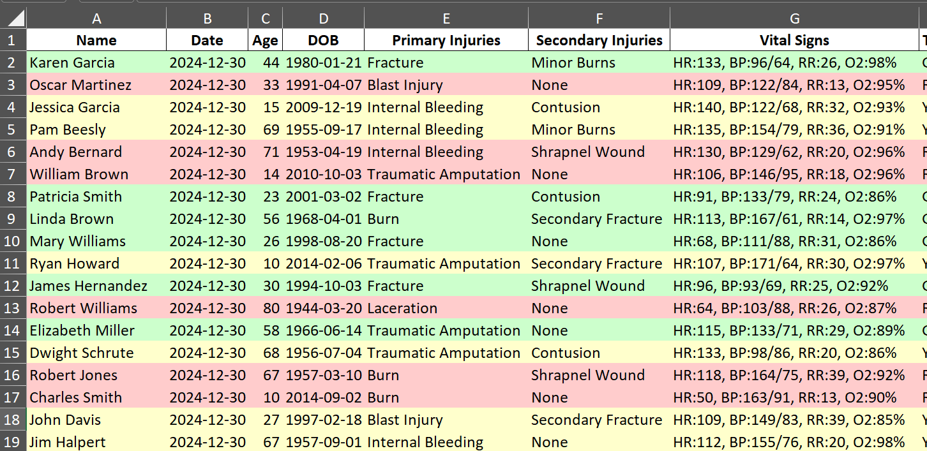
ED Patient Surge
All hospitals to receive patient manifests via Excel
Ability to mail merge to PDFs
Notes:
Hospitals to receive Patient Manifest
Ask clinicans to be realistic, use best judgement, recognizing that these may not be the most complete information to make concrete decisions.

Slide 66
Patient Profile Details
Elements of Profile
Name, DOB, Sex, Unique Identifier for exercise
Pre-Hospital Triage Category (G/Y/O/R)
Primary Injuries (Major Bleeding, Head Injury)
Secondary Injuries (Scrapes, Bruises, Burns)
Vital Signs (HR, B/P, GCS, RR, SPO2)
EMS Interventions (IV, Intubation)
Notes:
Expectant status??
Expected needs/interventions?
Generate via AI with QA/QC

Slide 67
Part 1: Process for Independent Hospitals
Obtain Hospital Census*
Evaluate Rapid Discharge Abilities
Receive, Triage, and Disposition Surge of ED Patients
Determine transfer needs or excess capacity availability
*Note: Census should be a snapshot of your hospitals at 11am on March 19. Census will be utilized for the entire duration of gameplay.
Notes:
This is a linear process. The initial hospital census should be the basis for your gameplay

Slide 68
Part 1: Process for Hospital Systems
Obtain Hospital Census (System)*
Evaluate Rapid Discharge Abilities (Locally)
Receive, Triage, and Disposition Surge of ED Patients (Locally)
Load-balance between hospital facilities (System)
Determine transfer needs or excess capacity availability (System)
*Note: Census should be a snapshot of your hospitals at 11am on March 19. Census will be utilized for the entire duration of gameplay.
Notes:
This is a linear process. The initial hospital census should be the basis for your gameplay

Slide 69
Part 2: March 26 at 9:30am
Game Time: November 2nd 2025, 6:00pm
Real Time Activity: March 26, 9:30am via Zoom
Hospital Coordination Call
Situation Update
Immediate surge needs
Health systems capacity report
Key Participants*
Health Systems & Highly Impacted Hospitals
Transfer Center / Patient Placement Leader
Clinical Leader
Emergency Management Leader
*All hospitals are encouraged to be observers for the Hospital Coordination Call

Slide 70
Part 2: Hospital Coordination Call
Health Systems represent 70% of hospitals in NYC
Systems must designate a key representative from their clinical leadership, bed placement/transfer center, and emergency management
Other representatives may listen-in and provide clarifying context
Independent Hospitals severely impacted will participate in coordination call

Slide 71
Part 3: After Exercise
Game Time: EndEx
Real-Time Activity: Due in early April
After Action Meeting Date TBD
Key Tasks
Complete survey providing answers to qualitative and bed capacity questions
Capture feedback and attend after-action meeting

Slide 72
Assumptions and Out-of-Play
GNYHA has convened chief executives prior to a Hospital Coordination Call
Decision Making: Players and representatives have been empowered by their leadership on patient transfer decisions
Improvise and Be Realistic: Clinical descriptions or unanticipated items may not have been planned for, use your best judgement

Slide 73
Assumptions and Out-of-Play
Staff Travel: Mass transit is running and driving is permitted with a valid hospital ID, as per NYPD
Ambulance Movement: ambulances can cross boroughs via roadway (except for the Queensboro bridge), patients can be transferred
Mass Decontamination: Out of play – we are testing bed capacity, coordination, and transfers

Slide 74
Summary Takeaways & Action Items
Calendar Exercise Dates
March 19 – 9:30-10:00am & March 26 – 9:30-11:30am
Identify Key Representatives
Clinical Leader, Transfer Center/Patient Placement Leader, Emergency Management Leader
Determine Surge Triage & Disposition Strategy
Health systems should coordinate between local hospitals

Slide 75
Questions?
Jade Smart
NYC DOHMH jsmart@health.nyc.gov
Andrew Dahl
GNYHA adahl@gnyha.org

Slide 76
NYC Health Centers
2025 Tabletop Exercise
HCC Presentation
February 11th, 2025

Slide 77
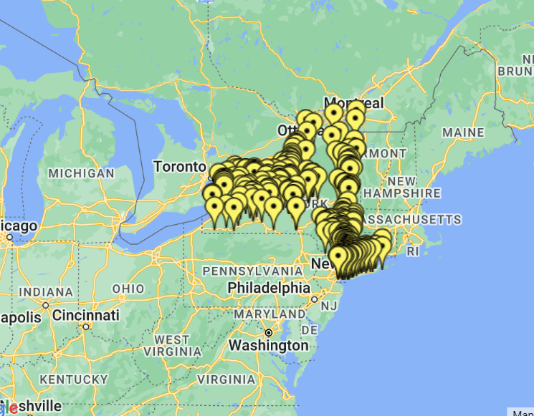
Who We Serve
For almost 50 years, CHCANYS has represented a diverse membership, from the large metropolitan community health systems of New York City to the rural health centers of Upstate and Western New York, and everything in between.​
Notes:
The Community Health Care Association of New York State is New York's Primary Care Association representing New York’s 70-plus community health centers ​
CHCANYS advocates on behalf of health centers at the local, state, and federal level.​
CHCANYS is a resource, providing technical assistance, updates, and updates on policy and regulatory issues.

Slide 78
CHCANYS & CHC’s

Slide 79
2025 Tabletop Exercise
Brief Overview

Slide 80
Exercise Participants
20 NYC-based Health Centers
Community Health Care Association of New York State (CHCANYS)
NYC Department of Health and Mental Hygiene (DOHMH)
New York Police Department (NYPD)

Slide 81
Notes:
HSEEP-compliant planning process.
-The TTX is a discussion-based exercise during which participants practice their emergency roles and decision-making in response to a detailed scenario and facilitated discussion in a low-stress environment. CHCANYS collaborated with NYC-based community health centers (CHCs) to design and conduct a Tabletop Exercise (TTX). Due to space each CHC could only have two representatives, one of which must sit on the Exercise Planning Team (EPT). Participants were expected to fill out the commitment form by October 25, 2024. Participating CHC’s were then sent the IMP zoom link.
When registering, CHC’s identified one (1) individual to serve on the EPT and attend all planning meetings. Participants were expected to be individuals with knowledge of their health center’s emergency management policies, procedures, and resources, as well as the ability to make decisions during an incident.

Slide 82
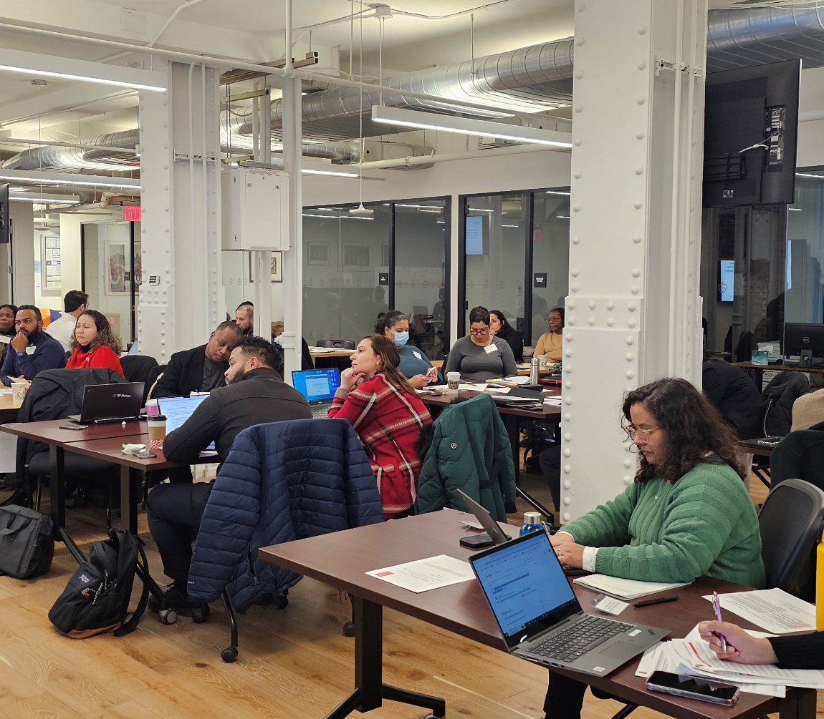
Exercise Overview
The TTX was hosted at the CHCANYS main office. It was an interactive, discussion-based activity tested existing plans and protocols and highlighted areas for improvement.
It is focused on the ability of participants to make high-level decisions and use emergency management concepts and plans.
Notes:
The CHC’s voted overwhelmingly for active shooter scenario: it was tied between Cyber Attack and Active Shooter. We got someone who wanted power outage (#3 in the ranking)

Slide 83
The TTX Objectives
Identify common gaps in NYC health center preparedness and response plans for active shooter incidents.
2. Identify common gaps in NYC health center continuity and recovery plans for active shooter incidents.
3. Define expectations for partner coordination and collaboration in active shooter incidents.
Notes:
The scenario and discussion questions for the exercise have been developed with these objectives in mind. Plans are assessed from the network level.

Slide 84
Exercise Structure
The TTX was designed around 3 modules. The modules entailed:
A detailed scenario and questions to guide discussion.
A discussion regarding key issues with colleagues.
A facilitated large group discussion with all participants.
Notes:
The exercise was broken into 3 modules. Each module of exercise play, was detailed scenario and followed by a discussion period to address the key issues for consideration related to the modules.
Discussions first occurred among health center team members at their tables, then into small group discussions, participants engaged in a moderated discussions. The discussion questions were provided to CHC’s.
Evaluators observed all discussions and documented key points. All evaluations are of policies and protocols, and NOT individuals. All of the data collected will be aggregated after the exercise into an AAR.

Slide 85
TTX Scenario
External Shooter: Domestic Dispute
Notes:
The scenario was focused on an active shooter incident resulting from a domestic dispute that began in the parking lot, then moved into the health center.

Slide 86
Active Shooter Scenario
The estranged partner of one of your health center’s employees arrives at the health center and begins shooting when confronted in the parking lot. Before anyone can warn the staff, the shooter gains entry to the health center and begins shooting. Injuries to staff, patients, and visitors inside the facility, as well as damage to the facility itself, require your health center to activate its continuity and recovery plans.

Slide 87
key Evaluation Findings
An Invaluable Exercise For The CHCs

Slide 88
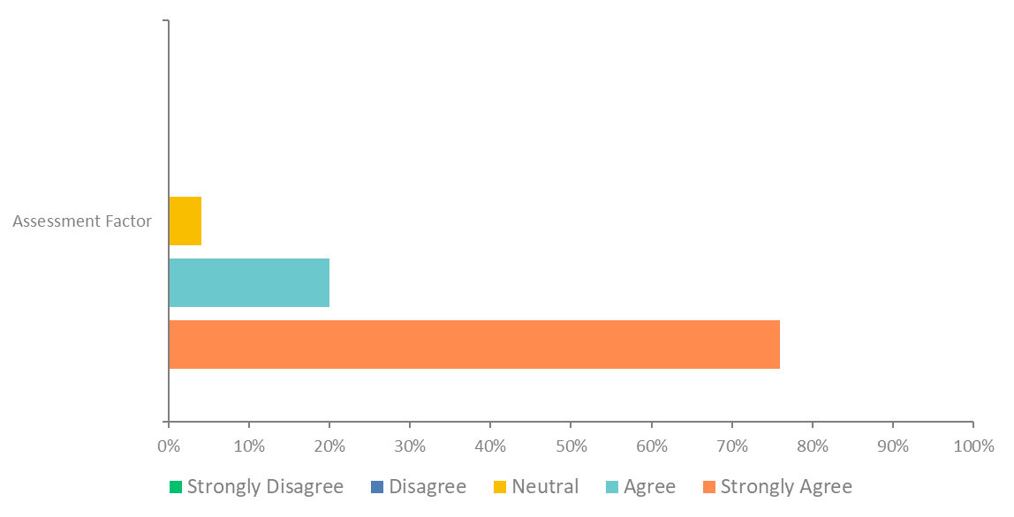
The exercise provided the opportunity to address significant needs and decisions in support of critical mission areas.

Slide 89
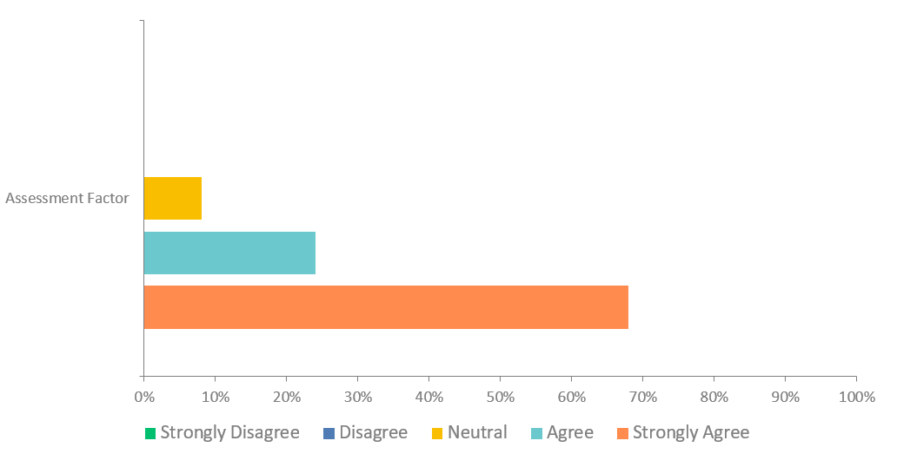
After this exercise, my organization is better prepared to deal with capabilities and hazards addressed.
Notes:
Usefulness is rated out of 5: 76% of participants strongly felt that the exercise helped them address needs and decisions for critical support. Score of 4.72

Slide 90
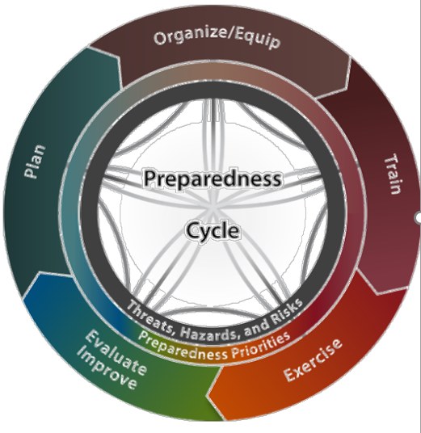
Post TTX Recomendations
Enhance stakeholder collaboration in active shooter plan development.
Standardize clear, consistent emergency alert protocols.
Establish formal protocols to assist individuals with disabilities during active shooter incidents.
Continue frequent and scenario-based training to improve staff preparedness.
Notes:
All participant data has been gathered. yet AAR is not written yet.

Slide 91
EMTeam@CHCANYS.org

Slide 92
COMMUNITY ENGAGEMENT AND RESPONSE
Lou Rivera
Director of Community Engagement and Response
Contact information: lrivera10@health.nyc.gov
Notes:
Community Engagement and Response | Director: Luis Rivera
Through Community Engagement and Response initiatives, the bureau will continue to provide technical assistance and preparedness capacity-building work with community partners across NYC, and leverage collaboration with community organizations to enhance healthcare system communications This program supports the development of public health systems that build community resilience and recovery, which includes engaging public and private organizations in preparedness activities that represent the functional needs of at-risk individuals as well as the cultural and socio-economic, demographic components of the community. Part of this role is to identify individuals and communities at higher risk for adverse health outcomes; to work with community organizations to build resilience and foster social connections that assure public health, medical and mental/behavioral health services in a community before, during, and after an incident. This position is responsible for working with community partners, (e.g., NGOs, healthcare organizations, business, education, and emergency management) to plan and build resilience so organizations, their clients and their communities are better able to withstand and recover after an emergency.

Slide 93
The world of community engagement & response
Community Leadership Sector
Sector based Approach
(Human Services/Faith-based/Community Leadership)
Internal Engagement (Divisions/ICS/Equity/CE SME)
External Engagement (CRPC/Education/Partner Engagement & Outreach
Systems (PHPC/Contracts/Equity)
Government Partners
DOHMH
Community Partners
Human Services Sector
Faith-based Sector
VOADs/COADS

Slide 94
THE COMMUNITY’S ROLE IS IMPORTANT
Increased capacity: Community organizations can reach neighborhoods quickly with innovative solutions in a disaster
Trust: Community organizations work with people every day and are a trusted resource in an emergency
Communication: Communication from trusted community leaders is critical to support public health messages
Notes:
Not only is it our mandate from the CDC but we also agree that engaging the community is very important. Communities are a key player in responding and recovering from emergencies.
Increasing and severity of emergencies requires organization participation to help clients and their community to recover from emergency.

Slide 95
CER Unit Staff & Structure
Lou Rivera, MPA
Director, Community Engagement and Response
Focus Areas:
CPP – Sector-based approach/7 contracted partners
Community Operations
Capacity Building and Technical Assistance
emPOWER data monitoring
Serve as SME on Community Engagement + Emergency Management.
Develop partnerships with other city agencies (NYCEM/DFTA/MOIA etc.)
Elyse Morris, MPH
CER Senior Program Manager
Manages E. Huerta Community Engagement Liaison
Provides oversight of the CPP Sector-based approach.
Manages 7 contracts across the Human Sr
Serves as Proxy in CER Director’s absence
Eddy Pierre, MA
Community Operations Manager
Manages Jamielee Polanco, Solomon Fellow.
Provides oversight of the development of the Community Engagement ERG
Supports Esmeralda Huerta in building out the CE ERG.
Leads in the development of the Community Recovery Collabrative and Framework
PHPC
Supports emPOWER data monitoring
Hannah Arnett
Community Planning and Capacity Building Lead
Leads the Community Resilience Planning Collaborative.
Planning and Execution of the National Workgroup
Serves as CE + Emergency Management SME to DOHMH colleagues
Represents DOHMH at the NYC VOAD
Services as CER liaison with other city agencies (NYCEM/DFTA/MOIA etc.)
Esmeralda Huerta, MPH
Community Engagement Liaison
Supports contract management of the CPP Sector-based approach.
Supports development of the Community Engagement ICS
Serve a lead for OEPR Resilience Group
Jamielee Polanco
NYCEM Solomon Fellow
Supports the development of the Community Engagement ERG
Supports the development of the Community Recovery Collabrative and Framework

Slide 96
Background: Sector Based Approach
Develop a sector-based approach to building community resilience
Sustainability is best when we build upon an existing structure instead of building new structures
CDC’s Public Health Emergency Preparedness (PHEP) Capabilities: Standards for State and Local Planning
Community Resilience: 2 of 15 capabilities required by CDC
Community Preparedness
Community Recovery
CDC Recommended Sectors – Public Health Emergency Preparedness
Cultural and faith-based* | Education and childcare
Social services/Human Services* | Business (NYCSBS)
Housing and sheltering | Community leadership* (NYCEM)
Mental/behavioral health* | Healthcare*
Aging (DFTA) | Emergency Management (NYCEM)
Media

Slide 97
EVOLUTION OF COMMUNITY ENGAGEMENT AND RESPONSE (CER)
Issue
Disproportionately impacted populations (undocumented, the aging, DAFN, historically divested communities) are often the least prepared for emergencies and less likely to seek out necessary services.
Recommendations
Increased communication and relationship building with communities pre-event;
Community organizations are often dispersed throughout the city and unaware of each other’s effort
Increased community education and information on public health emergencies; and
Continued involvement with communities post event
Sector-based Approach
Community Preparedness Program
Community Operations
Community Engagement in ICS
Community Recovery Collaborative
Community Planning & Capacity Building
CRPC
External partners & DOHMH staff
Intergovernmental community preparedness coordination
Notes:
- There were still some issues/recommendations that we needed to better address

Slide 98
3 Focuses
Focus I: CPP Sector based Approach Contracted Partners | Focus II: Community Planning & Capacity Building External and Internal | Focus III: Community Operations ICS Response & Recovery
Human Services Sector HSC Faith-based Sector NYDIS Community Leadership Sector (CENs) LES Ready FRANC SI COAD EH COAD SB COAD RFP Development CPP Sector based approach Research & Evaluation CPP Program Evaluation Develop New Sector Assessment Publications and Journals Research best practices specific to cross-section of Community Engagement & Emergency Management | Expand visibility and Increase reach of CER Develop new partnerships with community and faith-based organizations. Inform community partners of NYC’s emergency response structures and connect to resources. Participate in NYC VOAD meetings Funnel community and faith-based organizations to CPP and/or CRPC. Lead planning of wider community capacity building trainings and events Community Resilience Planning Collabrative Lead planning and execution of CRPC Support Interagency planning at the local and national level NYCEM/DOHMH/MOR/DFTA/MOIA etc. PHOs/EM government agencies focused on community engagement and equity. Internal Technical Assistance and Capacity Building Support DOHMH CE and public facing staff during emergencies Develop resource sharing tools | Build out and enhance Communty Engagement ICS development Lead a group of community focused SMEs to update and enhance CE ICS structure based on lessons learned from past activations. Develop Community Recovery framework and Functions Lead a group of community focused SMEs to develop Community Recovery Framework and recommendations to DOHMH leadership on recovery strategies. Integrate community partners into DOHMH’s Emergency Exercises Collaborate with BAPR on exercise planning for community partners Collaborate with BEFO on integrating community partners into PODs/PECO operations Public Health Partner Connect Data-driven program and strategic planning

Slide 99
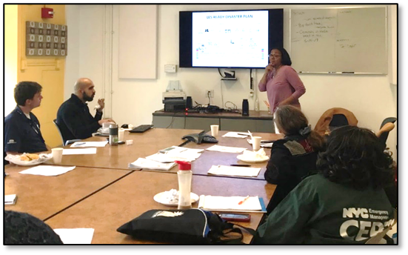
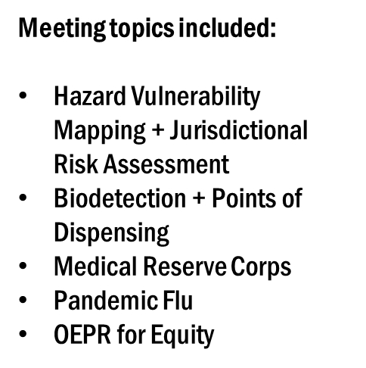
HOW CAN COMMUNITY PARTNERS ENRICH YOUR COALITION’S CAPACITY?
Serve as: Subject matter expertise in partner engagement to discern the best approach for integrating and gathering feedback from community and faith-based organizations (CFBOs) into your projects.
Increased Reach: CFBOs can enhance your projects by providing a community-focused perspective, access to hyperlocal resources, and innovative solutions for developing more robust and inclusive public health emergency response strategies during disasters
Building Pre-established and Trusted: CFBOs engage with New Yorkers daily and are trusted partners in their communities during emergencies. Building pre-existing relationships with CFBOs can assist public health organizations and hospitals in strengthening their emergency response strategies.
Communication: Bidirectional communication from trusted CFBOs is vital for strengthening public health emergency messaging. Strengthening communications between public health organizations and hospitals and CFBOs ensures that information flows freely. This proactive approach significantly enhances real-time situational awareness regarding the impacts of disasters at the hyperlocal level.
Notes:
This is where to explain how people should think about your unit in terms of support. When and what they would need to know that would direct them to you?

Slide 100
Questions

Slide 101
Thank you! Lou Rivera, MPA, CHES Director of Community Engagement & Response lrivera10@health.nyc.gov

