Slide 1
Overview: Citywide Radiological Incident Response
Mark L. Maiello, Ph.D.
mmaiello@health.nyc.gov
New York City Department of Health
Office of Emergency Preparedness and Response
42-09 28th Street, Long Island City, NY
March 25, 2025
Notes:
This talk will provide you with context only – by describing the overall first responder and NYC Health Dept actions in the earliest phases of a dirty bomb incident in NYC.
These actions have been planned and exercised by the participating agencies for many years and continue to evolve and to be reassessed periodically.
There are a few points of intersection with the ER and your work which we will try to point out.
My objective here is to give you this background material so that you have a more complete picture of a citywide radiological response…and to give you some reasons why you are preparing today.

Slide 2

Radiological Incident
Radiological Dispersion Device (RDD) or “Dirty Bomb”
RDD: Combine explosive device with radioactive materials stolen from regulated use: hospitals, biomedical research, industrial use.
Detonation causes:
-Radioactive shrapnel
-Dust impregnated with
radioactive materials
- Possibly a plume that travels considerable distances
Dirty Bomb: Radiological Dispersal Device Using Explosive - Illustration - Radiation Emergency Medical Management (hhs.gov)
Notes:
Radioactive materials generally are in liquid form when used in the laboratory but there are larger more potent sources that are solid or in powder form encapsulated in metal. An explosive could fracture metals into pieces that are propelled into the air or in the case of powders, are aerosolized and may be transported relatively greater distances downwind…
RM such as Iridium-192 ( T ½ = 74 days) is a metal used in radiography…Cesium-137 is also a metal but is often used in sources as a powder encapsulated in metal rods.
The issue then becomes, what direction did most of the material go? But hold that thought for a moment...

Slide 3
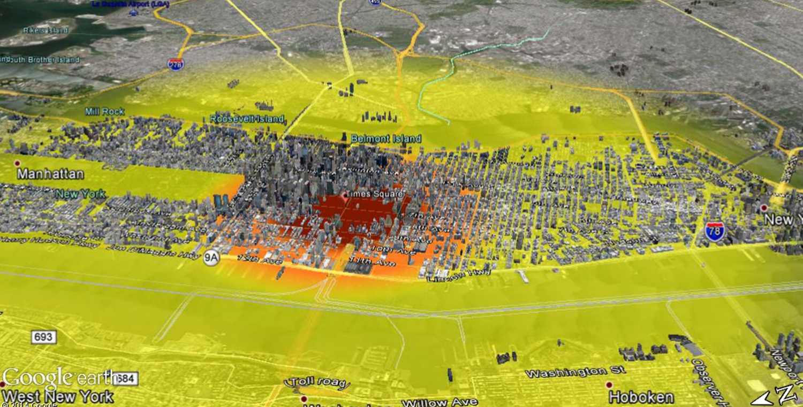
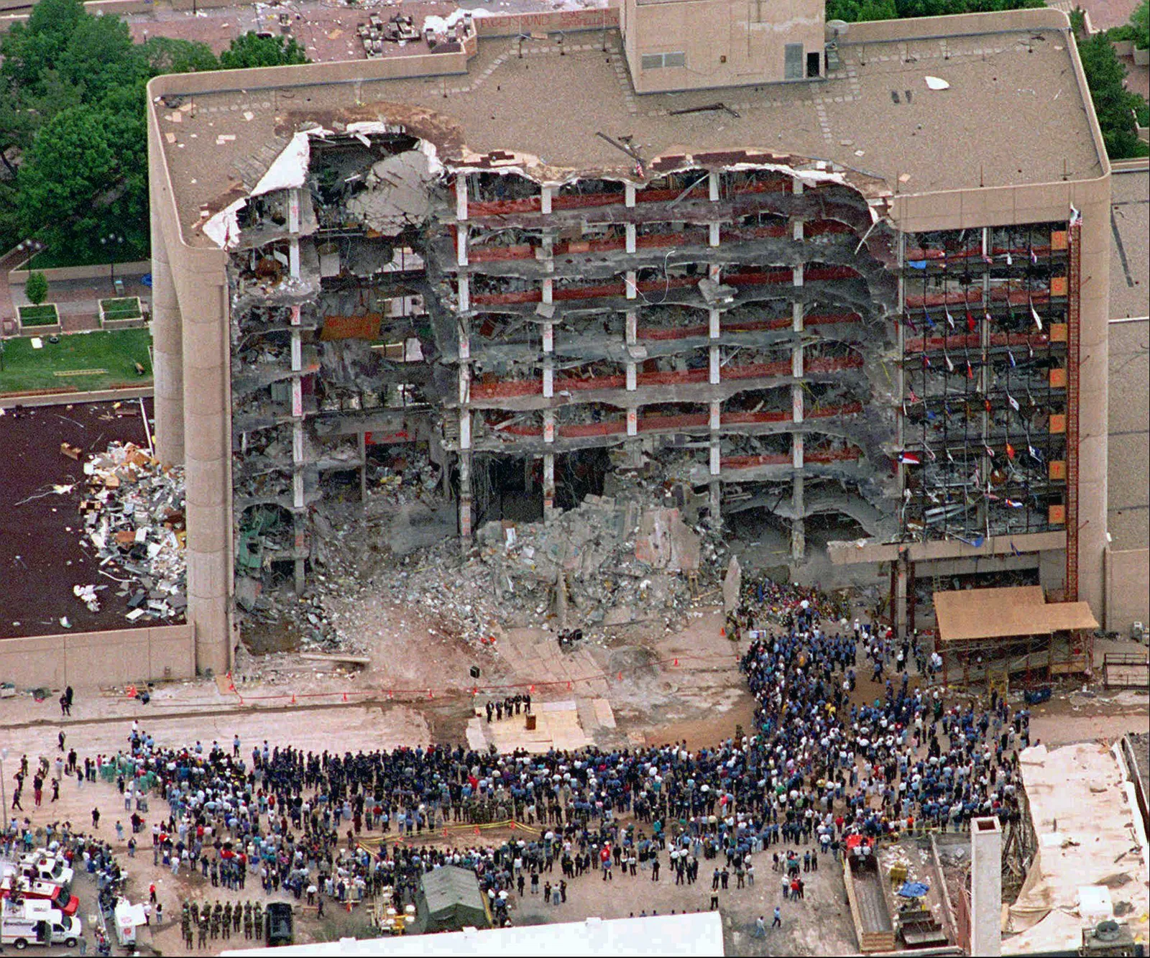
Dirty Bombs are not Nuclear Bombs
RDDs can be as small as a backpack…
…or maybe as large as a van packed with an explosive mixture.
A small nuclear bomb (10kT) detonated in Times Square will destroy & kill everyone within ½ mile of the detonation and inflict varying degrees of destruction from 0.5 miles to 3+ miles away.
2 tons of TNT
Oklahoma City bombing | Facts, Motive, Timothy McVeigh, Waco, & Deaths | Britannica
Buddemeier LLNL-PRES-677346
Notes:
So, obviously, dirty bombs are not nuclear weapons.
In a dirty bomb, the explosive is chemical in nature and the destructive power limited by the chemical interactions of the explosives.
They can be devastating as was the bombing of the Alfred P Murrah Building in OK city in 1995 when the equivalent of about 5000 lbs. of TNT (4,800 pounds or 2,200 kg of ammonium nitrate fertilizer, nitromethane, and diesel fuel mixture) was detonated.
324 buildings were damaged in a 4-block radius.
A terrorist-sized nuclear weapon of 10,000 tons TNT equivalent, using the enormous power of fission can do much more damage (refer to slide).

Slide 4
Citywide Response
Radiological Response and Recovery Plan
  Consists of strategies for 4 city agencies to implement.
  The agencies responding are:
  Fire Department (FDNY)
  New York City Police Department (NYPD)
  New York City Department of Environmental Protection (DEP)
  New York City Health Department
  Early messaging support and some response coordination from New York City Emergency Management (NYCEM)
Notes:
Slide info needs no further explanation.

Slide 5
Citywide Response
Radiological Response and Recovery Plan
  The early citywide response activity includes:
  Warn the public
  Determine the extent of the contamination
  Determine the hazard (record the exposure rates from contamination)
  Share the exposure rate data and the contamination map with other city agencies (using “Rad-Responder”)
Notes:
The RRRP is rather complex so only the highlights of the plan are mentioned and we include only those most relevant to medical providers.
There is much more that goes on when the plan is initiated including activation of incident commands in each agency, interagency conferences, decision-making…

Slide 6
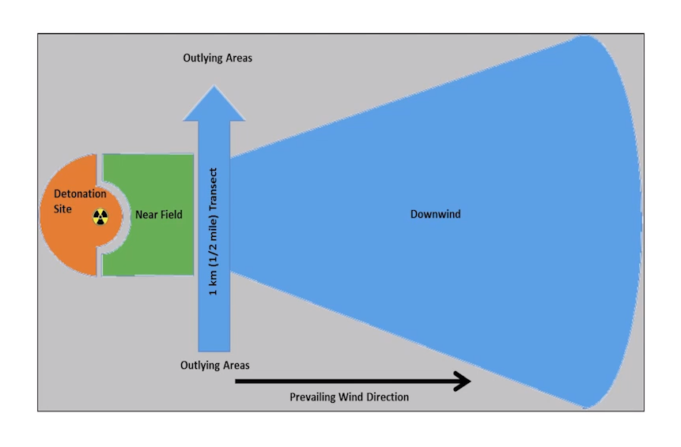
FDNY Measurements
FDNY will follow federal guidance to:
Determine the preferential direction of the contamination.
Measure the radiation contamination on the ground.
Measure as far as 3 miles away if warranted.
Share data with NYC Health Department on Rad-Responder to produce a map of exposure rates.
Identify the radionuclide
1
2.0
2.5
3.0
Miles from detonation
Notes:
This strategy is based on research conducted at Sanda National Lab outside Albuquerque NM in cooperation with Brookhaven National Lab out on LI. This strategy has gone nation wide.
The first responders measure contamination around the detonation site (hashed circle in diagram above), starting about 800 feet away and working TOWARDS the detonation. Those taking measurements do not enter closer than 75 feet from the detonation (border of hot zone).
In the predominant path of the contamination, at about ½ mile from the detonation, responders will walk across the path of contamination (i.e., the transect arrow in the diagram) and if radioactivity is detected here, they will measure every half mile downwind to determine the levels and extent of the contamination. Measurement points are shown by the red dots.

Slide 7
NYC Emergency Management
Issues Public Warning Messages
Wireless Emergency Alert (WEA) message sent directly to cell phones located within 1.2 miles of the incident epicenter.
Message A: Go inside (major explosion), location, close windows/doors.
Message B: Go inside (hazardous materials release), location, close windows/doors, PERFORM SELF-DECON
Message C: Go inside (radioactive materials release), stay inside, close windows/doors until further notice, PERFORM SELF-DECON, more info at 311 or at incident link.
This is shelter in place...
Notes:
Paralleling the activities of FDNY, NYPD and DEP are the public warning messages that NYCEM will transmit to cell phones that may be transmitted within minutes of the incident.
The initial message may only mention the explosion and the borough/street location and instructions to GET INSIDE.
The 2nd message may include mention of a hazardous material + the same GET INSIDE instruction in Message A.
The 3rd message will include mention of radioactivity when radioactivity is confirmed by measurements.

Slide 8
NYPD and NYC DEP
NYPD will
  Control ingress/egress to the incident site.
  Conduct the criminal investigation of incident along w/ FBI and the Department of Homeland Security.
  Can also supply rad readings.
DEP provides
  Response team* equipped with radiation detectors.
  Mobile lab devoted to Chem/Bio/Rad incidents
  Data from fixed station radiological & wind monitors around NYC
*Division of Emergency Response & Technical Assessment (DERTA)
Notes:
Self explanatory

Slide 9
Shelter in Place
Shelter in Place for several or more hours
  Recommended by federal guidance informed by modeling and empirical studies
  Allows for planning an orderly evacuation along routes that minimize radiation exposure to the public
Notes:
At some point afterward in this process, depending on circumstances, instructions may go out to all in the area (probably withing a bounded perimeter of streets), to Shelter In Place for protection against exposure from ground contamination.
Balance of slide is self-explanatory.

Slide 10
FDNY EMS & Patients
FDNY EMTs trained for a radiological hazard.
Will bring injured/contaminated CRITICAL patients to hospital ERs
  Consistent with federal guidelines.
Noncritical patients will be decontaminated prior to transport.
  No need to re-decontaminate these patients.
Limited medical/trauma care of all patients while enroute.
Ambulatory self-evacuating persons will require decontamination.
Notes:
The first intersection with medical providers comes from the services rendered by FDNY EMS to victims at the scene.
The EMTs have long ago been trained to understand the radiation hazard.
Those w/ life threatening injuries + contamination go directly to the ER.
Those w/ non-critical injuries will be deconned before transport by ambulance. Some medical and trauma care of ALL patients will occur enroute.
But, those who self evacuate and make it to the ER door may be contaminated….They will need to be surveyed to make sure and they may need decon (clothing removed, etc.).

Slide 11
Injuries
  Injuries associated with explosions and related effects:
    Wounds associated with:
      Blast Trauma from shock wave & from shrapnel and shattered glass
      Partial structural collapse
      Heat from detonation & fires
    Complicated by the presence of radioactive contamination (debris on clothing, skin, hair)…and in eyes, ears, wounds or inhaled.
    We cannot exclude the possibility of an exposure from an external or internal source of radiation that may result in Acute Radiation Sickness (which may not manifest for days or weeks)…
Notes:
Material on slide does not need further explanation.

Slide 12
FDNY & NYC Health Department
Community Reception Centers (CRCs)*
CRCs: public screening for radioactive contamination and decontaminated if necessary.
Set up in 6 designated NYC Public Schools (usually secondary schools).
Objective: dissuade people from going to hospitals for screening
CRCs:
  Do not provide medical care.
  Do identify people significantly contaminated & suspected of internalizing radioactivity.
  Do refer for medical follow-up.
Goal: process about 500-1000 people per hour.
*Supported by NYPD, NYCDEP and NYCEM. Use of select schools was acquired with the assistance of the NYC Dept. of Education.
Notes:
The 2nd intersection of the medical community with rad-response are the CRCs. It is possible that we may find contaminated people even after the NYCEM warning messaging and the instructions to shelter in place. Most of the contaminated people will likely be those injured or closest to the dirty bomb and some of those will be deconned on site (those with non-critical injuries)….Still, anything is possible and contaminated people may be found at CRCs.
So, if we find significant contamination (>100,000 cpm on the head, shoulders, and face, we will assume inhalation was possible and advise that the CRC client to seek a medical follow-up.
To give you an idea of the volume of people to be screened, FDNY estimated to be able to process up to 1000 people/hour.

Slide 13
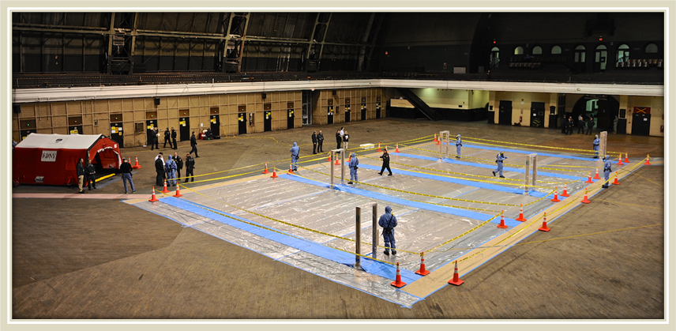
FDNY & NYC Health Department Community Reception Centers (CRCs)
DECON
Notes:
In this wide area image of a CRC set up by FDNY, you can see 4 lanes (in blue) which the public would be directed to walk down one at a time in one direction thru the portal monitors.
The portal monitors contain a Geiger counter on both legs and above in the cross piece. They alarm if a low level of radioactivity is detected (about 0.1 µCi)? by any of the Geiger counters.
After detection of contamination, the FDNY will localize the contaminated area with Geiger counters and send the person to the decon tent shown on the upper left.

Slide 14
NYC Health Department Support
Health Alert Network (Provider Messaging)
Information in plain language (in 2 pages or less) about:
  The incident
  Radiation hazard in general
  Radioisotope(s) involved
  Info to help answer patient questions
  Links to NYC Health Dept. rad-guidance
  Links to state and federal treatment
  guidance:
    REMM and REAC/TS
Notes:
Health Department can also put out messaging through the Health Alert Network directly to medical providers containing information about the incident, the type of radiation involved, background information on the health risk associated with radiation exposure, how to advise pregnant patients, etc.

Slide 15
Putting it altogether...
An RDD is a fast-paced event with a multi-faceted response evolving over days and more…
T=0
15 mins
1 hour
6 hours
72 hours
FDNY and NYPD on scene
Rad Plan Activated
Shelter in Place for time TBD
CRC Plan Activated
First CRC Opens
Full federal assistance; Recovery begins
NYCEM Message 1
NYCEM Message 2
Self-Decon
NYCEM Message: Self Decon for Rad
FDNY completes
measurements
Additional CRCs Open in next 24 h
EMTs triage patients
Notes:
The timeline for most of these response efforts looks something like this…

Slide 16
Acute Radiation Syndrome Overview and Medical Coutermeasures
Joseph Albanese, PhD
Radiation Biodosmetrist,
Yale New Haven Health
Center for Emergency Preparedness and Disaster Response

Slide 17
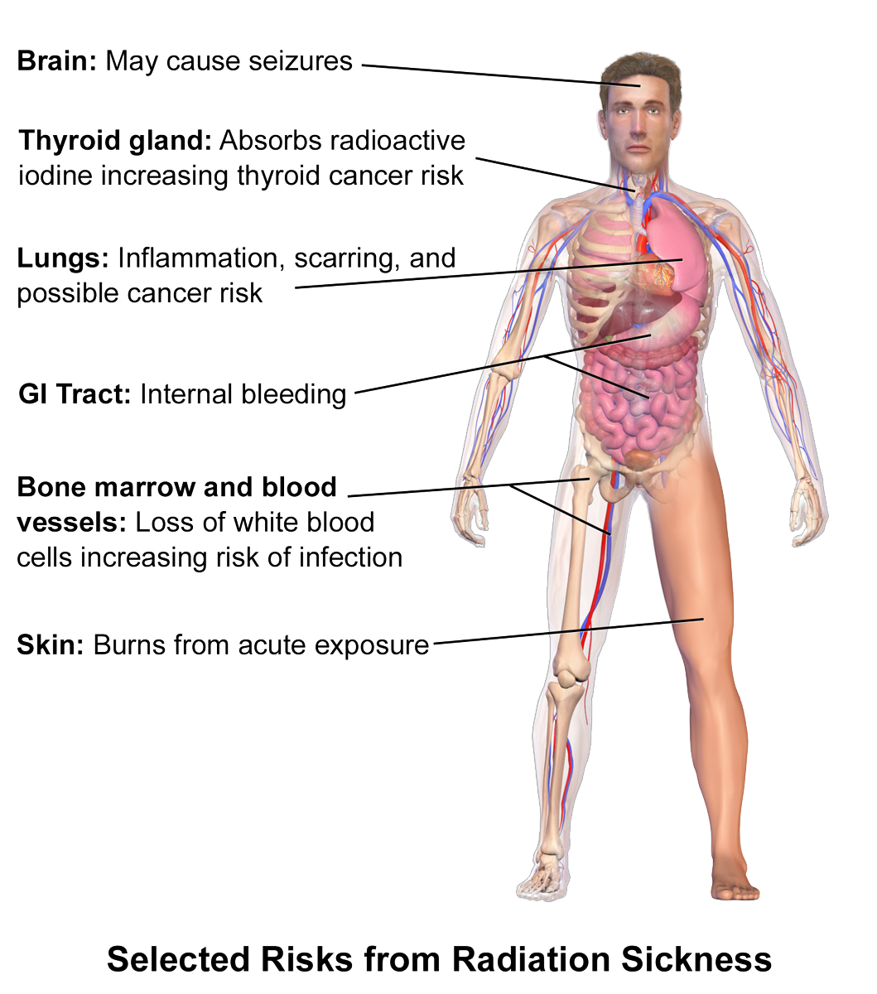
Linking Radiation injuries to Acute Radiation Syndrome (ARS)
Systemic Effects of Radiation Exposure
Beyond localized injuries → Whole-body radiation effects
High-dose exposure can cause multi-system failure
Objective: ARS & Medical Management
Recognizing ARS & its progression
Treatment priorities: Supportive care, infection control, cytokine therapy
Medical countermeasures: Chelation, G-CSF, targeted interventions
Systemic Effects of Radiation Exposure
Photo credit: https://en.wikipedia.org/wiki/Acute_radiation_syndrome

Slide 18
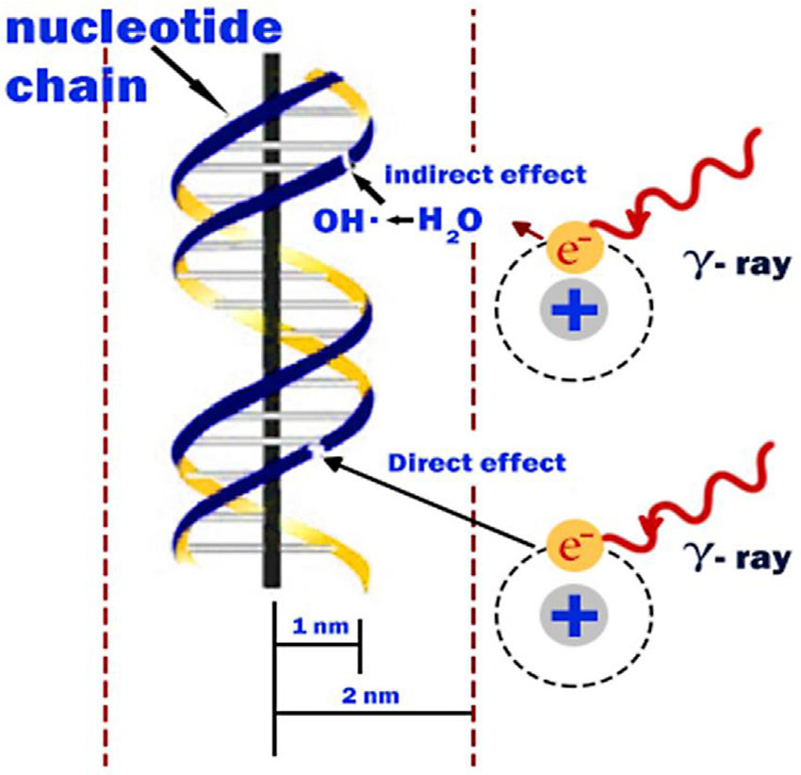
ARS: Definition & Pathophysiology
Definition
  Whole-body or significant partial-body exposure (>1 Gy)
  Requires exposure to occur over a short period of time (minutes to hours)
Pathophysiology of ARS
  Radiation damages rapidly dividing cells (bone marrow, GI tract, skin)
  Cellular injury leads to organ dysfunction and systemic failure
  Severity depends on dose and affected organ systems
Major Organ systems
  Hematopoietic (bone marrow suppression) → risk of infection/sepsis, bleeding
  Gastrointestinal (mucosal damage → nausea, vomiting, diarrhea, dehydration
  Neurovascular (severe radiation exposure) → seizures, shock, rapid death (>30 Gy)
Molecular Effects of Radiation Leading to Systemic ARS
Dainiak, N., & Albanese, J. (2022). Medical management of acute radiation syndrome. Journal of Radiological Protection, 42(3). https://doi.org/10.1088/1361-6498/ac7d18.
Illustration credit: Hall, E. J., & Giaccia, A. J. (2018). Radiobiology for the radiologist (8th ed.). Wolters Kluwer

Slide 19
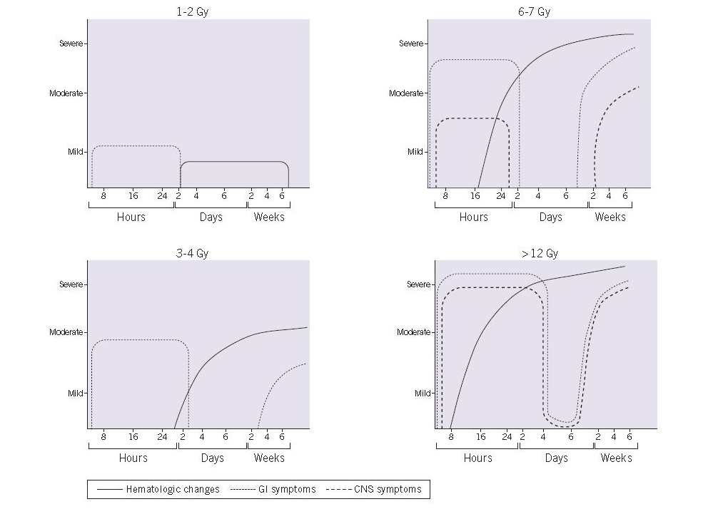
Phases of ARS Progression
Prodromal Phase (minutes to hours)
Nausea, vomiting, fatigue
Faster onset = Higher dose
Key sign: Time to vomiting → correlates with dose
Latent Phase (hours to days)
False Recovery" Period = Symptoms improve temporarily
Ongoing cell death (bone marrow, GI)
Can mislead responders into underestimating severity
Manifest Illness Phase (days to weeks)
Hematopoietic subsyndrome: Infection, bleeding risk
Gastrointestinal subsyndrome: Diarrhea, dehydration, sepsis
Neurovascular subsyndrome (>6 Gy): Confusion, seizures, rapid decline
Recovery or Death Phase (weeks to months)
Low-dose: Gradual recovery
High-dose (>6 Gy): Multi-organ failure → fatal
Treatment focus: Infection control, cytokines, transfusions
DiCarlo et al. (2011). Radiation injury after a nuclear detonation: Medical consequences and the need for scarce resources allocation. Disaster Medicine and Public Health Preparedness, 5(Suppl 1), S32–S44.

Slide 20
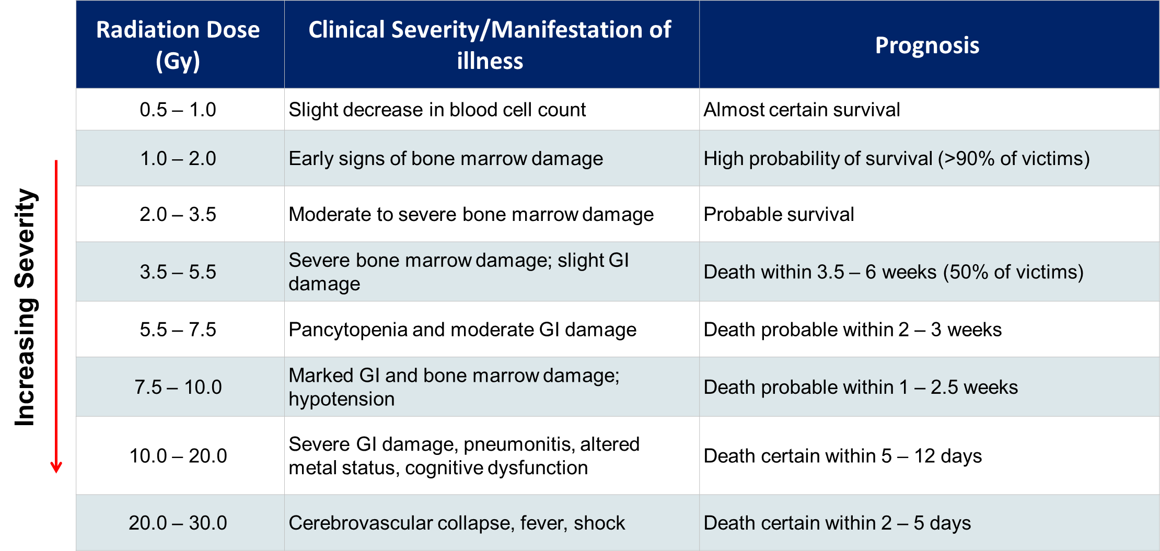
Dose-Dependent ARS Manifestations
Higher dose = greater clinical severity and decrease survival likelihood
Dose and symptom timing drive triage and care decisions
100
90
80
70
60
Percent Lethality
50
40
30
20
LD_{50/60} = 4.5 Gy
10
0
2
4
6
Left: Reproduced from NATO Handbook on the Medical Aspects of NBC Defensive Operations AMedP-6(B) Chapter 5, General Medical Effects of Nuclear Weapons: Diagnosis, Treatment and Prognosis, February 1, 1996. Available at: http://fas.org/nuke/guide/usa/doctrine/dod/fm8-9/1ch5.htm
Right: Adapted from Waselenko et al. Medical management of the acute radiation syndrome: recommendations of the Strategic National Stockpile Radiation Working Group. Ann Intern Med. 2004, 140:1037-51.
Dose (Gy)

Slide 21
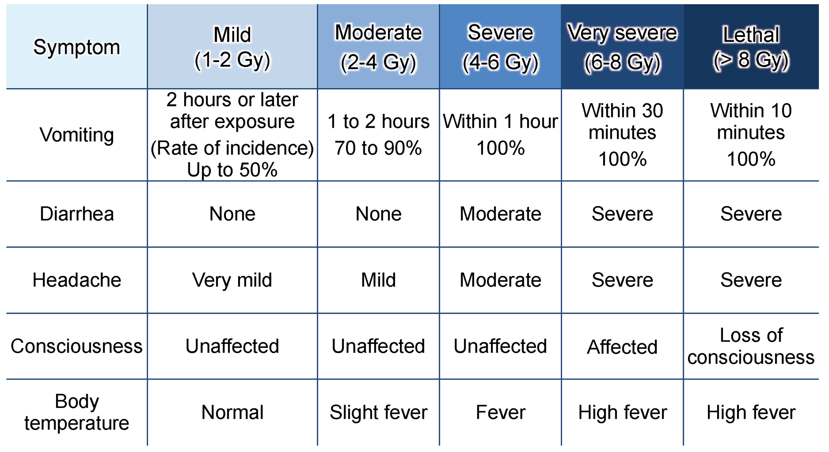
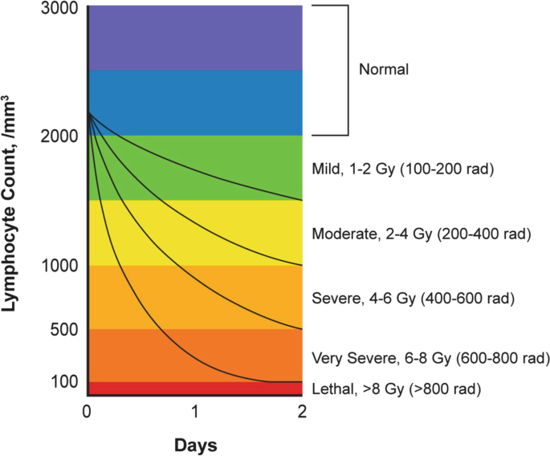
Quick ARS Severity Assessment: In the Field and Hospital
Symptoms vs. Dose Estimation
Time to vomiting (rapid radiological triage):
  <1 hr = severe (>6 Gy),
  1 - 2 hrs = moderate (2 – 4 Gy)
  > 2 hrs = Mild (<2 Gy)
Lymphocyte depletion (hospital setting): Faster drop = higher dose
Key Triage Markers
Field: Early symptoms (vomiting, neuro changes) guide triage
Hospital: Lymphocyte depletion confirms severity
Photo credit (ALC): Seedhouse, E. (2018). Treating acute radiation syndrome. In Space radiation and astronaut safety (pp. 89–99). Springer, Cham. https://doi.org/10.1007/978-3-319-74615-9_8

Slide 22
General Principles of ARS Management
No single cure – focus on damage control
  Treatment effectiveness depends on radiation dose and resource availability
Treat based on subsyndrome (hematopoietic, GI Neurovascular)
  Hematopoietic: Cytokines (G-CSF, GM-CSF), transfusions, infection prevention
  Gastrointestinal: IV hydration, antiemetics, bowel decontamination
  Neurovascular: Supportive care only, often fatal at high doses (>10 Gy)
Supportive measures: IV fluids, antiemetics, antibiotics, pain control
  IV fluids & electrolytes to counter dehydration from vomiting/diarrhea
  Antiemetics (ondansetron), antibiotics (broad-spectrum), opioids for pain

Slide 23
Bone Marrow Suppression & Infection Control
Neutropenia – Infection prevention is key
  Broad-spectrum antibiotics & antifungal for immunosuppressed patients
G-CSF (Neupogen/Neulasta) for WBC recovery
  Speeds up neutrophil recovery to reduce infection risk
  Initiate within 24 hours post-exposure for optimal benefit
Transfusions for thrombocytopenia
  Platelet transfusions for active bleeding or counts < 10, 000/μl
  Red blood cell transfusion if symptomatic anemia develops
  Isolation protocols
  Reverse isolation & HEPA filtration for high-risk neutropenic patients
  Limit invasive procedures to prevent secondary infections
Pharmacologic Countermeasures for Hematopoietic Subsyndrome
  G-CSF/GMCSF – stimulate immune cell production
  ESAs – stimulate red blood cell production (Epogen, Procrit, and Aranesp)
  Nplate – simulate platelet production
  Antibiotics (fluoroquinolone or similar)
  Antiviral (acyclovir) for HSV/VZV prophylaxis
    Anti-vomiting meds, diuretics, analgesics
Dainiak, N., & Albanese, J. (2022). Medical management of acute radiation syndrome. Journal of Radiological Protection, 42(3). https://doi.org/10.1088/1361-6498/ac7d18

Slide 24
Managing GI Radiation Toxicity
Prevent dehydration = Aggressive IV fluids, electrolyte correction
  Early correction of hypovolemia critical to maintain perfusion
  Replace potassium, magnesium losses as needed to prevent arrhythmias and muscle weakness
Mucosal integrity = Sucralfate, gut decontamination strategies
  Sucralfate may protect damaged GI mucosa and reduce ulceration (as discussed in narrative review)
  Non-absorbable oral antibiotics (gut decontamination) reduce bacterial translocation and sepsis risk
Infection control: Broad-spectrum antibiotics, antifungals
  Fluoroquinolones or similar agents recommended for high-dose exposures
  Add antifungal agents if febrile neutropenia persists >4–7 days
  Parenteral nutrition if prolonged GI failure
  Use if patients cannot maintain oral/enteral nutrition due to severe mucosal injury (explicitly described as part of supportive measures)
  Helps maintain metabolic balance during the mucosal healing phase
Dainiak, N., & Albanese, J. (2022). Medical management of acute radiation syndrome. Journal of Radiological Protection, 42(3). https://doi.org/10.1088/1361-6498/ac7d18

Slide 25
\
High-Dose Radiation & End-of-Life Considerations
>30 Gy exposure → non-survivable
  Outcome predictably fatal despite intervention
  Expect multiorgan failure and rapid progression to coma
Rapid symptom onset: Shock, seizures, unconsciousness
  At doses ≥10–12 Gy, severe neurovascular symptoms occur within hours to days
  Symptoms include ataxia, confusion, hypotension, seizures, and loss of consciousness
Palliative focus: Sedation, pain relief, dignity in care
  Palliative measures recommended when prognosis is poor
  Serotonin receptor antagonists, mannitol, analgesics, and comfort care measures should be emphasized
Dainiak, N., & Albanese, J. (2022). Medical management of acute radiation syndrome. Journal of Radiological Protection, 42(3). https://doi.org/10.1088/1361-6498/ac7d18
Waselenko, J. K., et al.. (2004). Medical management of the acute radiation syndrome: Recommendations of the Strategic National Stockpile Radiation Working Group. Annals of Internal Medicine, 140(12), 1037–1051. https://doi.org/10.7326/0003-4819-140-12-200406150-00015

Slide 26
Medical Countermeasures for Internalized Radioisotopes
Therapy | Mechanism of Action | Target Radionuclides | Primary Distribution / Organ Risk
Barium sulfate, Aluminum hydroxide, Calcium phosphate | Inhibit GI absorption | ²²⁶Ra, ⁹⁰Sr | Bone
Prussian Blue | Ion exchange; enhances fecal elimination | ¹³⁷Cs, Thallium (Tl) | Total body
DTPA (Ca-DTPA, Zn-DTPA) | Chelation; promotes urinary excretion | ²⁴¹Am, ²³⁸Pu, ²³⁹Pu, ⁶⁰Co | Lung, bone, liver
Sodium bicarbonate | Alkalinization; reduces renal toxicity | ²³⁴U, ²³⁵U, ²³⁸U (Uranium) | Lung, lymph nodes, kidneys, bladder
Hydration | Dilution; increases elimination rate | ³H (Tritium) | Total body
Potassium Iodide (KI) | Blocks thyroid uptake of radioactive iodine | ¹²⁵I, ¹³¹I (Radioiodine) | Thyroid
MCM depend on the radioisotope
Prussian Blue: Cesium, thallium elimination
  Binds cesium/thallium in the GI tract, reducing enterohepatic reabsorption
  Given orally; treatment may last weeks depending on body burden
DTPA (Ca/Zn): Plutonium, americium, curium binding
  Chelates transuranic metals, promoting urinary excretion
  IV or nebulized administration; early use is most effective
Potassium Iodide (KI): Blocks thyroid uptake of radioactive iodine
  Most effective if taken within hours of exposure
  Saturates thyroid with stable iodine, reducing cancer risk
Dainiak, N., & Albanese, J. (2022). Management of internal contamination with radionuclides. Journal of Radiological Protection, 42(4). https://doi.org/10.1088/1361-6498/ac9365

Slide 27
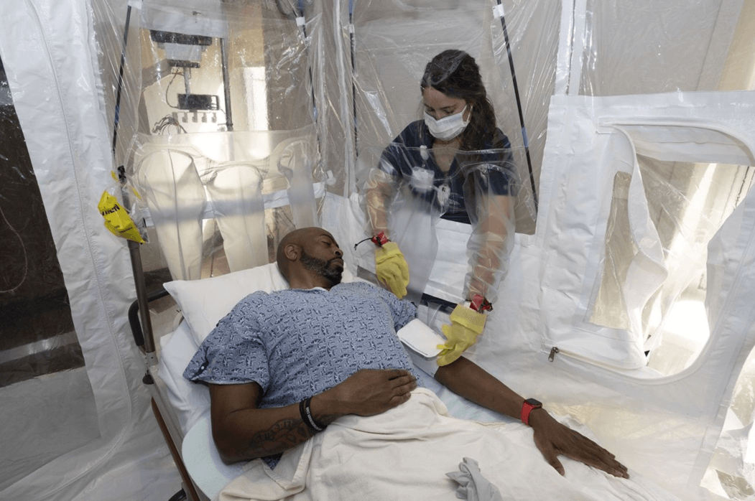
Inpatient Care Priorities
Monitor for complications
  Febrile neutropenia, sepsis, bleeding events
  GI damage progression and electrolyte imbalances
Daily supportive care considerations
  Transfusion thresholds (platelets <10k/µL or active bleeding; RBCs for symptomatic anemia)
  Parenteral nutrition if mucosal injury prevents oral intake
Multidisciplinary coordination
  Infectious disease, hematology, ICU, and mental health involvement

Slide 28
Field Management vs. Hospital Care
EMS & First Response: Focus on symptom recognition, contamination control
  Time to vomiting and neuro symptoms guide on-scene triage
  Decontamination and containment to limit spread
Hospital-Based Care: Long-term management, resource allocation
  Tailored supportive care, diagnostics, and MCM use
  Resource prioritization under crisis standards
Triage priorities: Severe ARS vs. salvageable cases
  Immediate vs. expectant categories based on dose and symptoms
  Early identification of those likely to benefit from aggressive intervention
>10
Likely fatal
Expectant
Expectant
Expectant
Expectant
Immediate
6 - 10
Severe
Immediate
Immediate
Delayed
Expectant
>2 - 6
Moderate
Immediate
Immediate
Immediate
Immediate
>0.5 - <2
Minimal
Minimal
Minimal
Minimal
Minimal
<0.5
Minimal
Minimal
Minimal
Minimal
Minimal
Resource Availability: Normal Good Fair Poor
Standard of Care: Conventional Contingency Crisis Criss
Radiation Dose-Based Triage and Treatment Prioritization
Coleman, C. N., et al. (2011). Triage and treatment tools for use in a scarce resources–crisis standards of care setting after a nuclear detonation. Disaster Medicine and Public Health Preparedness, 5(S1), S111–S122. https://doi.org/10.1001/dmp.2011.22
Dainiak, N., & Albanese, J. (2022). Medical management of acute radiation syndrome. Journal of Radiological Protection, 42(3). https://doi.org/10.1088/1361-6498/ac7d18

Slide 29
Key Take-Aways
1. ARS severity is dose-dependent
  Higher dose = faster symptom onset, more severe illness and lower survival probability
2. Symptom timing guides triage
  Time to vomiting and lymphocyte depletion are key early indicators
3. ARS management is syndrome-specific
  Hematopoietic: infection control, transfusions, G-CSF
  GI: hydration, gut protection, antibiotics
  Neurovascular: supportive/palliative care only
  4. Internal contamination requires rapid MCM intervention
  Prussian Blue, DTPA, and KI based on radionuclide
  5. Inpatient care focuses on complications & supportive measures
  Multidisciplinary coordination is critical
  6. Field triage differs from hospital care
  Field: rapid recognition, decontamination, expectant vs. immediate decisions
  Hospital: complex care, resource allocation, and patient-specific treatment

Slide 30

Questions

Slide 31

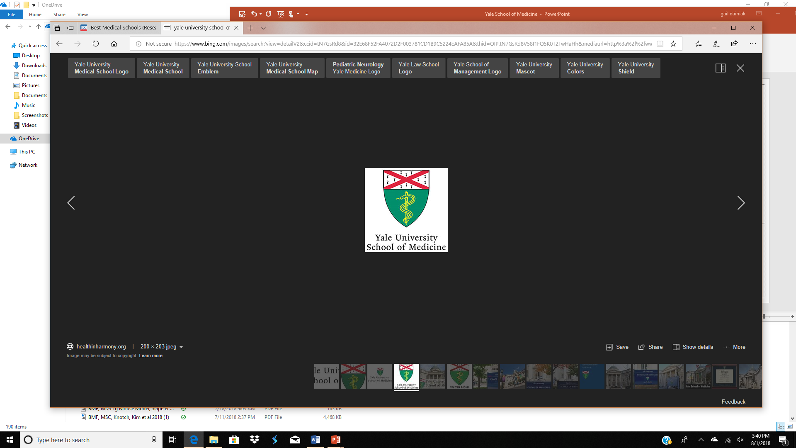
Clinical Management of Radioactive Contamination and Dose Estimation
Prepared by N Dainiak, MD for presentation by J Albanese, PhD
NYC DOHMH Coalition Meeting
CUNY School of Law
Long Island City, NY
March 25, 2025
Department of Therapeutic Radiology
Yale University School of Medicine
New Haven, CT

Slide 32
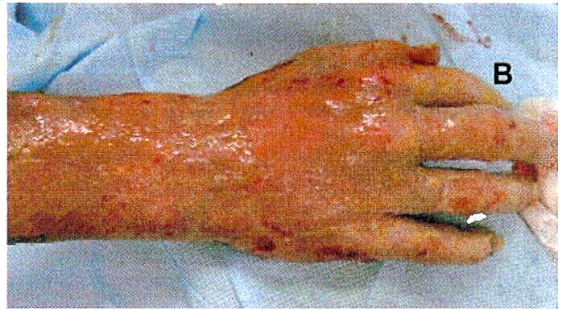

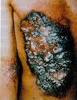

External Contamination and Skin Injuries
Skin as a Contamination Pathway
Contaminants can remain on skin or enter through cuts and abrasions
Skin contamination is common and usually managed with simple decontamination
Visual Cues
Redness, irritation, or minor skin reactions.
Look for puncture wounds or lacerations that could allow radionuclide uptake
Clinical Actions
Gently wash with soap and lukewarm water; avoid scrubbing.
Remove contaminated clothing.
Assess wounds carefully - contamination in wounds can lead to internalization
IAEA, 2000
Erythema
≥ 6 Gy
Swelling and onycholysis
IAEA, 2000
Moist desquamation
≥ 15 Gy
BJR, 2005
Ulceration
Necrosis
≥ 20 Gy
IAEA, 2000
IAEA, 2000
Notes:
Fortunately, contamination events rarely present with severe radiation burns or necrosis, as seen on these images. The focus is on managing superficial contamination and preventing internalization through wounds.”

Slide 33
Inhalation and Ingestion: Other Pathways of Internal Contamination
Inhalation
Fine particles (<5 µm) can reach deep into the lungs and remain for extended periods.
Nasal swabs and facial surveys help estimate inhalation intake.
Treatment consideration: DTPA (if elevated levels confirmed by bioassay or nasal swab results)
Ingestion
Can occur from contaminated hands, food, or water.
Only a portion of ingested material is absorbed into circulation.
Treatment consideration: Prussian Blue (for Cs-137 or thallium exposure), hydration, and supportive care as needed.

Slide 34
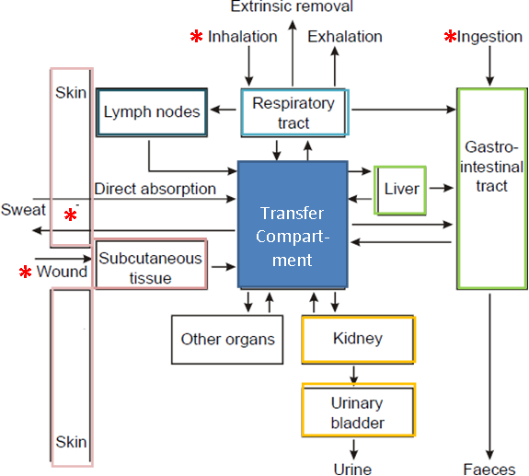
Main Routes of Radionuclide Intake and Distribution
Respiratory
Tract

Slide 35
Key Reference Terms
Annual Limit on Intake:
The amount of a specific radionuclide a person can safely intake in one year without significant health risk
Clinical Decision Guide (CDG):
Threshold values to help healthcare providers decide when medical intervention for internal contamination is needed
Derived Reference Level (DRL):
Reference activity levels (in disintegrations per minute or counts per minute) used for wounds or other intake pathways
Indicates when further assessment or treatment should be considered

Slide 36
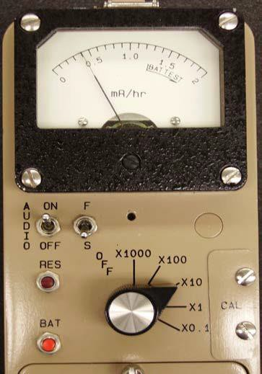
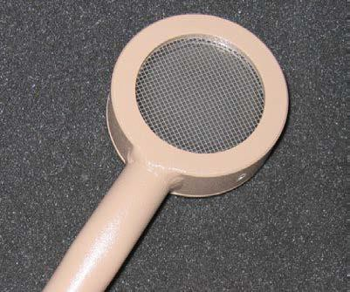
Selected Derived Reference Levels (DRLs) for Wounds are Used to Assess Internalization of a Radionuclide
Isotope | Based On* | Weak | Moderate | Strong | Avid
Co-60 | ED | 1.54E+08 | 1.54E+08 | 1.65E+08 | 2.01+08
Sr-90 | BS | 2.20E+07 | 2.20E+07 | 2.25E+07 | 2.38+07
Tc-99m | ED | 2.00E+11 | 2.56E+11 | 9.33+11 | 8.78E+11
I-131 | Thy | 7.06E+07 | 8.01E+07 | 1.26E+08 | 3.46E+08
Cs-137 | ED | 2.20E+08 | 2.20E+08 | 2.23E+08 | 2.34E+08
Ir-192 | ED | 4.49E+08 | 4.66E+08 | 6.21E+08 | 1.69E+09
U-235 | BS | 8.23E+05 | 8.23+05 | 8.29E+05 | 8.46+05
U-238 | BS | 8.55E+05 | 8.55+05 | 8.63E+05 | 8.78+05
Pu-239 | BS | 1.81E+03 | 1.81E+03 | 1.85E+03 | 1.92E+03
Am-241 | BS | 1.65E+03 | 1.65E+03 | 1.65E+03 | 1.65E+03
Cf-252 | BS | 5.14E+03 | 5.15E+03 | 5.75E+03 | 7.96E+03
Meter Efficiency = 10%
Compare to DRL
(analogous to ALI)

Slide 37
Interpreting Reading: Recognizing when contamination levels require escalation or expert involvement
Detection Tools
  Use handheld meters (GM, sodium iodide, or ZnS detectors) or available monitoring equipment to check for contamination.
Reference Points
  Compare detected counts per minute (cpm) to established reference values (CDG, ALI, DRL).
  These reference values help flag when further evaluation or action is needed.
Decision Thresholds
  High readings or readings above CDG/ALI/DRL levels indicate potential concern.
  Low or moderate readings typically do not require immediate intervention.
Action Steps
  If readings are elevated, consult health physics experts or dosimetrists.
  Document findings and continue medical stabilization.

Slide 38
Contamination Case Triage Process
Step 1: Prioritize Medical Stability
Life-threatening trauma, airway, and circulatory issues take precedence before addressing contamination
Step 2: Identify Likely Exposure Pathways
Determine if contamination occurred via inhalation, ingestion, or skin/wound contact
Step 3: Initial Field Actions
Perform rapid external surveys with handheld radiation detectors (GM, sodium iodide, or ZnS probes)
Decontaminate visible contamination (remove clothing, gentle washing)
Step 4: On-Scene Dose Estimation Cues
Nasal swab activity for inhalation estimation.
Face and hand swabs for surface contamination checks.
Compare measured counts to reference values (CDG, ALI) to determine urgency

Slide 39
Contamination Case Triage Process
Step 5: Hospital-Level Confirmation
Bioassays (urine, feces) and/or whole-body counting to confirm internal uptake
Step 6: Case Prioritization
High-count swabs or bioassay results exceeding CDG/ALI: Immediate treatment consideration
Low-level or uncertain results: Monitor and reassess
Step 7: Treatment Decision Points*
Initiate decorporation (DTPA, Prussian Blue) if internal contamination confirmed and
dose exceeds action levels
Perform wound decontamination, irrigation, and surgical excision as needed
* Considerations: If high external exposure doses are suspected, consult with dosimetry specialists. Don’t ignore external exposure just because contamination is the primary focus.

Slide 40
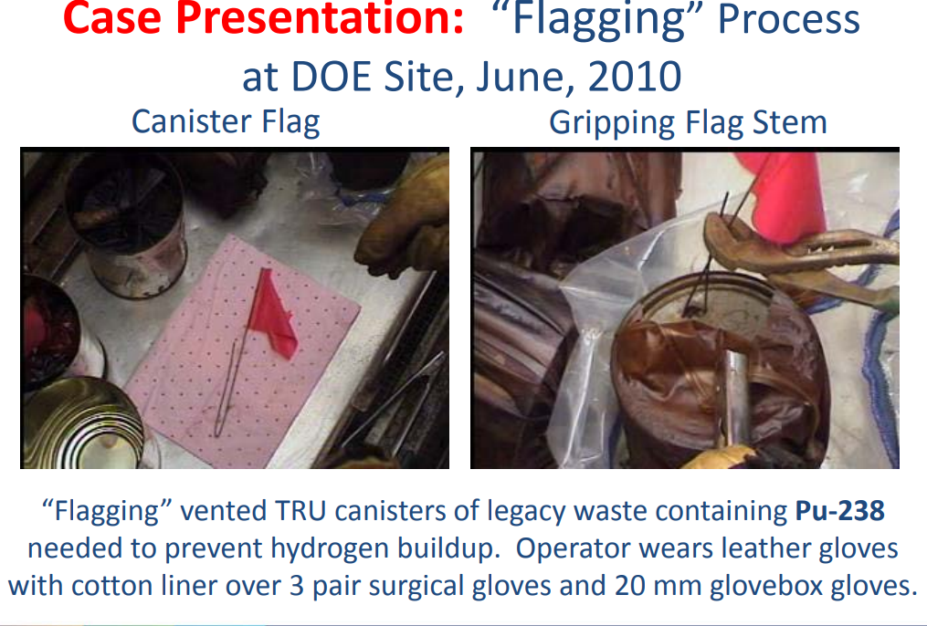

Slide 41
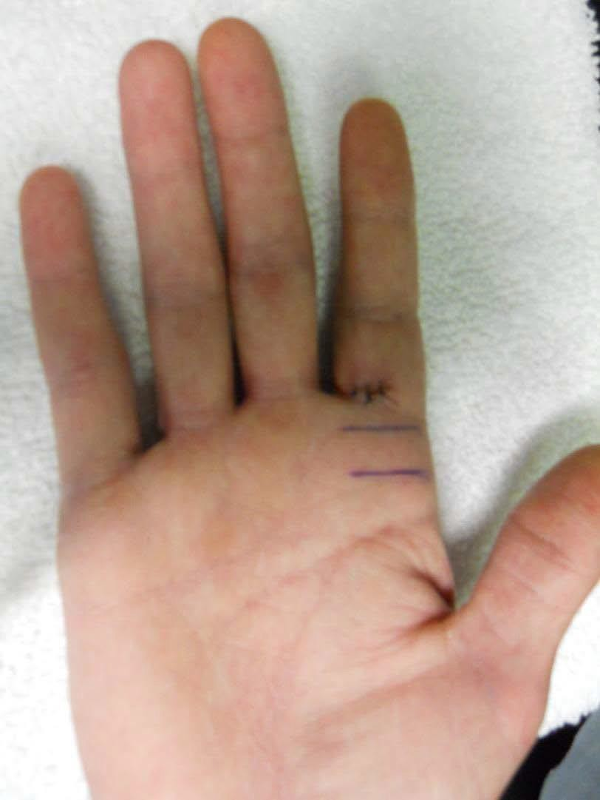
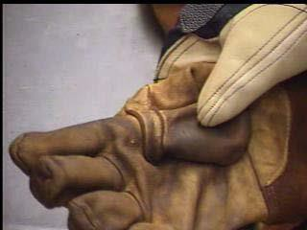
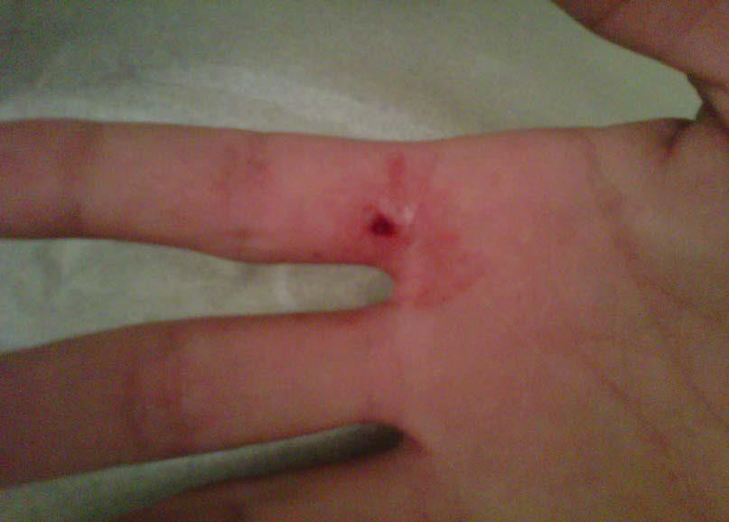

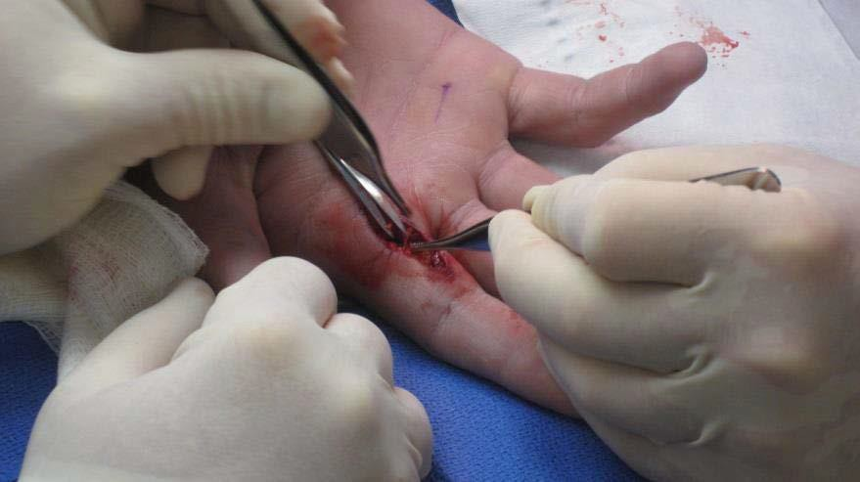

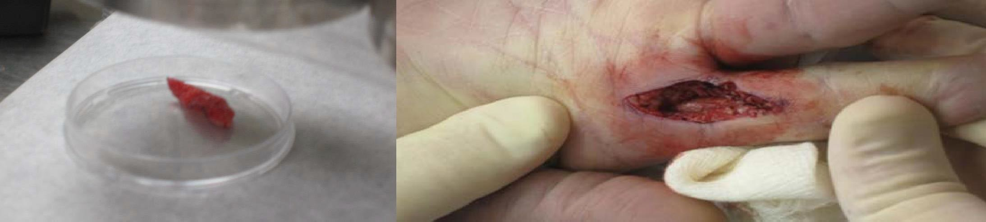
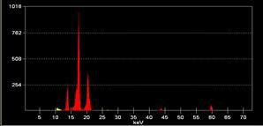



Internal Contamination after Puncture Wound
Glove puncture Wound Map of ²³⁸Pu
50%
25%
25%
Excisional biopsy Excised tissue Spectral analysis of puncture wound
HPGe
Pu and Am
I, shell x-rays
Sugarman SL, Findley WM, Toohey E, Dainiak N, Health Phys 2018; 115:57-64

Slide 42
Treatment of Internal Contamination
Therapy | Mechanism of Action | Selected Radioisotopes | Stochastic Risk
Barium sulfate Aluminum hydroxide Calcium phosphate | Inhibit GI absorption | Ra-226, Sr-90 | Bone
Prussian Blue | Ion exchange | Cs-137, Tl | Total body
DTPA | Chelation | Am-241, Pu-239, Pu-238, Co-60 | Lung, Bone, Liver
Sodium bicarbonate | Alters chemistry | U-234, -235, -238 | Lung, Lymph node, Kidney, Urinary bladder
Hydration | Dilution | H-3 | Total body
Blockade of uptake | KI | I-131, -125 | Thyroid

Slide 43
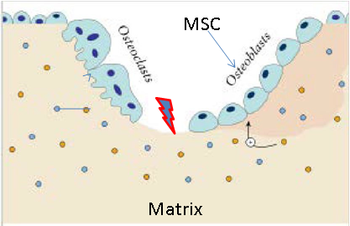
Uptake of Actinides is Remarkably Rapid
Bone Deposition Redistribution into Matrix
100
80
60
40
20
0
Percent Deposited (%)
0 1 2
Time (Hours)
TGF-beta: osteoclasts
IGF-1: osteoblasts

Slide 44
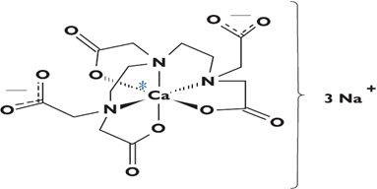
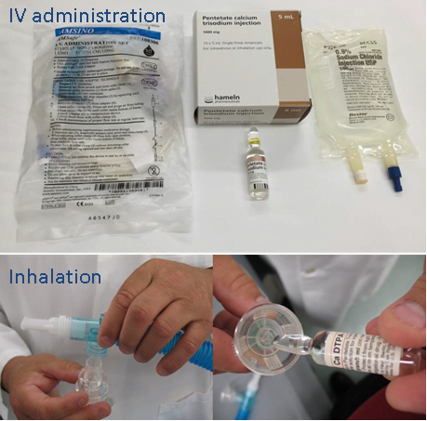
Chelation Therapy: DTPA - Diethylenetriaminepentaacetic acid
1967: Atomic Energy Commission acquired investigational new
drug (IND) from Geigy
2004: FDA approval for decorporation therapy; new drug
application (NDA) granted to Hameln (US)
Ca-DTPA, Zn-DTPA
New chelators (Hydroxypyridonate [HOPO] Ligands) under
development:
Tri-Sodium
Salt
Octadendate HOPO

Slide 45
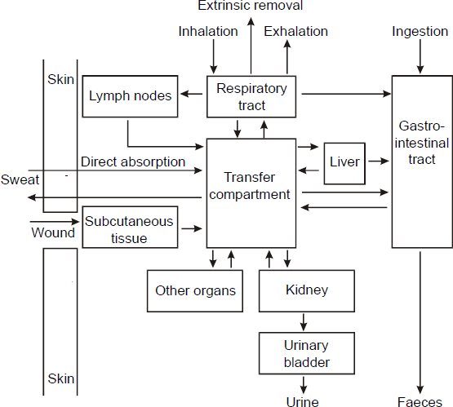
DTPA Induces Increased Excretion of Actinides
Liver
Transfer
Compartment

Slide 46
Summary
Prioritize life-threatening trauma before managing contamination
Determine the likely contamination pathways: Skin, inhalation, ingestion, or wound
Use reference values (ALI, CDG, DRL) to identify potential health concerns and know when to seek consult
Manage external contamination by gentle skin decontamination and careful wound assessment to prevent internalization
Assess inhalation and/or ingestion of contaminants via nasal swabs or bioassays; treat with DTPA or Prussian Blue when appropriate
Focus on Triggers, Not Complex Math. Teams aren’t expected to calculate doses, just recognize elevated readings and escalate to experts

Slide 47


Thank You!
Nicholas Dainiak, MD, FACP
Clinical Professor
Department of Therapeutic Radiology
Director, CT Biodosimetry Laboratory at Yale
Yale University School of Medicine
PO Box 08040
333 Cedar Street
New Haven, CT
06520
NickDainMD@aol.com
Nicholas.Dainiak@Yale.edu

Slide 48

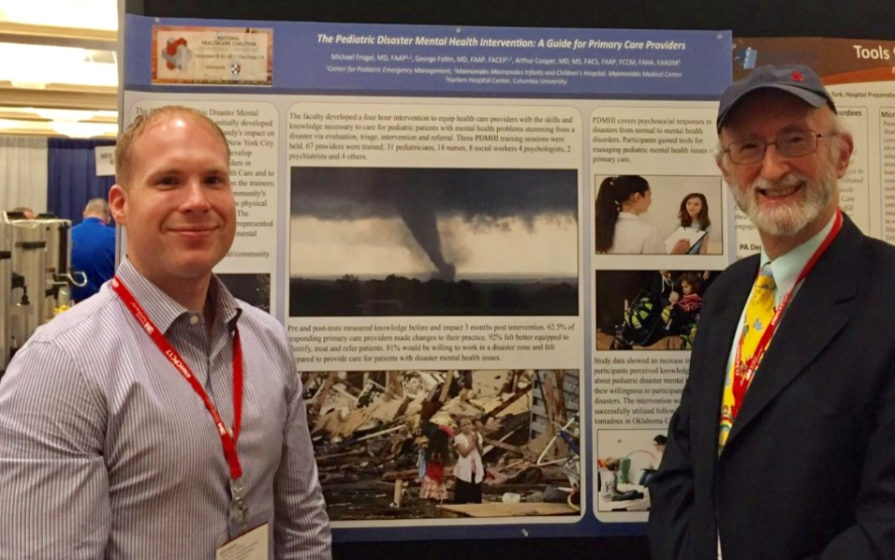


In Loving Memory of Dr. Michael Frogel (1950 – 2024)
“The Pediatric Disaster Coalition believes that it is imperative to realize that children and their needs must be specifically addressed in all stages of preparedness, response, and recovery” – Dr. Michael Frogel
Photo: John Jermyn and Dr. Frogel,
2017 National Healthcare Coalition Preparedness Conference

Slide 49

Summary of Two
Presentations from NHCPC24
Jose Rodriguez
Disclaimer – all materials were presented at the NHCPC.

Slide 50
Presentation Summary of 2024 NHCPC
1. Response Plan for the Management of Dialysis Patients in Puerto Rico during Emergencies: Dr. Ángel D. Toledo Rodríguez PhD. State Coordinator for the Access and Functional Needs Population / EOC At Risk Population Liaison. Organization: Division of the Public Health Preparedness and Response (DPHPR)
2. Preparing for a Hospital Rescue Behavior : Considerations, Challenges, and Best Practice
Mark Sevilla, DNP, RN, Vice President Behavioral Health & Emergency Services Yale New Haven Hospital; Roger Glick, Market Director Healthcare + Emergency Management Jensen Hughes

Slide 51


Response Plan for the Management of Dialysis Patients in Puerto Rico during Emergencies
Ensuring Continuity of Care
December 12th, 2024
Dr. Ángel D. Toledo-Rodríguez
State Coordinator for the Access and Functional Needs Population At Risk Population Liaison DOC-PRDoH
Division of the Public Health Preparedness and Response

Slide 52
Main Objective
To ensure the safety and continuity of care for dialysis patients during emergencies.

Slide 53
Kidney Patient Identification
Target Population: Puerto Rico has a renal patient population of about 320,000 people in the early stages of the condition.
The population of kidney patients receiving dialysis in Puerto Rico is as follows: 6,590 people on dialysis and 1,700 transplant patients.
Identifying vulnerable populations:
  Some of the factors that can increase the risk of chronic kidney disease are diabetes, high blood pressure, heart disease, smoking and obesity. Depending on the underlying cause, some types of kidney disease can be treated.
  Kidney disease can develop at any time, but people over the age of 60 are more likely to develop it. As people age, so do their kidneys. According to recent estimates from researchers at Johns Hopkins University, more than 50 percent of people over the age of 75 are believed to have kidney disease. It has also been found that kidney disease is more prevalent in people over the age of 60 compared to the rest of the general population. It is important to emphasize that the elderly population is part of the population at risk of an event that could become an emergency.

Slide 54

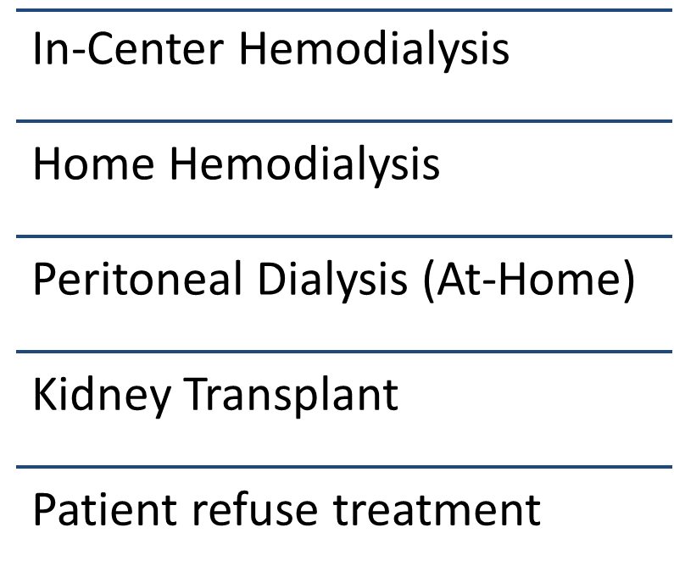

Treatment Options

Slide 55
Emergency Situations

Slide 56
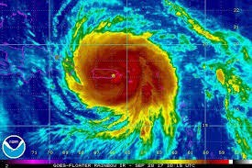
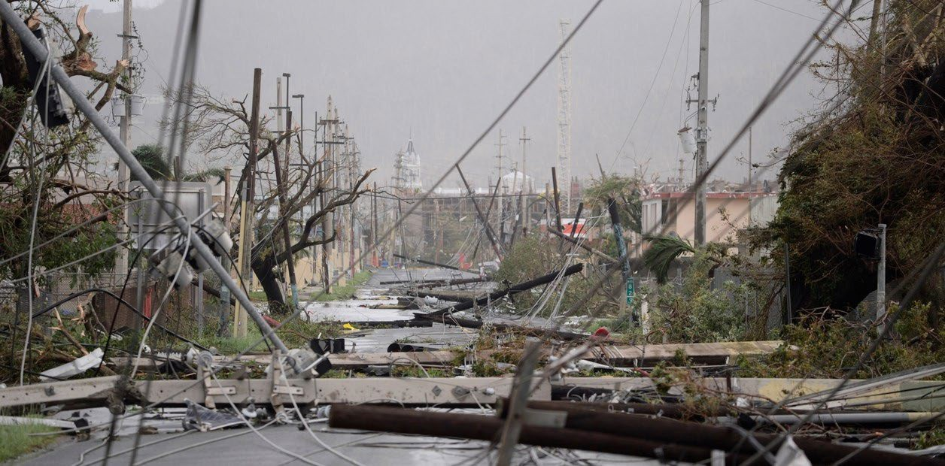
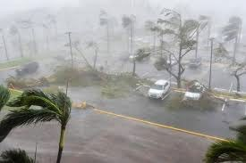
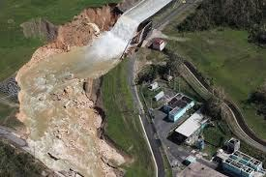
Hurricane María (September 20th, 2017).
150 mph winds.
Widespread damages (including dialysis treatment centers).
Destroyed the electric grid.
Rainfall of 15 to 20 inches brought flooding across of the Island.
Interruption of the water and sanitation services for approximately 50% of the residents.
PD. 7 years after María, utility services remain unreliable in rural areas.

Slide 57

COVID-19 Pandemic (2019)
One of the biggest challenge in the dialysis clinics, was caring for patients on dialysis during the COVID-19 pandemic. Patients on dialysis were amongst those at highest risk of death, not just because of the propensity for serious illness but also because of missed treatments.

Slide 58
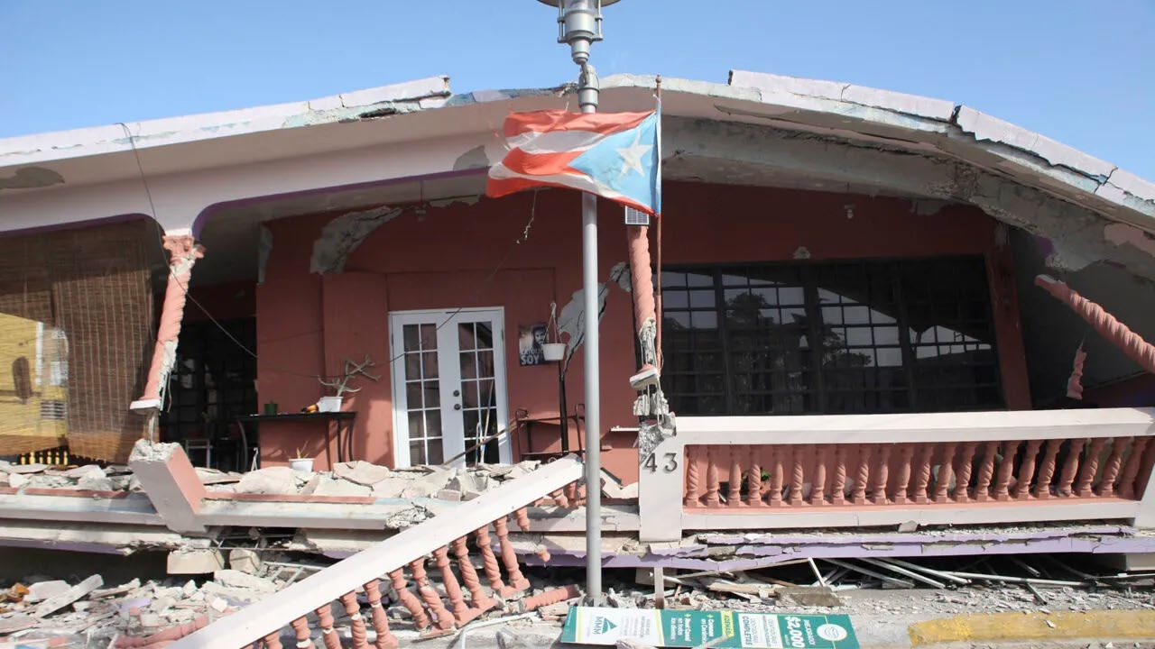
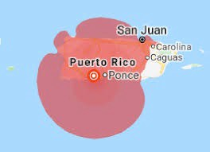
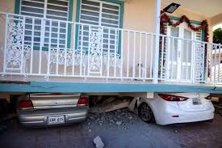
Earthquake in Puerto Rico (January 7th, 2020)
Earthquake in Puerto Rico (January 7^{th,} 2020) can have a significant impact on kidney patients, including:
  Disrupted care.
  Missed dialysis sessions.
  Increased hospitalizations.
  Mental health effects.
  Delayed diagnosis.

Slide 59
Patient Health Impact of Losing Treatments: the biggest fear in dialysis patients
Patient non-compliance with the recommended regimen is a major problem because it affects the patient's medical condition, exacerbates patient mental health conditions such as cognitive changes, constructional praxis, altered processing level, and adds to the financial burden. A United States study reports that failure to comply with medical therapy responsibly results in 125,000 deaths each year, as well as hundreds of thousands of hospitalizations. Non-compliance with treatment in the permanent kidney disease population is a problem with significant consequences in terms of morbidity and early mortality.
Fluid Retention
Blood pressure change
Pulmonary Edema Possible Intubation
Heart muscle fatigue
Pump failure Heart failure
HOSPITAL
Reduced immune response, making you more prone to infections.
Damage to the central nervous system, which may result in difficulty concentrating, personality changes or seizures.

Slide 60

Communication plan during emergency
A communication plan for dialysis patients during an emergency should include:
  Contact information
  Communication methods
  Information sharing
  Patient information
  Facility needs

Slide 61
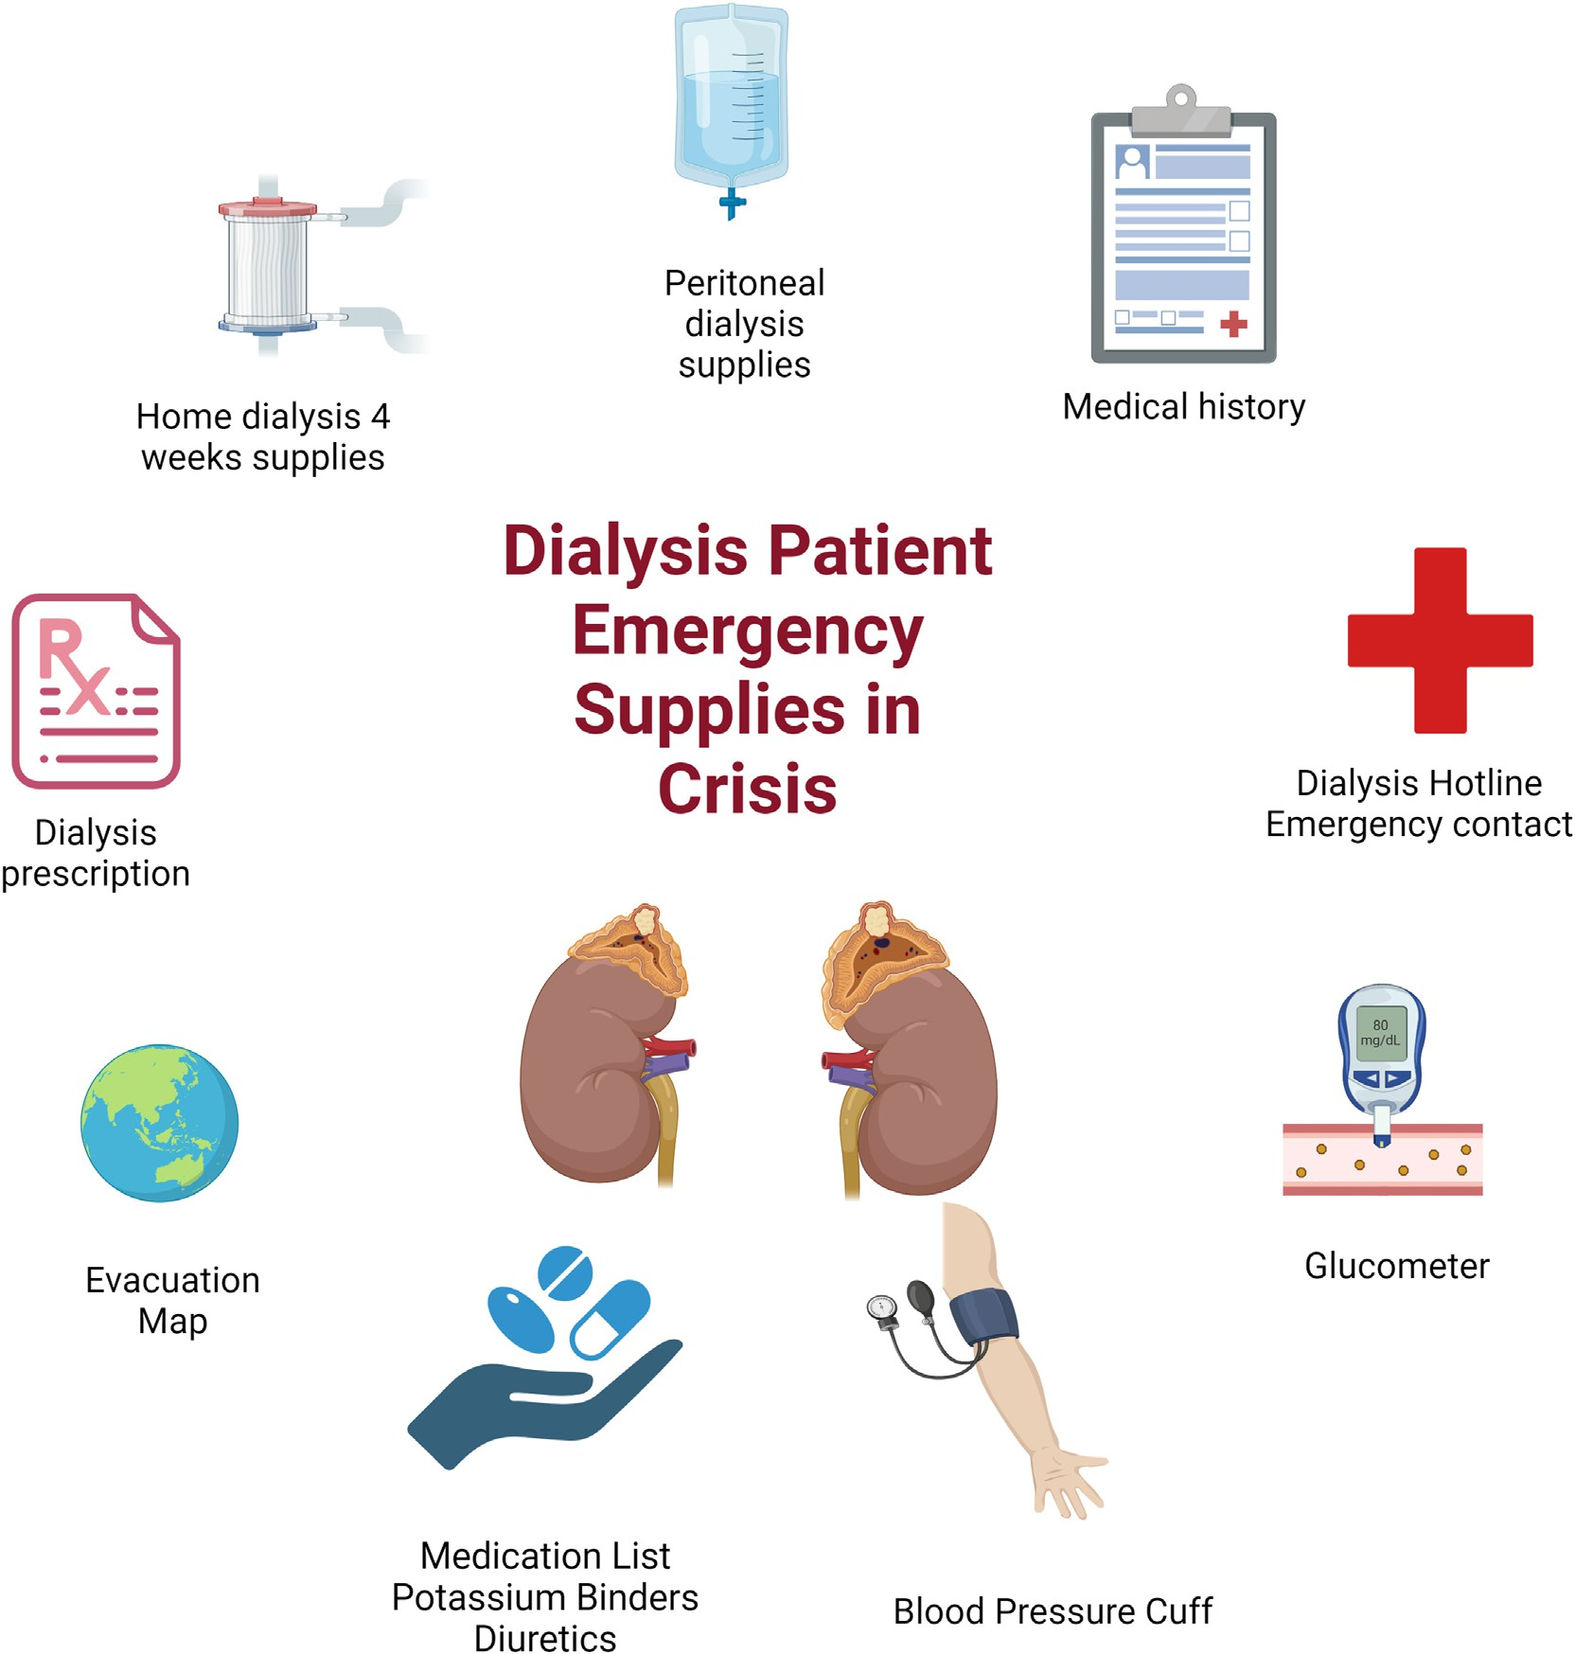
Resource Allocation
Essential Supplies
Stockpiling dialysis supplies (dialyzers, fluids, etc.)
Backup generators for clinics.

Slide 62

PREPARAR-C
How does it come about?
The Puerto Rico Emergency Preparedness and Response Activities Renal Coalition PREPARAR-C brings together representatives from organizations and companies that provide dialysis services to the renal population.
After the Hurricane Maria event in Puerto Rico, the companies that manage dialysis centers and the Puerto Rico Department of Health joined forces to develop an emergency management plan focused on preparedness and response activities for the dialysis population. This will ensure the continuity of dialysis services in Puerto Rico.
In emergencies that have arisen to date, the PREPARAR-C component has put into practice the response plan for the management of dialysis patients in Puerto Rico during emergencies.
Companies / Organizations
Currently, the following companies and organizations are part of this coalition:
Fresenius Kidney Care
Centro Renal Pediátrico
Centers for Medicare and Medicaid Services CMS
Centro Renal Universitario
Pure Life Renal of San Juan
Consejo Renal de Puerto Rico
Fundación Puertorriqueña del Pulmón.
Metro Dialysis Care
Quality Insights Renal Network

Slide 63
Training and Drills
Staff Training
Emergency response training for healthcare providers.
Regular drills to practice emergency protocols.

Slide 64
Collaboration with Agencies
Partners in Emergency Preparedness
Collaboration with FEMA, local hospitals, and community organizations who provides services to the at-risk population.
Establishing a network for resource sharing.

Slide 65
Recovery Plan
Post-Emergency Care
  To ensure the safety and continuity of care for dialysis patients during emergencies.
Follow-up protocols for affected patients.
  The importance of the trainings and drills to keep updated the protocols for the kidney population.
Assessment of health outcomes and adjusting plans as necessary considering the magnitude of the event or emergency and the needs for the kidney population.

Slide 66
Conclusion
While identifying the dialysis population and their needs during an emergency, it is important to plan, develop and practice preparedness and response plans for events that may put the renal population in Puerto Rico at risk.
It becomes relevant the importance of preparation and collaboration to ensure patient safety and care continuity.
It would be important to include dialysis emergency partners in the implementation of emergency preparedness and response plans.

Slide 67
Preparing for a Hospital Rescue Behavior :
Considerations, Challenges, and Best Practice
Mark Sevilla, DNP, RN, Vice President Behavioral Health & Emergency Services Yale New Haven Hospital
Roger Glick, Market Director Healthcare + Emergency Management Jensen Hughes

Slide 68
Empirical Findings
We all have thoughts, experiences, and war-stories but what does the literature teach us about Behavioral Health evacuations?
Frank & Trinidad, 2007 – Support to victims of Hurricane Katrina.
Griffies, 2009 – Reestablishing program structure for the LSU/Oschner psychiatric residency following Hurricane Katrina.
McClain et al., 2007 – Evacuation of 6 veterans following Hurricane Rita.
Previous to Hurricane Katrina…not a lot specific to psychiatric facilities, most assess fire related events.

Slide 69

Empirical Findings
Post Hurricane Katrina…
still not a lot,
but…
Thomas & Lackey, 2008 – Evacuation of a psychiatric hospital during Hurricane Katrina.
Waitz et al., 2024 – Disaster Preparation and Effects on Inpatient Psychiatric Care (Chapter 6 in Handbook of Evidence-Based Inpatient Mental Health Programs for Children and Adolescents).
Nouri et al., 2022 – Phoenix on Fire: A Phenomenological Study of a Psychiatric Hospital Fire in Iran.
Terui et al., 2021 – Determinants of the evacuation destination for psychiatric inpatients following the Fukushima nuclear disaster.

Slide 70
Differences: Behavioral Health vs. Acute Care
Acute patients are in the hospital by choice. Behavioral Health patients often aren’t, so they will leave if they can.
Acute patients can be cohorted. Behavioral Health patients may need to be separated.
One major difference is that you must distinguish between disaster preparation for the system and disaster preparedness for treating an individual patient or patients (Waitz et al., 2024).
Behavioral Health patients’ conditions are often exacerbated by stimulus. Evacuating would be a significant stimulus in various ways.

Slide 71
What Do We Need to Know?
Patient Condition
Staffing requirements
Destination
Patient equipment, supplies, and pharmaceuticals
Patient documentation

Slide 72





Patient Condition
Anxiety
Bipolar
Depressive
Dissociative
Neurocognitive
Personality
Schiziphrenia
Trauma and Stressor Related

Slide 73
Patient Condition
Typically, patients are cohorted by type of illness and/or age
Geropsychiatric
General Adult
Mood Disorders
Adolescent
Transitional Age Youth
Each patient should be assessed prior to movement
Consider pre-medication
Beware makeshift weapons and ligature risks

Slide 74
Patient Destination
What type of transportation will be required?
How long will the patient need to stay?
Where is it and how far?
Will the trip require food and rest stops?

Slide 75
Staffing Requirements
Staff to Patient ratio?
What about high-risk patients? (1:1) What if you need to restrain a patient?
Staff needed for movement vs. while in transport? What mix of staff?
RN
Mental Health Worker or Milieu Counselor
Security
What if you need to use untrained staff?

Slide 76
Patient Documentation
Medical records
Patient identification
Organizational forms (e.g., staffing sheets, flowsheets, etc.)

Slide 77
Patient Equipment, Supplies, & Pharmaceuticals
Personal belongings
Medical supplies & equipment (syringes, CPAP, etc.)
Refrigerated vs. non-refrigerated Sufficient doses
Medications:

Slide 78
What do you need to do, now?
RISK ASSESSMENT
EMERGENCY PLAN(S)
TRAINING
EXERCISING AND EVALUATE

Slide 79
Evacuation Checklist
Evacuation Element | Primary Considerations
Patient Condition | Triage (Most Ready to Least Ready) Ability to cohort Need to separate
Destination | How far? How long will it take? How will you transport? Psychiatric vs. non-psychiatric plant?
Staffing Requirements | Orientation of non-psychiatric staff Requirements for 1:1 staffing Sufficient staffing during transportation (e.g., bathroom breaks)
Patient Documentation | Required notifications Notification to payors Medical Records
Patient Equipment, Supplies, and Pharmaceuticals | Personal belongings (patients and staff) Medical supplies and equipment

Slide 80

March 2025 EPS Meeting
Greg Wayrich, EMT-P
Chair, BQEPC,
EPC, NYP Queens

Slide 81

National Healthcare Coalition Preparedness Conference
Rosen Shingle Creek – Orlando, FL
1200+ Attendees
50+ Vendors
3 Days of Conference content
BQEPC/PDC/NYC HCC presence
Networking and best practices
Federal partners/ASPR

Slide 82
National Healthcare Coalition Preparedness Conference
Key Takeaways
Keynote: Positive Mindset and Building Resilience for Life by Brandon Webb, Former Navy Seal and Current Author
General Session on MCI – Ybor City Shooting: Chief Christopher Shipp, Major Eric DeFelice
Address by Jennifer Pitcher, Exec. Dir. MESH
Dr. Mike Frogel Memorial Dinner

Slide 83
National Healthcare Coalition Preparedness Conference
BQEPC Attendees:
  Greg Wayrich, NYP Queens, Chair – BQEPC
  John Jermyn, Maimonides MC/PDC, Vice Chair - BQEPC
  Jose Rodriguez, NYC H&H-Coler, Treasurer - BQEPC

Slide 84
National Healthcare Coalition Preparedness Conference
Key Takeaways
The NHCPC conducts a great event.
Exhibitors were very engaged (Grainger, AHEPP)
Networking opportunities

Slide 85

National Healthcare Coalition Preparedness Conference
SAVE THE DATE FOR #NHCPC25

Slide 86
QUESTIONS?

Slide 87
Ready and Resilient
Healthcare Business Continuity
Greg Wayrich
Chair, BQEPC
(Summary from presentation from Ralph Nazzaro/Kristopher Mattson, Atlanta, GA)
National Healthcare Coalition
Preparedness Conference
Dec 10-12, 2024
Orlando, FL

Slide 88
Discussion Topics
• Continuity of Operations Vs. Business Continuity
Essential Functions – Recovery to Normal
• Requirements for TJC (13.01.01) and CMS
• Planning, Development and Execution challenges

Slide 89
Project Scope
• Designed to better prepare the healthcare system and meet TJC requirements
• 3-year approach, building to an internal capability
• Year 1 – Plan Development
• Year 2 – AMBH incorporation and staff training
• Year 3 – Test, Training & Exercise (TT&E) implementation and transition continuity program to Children’s staff

Slide 90
Establishing Governance- Start of Planning
Concept:
• Department Continuity Champions provide direct input
• Steering Committee (Systemwide EM Committee) reviews products and approves key decisions
• Executive Committee provides final approval of plan
Issues:
• Continuity Champion availability and delegation below appropriate level
• EM Committee meeting frequency and EM Department capacity created review bottleneck
• February 2024 healthcare cyberattacks

Slide 91
Establishing Governance- End of Year 1
• Increased emphasis on Department Continuity Champion participation
• Creation of Business Continuity Steering Committee
• Delegation of final approval authority for the plan to the BC Steering Committee

Slide 92
Identifying Essential Functions
• FEMA CGC (2024) Definition: “A subset of organizational functions that are determined to be critical activities.”
• “[Identifies] supporting tasks and resources that must be included in the organization’s continuity planning process.”
• Healthcare Practice: define EFs as Departments
• System EFs versus Department EFs
• Need to identify critical processes within Departments

Slide 93
Identifying Essential Functions
Approach:
• Created Essential Functions worksheet for departments to self- assess
• Identified 38 Departments as Essential Functions
• 22 Clinical
• 16 Non-Clinical/Support Services
• Reviewed and approved by Steering Committee (EM Committee)

Slide 94
Department Essential Functions Worksheet

Slide 95
Business Process Analysis (BPA)
• Identifies for each EF*:
• The workflow and steps necessary for critical processes
• Critical staff, equipment, and other resources
• Dependencies with other departments and organizations
• Department BPAs accomplished through:
• BPA Worksheets sent to Department Continuity Champions at each hospital
• Step-by-step written instructions and training video
• Virtual interviews and email follow-up as required
*Source: FEMA BPA/BIA User’s Guide (July 2019)

Slide 96
Department BPA Worksheet
• Based on California Hospital Association Hospital Continuity Toolkithttps://www.calhospitalprepare.org/continuity
• Output Statement and Critical Processes
• Critical Equipment and Staff
• Required IT Applications
• Essential Records
• Department and External Organization or Vendor Dependencies
• Critical Process Workflow
• Resources described by Recovery Time Objective(RTO), or how quickly access to the resource or system must resume to support EF performance

Slide 97
Business Impact Analysis (BIA)
• A method of identifying and evaluating the effects of various threats and hazards and the impact they may have on the ability of an organization to perform its EFs
• Steps:
• Identify likely hazards
• Determine vulnerability of EFs (Departments) to disruption
• Consider operational and financial impacts
• Identify mitigation measures

Slide 98
Department BIA Worksheet

Slide 99
Where Are We Now?
• Phase 1 (April 2024 – December 2024): Complete Draft Plan
• Initial draft plan completed for BC Committee review
• Internal focus on downtime procedure standardization and hospital move
• Phase 2 (January 2025 – July 2025): Plan Validation and Revision
• Post-hospital move, the systemwide strategic priority shifts to continuity
• Conduct department-level workshops to validate BPA/BIA data and annex procedures with Continuity Champions and incorporate new facility into plans
• Computer-Based Training and TT&E program development
• Phase 3 (Summer 2025 – 2027)
• Launch Computer-Based Training and begin TT&E delivery

Slide 100
Achieving Efficiencies in Exercise Design & Delivery
Greg Wayrich
Chair, BQEPC
(Summary from presentation from Steve Meir, The Meir Group)
National Healthcare Coalition
Preparedness Conference
Dec 10-12, 2024
Orlando, FL

Slide 101
Chicago Area HCC’s
County Population Data:
Suburban Cook County: 2,448,913
DuPage County: 920,762
Lake County: 714,342
Will County: 696,757
Kane County: 516,522
McHenry County: 314,042
Kendall County: 131,869
Kankakee County: 107,502
Grundy County: 52,533
Total Population Regions 7-10: 5,903,242
50 Hospitals

Slide 102
Their Challenges (Sound Familiar?)
Multiple exercise demands in addition to planning for special events and responding to real-life incidents.
MRSE
Chemical Annex Tabletop
CHEMPACK Training
Decontamination Training
Democratic National Convention
Cyber incidents at hospitals

Slide 103
The Scenario
  A domestic terror cell has been able to acquire 18 gallons of agent Yellow (a 50/50 blend of blister agents Sulfur Mustard and Lewisite).
  A domestic terror cell has been able to acquire 18 gallons of agent Yellow (a 50/50 blend of blister agents Sulfur Mustard and Lewisite).
  Released at 4 Summer festivals in each Region (7-10)

Slide 104
Casualties by HCC Region
Total Patients 579 557 576 291
EMS Transport (50%) 289 279 288 146
Self-Transport (50%) 290 278 288 145

Slide 105
Decompression Summary
Region 7:
A total of 358 patients can be rapidly discharged for an average of 33 patients per hospital.
Region 8:
A total of 335 patients can be rapidly discharged for an average of 26 patients per hospital.
Region 9:
A total of 469 patients can be rapidly discharged for an average of 36 patients per hospital.
Region 10:
A total of 188 patients can be rapidly discharged for an average of 24 patients per hospital.

Slide 106
Patient Transfers Summaries
Region 7: 510 patients were successfully admitted across all hospitals (this includes ED treats + release).
41 patients requiring admission also need transfer (from 4 hospitals). All (100%) of those patients were designated a transfer facility.
Region 8: 472 patients were successfully admitted across all hospitals (this includes ED treats + release).
30 patients requiring admission also need transfer (from 4 hospitals). 26 (87%) of those patients were designated a transfer facility.
Region 9: 508 patients were successfully admitted across all hospitals (this includes ED treats + release).
46 patients requiring admission also need transfer (from 6 hospitals). 44 (96%) of those patients were designated a transfer facility.
Region 10: 259 patients were successfully admitted across all hospitals (this includes ED treats + release).
33 patients requiring admission also need transfer (from 5 hospitals). 27 (82%) of those patients were designated a transfer facility.

Slide 107
QUESTIONS?

Slide 108
A BIG
ANNOUNCEMENT

Slide 109
Introducing!
The Inaugural
Stay Inservice: Mental Health and Wellness for the First Responder
An In-Person Symposium
Notes:
Half the disbursement will be split evenly with participation criteria
Health care facilities only
No double dip
No city government entity
Service Half will be based on service to BQEPC
Service activity, active involvement (running for office, attend meetings for the coalition, etc)
Annual payments (roughly 20%)
Mass notification
Conference
This will be rolled out this year.

Slide 110
What:
A Full (mostly) Day Symposium
Includes a Training Session (NYC REMSCO)
Keynote Speaker: Matthew Giacopelli, EMT-P
Panel Discussion: Various MH Professionals
Co-Branding Opportunity
Notes:
We removed Healthcare from our name, we want to be more inclusive to all aspects of our community
Search for best practices, locally and nationally: we have really embraced the national conference the last 2 years and for the future. Some of the elements like MOCC and shared governance lent increase in engagement in our members and success to operationalizing BQEPC
My fellow coalition members will be sharing some of those best practices we learned at the most recent conference.

Slide 111
When/Where:
Thursday, May 15
10 AM – 4 PM
Marriott LaGuardia

Slide 112
Why:
Our members had been heavily brainstorming for a new way to reach the community
Having attended the NHCPC infused us with ideas
Many of us are from the First Responder/Public Safety Realm
We think the timing is ideal (week prior to National EMS Week)

Slide 113
Next:
Please Attend!
We will have some flyers, media etc. forthcoming soon!
No cost to attend
There will be giveaways for all attendees
Lunch will be served

Slide 114
QUESTIONS?

