Slide 3
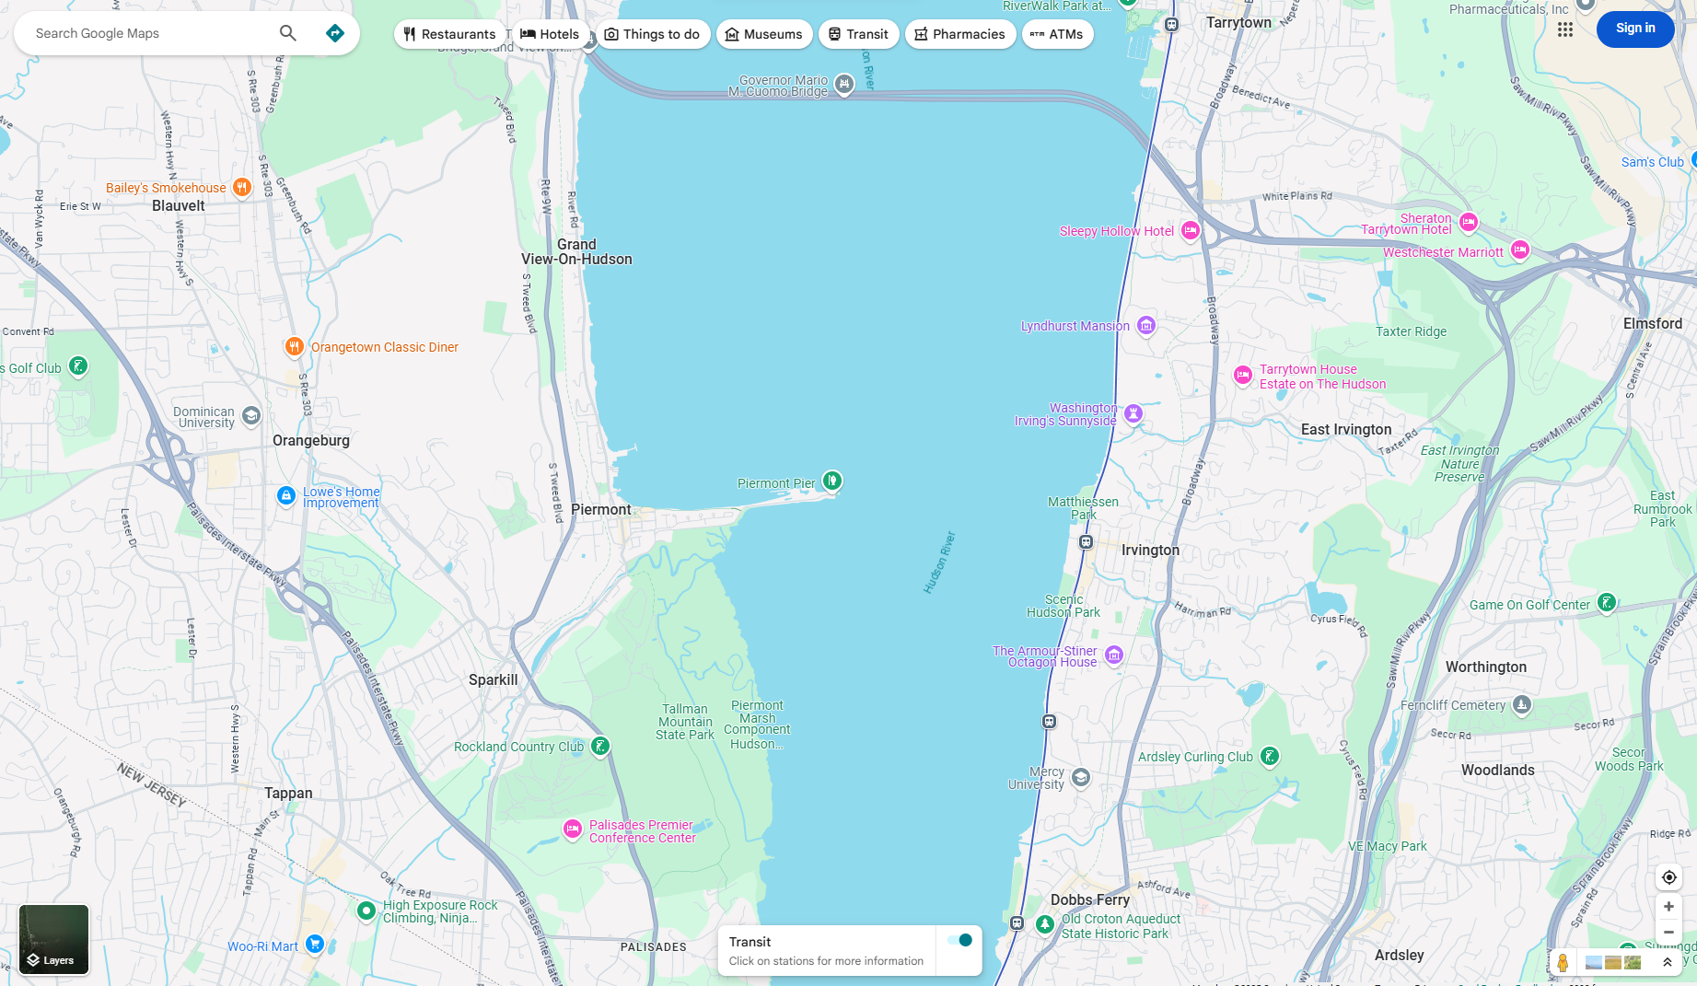

Slide 7
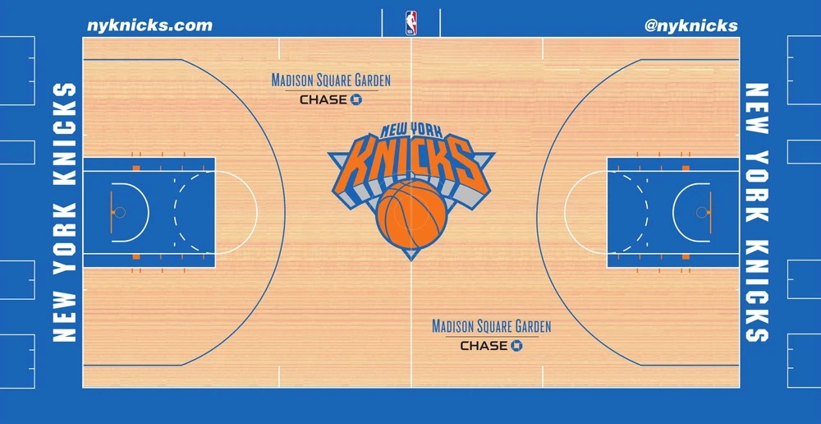

Slide 8
BP1 Highlights (7/1/24 – 6/30/25)
New For BP1
Coalition Educational Series
- SUNY Downstate COOP
- MTA Emergency Management
Home Care & Hospice Emergency Management Forums & HCANYS Emergency Management Series
“Year Of The MRSE!”
Collaborative Planning
New Exercise Format
Hospital Conference Call Pilot
Coalition Partners Supporting One Another
NorthHELP → Infusion (Home)
PDC → NERUCA (Peds)
3 Coalition Meetings &
1 Coalition Conference Cohosted by: BEPC, TBC, EPCOM, BQEPC, SICOAD
Coalition Strategic Plan
“Road Map” For BP2-5+
Ongoing Development & Engagement With All Sectors
Coalition Calendar
On Coalition Website
Coalition-Wide Meetings, Exercises, Initiatives, etc.
Coalition Conferences
BQEPC Mental Health, Community Emergency Network, NorthHelp, PDC, etc.
Long-Term Care “Company’s Coming” MRSE-Adjacent TTX &
“Operation NHExIS”
Extreme Heat FE
HPP BP1 Requirements
- Plans
- Assessments
- Exercises
3 Coalition Newsletters
- July 2024
- January 2025
- April 2025
Healthcare System
Support Branch (HSSB)
Emergency Response Group (ERG) Updates

Slide 9
Healthcare Systems Support Branch (HSSB) Overview
By: Asad Ghafoor, MPH
Emergency Response Coordinator
HSSB ICS Coordinator

Slide 10
HSSB roles
Lead coordination with healthcare facilities and public health partners during emergencies by tapping into pre – existing coalitions, associations, etc.
HSSB keeps DOHMH leadership informed about healthcare impacts and equips healthcare partners with the necessary resources to implement public health guidance and respond throughout the incident.
HSSB plays a crucial role in restoring healthcare services to their normal state, enabling New York City residents to access healthcare in their daily lives.

Slide 11
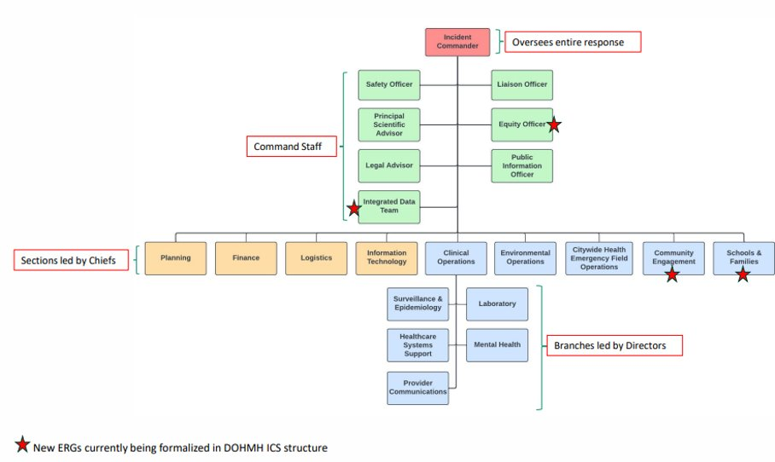
NYCDOHMH
ICS
Structure

Slide 12
HSSB ERG ICS Structure

Slide 13
Agencies in the City’s EOC are grouped by Emergency Support Functions (ESF) ​ ​
Public Safety (ESF-13)
Health & Medical (ESF-8)
Human Services, Mass Care, Housing (ESF-6)
Energy (ESF-12)
Infrastructure (ESF-3)
Private Sector (ESF-14)
Transportation (ESF-1)
NYCEM is lead agency for ESF-8
- HSSB is DOHMH lead
External Affairs (ESF-15)

Slide 14
HSSB Emergency Response Group (ERG)
Each ERG is owned by a division or bureau whose mission and programs most closely align with the ERG’s response functions.
Each ERG has pre-assigned leadership and general staff​.
- 10 HSSB Branch Directors
- Rotating on – call schedule
Key position descriptions​: Defines roles and responsibilities of all positions on the ERG org chart via Job Action Sheets.
Participate in agency exercise and trainings
- NYC Rad Ready
Staff Healthcare Evacuation Center (HEC)

Slide 15
Closing Remarks
In summary, HSSB is not only a vital part of emergency response but also a key player in ensuring continuity and recovery for New York City’s healthcare system.
Our flexible ICS structure, pre-assigned leadership, and continuous training make sure we can meet any emergency head – on – 24/7.

Slide 16
Thank you!
Asad Ghafoor, MPH
mghafoor@health.nyc.gov
P: 347 – 396 – 2885
C: 917 – 920 – 1344

Slide 17
Thinking about: Resource Allocation and Crisis Standards of Care
Jessica Cole, Sr. Strategist Healthcare Readiness
Strategic Initiatives Unit
Office of Emergency Preparedness (OEPR)

Slide 18
What are we doing?
Meeting with NYC stakeholders to discuss and align on a shared understanding of resource allocation, including during crisis standards of care (CSC).
Hearing about best practices from our partners (YOU) and thinking about how to develop methods to synthesize and share back.
Developing ways to incorporate resource allocation into planning and exercises.
Notes:
If the past few years, we have been exploring resource allocation and CSC at the conceptual level, trying to get a better understanding how other states and jurisdictions approach it, taking a deeper look at the literature, discussing internally some of the challenges from the public health lens.
We now pivoting, we are expanding our scope to collaborate with external community and healthcare partners and so want to better understand the planning efforts and solutions you have been developing. We are especially interested in notable gaps, where we can best support you and work together.

Slide 19
What does resource allocation look like in healthcare settings?
To achieve the best possible health outcomes for all patients during contingency and crisis standards of care, healthcare systems need to adopt strategies that maximize limited resources (space, staff, and stuff). For example, healthcare settings may implement strategies such as ’conserve, adapt, repurpose, reuse, or extend’ (CARRE) limited resources.
Source: https://fastercapital.com/keyword/healthcare-resource-allocation.html
Notes:
Briefly, I wanted to go over some of the core concepts of resource allocation and CSC we have been focusing on.
The literature highlights that the best practices in order to achieve the best possible health outcomes for all patients during contingency and crisis standards of care, we need to adopt strategies that maximize limited resources (space, staff, and stuff).
Outside of normal operating conditions, when standards of care are contingency or crisis standards of care, healthcare settings may implement strategies to ‘conserve, adapt, repurpose, reuse, or extend’ (CARRE) limited resources. I will cover some examples of this later.

Slide 20
When does it become a ‘crisis’?
Souce: https://www.eenews.net/articles/slow-recovery-in-puerto-rico-threatens-an-important-industry/
Notes:
In healthcare settings, standards of care, whether for a heart attack, a respiratory condition, or a gun shot wound, can move from normal operating conditions to extreme operating conditions due to medical surge or significant supply chain issues.
When standards of care shift significantly, this may become what is known as “Crisis Standards of Care” (CSC).
This table above from the National Academy of Medicine (2009 IOM report) represents "the continuum of standards of care related to the degree of surge response required in a large-scale disaster that range from conventional to contingency to crisis." As healthcare settings move out of normal operation conditions and conventional standards of care towards contingency and crisis standards of care, this is when the demands of the incident exceed the resources available.
The goal of healthcare settings is to avoid, if possible, the need to change how they operate. However, this is not always the case. To prepare for extreme conditions, healthcare systems need to optimize limited resources – namely the space, staff, stuff.
Next, lets look at some examples…

Slide 21
Systems Planning
Outside of normal operating conditions, leadership and planning in a healthcare setting may adapt their clinical operation protocols that can limit, delay, or cancel procedures in order to refocus resources.
Notes:
Before we can talk about ‘space, staff, and stuff’, we must first understand the larger ‘systems planning’ used to make decisions about how changes can, or should, be made: Systems planning is a structured framework that manages healthcare operations and makes system-wide adjustments, such as reallocating resources or delaying procedures, to maintain efficiency during changing conditions.
When talking about systems in healthcare settings, the focus is the planning and leadership needed to operationalize and optimize a response effort. The role of planning and leadership is to provide targeted strategies to that free up resources to meet the demands of a medical surge.
Functionally, this means that outside of normal operations conditions, leadership and planning in a healthcare setting may adapt their clinical operation protocols that can limit, delay, or cancel procedures. This is one of the primary ways used to limit impacts in an emerging rescores shortage.
Critical Care Explorations (lww.com)

Slide 22
Space Allocation
Outside of normal operating conditions, healthcare settings can repurpose nonclinical areas (e.g., small waiting rooms, hallways, cafeterias, etc.) to provide care.
Picture Source: Getty Images
Notes:
Space refers to bed capacity for patient care and is often one of the most visible and challenging issues due to the additional logistical needs that can come with flex spaces (such as electrical and medical gas systems).

Slide 23
Staff Allocation
Outside of normal operating conditions, healthcare settings may extend staff credentials that increases scope of practice for existing staff.
Notes:
Staff allocation refers to the personnel involved in care delivery or operations of a healthcare settings. This is one of the ways the state and regulatory relief may be the most helpful, such as by extending who can work in clinical settings, it but can also be controversial if it includes increasing staffing ratios or potentially infringes on employment contracts.

Slide 24
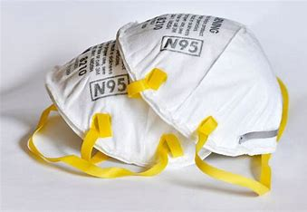
Stuff Allocation
Outside of normal operating conditions, healthcare settings may conserve supplies.
Additionally, healthcare settings may practice limited reuse of single-use supplies or extend the shelf-life of certain supplies.
Notes:
Stuff refers to the physical equipment required to deliver care and support care delivery. Just-in-time purchasing is not companiable with the rapid and unpredictable needs of healthcare settings during extreme surging/ public health emergencies. Additionally, as was seen with the saline bags shortages after the 2017 hurricanes decimated manufacturing plants in Puerto Rico as we entered a bad flu season, supply change can suffer in unrelated emergencies that layer on top of the healthcare system’s emerging one.

Slide 25
Next Steps
We will be finding ways to connect with you on these topics!
We especially want to know:
How do you manage day-to-day resource shortages?
How do you incorporate day-to-day allocation strategies into planning for changes to standards to care?
What emerging gaps or challenges have you identified?

Slide 26
Let’s chat!
Jessica Cole
Sr. Strategist- Healthcare Readiness
Strategic Initiatives Unit
Office of Emergency Preparedness and Response, DOHMH
joneill@health.nyc.gov

