Slide 1
Utilizing the Five Mission Areas of EM to Target Workplace Violence in Healthcare
Michael Karam, MS HEM
Senior Emergency Management Specialist
Northwell LHH, GVH, MEETH

Slide 2
What is Workplace Violence?
Any act or threat—verbal, nonverbal, written, or physical—that involves aggression, harassment, bullying, sabotage, sexual harassment, or assault by staff, patients, or visitors.
TJC increased focus in recent years
Burnout, decreased productivity, & affects patient care
The Joint Commission

Slide 3
Understanding the Problem
Workplace
Violence
Injuries
Healthcare Sector
Nurses
5x as likely
73%
all incidents
82%
experienced
*Data from The CDC & National Nurses United
Notes:
© Copyright PresentationGO.com – The free PowerPoint and Google Slides template library

Slide 4
Types of Workplace Violence
01
02
03
Patient Incidents
Staff Incidents
Visitor Incidents
Patient - Staff
Patient – Patient
Patient - Visitor
Staff - Staff
Staff – Patient
Staff – Visitor
Visitor - Visitor
Visitor - Patient
Visitor - Staff
Notes:
© Copyright PresentationGO.com – The free PowerPoint and Google Slides template library

Slide 5
The Role of Emergency Management
Reactive Measures
Proactive Approach

Slide 6
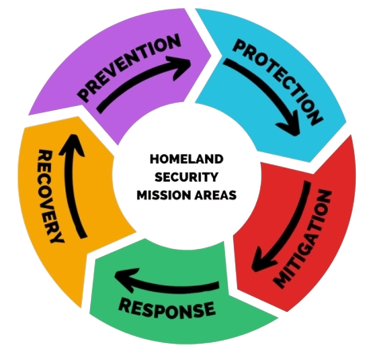

Slide 7
Prevention
Risk Assessments
Policies & Reporting
“Speak-Up” Culture
Training & Education
Behavioral Threat Assessment Teams

Slide 8
Protection
Physical Security Measures
Security Personnel
Personal Protective Equipment (PPE)
Environmental Design

Slide 9
Mitigation
Collaboration with Law Enforcement
Communication Systems
Crisis Intervention Teams
De-escalation Training Awareness

Slide 10
Response
Internal Security and Law Enforcement
Containment and Control
Communication and Information Dissemination

Slide 11
Recovery
After-Action Reports
Follow-Up
Improvement Items

Slide 12
Integration & Collaboration
Not solely a Security issue
Emergency Managers facilitate collaboration
Break down the silos

Slide 13
Call to Action
Share Best Practices
Change the Perspective
Conduct Drills
Raise Awareness

Slide 14
Thank You!

Slide 15
Clinical Engagement in Emergency Management and Business Continuity Matthew Harris MD, FAEMS Medical Director, Emergency Management and Business Continuity

Slide 16
Objectives
A history of clinical challenges
Engaging with clinicians to optimize EM/BC
Not just grey skies
Changing the way we educate clinicians

Slide 17
Breaking Tradition: Integrating Clinical Leaders into the ICS Leadership

Slide 18
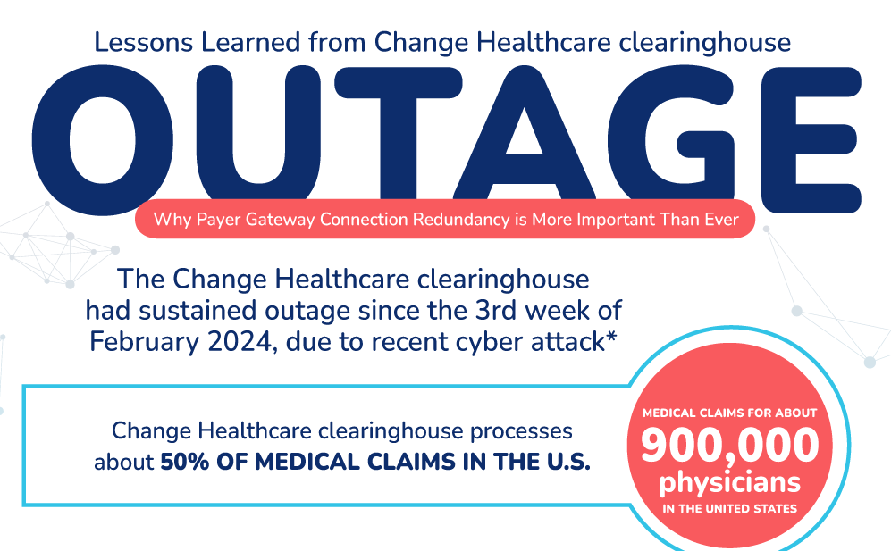
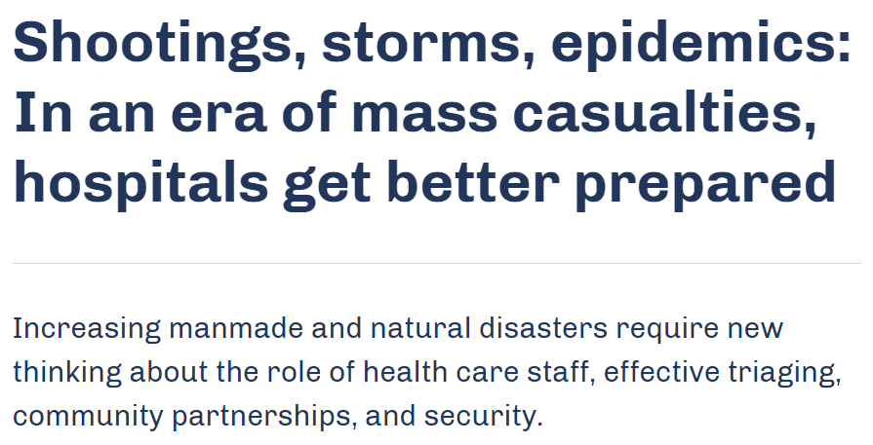
Challenges in the Healthcare Environment
“We Live in a VUCA World –Volatile, Uncertain, Complex and Ambiguous”
– US ARMY War College

Slide 19
Emergency Event Timeline & Lessons Learned
COVID-19 Pandemic Response & Recovery
Northeast
Blackout
Ebola Outbreak
Disaster Relief:
Puerto Rico Earthquake
MPox
Y2K
SARS
Outbreak
Eric Gardner Civil Demonstrations
Change Health Cyber Attack
Hurricane Floyd
H1N1 Outbreak
Hurricane Irene
Hurricane Maria
Crowdstrike Outage
1999 2000 2001 2002 2003 2004 2005 2006 2007 2008 2009 2010 2011 2012 2013 2014 2015 2016 2017 2018 2019 2020 2021 2022 2023 2024
NYC Transit Strike
Great Neck Tornado
Seasonal Winter Storms & Spring Nor'easters
Hurricane Ida
9/11 Attack
George Floyd Civil Demonstrations
EPIC Transition
Christmas Blizzards
Anthrax
Superstorm Sandy
Lessons Learned
Hurricane Sandy – Maintain stable supply chains by limiting dependence on third party vendors. COVID-19 Pandemic – Technological readiness to enable smooth transitions to remote work and care delivery. Hurricane Irene – Early evacuation decisions and patient movement. Terrorism/Bio-terrorism – Importance of education on the impact terrorism events can have on hospital operations. SARS/Ebola/H1N1 – Recurring infection prevention and personal protective equipment (PPE) education. Hazardous Weather – Staff personal preparedness practices and training. Hurricane Ida – Protection of critical surgical subspecialties in the wake of disaster. Vaccine Rollout – Importance of agility to flex POD operations and supply chain as needed based on the latest clinical guidance and executive orders.
Hazardous Weather
Cyber
Terrorism/Bio-Terrorism
Infectious Disease
Civil Demonstrations
Special Missions & Deployments

Slide 20
The Importance of Emergency Preparedness in Healthcare:
Patient Centered Operations
Emergency Management Phases:
EMERGENCY PREPAREDNESS IS CRUCIAL FOR HEALTHCARE AS IT ENSURES READINESS AND COORDINATION DURING CRISES, DIRECTLY IMPACTING PATIENT CARE AND REQUIRING SUPPORT FROM CLINICAL LEADERSHIP AT ALL STAGES TO OPTIMIZE RESPONSE AND RECOVERY EFFORTS.
Public Education
Hazard Vulnerability/Risk Assessments
Improved Infrastructure
Emergency Response Plans
Continuity Planning
Training & Exercises
Mitigation
Preparedness
Economic Recovery
Debris Management
Alternate Care Locations
Community Access
Property Remediation
Recovery
Response
Life Safety
Incident Stabilization
Property Preservation
Evacuation & Shelters
Mass Care
Notes:
We believe it is a key foundational component of our approach to EM education to understand the 4 major principles of EM including mitigation, preparedness, response and recovery. These concepts are the basis for our response infrastructure and are critical to ensuring patient safety and un-interruppted, high-quality care. It is our belief that our preparedness efforts are bolstered and are stronger with robust clinical involvment.

Slide 21
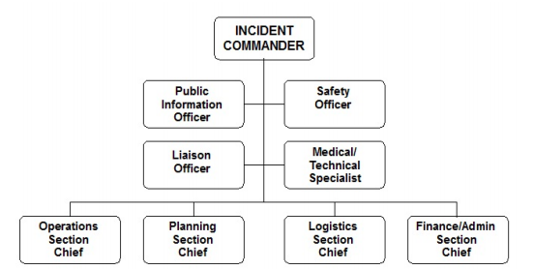
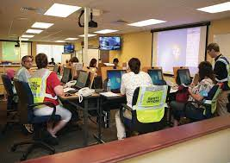
Traditional Incident Command Structure

Slide 22
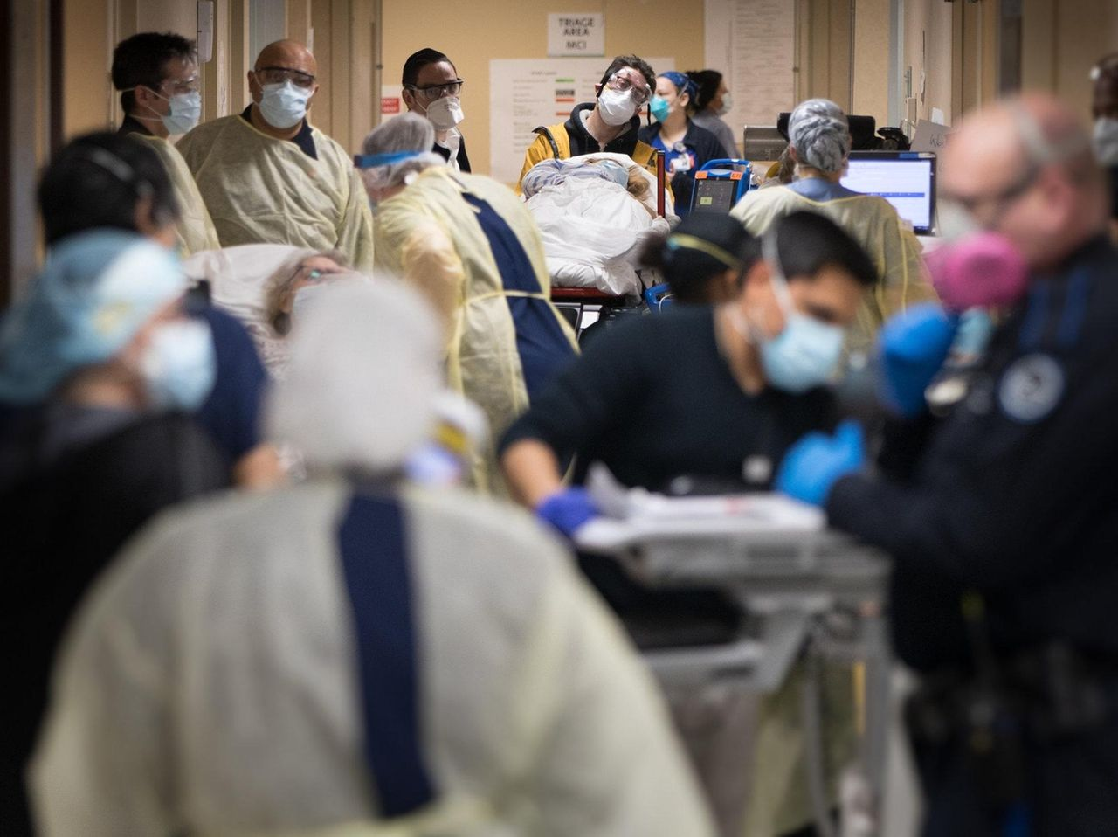
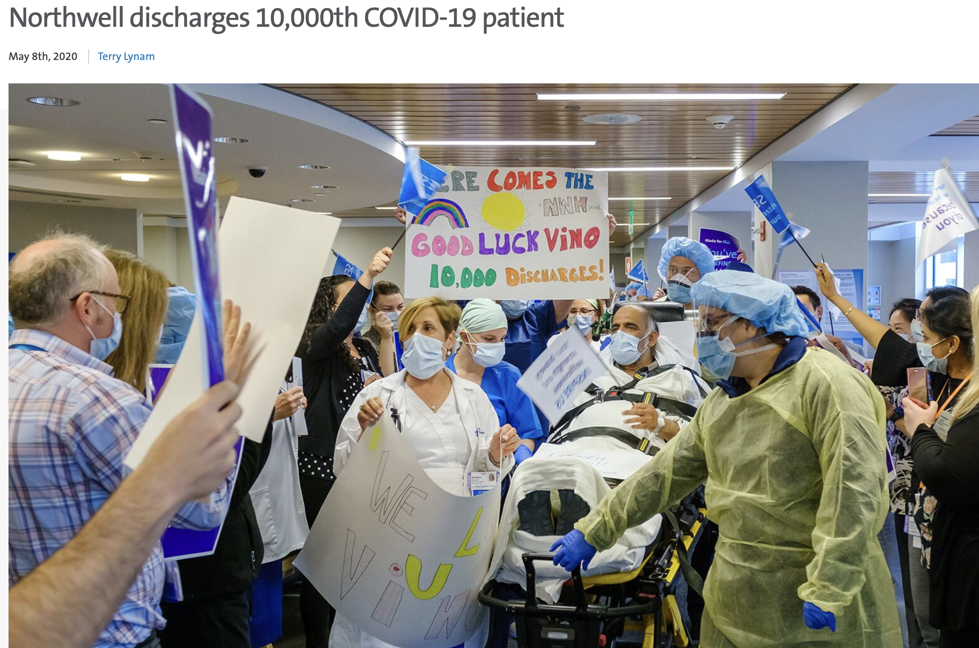
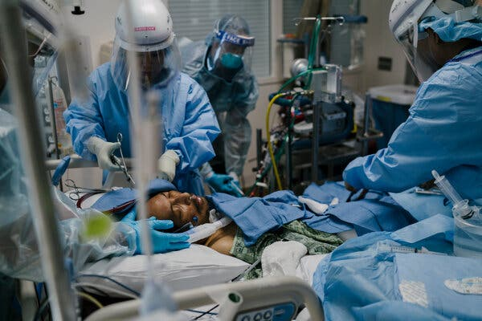
COVID 19 – An Overwhelming Clinical Challenge

Slide 23
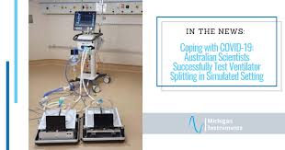
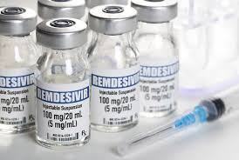
COVID 19 – An Overwhelming Clinical Challenge

Slide 24
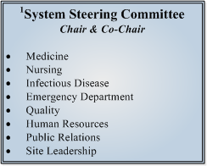
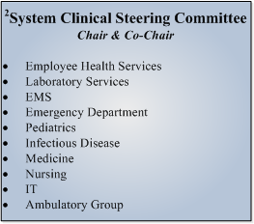
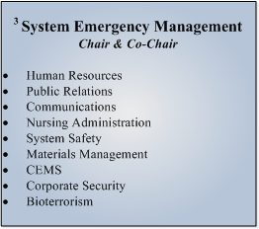
Clinical Advisory Group

Slide 25
Clinical Advisory Group
Real Time Enterprise-Wide Decision Making
Expedited Policies and Procedures Review
Multi-disciplinary Evidence Based Review of a rapidly evolving body of literature
Clinical Operational challenges
Emergency Credentialing
Scope of Practice Expansion
Development of Crisis Standards of Care

Slide 26
Engaging Clinicians in Daily EM/BC Functions

Slide 27
Remember the Why? – Emergency Management Beyond Corporate Compliance
Cyber threats, weather, social unrest Loss of infrastructure Deviation of from normal Operations
This is a PATIENT SAFETY ISSUE

Slide 28
The Importance of High Reliability & Resiliency in Healthcare:
Increasing Regulatory Requirements
CMS & HHS, PROPOSED (FY 29) - Increased available funding to support operations and mission-critical infrastructure
Medicare Incentive and disincentives for the essential and enhance practice programs, incentives encourage updrawing cybersecurity programs from essential to enhanced
CMS, 2019 - Updated Emergency Preparedness rules to focus on:
Elements of an emergency plan including interruption in communication & safety and availability of patient records during an incident
Facility plans to continue operations & availability of services
Staff education and training
HHS, 2017 - In event of cyber attack or similar emergency, entity must:
Execute response, mitigation & contingency plans
Report to OCR no later than 60 days after discovery if impacted 500 + Individuals
Report crime to law enforcement and information-sharing analysis organizations
NYSDOH, PROPOSED - Development of new section 405.46 Title (10 (Health) of the Official Compilation of Codes, Reules, and Regulations of the State of NY, to create cybersecurity requirements for all hospital facilities
TJC, 2022 - Changes to Emergency Management and Leadership standards including:
Strong, flexible written Emergency Operation Plan (EOP) that provides guidance for any type of emergency
Development of Continuity of Operations Plan
Organizational support including hospital leadership participation
Notes:
As the world changes, our regulatory bodies are changing with it. CMS, the Joint Comission, all have a greater appreciation for the clinical impacts of the major events we've faced and have highlighted the need for a greater degree of engagement from clinical leaders. Inherent in this is affording leaders the appropriate and targeted education to support their role in the preparedness and response infrastructure.

Slide 29
Threats fundamentally impact patient care
Cyber Sabotage & Crimes
Mass Causality Incidents (MCI) / Weapons of Mass Destruction
Chemical
Biological
Radiological
Nuclear
Explosive
Hazardous Materials Incidents
Active Shooters / Hostile Incidents
Natural Disasters
Hurricane
Flooding
Ice Storms
Note: This is not a comprehensive list.

Slide 30
(Engagement with) Emergency Preparedness Coordinator (EPC)
This is your ‘right hand man.’
Responsible for hospital regulatory requirements for EM preparedness for Joint Commission, local enforcement (i.e. Fire/evacuation plans)
Typically with EMS/Fire/Law Enforcement Background
Strong knowledge of incident command and control
Responsible for the Emergency Operation Plan(s)
** Institutional variability in reporting structure**

Slide 31
Leveraging Clinical Expertise in Day-to-Day EM/BC
All Hazards Approach
Hazard Vulnerability Assessments (HVA)
Drills, Education,
Exercises, and After-Action Reports
Plans:
Emergency Operations Plan (EOP)
Departmental EOPs

Slide 32
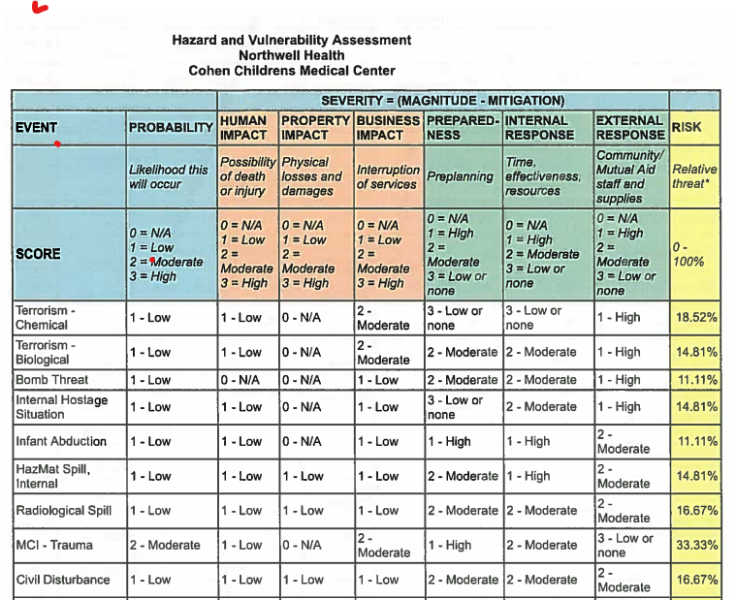
Hazard Vulnerability Assessment (HVA)

Slide 33
Hallmark of Emergency Management is identifying risk: Hazard Vulnerability Assessments
Identifying Potential Hazards
Assessing Vulnerabilities
Analyzing Potential Impacts
Hazardous Materials
Accidental spills
Terrorism
Industrial accidents
Technological Events
Cyber attacks
Communications interruption
Access to the Internet
Loss of applications
Vendor loss/interruptions
Power outage
Naturally Occurring Threats
Winter Storms
Hurricanes
Heat Waves
Wildfires
Earthquakes
Pandemic
Human Related Events
Mass casualties
Staffing/labor action
Bad actors
Loss of staff due to illness
Notes:
Scored risk assessment
Likelihood of occurrence
Probability
Impact

Slide 34
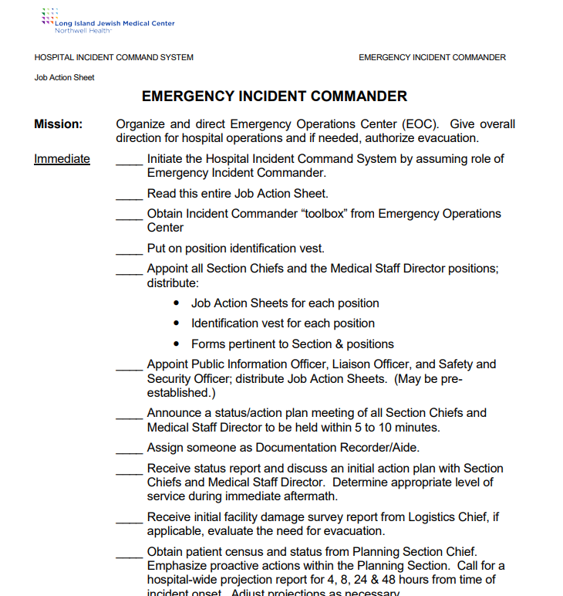
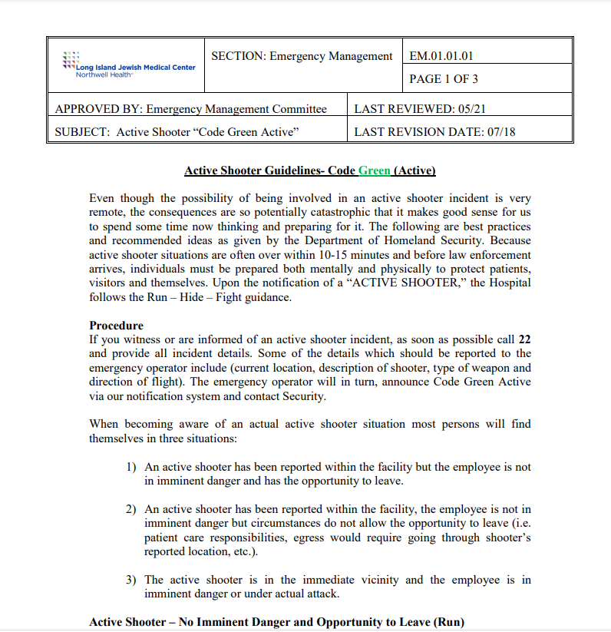
Policies and Procedures: Dust Them Off

Slide 35
All Hazards Planning: System, Hospital, Unit, Practice.
An integrated planning approach must be utilized to minimize and deny disruption and ensure identified mission critical functions are maintained.
Northwell’s Continuity Planning efforts focus on how those mission essential services are impacted due to consequences of:
Loss of facility /
community infrastructure
Loss of staff
Loss of connectivity
Loss of primary application of software
Loss of vendor
support
Loss of biomedical equipment

Slide 36
What might seem routine....
Planned EMR downtime
Closure of the ambulance bay doors for several hours
Loss of Steam
Labor Action
Weather

Slide 37
Defining the Problem
Clinical Safety Definitions
Event: An observable occurrence or change within a system or operation.
Type I: An occurrence with no immediate impact on patient safety or clinical operations.
Type II: An occurrence with minor impact on patient safety or clinical operations.
Type III: An occurrence involving patient harm, and potential for further impact on patient safety or clinical operations.
Incident: An event that disrupts normal operations or services, requiring immediate action.
Type I: An event requiring immediate action, with minor impact on patient safety or clinical operations.
Type II: An event requiring immediate action, with moderate impact on patient safety or clinical operations.
Type III: An event requiring immediate action involving serious injury and/or major impact on patient safety or clinical operations.

Slide 38
Changing the way we educate clinicians

Slide 39
Northwell’s Culture of Preparedness
Developing the Next Chapter
Notes:
Our own history, outlined in many of Michael's books, demonstrates a commitment, at the organizational level, to preparedness. Clinicians in many institutions have been relegated to the role of consultant to operational leaders on issues of preparedness. Northwell has broken that mold, placing clinicians at the center of many of these decisions, to keep us grounded in the reality that all of our operations come down to one goal- to keep our patients and our team members safe. This requires a new and evolving set of competencies for clinicians and clinical leaders. We believe that how we frame and deliver these competencies and education will be part of the next chapter of the organization.

Slide 40
Steps to Enhancing Clinical Preparedness
Phase One |  | Phase Two |  | Phase Three
Complete Needs Assessment |  | Development of Training Program |  | Train & Educate Team Members
Notes:
Our goal is to move beyond the status quo, where emergency preparedness training has been a box to check, We want to develop a program that is deeply engaging and meaningful, but respectful of the many demands for your time. We want to use this proposed educational plan to foster a culture where the clinical lessons learned from the after action reports, debriefs, and quality management processes that surround emergency management can fuel the same sense of energy amongst clinical leaders to share their stories, akin to the work we've done with CLABSI and CAUTi, the collaboration we are seeing now with sepsis. We plan to approach this challenge in three phases.

Slide 41
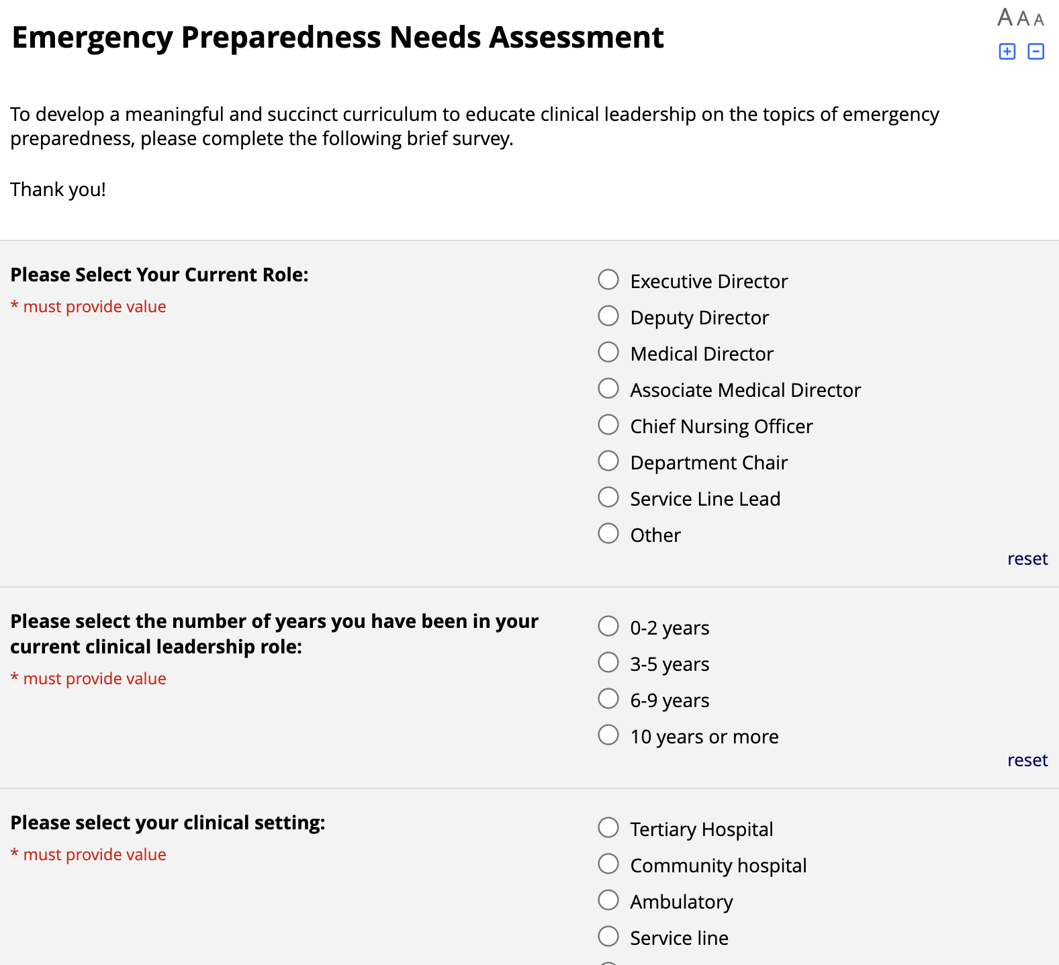
Phase One: Assessing the Current State
Emergency Preparedness Needs Assessment Goals:
Define target audience Understand relevant past experiences of our clinical leaders Evaluate prior trainings / certifications of clinical leadership Identify training priorities
Notes:
The first phase is our needs assessment, a BRIEF 10 question survey that will be disseiminated in the upcoming weeks. We want to better understand our colleagues and their previous experiences and education in emergency preparedness. What roles have you played in the emergency response infrastructure, and how does that translate to the education that you are looking for.

Slide 42
Emergency Preparedness Clinical Education Survey Results

Slide 44
N = 376
40% < 2 years in current role representation
20% with > 10 years in current role

Slide 45
N = 377
71% of respondents are hospital based
29% ambulatory/other

Slide 46
N = 377
73% report no previous role in an EOC

Slide 50
Next Steps
Curriculum Development with CLI
Derive Pilot Target Audience (i.e. Associate Medical Director boot camp)
Finalize Format
Develop Feedback Survey

Slide 51
Phase Two: The Traditional Approach to EM Education
 | ICS 100 | ICS 200 | ICS 300 | Participate in DEOP Development | Participate in Si2t Exercises | Participate in System Exercises
Medical Director
Staff Physician
Advanced Care Providers
Nurse Managers
Registered Nurses
Students (Medical/Nursing)
Based on the needs assessment results and feedback from clinical and operational leadership, a comprehensive and sustainable training program tailored to clinical leadership and specific roles will be developed.
Notes:
As mentioned earlier, it's time to disrupt the paradigm of traditional emergency management education, where we check the regulatory boxes and obtain our certificates and ribbons, but often walk away with little value added.

Slide 52
Phase Two: Disrupting the Paradigm of Education and Training
Site Medical
Director &
CNO
Knowledge
Section
Chief &
Nurse
Manager
Staff
Physician
& Nurse
Para-
Clinical
Staff
Responsibility
Notes:
We as physicians learn differently. We want to change the way we learn here. The days of sitting in a classroom all day or behind a computer watching hours of training that are not geared to the work we do, are behind us. In our proposed program, we aim to shift towards targeted asynchronous learning for much of the foundational concepts. 15 minute pod casts, brief TED talk-stype recordings. We want this to be high quality, digestible, and USEFUL.
Done well, this work can fuel change the way that EM education is pushed at the regional and the national levels. We can advocate to some of our regulatory bodies to change their recommendations to reflect a model of adult learning that promotes growth, and not just obtaining a certificate.
If we're successful in launching this program, the next challenge we face is how to measure this success. How do we measure that change? Remember, we are looking to avoid harm. What are the metrics we can use to understand if our model is making change? We look to you all as clinical leaders to help us define these outcomes.

Slide 53
Phase Three: Participation in Training & Education
Once the comprehensive training program is developed, team members are encouraged to complete the recommended training.
Training Methods
Online, asynchronous training In-person training Group Discussions Department, site, and system tabletop and full-scale exercises
Training Partners
Note: this is not a comprehensive list of training methods and training providers.
Notes:
If we are getting you together in person, to which I believe we all see the value of in-person learning, it should be deeply imapctful to the work you do. An annual tabletop or drill, amongst this group and our clinical leaders from nursing and elsewhere. It should be brief, collaborative, and we want you to walk away with the sense that this it he best darn EM class you've taken.

Slide 54
Targeted and Asynchronous Education
Training Methods
Online, asynchronous training * "At the Table With _______" * 10-15 minutes Department, site, and system tabletop and full-scale exercises
Training Partners
Dr. Mike Cassera (Adult Education) Jason Nadich and CLI

Slide 55
Peer Driven Education

Slide 56
Cornerstone

Slide 57
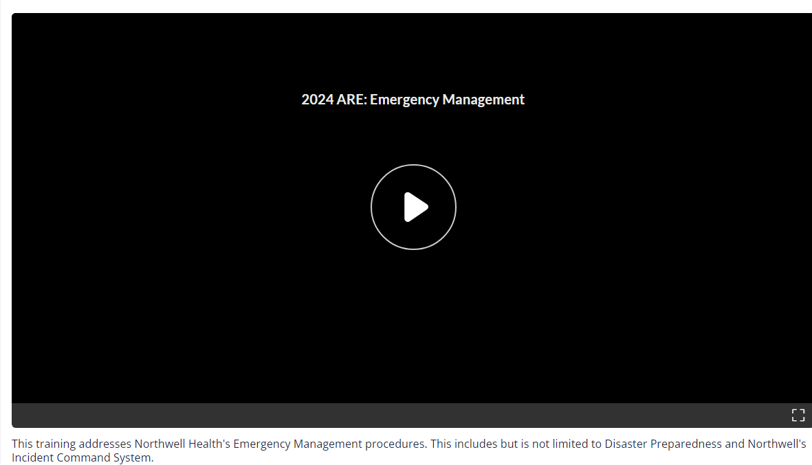
Cornerstone
Northwell Incident Command Systems (NICS) at a Glance: Dr. Matthew Harris (9 min)

Slide 58
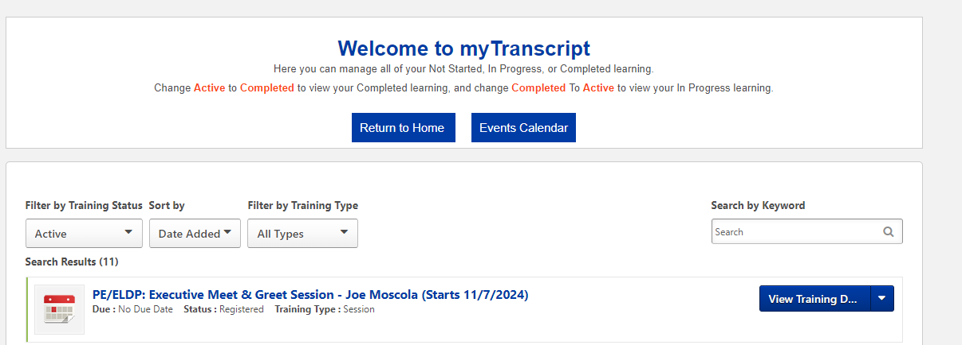
Tracking Your Progress

Slide 59
One more point on education
Early EM/BC training in primary education (MD/RN/ACP)
Exposure to residencies and fellowships
Meaningful ongoing education

Slide 60
Take-Home Points
Time for a Paradigm Change
Engaging Clinicains in Blue and Grey Sky Planning
Modify our approach to education
Defining Appropriate Clinican Competencies
Thank you!

Slide 61
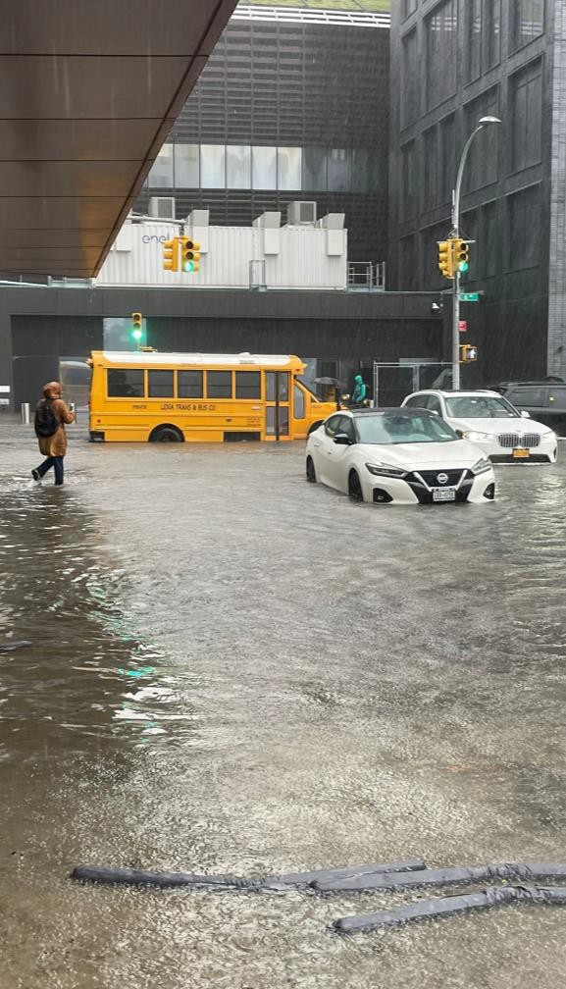
Enhancing Objectivity of the HVA
Lessons Learned in HVA Strategy, Data
Management and Execution
20 May 2025

Slide 62
Agenda
01
02
Introduction
Program Evaluation
03
04
Strategic Planning
Strategic Improvements
05
06
Results and Conclusions
Lessons Learned
2

Slide 63
Introduction
01
4

Slide 64
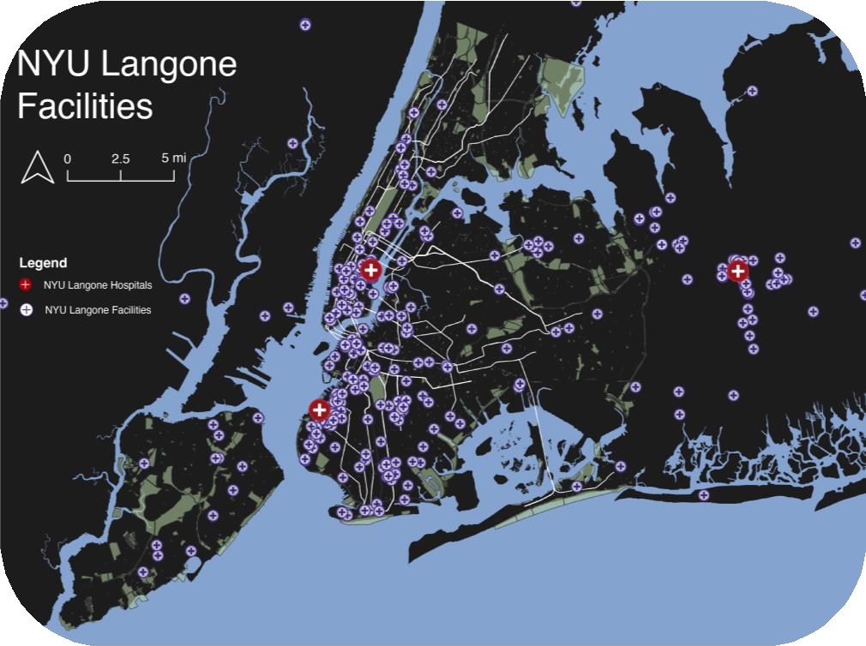
NYU Langone Health Footprint
4 Hospitals
350 Ambulatory Offsites 2 Schools of Medicine
300+ Research Labs 45,000+ Staff and Faculty
21 EM+ER Staff
7

Slide 65
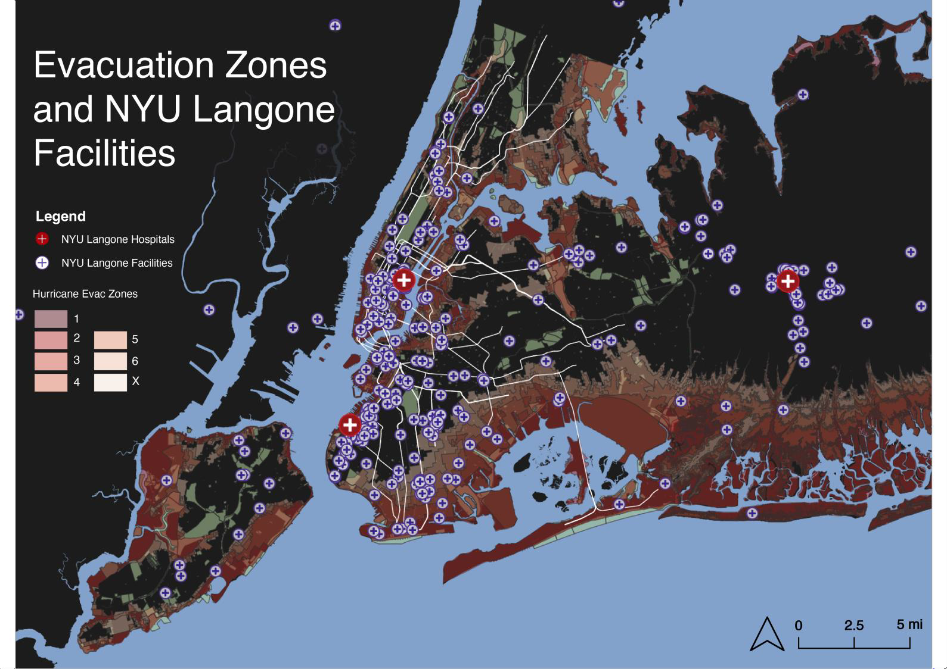
8
2024 | Hazard Vulnerability Analysis

Slide 66
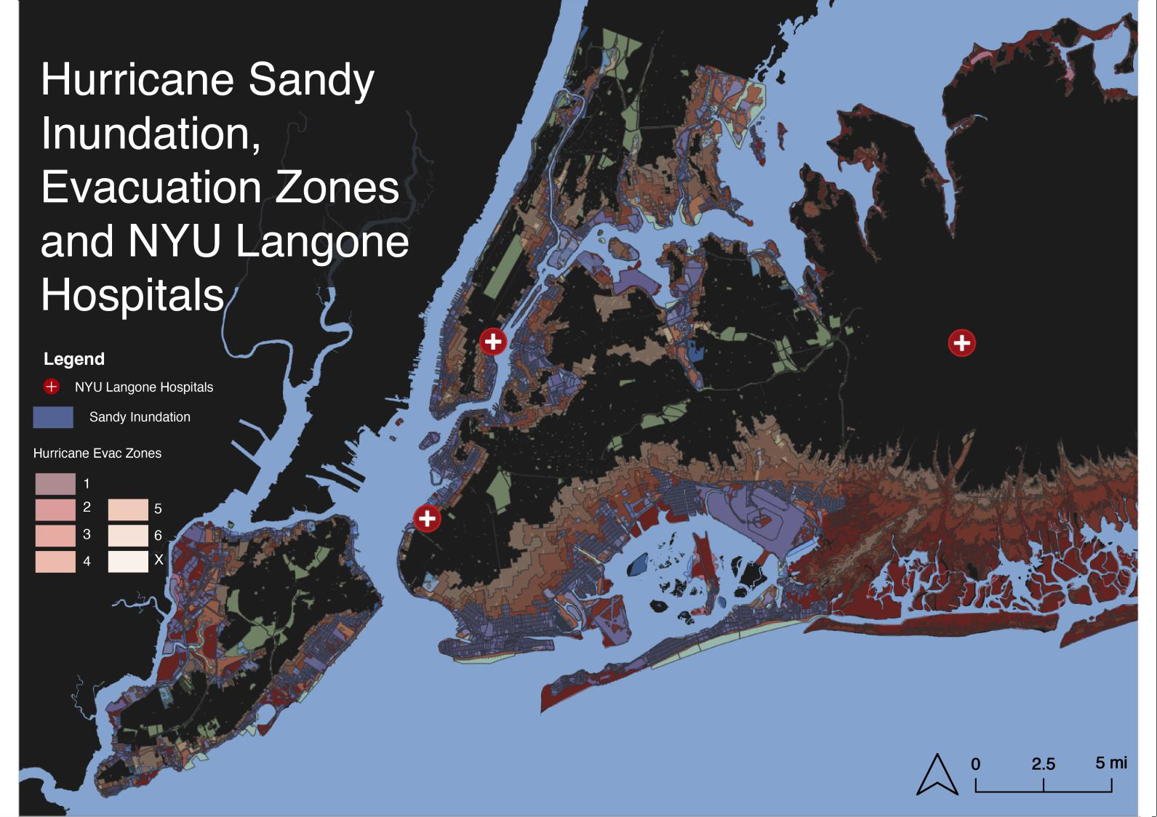
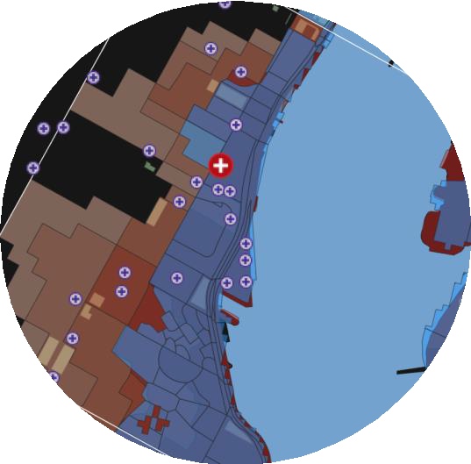
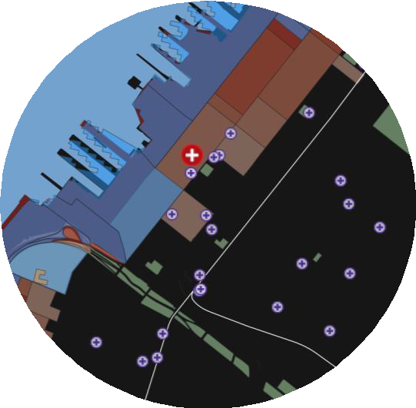
MANHATTAN MAIN CAMPUS
NYU LANGONE - BROOKLYN
9
Source: NYCEM, HAZUS, NYU Langone Health, 2022

Slide 67
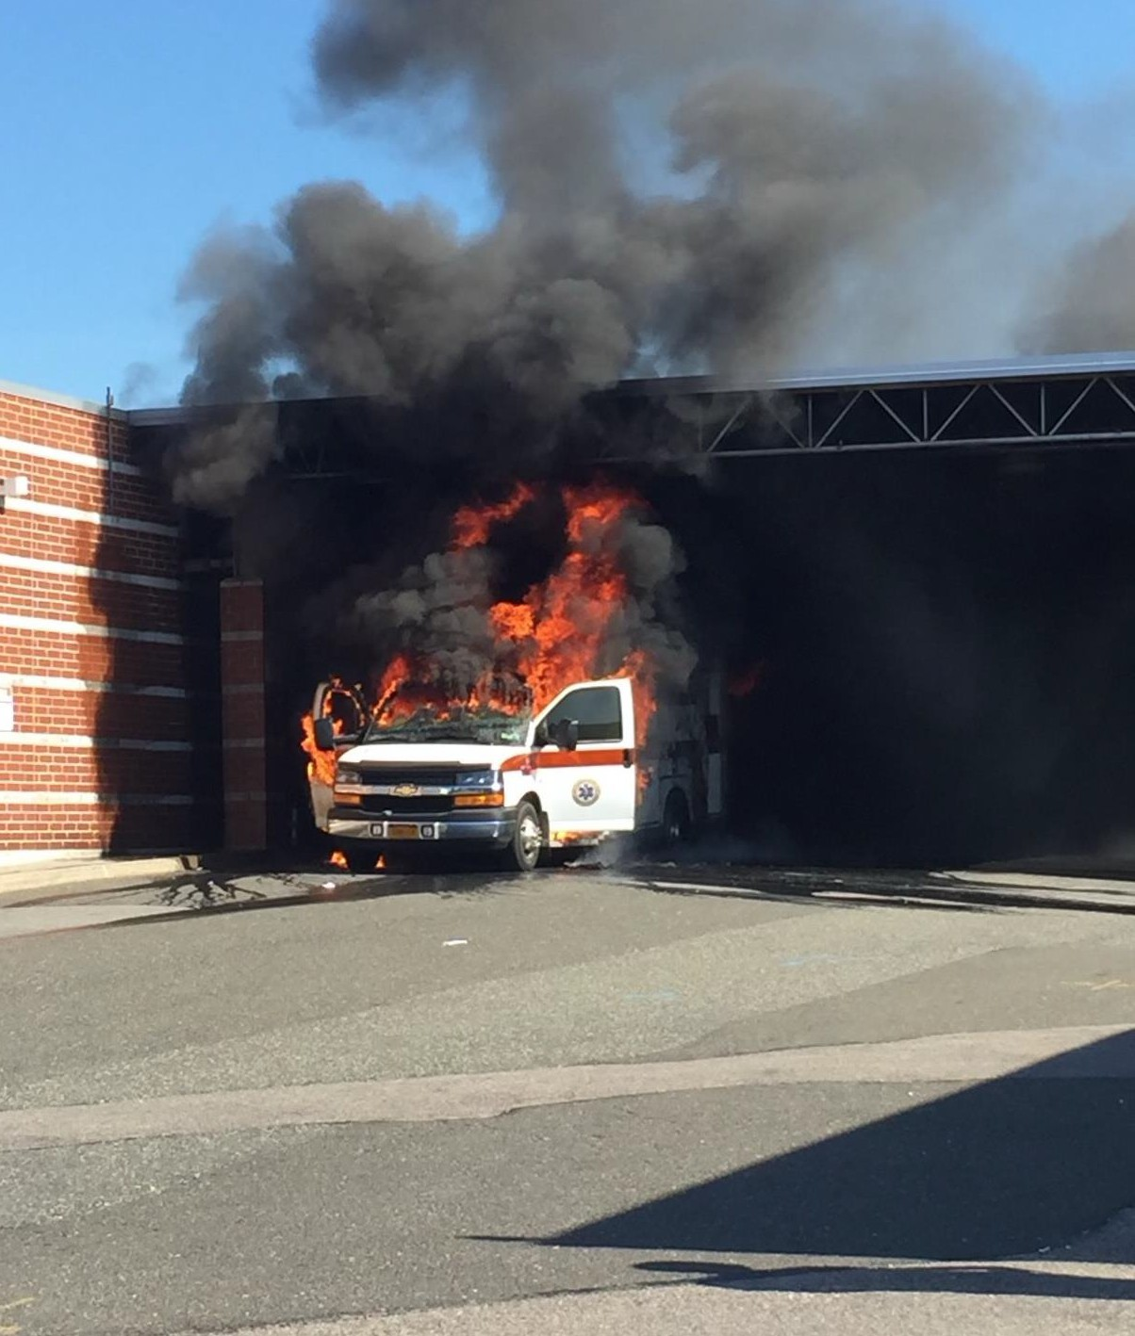
02
Program Evaluation
12

Slide 68
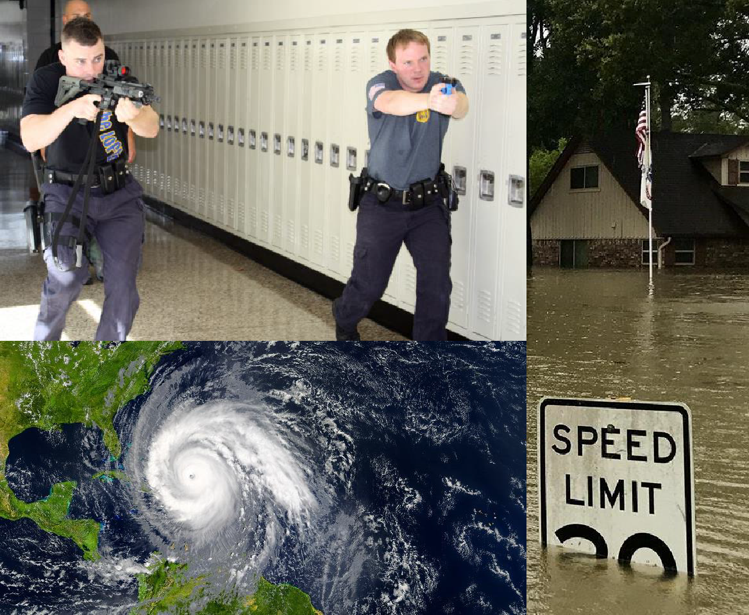
Objectivity through Data Integration
Previous Strategy
Probability and risk assessment based on responses to qualitative surveying
Led to bias towards certain hazard types

Slide 69
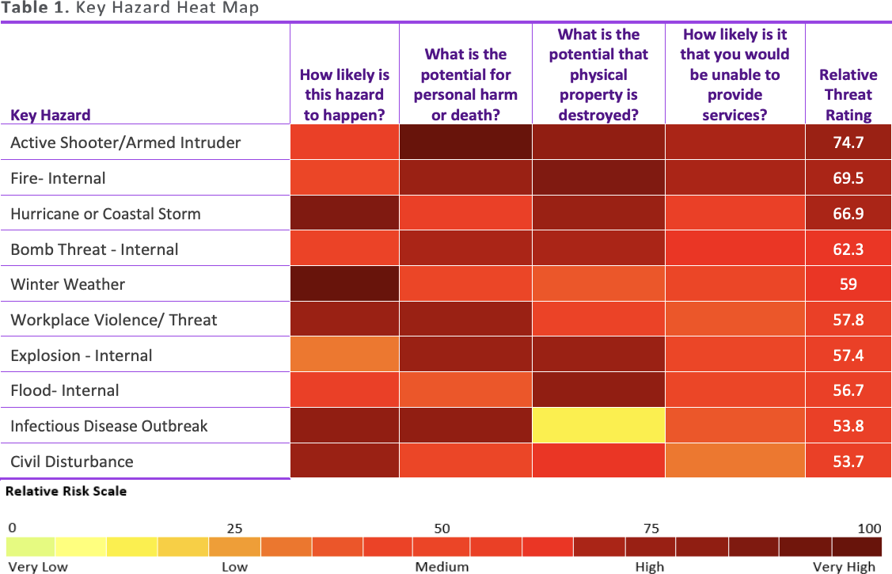
Stakeholder Engagement and Surveying

Slide 70
Assessing Redundancies in Hazard List
Active Shooter/ Armed Intruder
Bomb Threat- External
Bomb Threat- Internal
Chemical Spill- External
Chemical Spill- Internal
Civil Disturbance
Communication: Email Failure
Communication: Telephone Failure
Cyberattack
Dam Failure
Drought
Earthquake
EPIC System Outage
Evacuation of Patients and/or Staff
Explosion- External
Explosion- Internal
Fire- External
Fire- Internal
Flood- External
Flood- Internal
Generator Failure
Hazmat Incident/ Mass Decon
HVAC Failure
Hurricane or Coastal Storm
Infant/ Ped Abduction
Infectious Disease Outbreak
Landslide
Mass Casualty Incident/ Patient Surge
Medical Gas Disruption/ Failure
Natural Gas Disruption/ Failure
Pandemic
Power Outage- External
Power Outage- Internal
Radiation Exposure
Sewage Failure- Internal
Sewage Failure- External
Strike/ Labor Action/ Work Stoppage
Supply Chain Shortage/ Failure
Temperature Extremes
Terrorist Attack
Tornado
Transportation Failure
Tsunami
Water Contamination/ Disruption
Winter Weather
Workplace Violence/ Threat

Slide 71
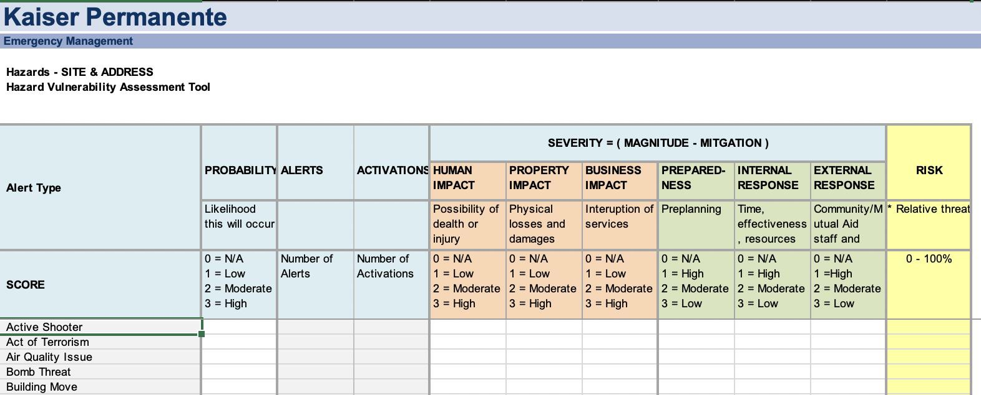
Tools and Best Practices

Slide 72
Opportunities for Improvement
1
2
3
4
Criticaly Assess Hazard List
Better Integrate Objective and Unbiased Data
Improve Our Data Colection Strategy
More Effectively Engage Stakeholdersin the Process

Slide 73
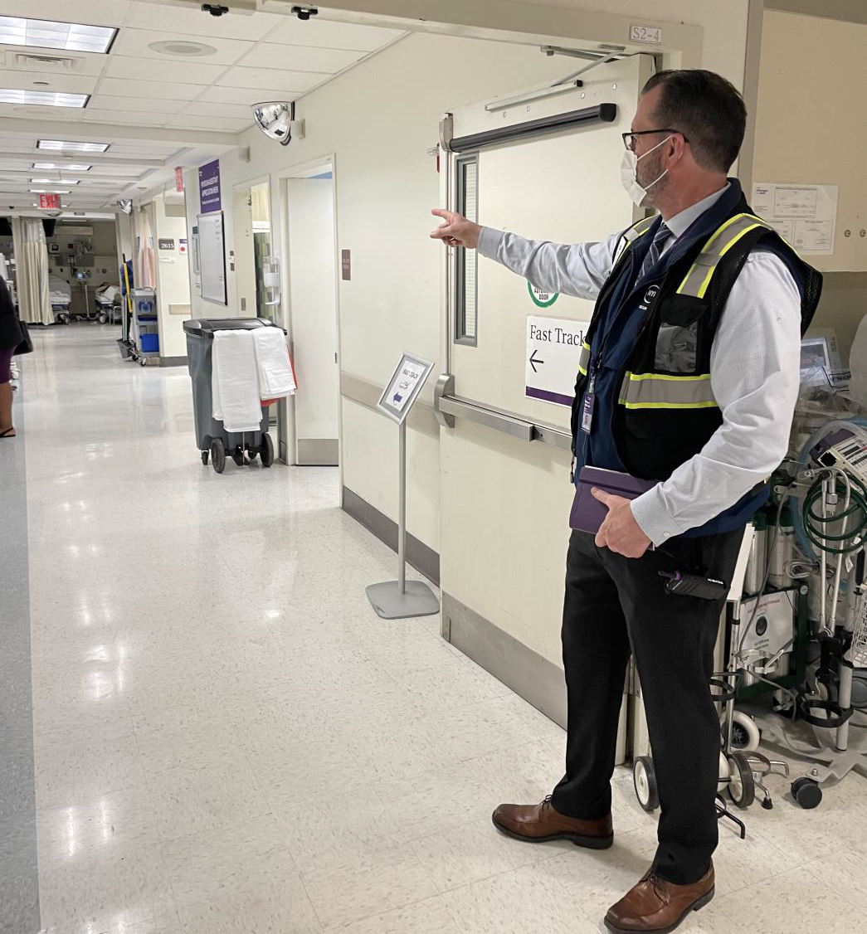
03
Strategic Planning

Slide 74
Strategy and Data Flow within EM+ER
Use HVA to in for m
pre paredn ess strategy and
evaluate effectiveness of
pro gramming over time
Go al Setting
Pro grams
Mitigation Strate gy
Pro gram Eva luations
Align pr ograms to threat
environ ment to ensure
pro grams re flect vulne rabilities
Emerg ency Pre paredn ess Pro grams
Response
Ensure existin g/n ew plan s, training s and exercises reflect curren t best pr actice and hazard lan dscape
AARs
Plan Writing
Training an d
Exercises
Supply Pro curement

Slide 75
Basic Process

Slide 76
Basic Process
Identification of Key Hazards
Analysis of Potential Impacts to Enterprise
Prioritization of Hazards for Strategic Planning, Programs, Trainings and Exercises

Slide 77
04
Strategic Improvements

Slide 78
Building Objectivity over Two Years
2022- 2023
Used more and better data to inform KP Tool
Formed a baseline reasoning for scoring
Focus on hazard types, impact definitions, and overall strategy
2023 - 2024
Build upon baseline research
Enhanced data collection strategies
Focused on assessing vulnerability and preparedness

Slide 79
Timeline for Improvement
1
2
3
Criticaly Assess Hazard List
2023
Better Integrate Objective and Unbiased Data
2024
Improve Our Data Colection Strategy
2025
4
More Effectively Engage Stakeholdersin the Process

Slide 80
Improvement Checklist
1
Criticaly Assess Hazard List
2
3
4
Better Integrate Objective and Unbiased Data
Improve Our Data Colection Strategy
More Effectively Engage Stakeholdersin the Process
25

Slide 81
Critically Assess Hazard List

Slide 82
Critically Assess Hazard List

Slide 83
Categorization of Key Hazards
Natural
Technological
Human-Caused
Accidents and Technical Failures
Intentional acts by an adversary
Acts of Nature
28

Slide 84
Key Hazards
29

Slide 85
Improvement Checklist
Criticaly Assess Hazard List
2
Better Integrate Objective and Unbiased Data
3
4
Improve Our Data Colection Strategy
More Effectively Engage Stakeholdersin the Process

Slide 86
Indicators in Kaiser Permanente

Slide 87
DATA INTEGRATION INTO KAISER PERMANENTE TOOL
Data Utilized to Inform Risk

Slide 88
CATEGORIES
Data Utilized to Inform Risk

Slide 89
CATEGORIES
Risk
lized to Inform
Data Uti

Slide 90
DEFINITIONS
Data Utilized to Inform Risk

Slide 91
DATASETS TO INTEGRATE
Data Utilized to Inform Risk

Slide 92
Integration of Quantitative data
Incidents and Events
Exercises and Trainings
Measure alerts and activations
of each hazard type
Data plus literature review used to inform hazard impact scoring
Understand baseline preparedness activities per hazard type
Identify gaps in
preparedness activities

Slide 93
Integration of Qualitative Data
Risk Review Sessions
Stakeholder Survey
Focus Group Sessions
Overview with wider Stakeholder and Leadership Group
Interactive Data Collection
Assessment of:
Department Preparedness
Internal Response Capability
Reliance on External Partnerships
Facilities, Security and MCIT
Discussion of Preparedness
Priorities and Initiatives
Identification of Gaps

Slide 94
Context Descriptions

Slide 95
Improvement Checklist
Criticaly Assess Hazard List
Better Integrate Objective and Unbiased Data
3
Improve Our Data Colection Strategy
4
More Effectively Engage Stakeholdersin the Process

Slide 96
QUANTITATIVE
Data Utilized to Inform Risk

Slide 97
INCIDENT DATA
Data Utilized to Inform Risk

Slide 98
Phases of Incident Data Transition
Phase 1
Now
Phase 2
Future
Merge Watch Center and Incident Data Collection Forms
HVA Integration + Better Data Collection
•
•
Form reorganization/ cleaning
Addition of priority levels, HVA categories and scoring thresholds
Team training on data collection
• Merging Forms
• Create one data repository, flexible enough for multiple uses
•

Slide 99
Phases of Incident Data Transition
Phase 1
Now
HVA Integration + Better Data Collection
Phase 2
Future
Merge Watch Center and Incident Data Collection Forms
IMPROVE QUALITY
IMPROVE PROCESS
•
•
Form reorganization/ cleaning
Addition of priority levels, HVA categories and scoring thresholds
Team training on data collection
• Merging Forms
• Create one data repository, flexible enough for multiple uses
•

Slide 100
Goals of Incident Data Transition
Overall Goal
Enhance data collection strategy and plan data collection intentionally
DEFINE
Clearly define severity of incident and reasoning for escalation
ALIGN WITH THE HVA
Categorize incident data upon collection to align dataset with the HVA
STREAMLINE
Enhance the specificity of data we collect while maintaining efficiency
45

Slide 101
Data Transition - Completed Goals
Defined Scoring
Thresholds
EXAMPLE

Slide 102
Data Transition - Completed Goals
Aligned Hazard List with HVA

Slide 103
Data Transition - Completed Goals
Streamlined Data Collection

Slide 104
Data Transition - Completed Goals
Streamlined Data Collection
(ONGOING)

Slide 105
QUALITATIVE
Data Utilized to Inform Risk

Slide 106
HVA Stakeholder Survey
Internal Response Capabilities
Reliance on External Partnerships

Slide 107
Improvement Checklist
Criticaly Assess Hazard List
Better Integrate Objective and Unbiased Data
Improve Our Data Colection Strategy
4
More Effectively Engage Stakeholdersin the Process

Slide 108
REAL-TIME DATA COLLECTION
Data Utilized to Inform Risk
54

Slide 109
Perceptions in Preparedness
My departmental resilience has improved over the last year
The Current Risk Landscape
Protection of operations, Services and Systems
Departmental Resilience Improvement
“Cybersecurity is a key focus for the future because every risk listed is impacted by cybersecurity... any failures would have drastic
implications.”
“Staffing, listed as the biggest concern, is impacted by burnout and subsequent availability…factors such as transportation and weather can impact their ability to cover all necessary sites.”
“The shutdown due to COVID-19 showed the resilience and adaptability of many staff members. Certain departments were flexible and able to work remotely, creating the possibility for resilient operations to future
risks.”
55

Slide 110
Internal Partnership
Enhanced Research and Context
Descriptions
Climate Change and NYU Langone Health
Health impacts of climate change
Potential impacts to NYU Langone over time
Current sustainability goals and initiatives that focus
on mitigating climate-related issues
How Emergency Management and Facilities departments collaborate to create resilience

Slide 111
Climate Resiliency Approach

Slide 112
Improvement Checklist
Criticaly Assess Hazard List
Better Integrate Objective and Unbiased Data
Improve Our Data Colection Strategy
More Effectively Engage Stakeholdersin the Process

Slide 113
05
Results + Conclusions

Slide 114
Conclusions are based on a culmination of:

Slide 115
Top 10 Enterprise Hazards - 2024
1
Flood/ Water Leakage
6
Coastal Storm/ Hurricane/ heavy Rainfall
2
Violence/ Threat of Violence
7
IT Disruption/ Outage
3
Infectious Disease/ Pandemic
8
Power Disruption/ Outage
4
Medical Equipment Disruption/ Failure
9
Cyber Attack
5
Fire/ Smoke Condition
10
Water Contamination/ Disruption

Slide 118
Physical Resilience + Mitigations
Infrastructure Hardening
Movement of critical equipment to emergency power
Security Management Plan – critical access control
systems disruption planning
Significant insulation improvements have been
conducted
Internal + External Agency Coordination
Coordination with Metro Detention Center + High-
Profile Inmate Contingency Plan
Continued monitoring by the Watch Center enhances
situational awareness of incidents
Climate and Sustainability
Green Infrastructure development on campuses,
managing stormwater runoff
Physical Resilience + Mitigations
Browning water and water leak issues persist
across campuses
Many non-hospital locations are not staffed with
security personnel
Understanding and preparedness efforts for space
weather remain low
Programs and Protocol
Vendor outages and lack of operational readiness
exist within some applications
Training and Education
Staff capacity and geographic distancelimits information sharing and training for active shooter prep talks across campuses
Strengths
Weaknesses
S
W
SWOT
Opportunities
Physical Resilience + Mitigations
Enhancing preparedness towards a large-scale blackout
Increased preparedness towards sustained winds
IT, Telecom and Cyber Resilience
Targeted exercises regarding data recovery strategies
across IT platforms
Climate Change
Climate change will exacerbate many hazard types, including the cascading impacts of worsening extreme temperatures and increasingly severe storms
Power/utility failure across hospital locations due to volatility of grid infrastructure in the City and evolving infrastructure improvements
Violence on Campuses
Active shooter and workplace violence remain
concerns, especially considering high-risk locations in
proximity to hospital locations
Sudden upticks in unexpected violent activity
Social media can serve as a multiplier for civil unrest and acts of violence that could permeate onto
O
T
Threats
Increased transparency and information sharing about cyber security threats to ensure emergencies are managed most efficiently
Examining staffing redundancies: relocating and reassigning
staff to provide redundancies to critical departments
Training and Education
Training initiative for staff on proper pull station utilization
Continued improvement of project manager training with
RED+F
2025 | Enhancing Objectivity of the HVA
hospital campuses

Slide 119
06
Lessons Learned
…and how we can use them

Slide 120
Improvement Checklist
Criticaly Assess Hazard List
Better Integrate Objective and Unbiased Data
Improve Our Data Colection Strategy
More Effectively Engage Stakeholdersin the Process

Slide 121
Lessons Learned in Data + HVA
Mitigate Bias in Stakeholder Input
Allow Hazard Lists to Evolve
1
Integrating objective data reduced media + availability biases in HVA
4
Continuously updated categories makes for a more precise HVA over time while allowing flexibility
Clearly Define Hazards and Scoring
Build a Foundation First
2
Clearly defined hazards and scores standardized the dataset and improved data quality
5
Focusing on building a solid foundational analysis forces you to think intentionally
Align your Data to the HVA
Phase Improvements over Several Years
3
Aligning hazard categories in data and identifying datasets to feed into the KP tool ensured a more streamlined analysis
6 |  | Implementing multi-year enhancements allowed for incremental but impactful changes over time

Slide 122
Questions?
Leanna Molnar
Emergency Management Analyst
E: Leanna.Molnar@nyulangone.org
CREDITS: This presentation template was created by Slidesgo, including icons by Flaticon and infographics & images by Freepik
Emergency Management and Enterprise Resilience
NYU Langone Health
70

