Slide 1





Lincoln Flood Mitigation
Michael Giuliano, Emergency Management Director
January 27, 2026

Slide 2
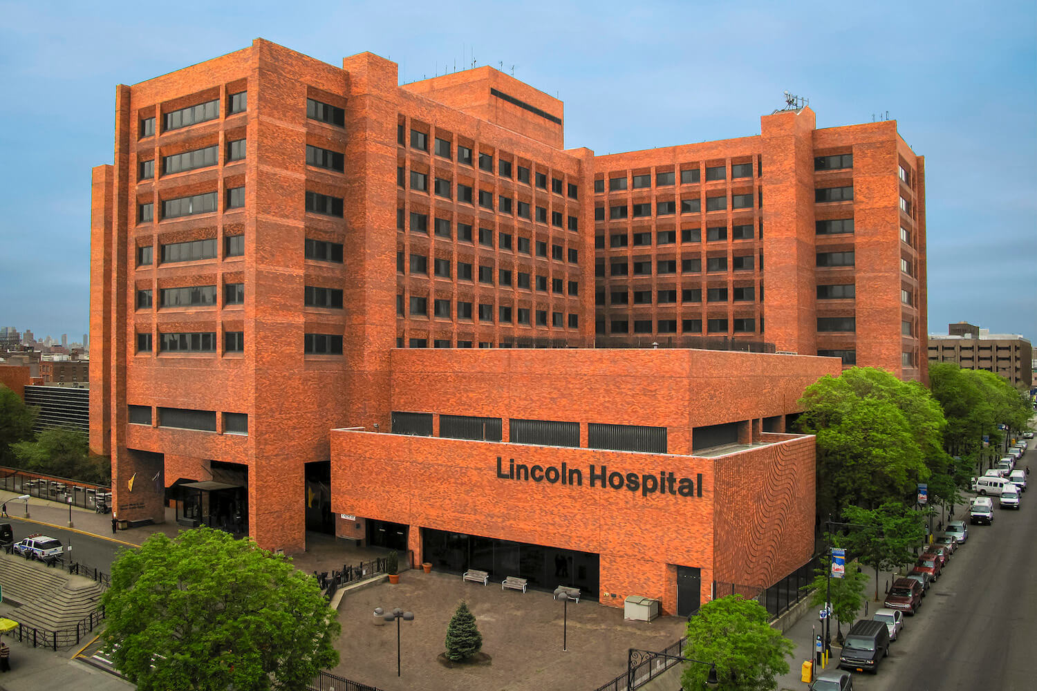
South Bronx
Current building opened in 1976
362 Beds
Level 1 Trauma Center
2nd Busiest ED in New York City
10th Busiest ED in the US

Slide 3
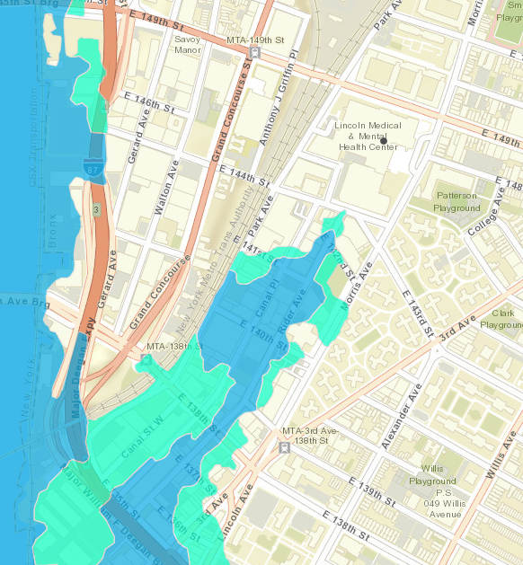
Outside of coastal flood zones
Hurricane Evacuation Zone 4
Flooding issues related to rain
NYC drainage system can handle up to 1.75” of rain per hour

Slide 4

Courtyard located below street level
Multiple entry points into basement
MRI, Radiation Oncology, Nuclear Medicine, Central Sterile, Morgue, Pathology, Pharmacy, Linen, Kitchen

Slide 5

September 1, 2021: Remnants of Hurricane Ida
Most rain in a single hour in NYC history: 3.47”
13 killed throughout NYC
Lincoln’s courtyard floods for the first time
Dietary & Central Sterile services interrupted. Pharmacy was close to being affected and would have caused an evacuation
Disruptions to elevator service

Slide 6
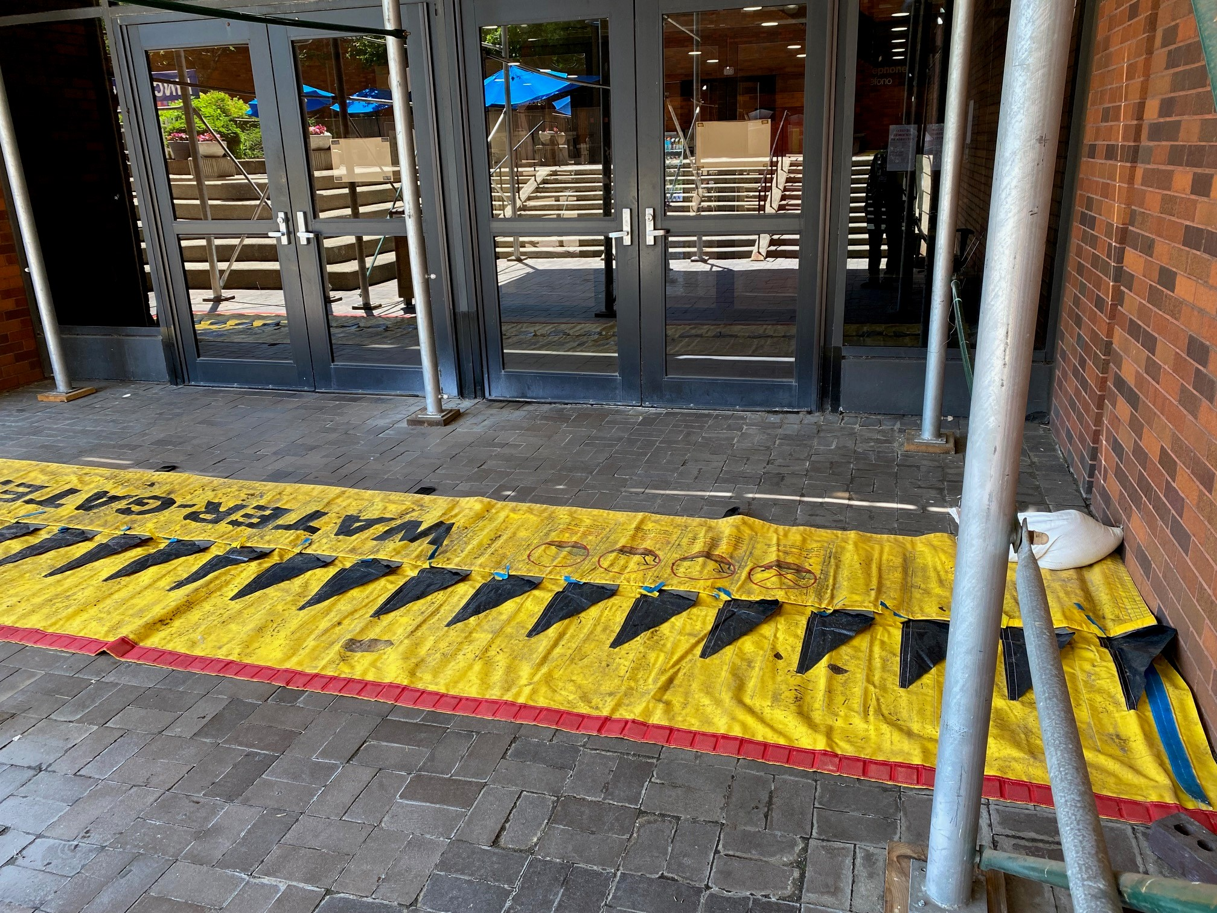
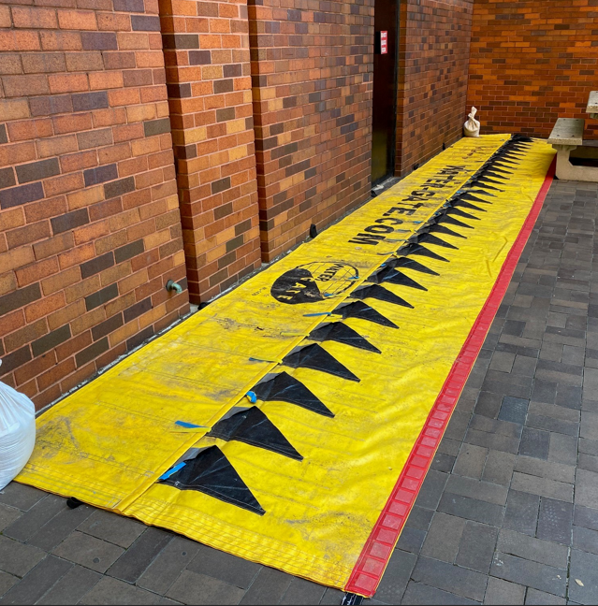
Purchased in 2022
Deployed when forecast calls for 1” of rain or higher

Slide 7

No flooding events in 2022
September 29, 2023: Remnants of Tropical Storm Ophelia
6” of rain in the Bronx, peaking at over 2” an hour
State of Emergency declared for all five boroughs
First time the dams were put to the test, and they failed

Slide 8
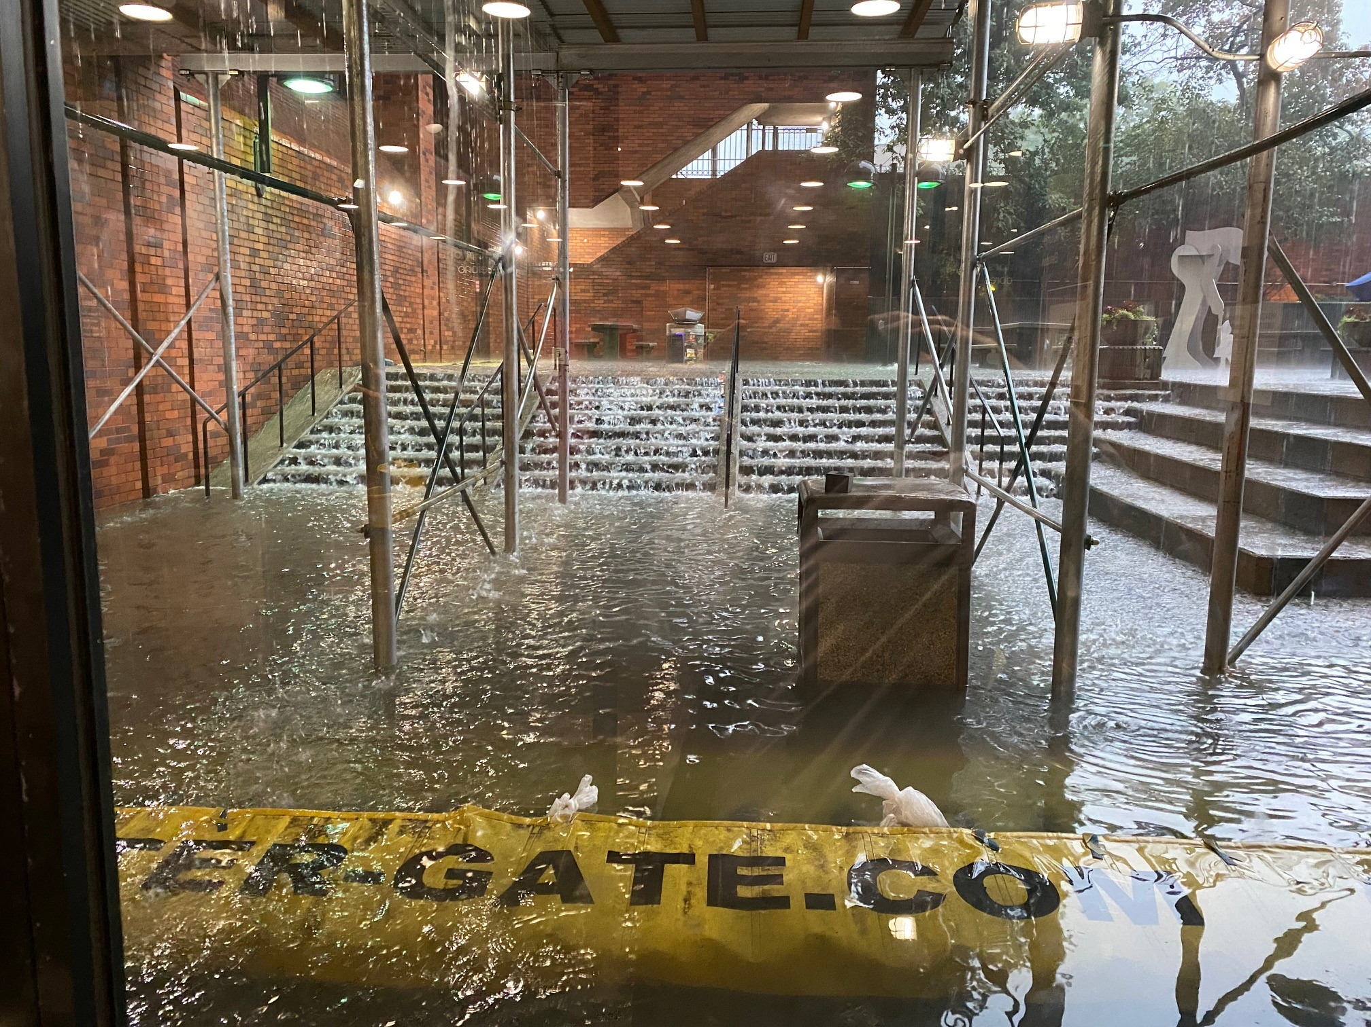


Slide 9
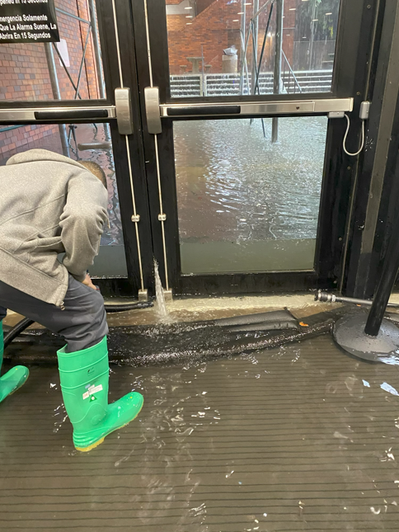
Radiology services interrupted, but no damage to MRI
Elevator shafts filled with water, no elevator service to basement
Command Center opened to respond and remained open for the Woodhull evacuation

Slide 10
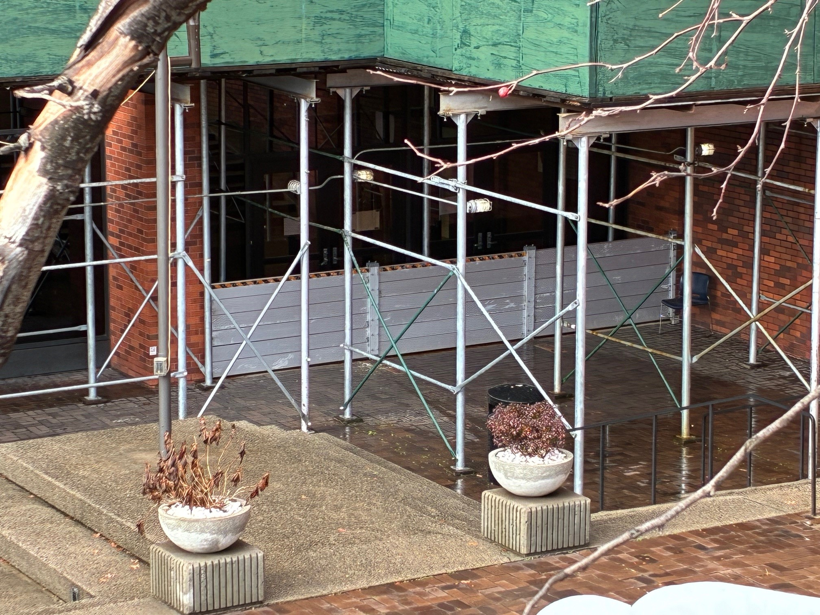
New flood barriers purchased in early 2024
Mounting brackets are permanently installed. Slats are installed as needed.
Same criteria for deployment: Forecast of 1” or more of rain per hour
Safety concern: Blocks all exits
Signage for staff & Everbridge message

Slide 11

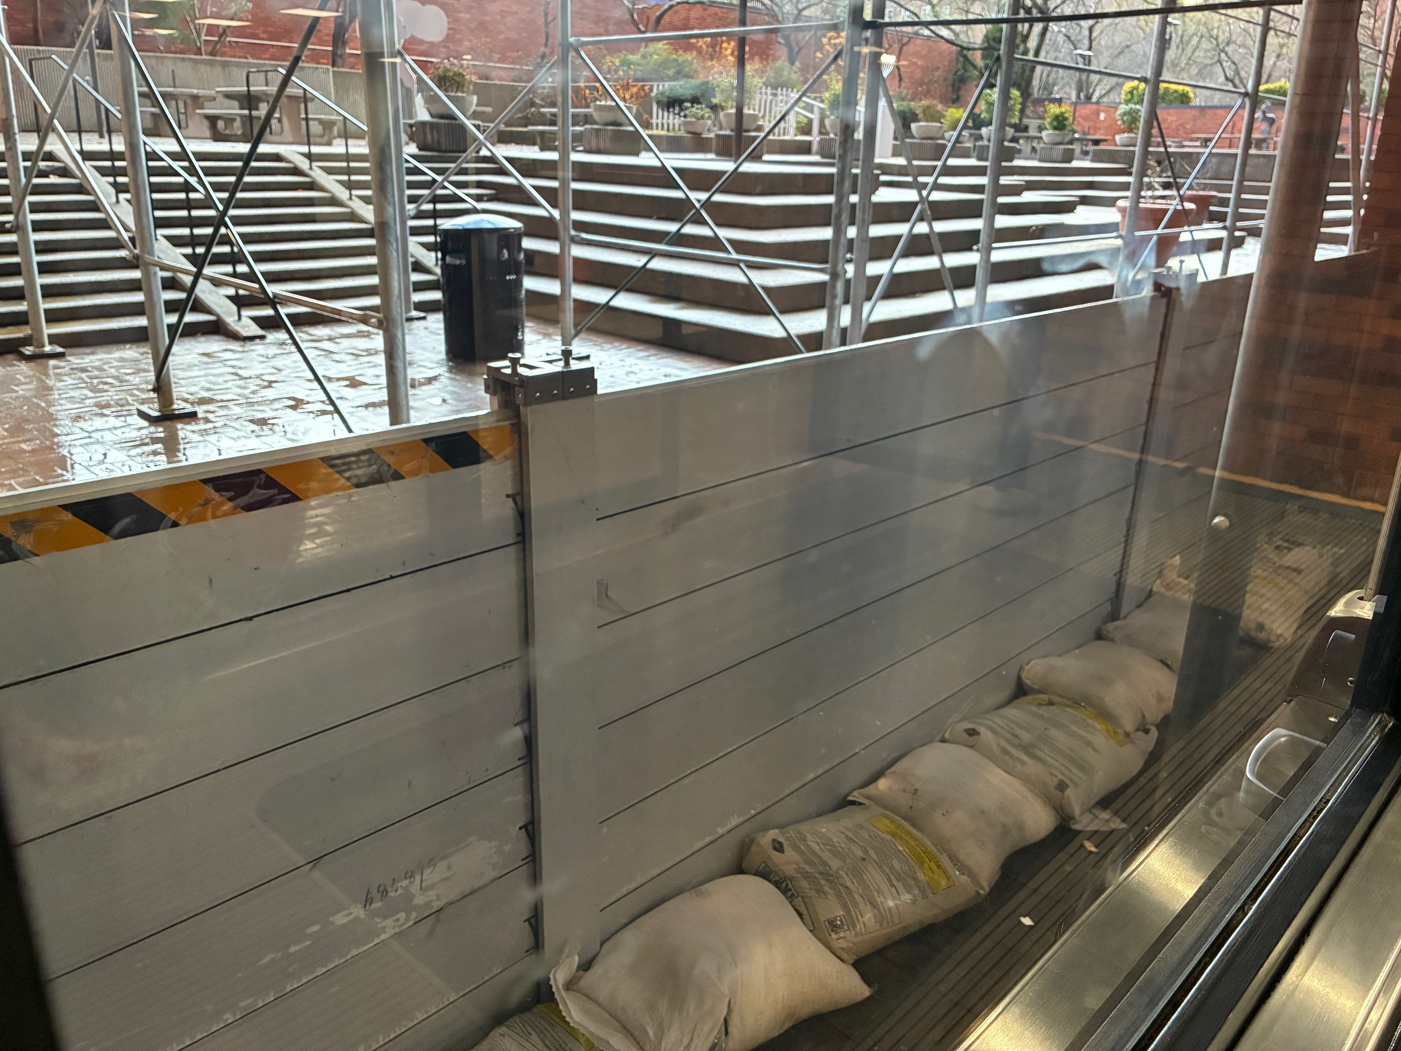

Slide 12
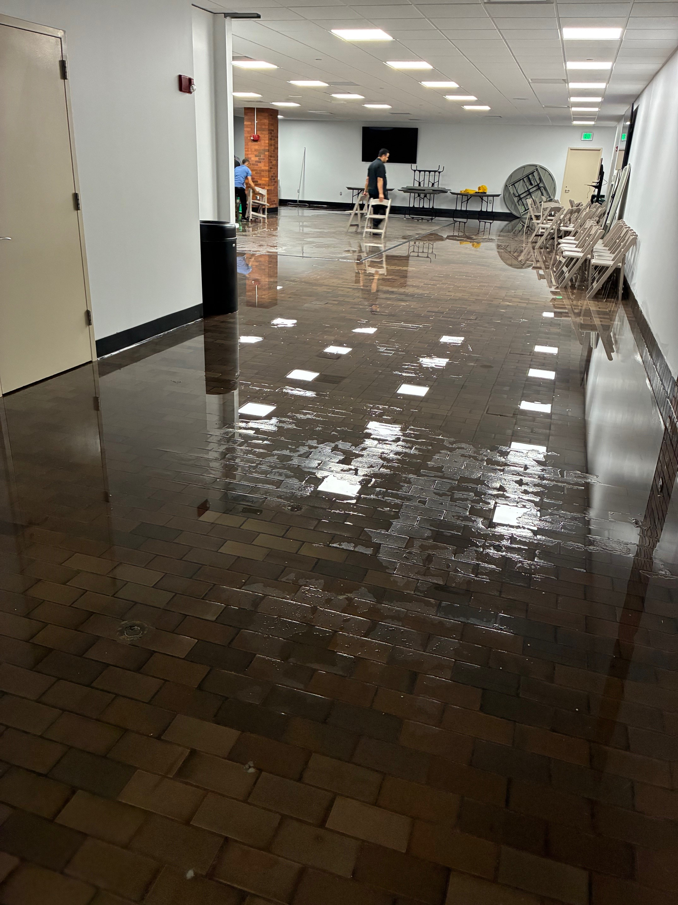
No flooding incidents in 2024
July 14 & October 30, 2025: The barriers slowed the water but didn’t fully stop it
Engineering also installs pumps in the courtyard when the barriers are deployed
Water pumped up to street level
Internal response: Wet vacs, absorbent flood dams, sandbags, EVS & Engineering teams

Slide 13

New issues
Lincoln’s Facilities team installed a new door between the courtyard and basement, but did not purchase a new flood barrier
Water entered through this new door during both flooding events in 2025
Become best friends with your Facilities team
Flooding occurred in a new area inside the basement, coming down from the ceiling. Water will find a way in!

Slide 14
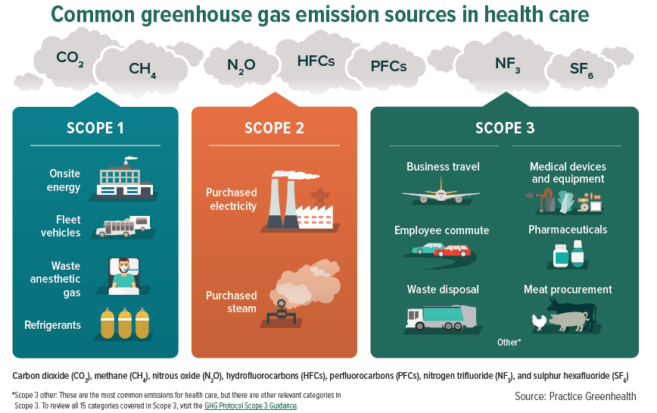
NYC’s top per-hour rainfall events have all occurred in the last 5 years. This is becoming the new normal.
Healthcare as an industry contributes close to 5% of all global emissions. The United States is number one.
We are contributing to the increased frequency and severity of the storms we then have to respond to

Slide 15

Flood barrier for new door
Capital projects:
Sewage system improvements
New MRI on the 1st floor
Thank you! Any questions?

Slide 16
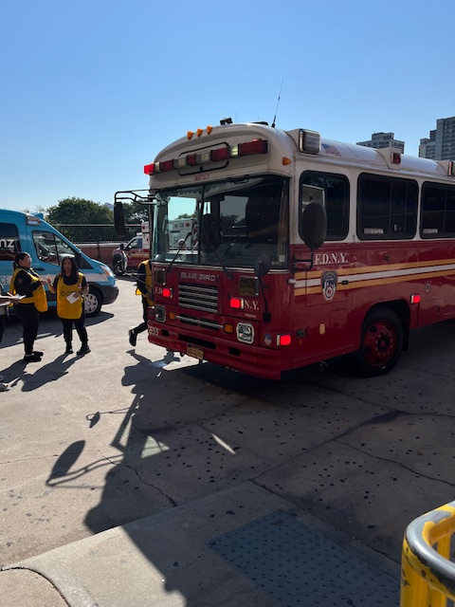
NYC Health + Hospitals Jacobi | NCB- Hosted Mass Casualty Full-Scale Exercise
BEPC Participants:
Jacobi
NCB
FDNY
Ambulnz
DOHMH
American Red Cross
CUNY – School of Public Health
NYC Health + Hospitals Central Office Emergency Management
City Island Rising COAD
Jacobi Community Advisory Board Members
Premise: Explosion and Electrical Fire at a Bronx Migrant Shelter
Compounding Factors
Heatwave
Wildfires
Rolling Power Outages

Slide 17
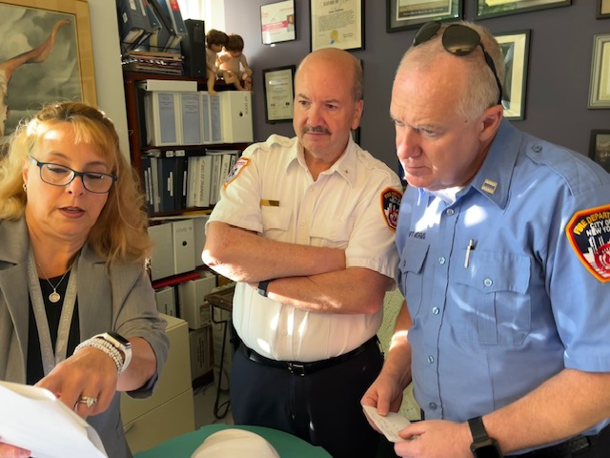
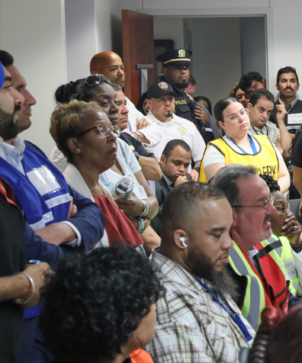

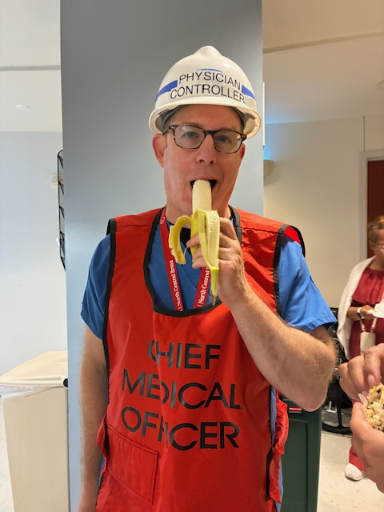

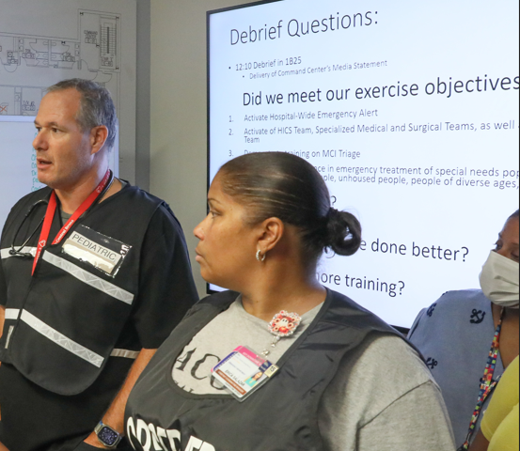

Slide 18

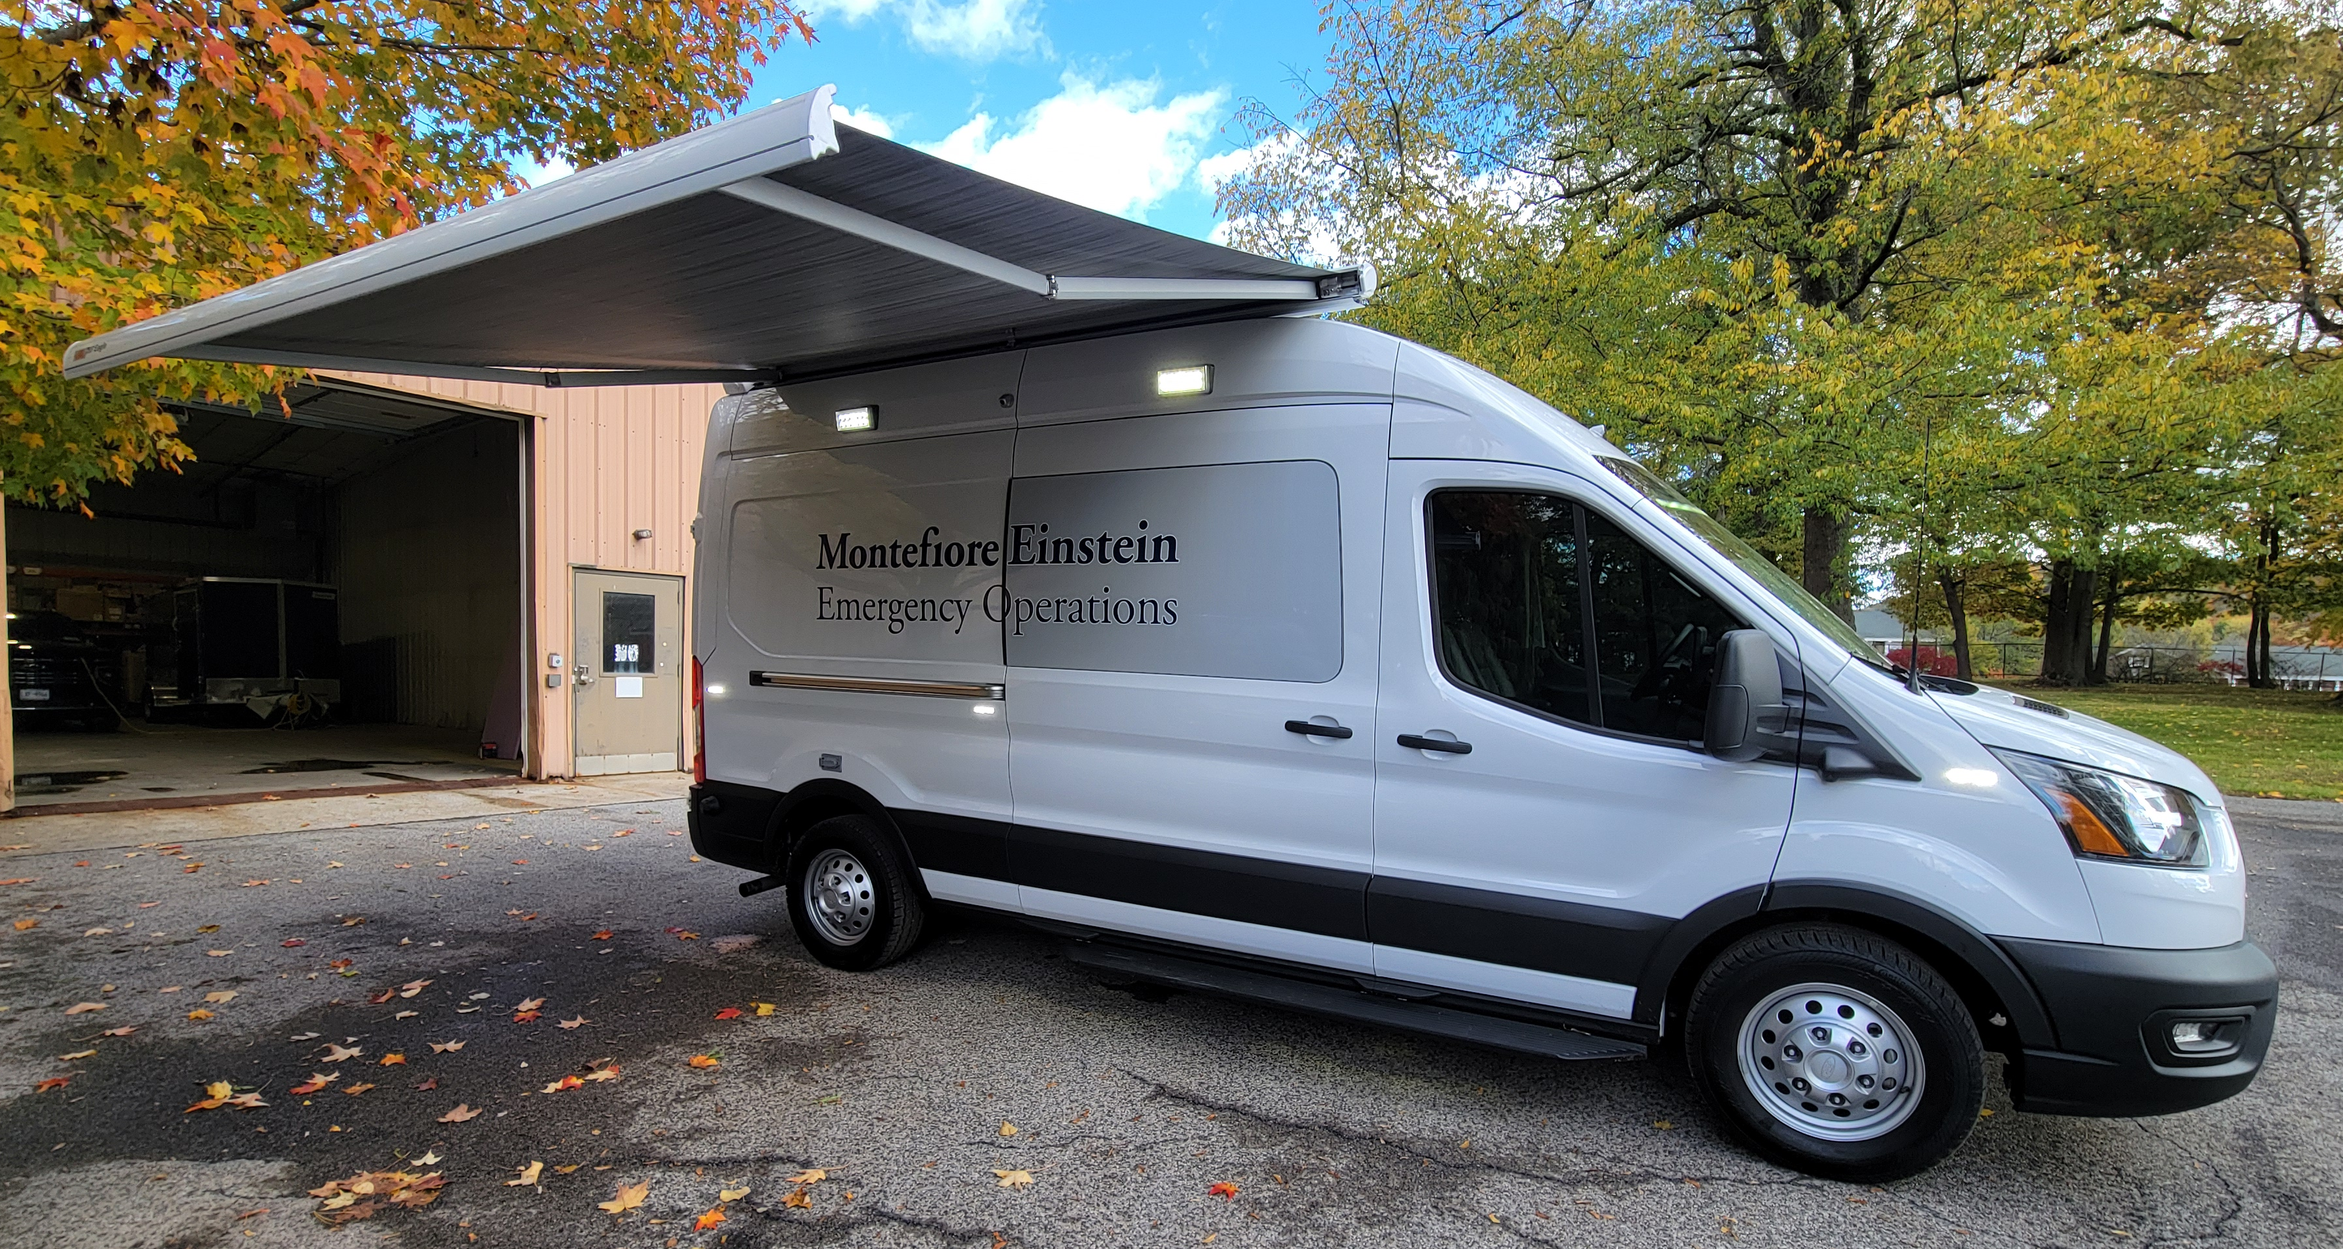

Montefiore Einstein Field Communications Unit
Emergency Preparedness Coalition
Michael J. Moculski, EMT-P, CIC, RF, CHEP, CHSP
Director, EMS & Emergency Management
Environmental Health & Safety Department
Emergency Preparedness Coalition

Slide 19
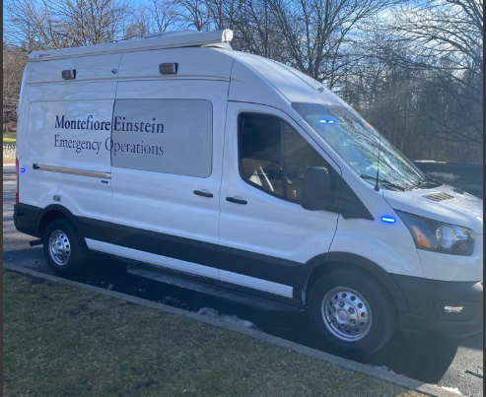
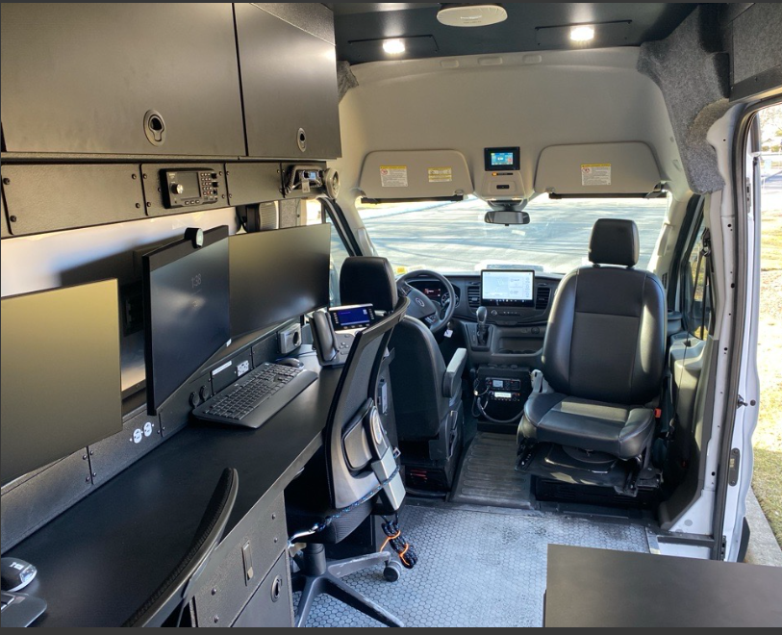
Introduction
Central Laundry fire, July 22, 2022
Responding IMT in the rain using cell phones for coordination
The Vision -> Primary Mission
Climate-controlled, secure area for managing incident communications
Role in disaster response and large-scale event support
Rapid deployment
Urban environment
Remote access to Health System intranet
19

Slide 20
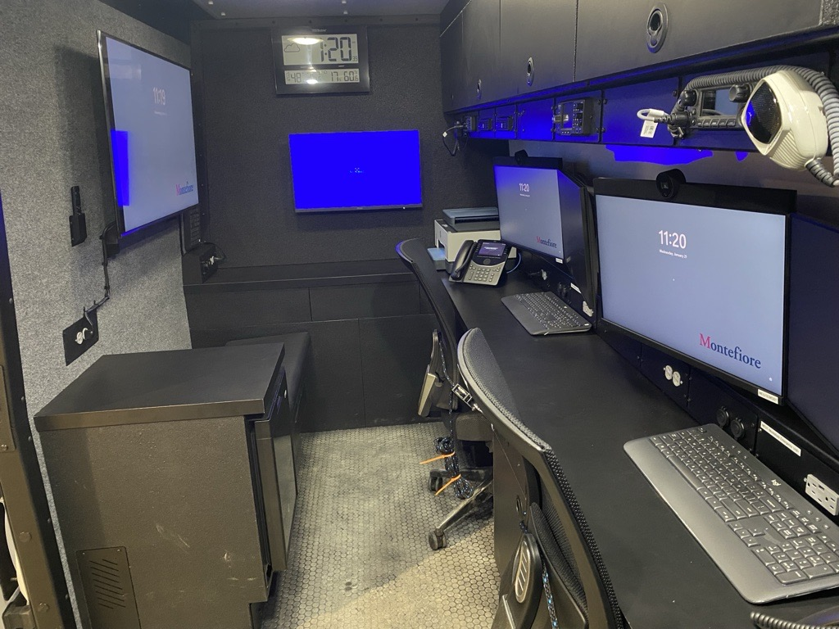
The Solution
Ford Transit 350 Van
Emergency response capability
Ability to work on a shoreline or off the grid
Climate-controlled space for incident management
Two workstations with desktop computers and intranet access
360-degree camera view around the vehicle
Communications on any of our member hospitals’ radio frequencies
Ability to monitor public safety frequencies in the areas our hospitals are in
Refrigerator

Slide 21
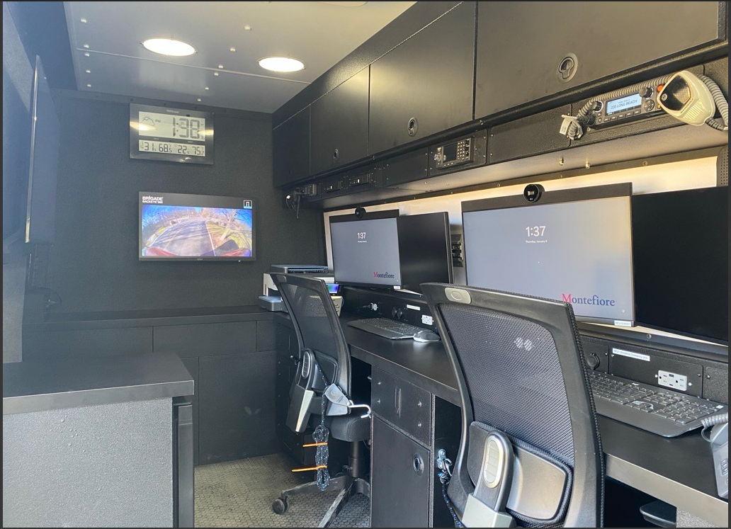
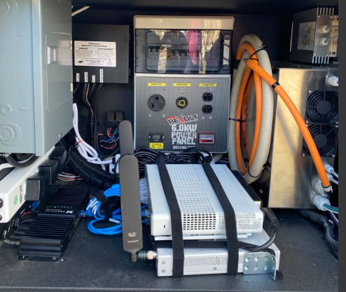
Communications and Technology
Computer technology
Dell small form factor PC’s
Dell Monitors with Video Cameras
Aruba access point
Cisco C1113 Router
Cisco Catalyst C3560 12 port switch
ExacVision security camera monitoring
Situational awareness software
Two-way videoconferencing
Ability to view any Montefiore Security Cameras
Cellular VOIP using Verizon One Talk LTE desk phones
Copier-printer-scanner
Weather station
Nextivity FirstNet Router
MegaFi HPUE WiFi

Slide 22


Portable Technology for Deployment
Nextivity
SHIELD MegaGo FirstNet® MegaRange™ HPUE Portable Cellular Coverage Solution
32 clients
12 hrs battery time
Sonim Megaconnect (WiFi)
5G MegaRange™ Power Class 1 (PC1) on Band 14/n14;
Wi-Fi 7 supports up to 64 connected devices

Slide 23
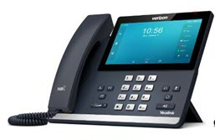

Telecommunications Outage, Moses/CHAM Campus
January 5, 2026
IT failure cascading to the hospital-wide VOIP phone system and computers
24 hours until restoration
Patient Transfer Center computers also affected
Verizon One Talk phones
200 deployed across the campus
Sonim Wi-Fi sent to Patient Transfer Center for laptop use

Slide 24

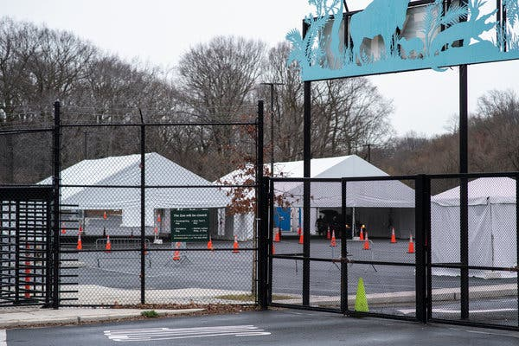
Drone Technology
Drone on board
DJI Mavic 3 Pro
3 cameras
43-minute flight time
Enhancing situational awareness
Scouting hazardous environments
Drone view of COVID testing sites

Slide 25
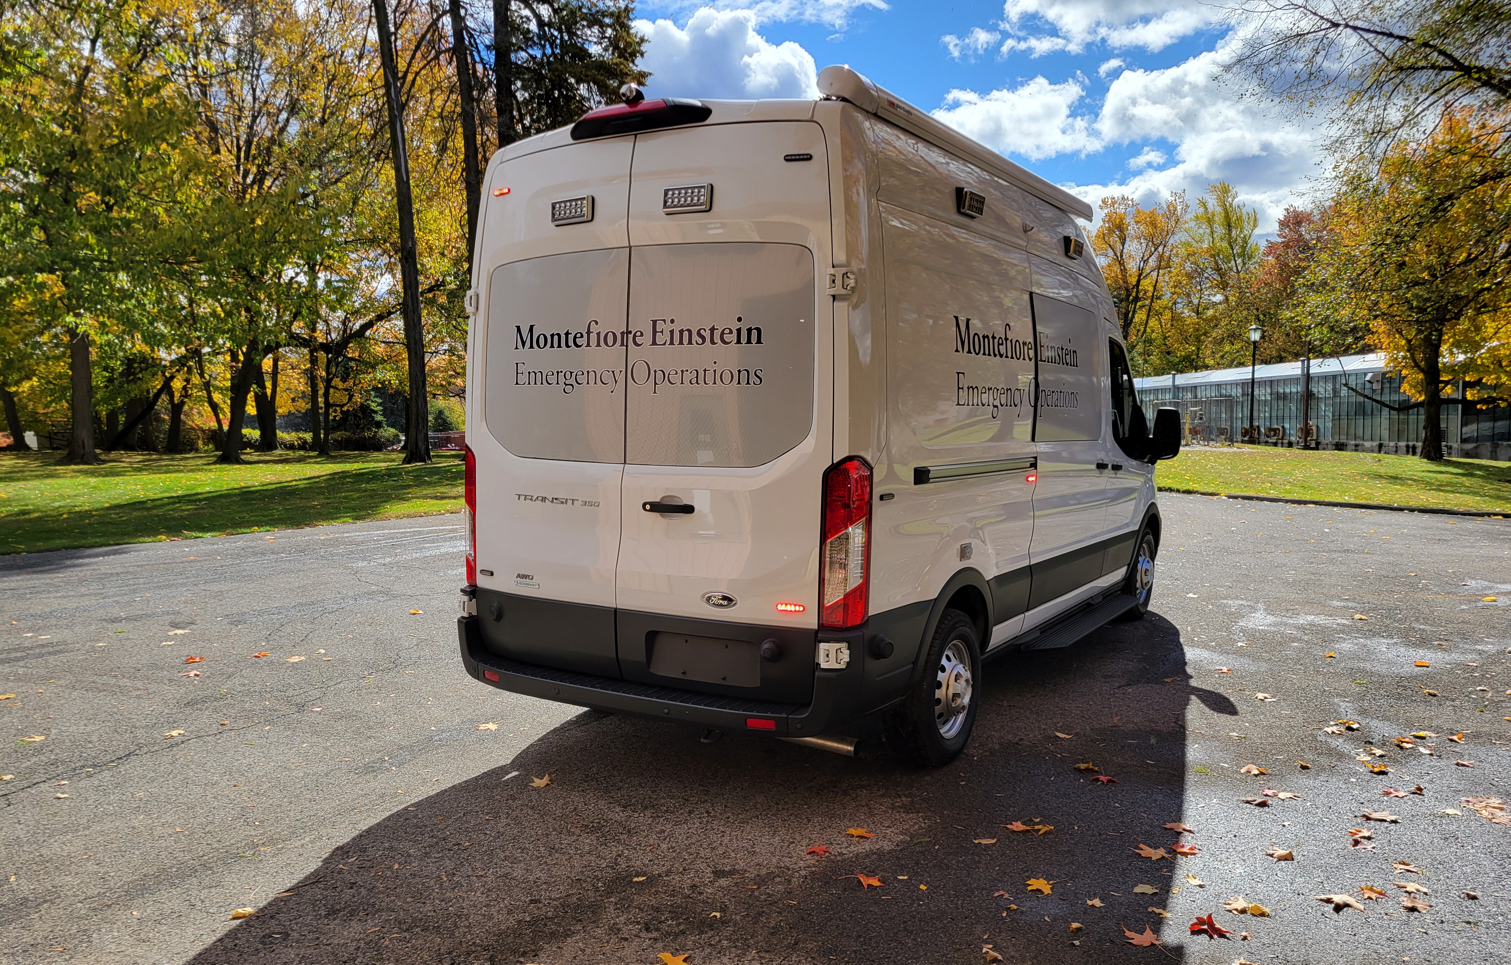
Deployment Protocol
Activation
Requesting the vehicle
Staffing requirements
Available to BEPC members
Radio frequencies can be added (in advance)
25

Slide 26
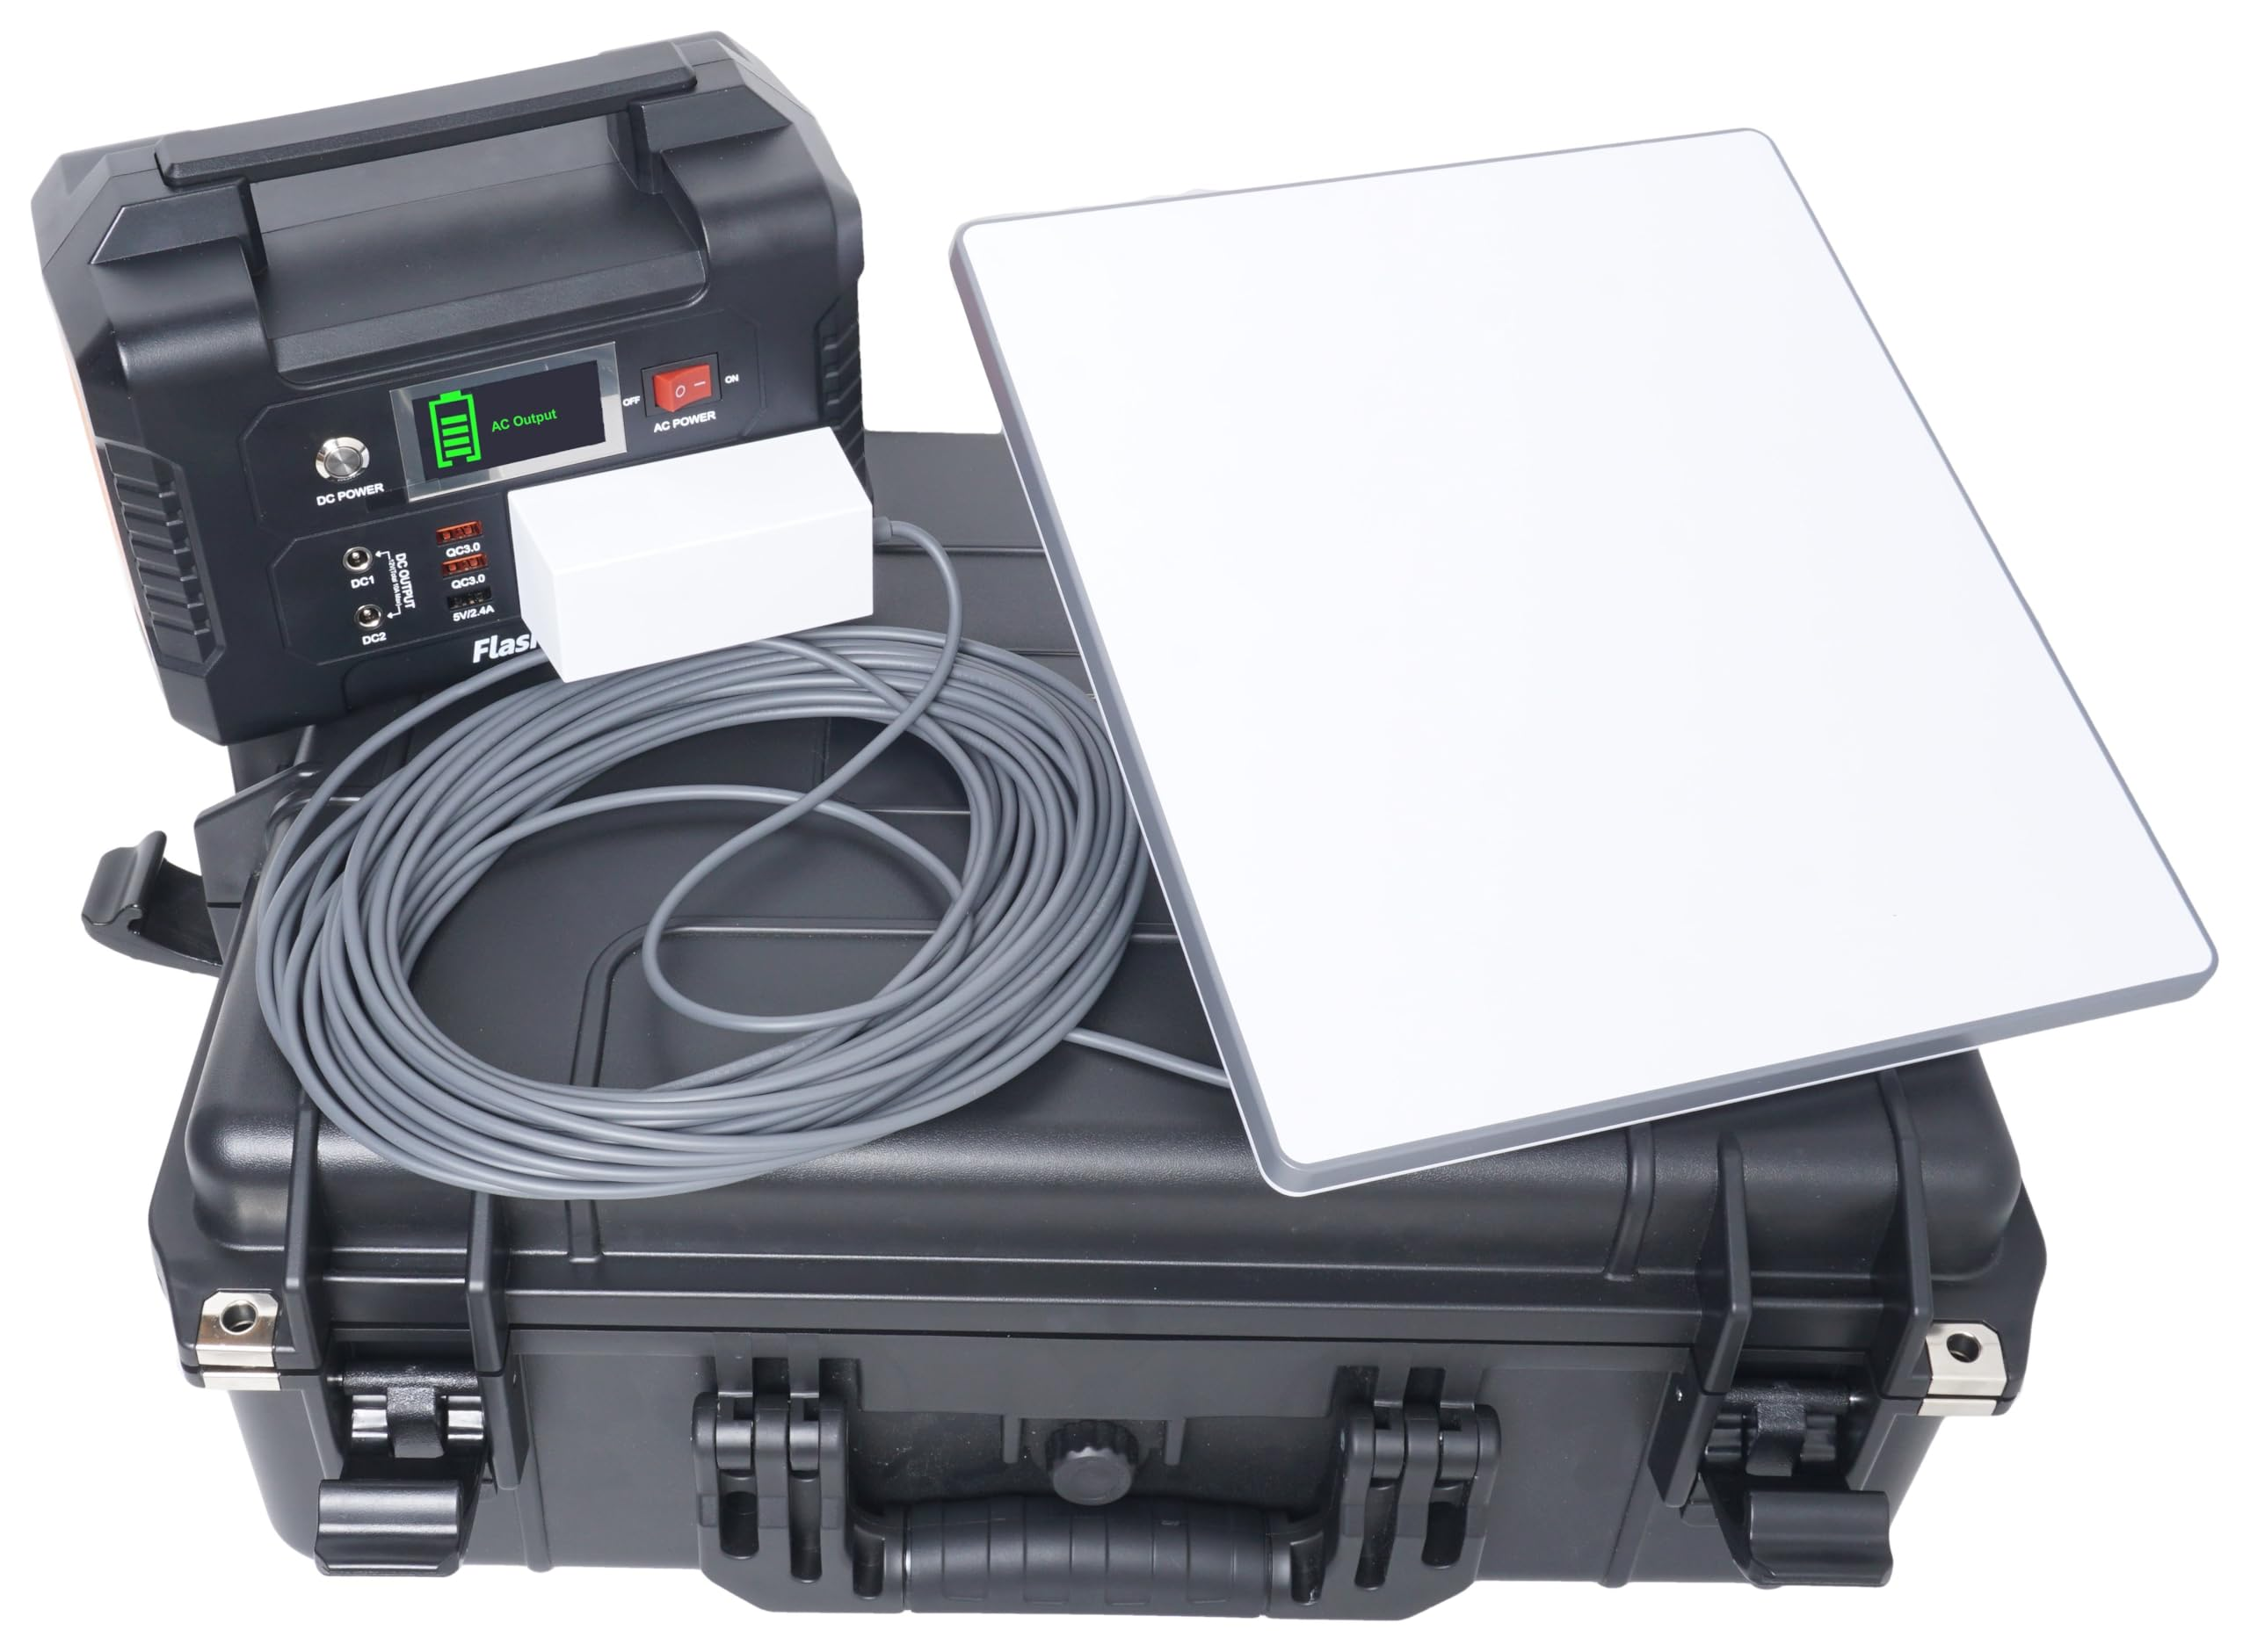
Future Enhancements and Conclusion
Technology outlook
Scalability
Starlink Satellite connection
Multi-path connectivity, including mobile mesh network communication
Sustainable power system
Upcoming training and exercises
Coalition support
Monitor encrypted frequencies and two-way communications with the agency’s permission
Add Coalition hospital frequencies upon their request
Deploy to Coalition members’ events upon request
Keurig

Slide 27
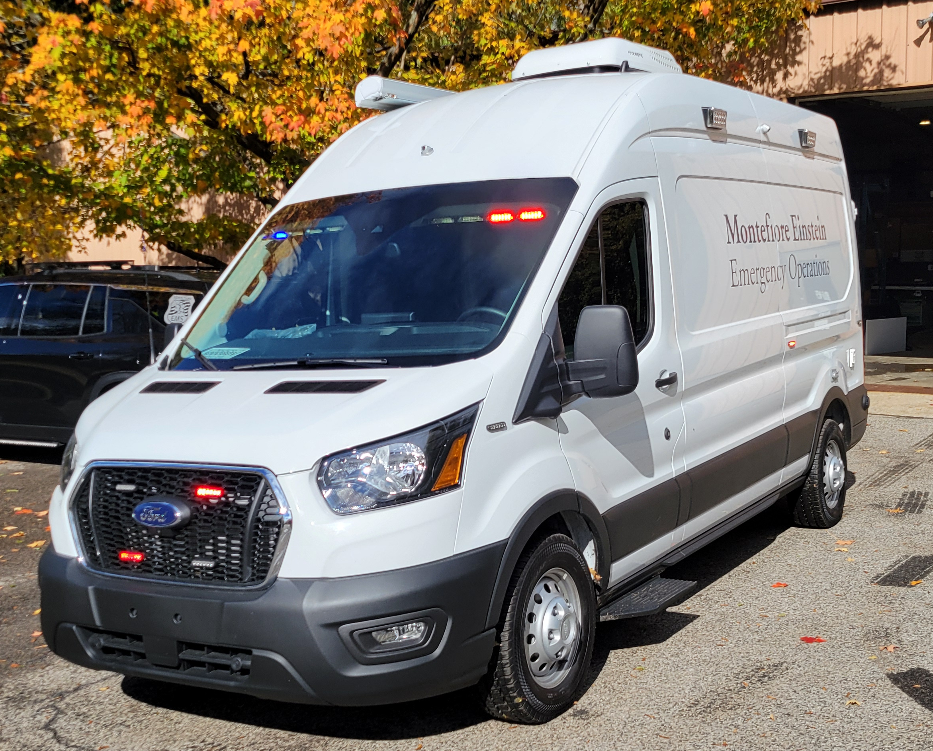
Let’s Go Check it Out!
27
Notes:
https://nextivityinc.com/products/shield-megago-hpue/
https://www.dji.com/mavic-3-pro?site=brandsite&from=landing_page
https://www.dji.com/support/product/mavic
https://www.firstnet.com/devices/connected-devices/sonim-megaconnect.html
https://www.verizon.com/support/one-talk-lte-desk-phones-overview/

Slide 29
Final Strategic Plan Presentation
New York City Hospital Preparedness Program – Five Year Strategic Plan
January 27, 2026
Notes:
Hagerty to kickoff

Slide 30
Welcome & Opening Remarks
Notes:
GNYHA/DOHMH to provide opening remarks

Slide 31
Meeting Purpose/Objectives & Agenda
Project Overview: Provide a brief overview of project milestones, progress, and key next steps.
Strategic Plan Presentation: Provide an overview of the final Strategic Plan documentation for validation.
Next Steps & Action Items: Outline next steps for the final Strategic Plan documentation and beyond conclusion of the project.
Time | Topic
10 minutes | Welcome, & Opening Remarks
10 minutes | Project Overview/Updates
40 minutes | Strategic Plan Documentation Overview
15 minutes | Closing & Next Steps
Notes:
Hagerty to take over the presentation from here

Slide 32
Project Overview/Updates
Notes:
Speaker:
Notes:

Slide 33






Project Objectives
During this project, Hagerty’s goal was to support the New York City Health Care Coalition (NYCHCC) with developing a comprehensive, strategic plan that:
Provides a framework for the NYCHCC to drive and ensure compliance with healthcare preparedness goals in NYC.
Documents key readiness priorities on behalf of NYCHCC by identifying goals that can move the whole City (i.e., beyond the Coalition) ahead, aligning and coordinating across NYC.
Outlines initiatives, strategies, and key objectives to support those initiatives, over the next few years through 2028.
Meets Hospital Preparedness Program (HPP) Strategic Plan requirements.
Final Strategic Plan Presentation | 5

Slide 34






Project Activities
August – September 2026
July 2026
Stakeholder Survey
Stakeholder Interviews
Draft Strategic Plan
Validation Workshop
Final Plan Presentation
Final Strategic Plan Submission
October 2025
October 2025
January 2026
February 2026
Planning Committee Kickoff Meeting
Planning Committee Meeting #1
Planning Committee Meeting #2
June 2025
August 2025
September 2025

Slide 35

Project Activities
August – September 2026
July 2026
Stakeholder Survey
Stakeholder Interviews
Draft Strategic Plan
Validation Workshop
Final Plan Presentation
Final Strategic Plan Submission
October 2025
October 2025
January 2026
February 2026
Planning Committee Kickoff Meeting
Planning Committee Meeting #1
Planning Committee Meeting #2
June 2025
August 2025
September 2025

Slide 36

Data Collection Activities
Document Review
The strategic planning process began with a thorough review of approximately 15 relevant documents, plans, and guidance materials. Examples included:
NYCHCC Charter (2019 Version)
GNYHA Incident Management Protocol
HPP 2024 – 2028 Requirements
Stakeholder Survey
To set the strategic planning process up for success, a stakeholder survey was distributed to members of the NYCHCC Planning Committee with a response rate of roughly 78%. Questions addressed the following categories:
Scene-Setting Questions
Organization-Specific Questions
Strengths, Weaknesses, Opportunities, and Threats Questions

Slide 37

Data Collection Activities (cont.)
Sample topic areas and questions included:
Goals and Priorities
Strengths and Areas for Improvement
Coordination and Communication
Current Initiatives and Funding
Emergency Preparedness
Stakeholder Interviews
As the next step, 23 interviews were conducted with key NYC partners:
DOHMH
DOHMH - Community Preparedness
GNYHA
Hospital/Health Care Networks
Home Care Associations
Long-Term Care Associations
NYCEM
Community Health Care
Hospice and Palliative Care
Independent Hospital Systems
Subject Matter Experts (i.e., Pediatric Disaster Coalition, Dialysis)
EMS/FDNY
Borough Coalitions
Nursing Homes/Long-Term Care Facilities
Urgent Care
Pharmacy
State Department of Health

Slide 38
SWOT Analysis
The Project Team then conducted a Strengths, Weaknesses, Opportunities, and Threats (SWOT) analysis to assess current circumstances, make informed decisions, and identify current/future opportunities based on results from all data collection activities.
SWOT themes included:
Regional, State, and Federal Coordination
Coalition Coordination
Communication & Information Sharing
Resource Reallocation and Sharing
Emergency Preparedness
Training & Exercises
Post-Acute and Community Based Providers
Whole-Community Approach
Workforce
Funding
Notes:
Speaker:
Notes:

Slide 39

Project Activities
August – September 2026
July 2026
Stakeholder Survey
Stakeholder Interviews
Draft Strategic Plan
Validation Workshop
Final Plan Presentation
Final Strategic Plan Submission
October 2025
October 2025
January 2026
February 2026
Planning Committee Kickoff Meeting
Planning Committee Meeting #1
Planning Committee Meeting #2
June 2025
August 2025
September 2025

Slide 40


Planning & Validation Engagements
Planning Meeting #1
Following the Kickoff Meeting, Planning Committee Meeting #1 was held in August 2025 to review the project status, strategic plan outline, confirm the mission and vision statements, and finalize the stakeholder interview process and interviewee list.
Planning Meeting #2
Planning Committee Meeting #2 was held in September 2025 and built on these discussions, focusing on reviewing survey results and discussing/validating the draft SWOT analysis.
Validation Workshop
To ensure the draft priorities reflected the needs and priorities of hospitals and health care systems in NYC, a validation workshop was held in October 2025. This session provided a forum to review and provide feedback on the proposed strategic priorities and associated objectives, ensuring alignment with operational realities and stakeholder perspectives. Further, this workshop provided an opportunity to collect feedback on opportunities to improve the organization and governance of the Coalition.

Slide 41

Project Activities
August – September 2026
July 2026
Stakeholder Survey
Stakeholder Interviews
Draft Strategic Plan
Validation Workshop
Final Plan Presentation
Final Strategic Plan Submission
October 2025
October 2025
January 2026
February 2026
Planning Committee Kickoff Meeting
Planning Committee Meeting #1
Planning Committee Meeting #2
June 2025
August 2025
September 2025

Slide 42
Strategic Plan Documentation Overview
Notes:
Speaker:
Notes:

Slide 43
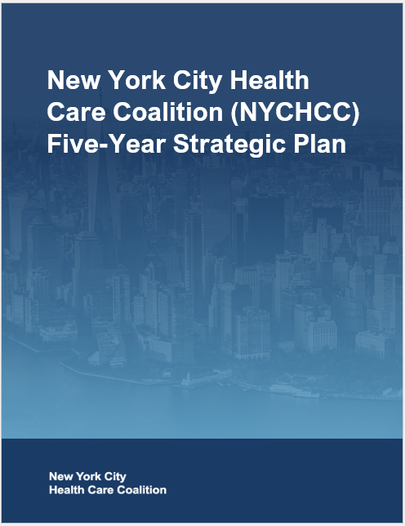
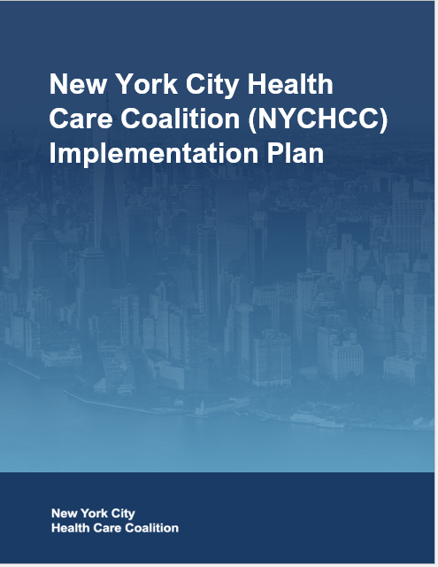
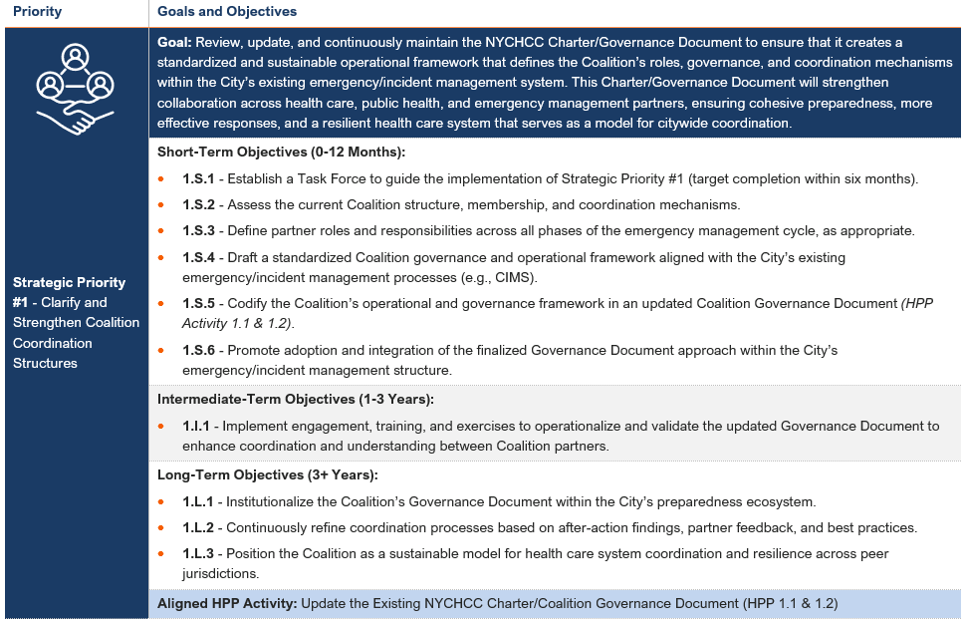
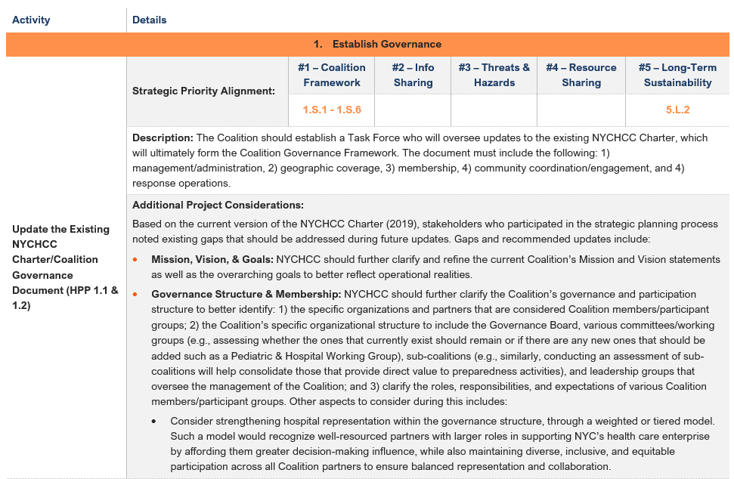
Strategic Plan Documentation
NYCHCC Five-Year Strategic Plan
Goal/Purpose: Provide a framework to proactively address emerging threats, strengthen health care system capabilities, and promote a culture of collaboration, equity, and resilience.
Documents: 1) Strategic Priorities, 2) Goals, and 3) Objectives (Short, Intermediate, Long) that outline how to strengthen NYC’s health care system preparedness, coordination, and resilience across the five boroughs.
NYCHCC Implementation Plan
Goal/Purpose: Complements the Strategic Plan and translates Strategic Priorities, Goals, and Objectives into actionable projects and activities.
Documents: 1) ASPR HPP Required and Non-Required Activities, 2) an Implementation Tracker (HPP Projects Only).

Slide 44
NYCHCC Five-Year Strategic Plan Overview
Notes:
Speaker:
Notes:

Slide 45
Strategic Plan Outline
The Strategic Plan is composed of the following sections:
Acknowledgments
Letter from the NYCHCC Five-Year Strategic Plan Planning Committee
Record of Changes
Executive Summary
Background
Strategic Plan Overview
Purpose
Planning Process & Development Timeline
SWOT Analysis
Strategic Priorities Overview
Appendix A: Stakeholder Acknowledgements
Appendix B: Data Collection Methodology
Appendix C: Relevant Emergency Management Assessments and Surveys
THIRA Health Care Results
SPR Overview
2024 Jurisdictional Risk Assessment
Appendix D: Detailed SWOT Analysis
Appendix E: Acronyms
Notes:
Speaker:
Notes:

Slide 46





Strategic Priorities
Strategic Priority #1 - Clarify and Strengthen Coalition Coordination Structures
Strategic Priority #3 - Prepare for Emerging Threats and Hazards
Strategic Priority #5 – Strengthen Administrative Sustainability
Strategic Priority #2 - Enhance Communications and Information Sharing
Strategic Priority #4 - Improve Resource Reallocation and Sharing Across Health Care Partners

Slide 47
NYCHCC Implementation Plan
Notes:
Speaker:
Notes:

Slide 48
Implementation Plan Outline
The Implementation Plan is composed of the following sections:
Record of Changes
Introduction
Strategic Priority Aligned Activities
Strategic Priority Aligned Activities Implementation Tracker
Appendix A: Strategic Priorities
Appendix B: Acronyms
Notes:
Speaker:
Notes:

Slide 49
Implementation Plan Overview
The Implementation Plan details ASPR HPP Required Activities along with other activity recommendations identified during the strategic planning process that support achieving the Strategic Priorities outlined in the Strategic Plan.
Each activity includes the following:
Activity Title & HPP Requirement (if relevant)
Strategic Priority/Objective Alignment
Activity Description
Additional Considerations

Slide 50
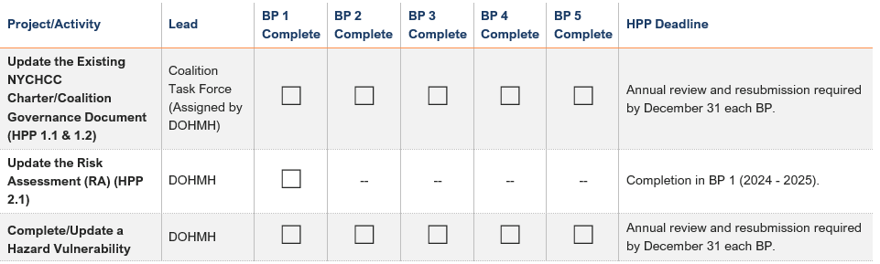
Implementation Tracker
A separate Implementation Tracker will also be provided that can be used as a tool for tracking all activities across all Budget Periods (BP) along with any deadline considerations.

Slide 51
Closing & Next Steps

Slide 52
Next Steps
Coalition Members
Share any final feedback or considerations related to the Strategic Plan or Implementation Plan as soon as possible
Contract Team
Finalize the Strategic Plan or Implementation Plan prior to project closeout in February 2026

Slide 53



Thank you!
Gurdeep Nagi
Deputy Director
Gurdeep.Nagi@hagertyconsulting.com
Claire Doyle
Manager
Claire.Doyle@hagertyconsulting.com
Jaesa Rogers
Senior Managing Associate
Jaesa.Rogers@hagertyconsulting.com
Notes:
Hagerty to pass to Tamer to discuss BP 3

Slide 54
NYC Health Care Coalition Vision for the Future
NYC Health Care Coalition Meeting #1
January 27, 2026
Tamer Hadi – Assistant Commissioner
Office of Emergency Preparedness and Response
Bureau of Healthcare and Community Readiness

Slide 55
HPP Funding Stable…for now
On 1/22, the House passed LHHS appropriations (including CDC & ASPR funding) as part of a larger funding package.
$735M for CDC PHEP (level funding)
$240M for ASPR HPP (level funding)
Bill passed House with bipartisan approval; however, recent events in Minnesota have imperiled this bill
Senate Democrats are refusing to agree to the DHS budget, and want it stripped out of the funding package and renegotiated
Discussions are happening in the Senate about a path forward, but the future of the bill is currently up in the air
Next steps: Senate needs to pass it, then President needs to sign it into law
A version of this bill, or another CR, need to be passed before the end of 1/30, or there will be a partial government shutdown.
Notes:
Labor, Health and Human Services

Slide 56
Working Differently in BP3
Greater involvement of NYCHCC partners in decision-making processes
Forming strategic Task Forces to work on specific initiatives with diverse NYCHCC representation as needed
Fewer facility-level deliverables → More coalition capabilities projects
Feedback and evaluation processes to ensure hitting milestones towards larger goals

Slide 57
Major Inputs that will Drive HPP Work
ASPR HPP grant requirements
NYCHCC Strategic Plan
COVID AAR Corrective Actions

Slide 58
NYCHCC Vs. ESF-8
Membership should be identical for seamless transition from preparedness to response
Requires onboarding other umbrella organizations into ESF-8 to enable bidirectional communication with that sector (e.g., pharmacy & urgent care)
PREPAREDNESS | RESPONSE
NYC HCC | ESF-8
Normal communication channels | Physical / Virtual EOC Mass notifications
Strategic plan driven work | Scenario driven objectives

Slide 59
ASPR Deliverable | Deadline | Synergies | Plan for Completion |  | Your Input
Establish Governance
Governance Document | 6/30/26 (Annual submission) | Strategic Priority #1 & #5 | Per Strategic Plan, establish task force to review coalition structures and redraft deliverable. | Per Strategic Plan, establish task force to review coalition structures and redraft deliverable. | Task Force TBD
Assess Readiness
Workforce Assessment | Draft due by 6/30/26 | COVID AAR Rec 4.2-5 | Complete by 6/30, in order to meet deadline for Workforce Readiness/ Resilience Plan due 12/31/26. | Complete by 6/30, in order to meet deadline for Workforce Readiness/ Resilience Plan due 12/31/26. | Respond to surveys
Cyber Security & Extended Downtime Assessments | 6/30/26 (Annual submission) |  | Validate assessment completed in BP1, extend survey to additional HCC members | Validate assessment completed in BP1, extend survey to additional HCC members | Respond to surveys
Plan and Implement
Strategic Plan | 6/30/26 |  | Strategic Plan to be finalized over the next month and will be widely circulated to NYCHCC members | Strategic Plan to be finalized over the next month and will be widely circulated to NYCHCC members
Information Sharing Plan | 6/30/26 (Annual submission) | Strategic Priority #2; COVID AAR Rec 5.3-4 | Per Strategic Plan, establish task force to review information sharing processes and redraft deliverable. | Per Strategic Plan, establish task force to review information sharing processes and redraft deliverable. | Seeking volunteers for task force
Medical Surge Support Plan | 6/30/26 (Annual submission) |  | Plan includes Base Surge Plan and Pediatric, Burn, Special Pathogen, Radiation, and Chemical Annexes. NYC Health Department has drafted these plans, but NYCHCC could prioritize a collaborative revision. | Includes Base Surge Plan and Pediatric, Burn, Special Pathogen, Radiation, and Chemical Annexes. NYC Health Department has drafted these plans, but NYCHCC could prioritize a collaborative revision. | TBD depending on prioritization
Continuity of Operations Plan (COOP) | 6/30/26 (Annual submission) |  | NYC Health Department has drafted this plan, but NYCHCC could prioritize a collaborative revision. | NYC Health Department has drafted this plan, but NYCHCC could prioritize a collaborative revision. | TBD depending on prioritization
Recovery Plan | 6/30/26 (Annual submission) |  | NYC Health Department has drafted this plan, but NYCHCC could prioritize a collaborative revision. | NYC Health Department has drafted this plan, but NYCHCC could prioritize a collaborative revision. | TBD depending on prioritization
Exercise and Improve
Medical Response and Surge Exercise (MRSE) | 6/30/26 (Annually) | COVID AAR Rec 2.5 | MRSE preparations are ongoing | MRSE preparations are ongoing | Participate in MRSE
BP2 July 1, 2025 – June 30, 2026
Notes:
As part of our agreement with the Administration for Strategic Preparedness and Response (ASPR) for the Hospital Preparedness Program (HPP), the NYC Health Department is required to submit a number of deliverables each budget period. These deliverables are intended to support the health care coalition’s (HCC) preparedness, response, and recovery efforts.
This an overview of the deliverables the NYC Health Department and NYC HCC are required to submit in BP2. A full list of deliverables can be found in the Implementation Plan annex of the Strategic Plan.

Slide 60
ASPR Deliverable | Deadline | Synergies | Plan for Completion | Your Input
Assess Readiness
Hazard Vulnerability Assessment (HVA) | 12/31/26 | Strategic Priority #3 | NYC Health Department in the process of revising the HVA methodology and will roll this out in subsequent coalition meetings | TBD - participate in assessment approach
Supply Chain Integrity Assessment | 12/31/26 | Strategic Priority #4 | Complete draft by fall, in order to start informing Resource Management Plan due 6/30/27. | Respond to surveys
Plan and Implement
Resource Management Plan | 6/30/27 (Annual submission) | Strategic Priority #4; COVID AAR Rec 2.5 | Per Strategic Plan, establish task force to review information sharing processes and redraft deliverable. | Task Force TBD
Workforce Readiness/Resilience Plan | 12/31/26 | COVID AAR Rec 4.2-5 | Establish task force to review Workforce Assessment and draft plan. | Task Force TBD
Cybersecurity and Extended Downtime Support Plans | 6/30/27 |  | Establish task force to review Cybersecurity and Extended Downtime Assessments and draft plan. | Task Force TBD
Exercise and Improve
Medical Response and Surge Exercise (MRSE) | 6/30/27 (Annually) | COVID AAR Rec 2.5 | MRSE preparations are ongoing. Potential to merge Patient Movement Exercise and MRSE in BP3. | Participate in MRSE
BP3 July 1, 2026 – June 30, 2027
Notes:
This is an overview of the deliverables the NYC Health Department and NYC HCC are required to submit in BP3. A full list of deliverables can be found in the Implementation Plan annex of the Strategic Plan.

Slide 61
Next Steps
In the coming weeks and months:
Forming a Governance / Charter Task Force
Advise on forming a new Governance Board
Update the NYCHCC Charter (last revised in 2019)
Work with NYCEM and GNYHA on enhanced communications and information sharing capabilities for NYCHCC/ESF-8 prior to the World Cup
Establish other task forces and determine what deliverables will be completed in BP3.
*** More collaborative decision-making ***
Notes:
A results framework is a visual tool that maps out the logical, cause-and-effect relationships between activities, their deliverables (outputs), the changes they create (outcomes), and the long-term goals (impacts).

