Slide 1

March 2026 EPS Meeting
Greg Wayrich, EMT-P
Chair, BQEPC,
EPC, NYP Queens

Slide 2

National Healthcare Coalition Preparedness Conference
Gaylord Grapevine – Grapevine, TX
1200+ Attendees
50+ Vendors
3 Days of Conference content
BQEPC/PDC/NYC HCC presence
Networking and best practices
Federal partners/ASPR

Slide 3
National Healthcare Coalition Preparedness Conference
Key Takeaways
General Sessions cover a variety of subject from MCI to Technology
Our very own Jennifer Guzman and Carlos Crus Presented!
State of the Industry: ASPR Leaders
GNYHA Social

Slide 4
National Healthcare Coalition Preparedness Conference
BQEPC Attendees:
Greg Wayrich, NYP Queens, Chair – BQEPC
John Jermyn, Maimonides MC/PDC, Vice Chair – BQEPC
Dr. Matthew Harris, PDC
Mary Mahoney and Tim Lanigan, Northwell Health
Bernard Robinson, NYC H&H

Slide 5
National Healthcare Coalition Preparedness Conference
Key Takeaways
The NHCPC conducts a great event.
Exhibitors were very engaged (Grainger, AHEPP)
Networking opportunities

Slide 6

National Healthcare Coalition Preparedness Conference
SAVE THE DATE FOR #NHCPC26

Slide 7
QUESTIONS?

Slide 8
Behavioral Threat Assessment Management A Primer on Violence Risks, Consequences, and Solutions Presented by Keith Hansen AHEPP
National Healthcare Coalition Preparedness Conference
Dec 1-3, 2025
Grapevine, TX

Slide 9
Discussion Topics
Objectives
Define Behavioral Threat Assessment and its importance in public health, healthcare, and the public sector
Explain the key components of the Behavioral Threat Assessment process
Explain the key steps in forming and leading a Behavioral Threat Assessment Team
Numerous slides are taken from the National Threat Evaluating and Reporting Program Office

Slide 10
Targeted Violence Defined
Generally, any premeditated act of violence directed at a specific individual, group, or location, regardless of motivation, that violates the criminal laws of the United States or of any State or subdivision of the United States.
Adapted from: Making Prevention a Reality: Identifying, Assessing, and Managing the Threat of Targeted Attacks – FBI

Slide 11
Healthcare Behavioral Threat Assessment Management

Slide 12
Why should Healthcare be involved?
University of Pittsburgh Medical Center
United Healthcare Headquarters, Minnetonka, MN
Aultman Hospital, Canton, OH
Provident Hospital, Chicago, IL
HCA Palms West Hospital, Loxahatchee, FL
University of Illinois, Chicago
Integris Health, Enid OK
Henry Ford Hospital, Detroit, MI
Mr. R. 07-21-2025. University of Illinois Chicago Hospital.
Aramark (food service). Shot two off campus.
Channel 7 Eyewitness News. Chicago & Suburban Cook Co.

Slide 13
Nursing Data
80% of nurses do not feel safe in their workplace (Peek-Asa et al., 2009).
In a survey of 125 ED nurses, intensive care unit and general floor nurses at a regional medical center, 82% of ED nurses had been physically assaulted at work in one year (May & Grubbs, 2002).
25% of psychiatric nurses experienced disabling injuries from patient assaults (Quanbeck, 2006).

Slide 14
Pathway to Violence Warning Behaviors

Slide 15
Mitigators

Slide 16
Key Components of the Behavioral Threat Assessment Management Teams
Threat assessment and management teams are effective proactive and protective measures that are designed to prevent – not predict – potential acts of targeted violence and terrorism.
Through identifying and managing potential threats, these teams provide alternatives to investigation and/or prosecution for bystanders who are actively seeking intervention assistance with a known individual at risk of mobilizing to violence. (USDHS, 2021)

Slide 17
Central Region HCC of PA Welcomes the World. HCC Support of Little League World Series
Presented By:
Jeremy Reese, Emergency Preparedness Coordinator, Geisinger
Mark Trueman, Deputy Chief, Susquehanna Regional EMS

Slide 18
Background and Event Overview
Over 75 years old, Little League World Series is an International Baseball Tournament hosted in South Williamsport, Pennsylvania each August
10 teams from US regions and 10 teams from International regions compete for nearly 2 weeks for the Little League Championship
The complex includes 2 stadiums Volunteer Stadium which has a capacity of hosting 5000 spectators and Howard J Lamade Stadium which hosts over 40000 spectators in the Stadium on hill on the outfield

Slide 20
Background and Event Overview
Event is televised on ESPN and ABC along with various other National and International media outlets.
Dignitary visits to the visit include POTUS, VPOTUS, famous athletes, and State and Regional dignitaries.
Participating teams are housed on site in a dormitory type complex that includes a recreational area.
Coinciding Events include the Little League World Series Parade, MLB Classic, and Williamsport Welcomes the World Festival

Slide 21
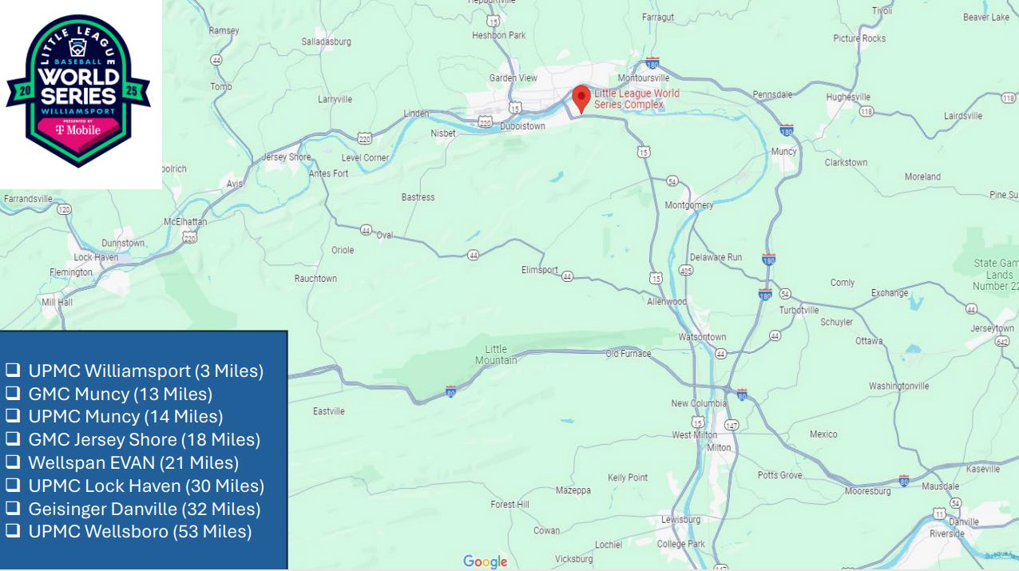

Slide 22
Planning Activities – Training & Exercises
HCC Funded Patient Decontamination Courses Held at Front Line Receiver Facilities
2025 MRSE / Patient Movement Exercise simulated event at LLWS
PA HIMS and Patient Tracking training provided to First Due and Mutual Aid EMS and Regional Hospitals
MCI Drill Held by EMS
On Field Drill Held by EMS in Collaboration with LLWS

Slide 23
Use of PA HIMS
The Pennsylvania Health Information System (PA HIMS) is leveraged through the event via 3 areas of focus to support the event:
EICS: Used for Coordination, Documentation, and Communication between the Site, County, Hospitals, Coalition, and State.
EMResource: Used to send bed polls to hospitals for bed availability. Offers dashboard real time data for regional hospital capacity and also statewide specialty bed capacity for pediatric available beds.
EMTrack: Used for Patient Tracking and Accountability during the Triage, Treatment, and Transport phases. Also used for patient census tracking for EMS and LLWS Command.

Slide 24
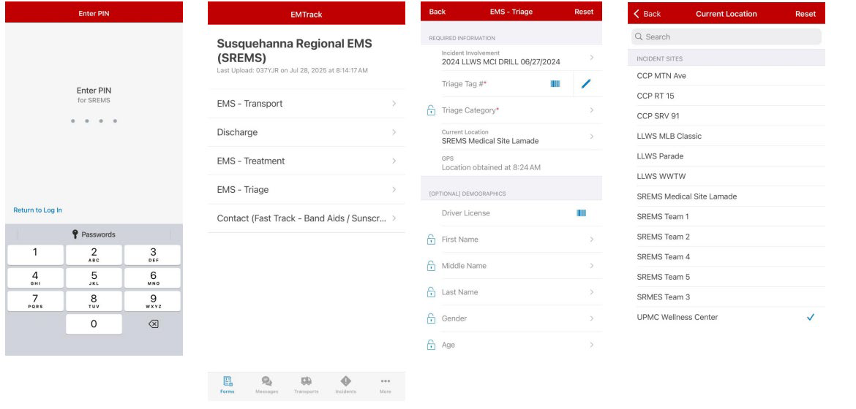
Patient Tracking Application Set Up

Slide 25
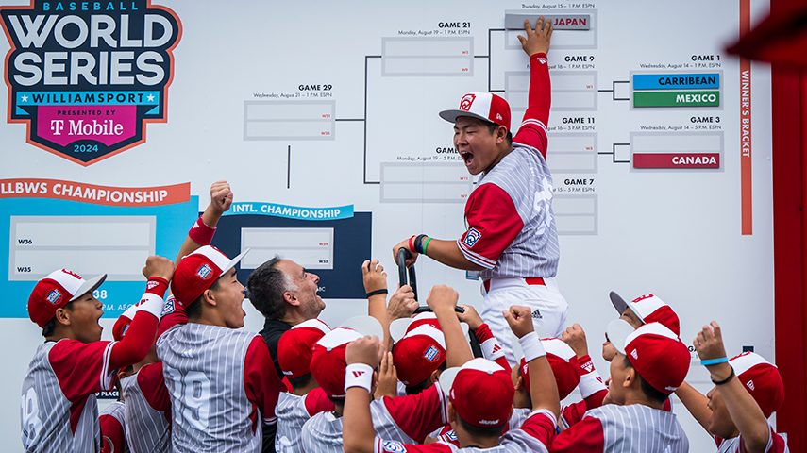
Final – Asia Pacific beat Mountain 7-0

Slide 27
How did we get here?
The winner was… Youth Centered Training!

Slide 28
Why Youth?
1 in 5 Brooklyn Residents are under 18Large, high-impact audience
Millions of residents in Brooklyn live in neighborhoods that are vulnerable to hazards
Clear disconnect between Youth outreach and Healthcare Emergency Preparedness

Slide 29
Why Youth?

Slide 30
Operational Planning
Pre-event Outreach: Registration opened 4 weeks in advance through coalition networks, partner schools, and social media.
Parental Consent: Required for all minors; forms included photography/media release and emergency contact details.
Tracking & Accountability: Digital sign-in via QR code and crosschecked at event check-in.
Safety First: Registration table doubled as a safety checkpoint — confirming medical needs, allergies, and guardian pickup instructions.

Slide 31
Measurable outcomes
47 Students Trained
10+ Agencies and Partners Involved
Increased Youth Awareness
Positive Feedback via Surveys and email

Slide 33
QUESTIONS?

Slide 34
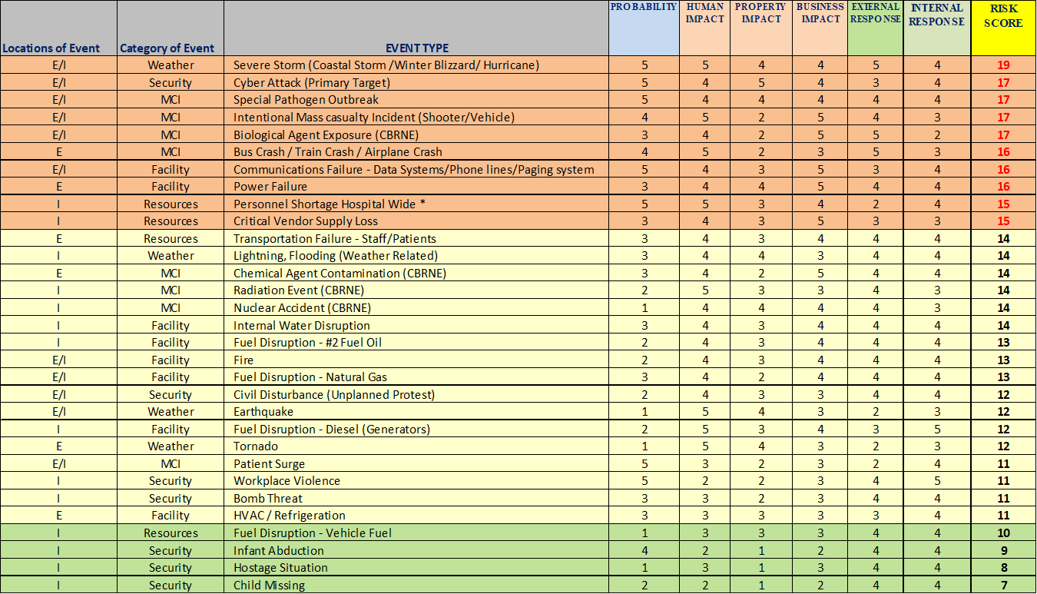
Strengthening Hazard Analysis & Engagement
Captivating Compliance: Bringing Data & Stakeholders Back to Hazard Analysis
Coalition‑wide HVAs - improve regional alignment; EMS approval tied to ED capability.
Engagement strategies that work:
Invite diverse stakeholders early.
Pre‑activity polling reveals gaps between perceived and actual risk.
Facilitate discussion on top hazards and what mitigation actions already exist.
Sticker‑board activity to visualize top risks across the room.
Emergency Management completes the Kaiser tool after stakeholder input, not before.

Slide 35
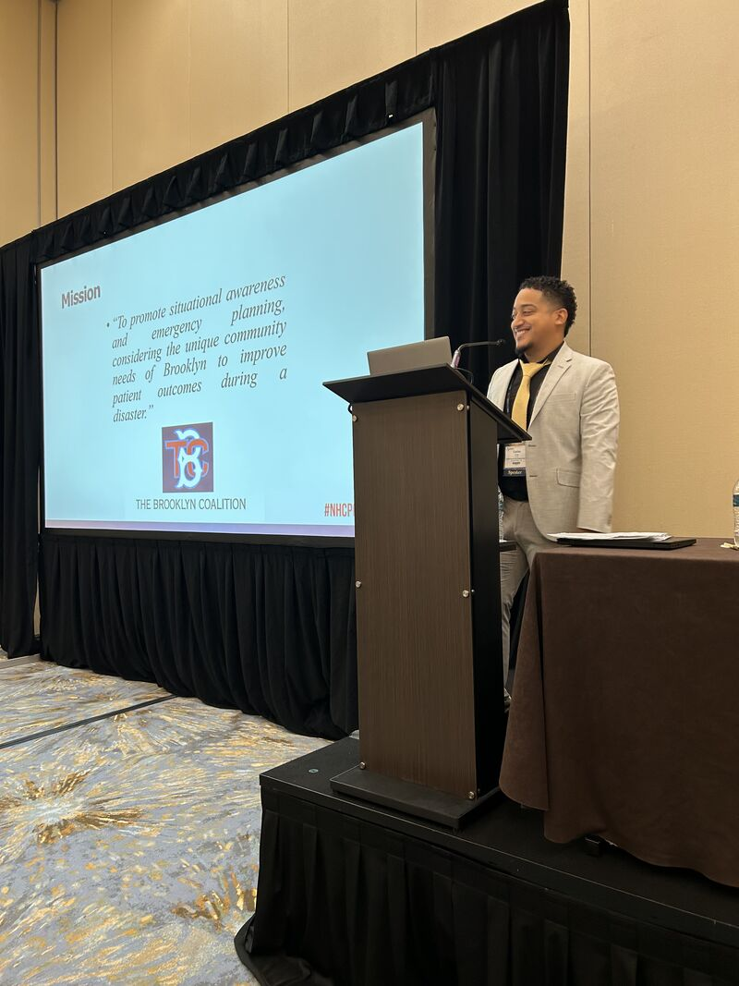
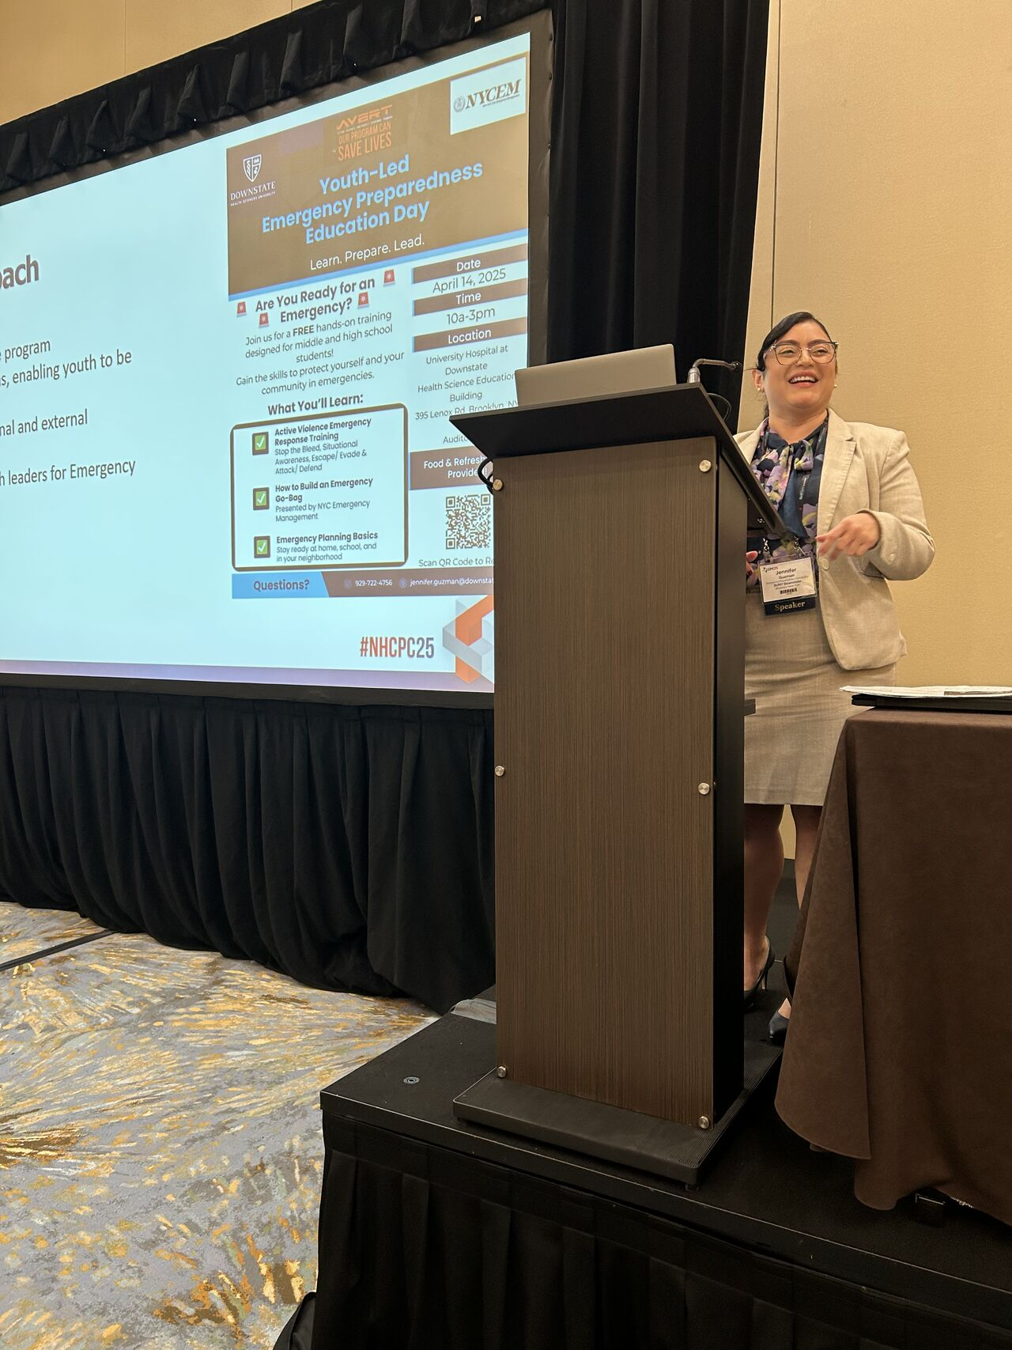
Engaging Youth in Emergency Preparedness
Why Youth Matter
Youth are natural community influencers who spread preparedness messages at home and online.
Early engagement builds a future pipeline for healthcare and emergency management careers
Program Model
Full‑day interactive sessions with internal and external partners.
Impact & Outcomes
Creates youth ambassadors for community resilience.
Strengthens preparedness culture through peer influence and family engagement.
Strong participation metrics: 100 invites → 87 registered → 47 attended.
Follow‑up process maintains engagement and builds long‑term relationships.

Slide 36
FIFA Hospital Preparedness
March 10, 2026

Slide 37

Agenda
Overview
FIFA Background and Events
Sail4th 250 / Independence Day
Preparedness Considerations
Lines of Effort
Briefings
Trainings
Summits
Sit Stat / Everbridge

Slide 38
FIFA Planning Committees
FIFA Planning Committees
NYC
New Jersey
EMS
Health & Medical
MCI
Information Sharing
Hospital Preparedness
Public Health

Slide 39
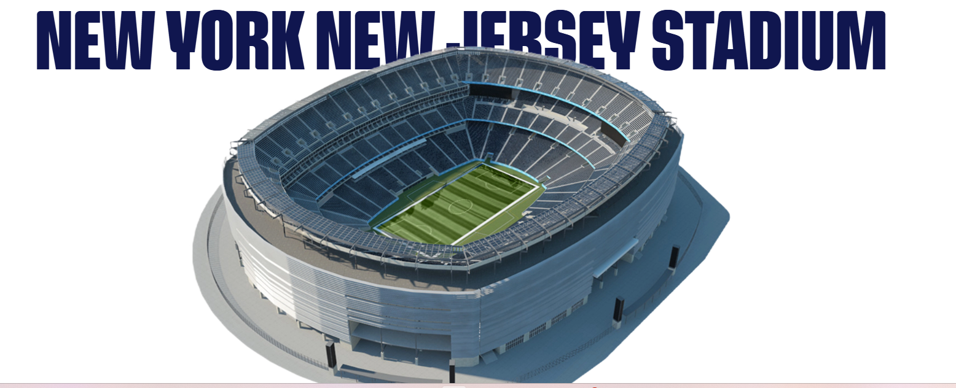

FIFA Match Location
(MetLife Stadium)

Slide 40
FIFA Match Schedule in NJ
Date | Day | Time | Match
June 13 | Saturday | 6:00 pm | Brazil v. Morocco
June 16 | Tuesday | 3:00 pm | France v. Senegal
June 22 | Monday | 8:00 pm | Norway v. Senegal
June 25 | Thursday | 4:00 pm | Ecuador v. Germany
June 27 | Saturday | 5:00 pm | Panama v. England
June 30 | Tuesday | 5:00 pm | Round of 32
July 5 | Sunday | 4:00 pm | Round of 16
July 19 | Sunday | 3:00 pm | FIFA World Cup Final

Slide 41
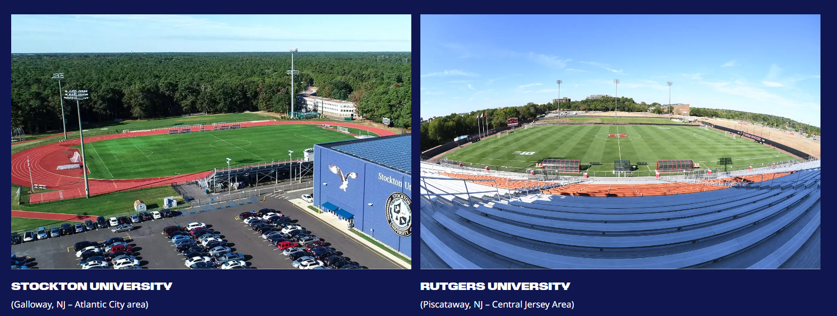
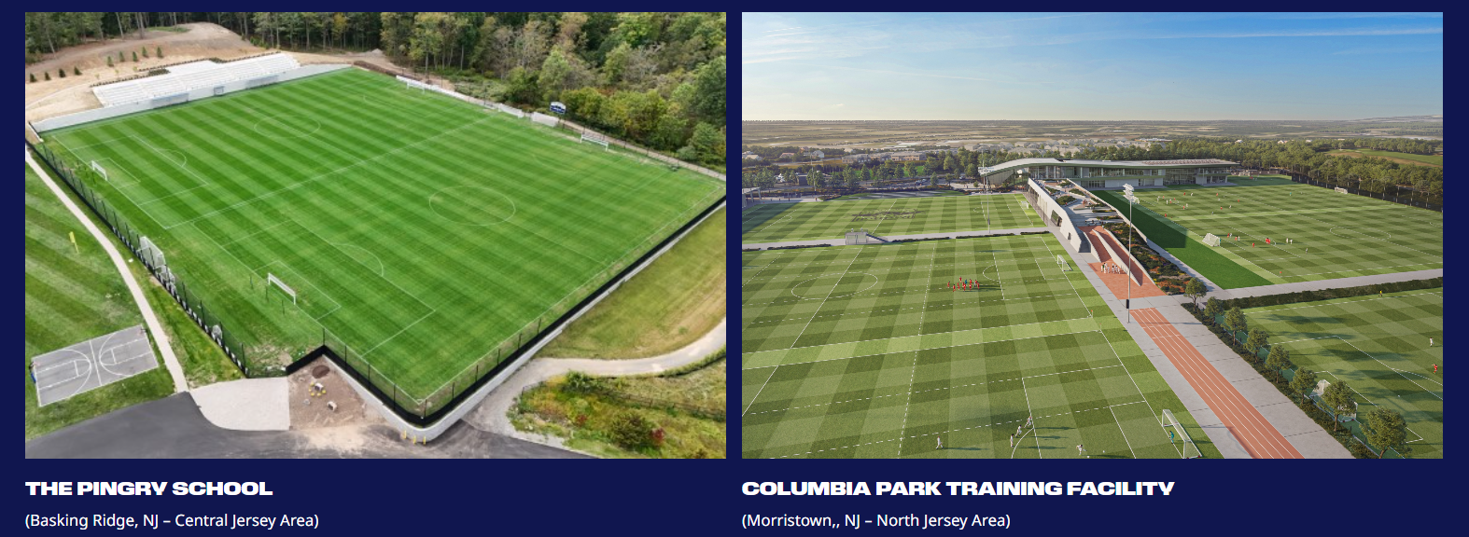
Team Base Camps
Base camps in NJ
Expect team officials to stay in NYC
Winning teams from matches elsewhere
will rotate in and out of base camps

Slide 42
Team Activities
Training
Venue specific training sites (VSTS): New Jersey
Venue specific hotel sites (VSHS): New Jersey
Teams coming in to matches will arrive 1-2 days before and then return to their base camps
VIPs and VVIPs: visiting / lodging in NYC
Hotels centered around 5th Ave / Park Ave
Traffic disruptions: lane closures, tunnel traffic

Slide 43
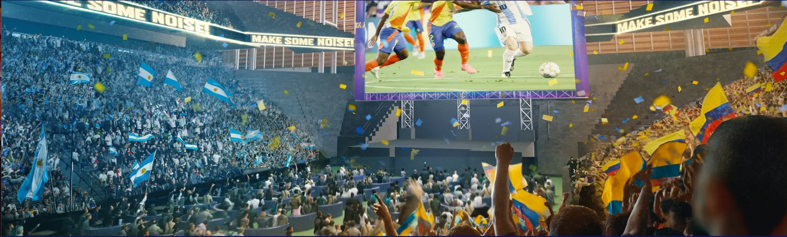
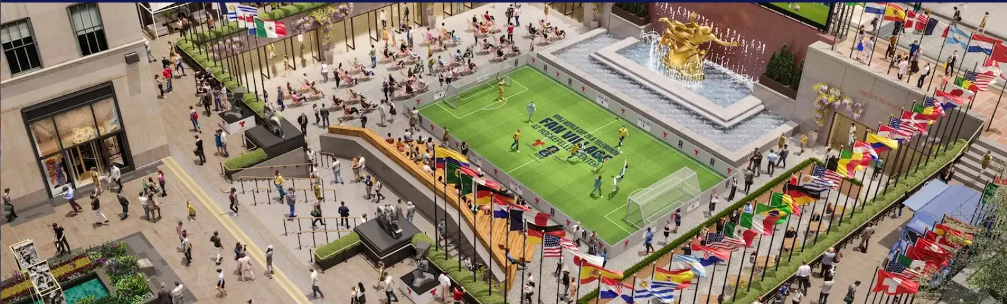
Fan Events
New Jersey
Liberty State Park Fan Festival cancelled
Brooklyn
Brooklyn Bridge Park
Queens
USTA Billie Jean King Tennis Center
Manhattan
Rockefeller Plaza
Javits Center
Central Park
Staten Island
Ferryhawks Stadium
Bronx
TBA
Local NJ events to be determined

Slide 44


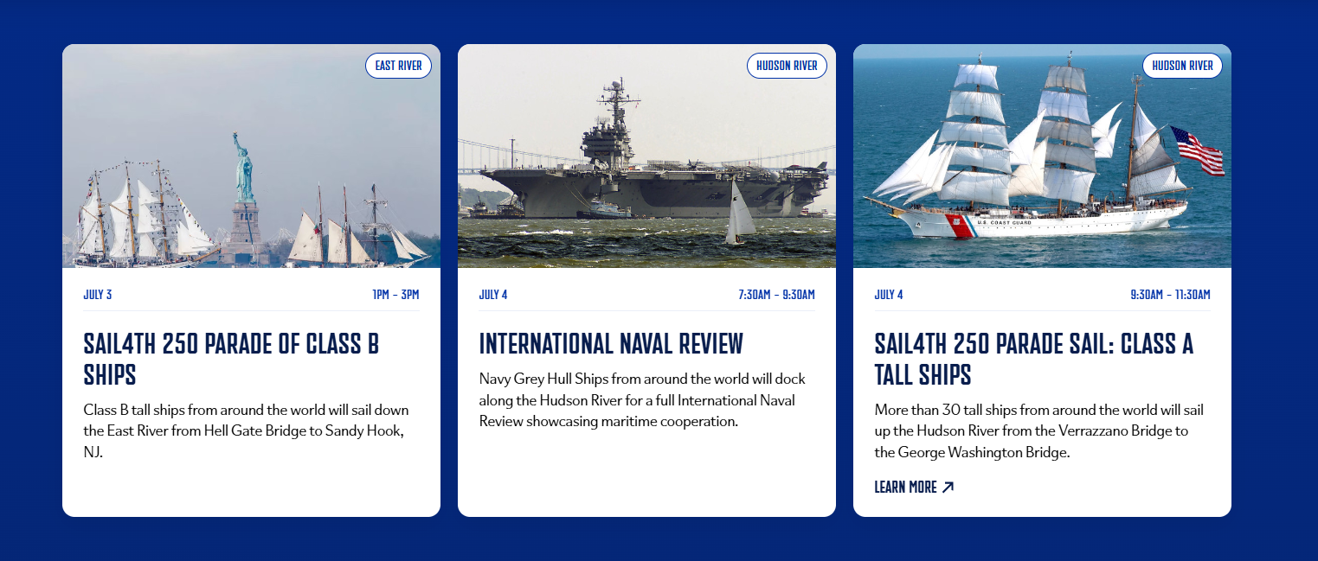
Sail4th 250: 7 days, July 3rd to 9th

Slide 45
International Naval Review / Sail 250
Participation
Command Center
12 US Naval ships
32 partner nation tall ships
~100 to 125 aircraft
~27,000 service personnel
50+ participating countries
Javits Center
Dedicated Command Center
State and City representation
June 24 to July 9
Medical cell
24/7 staffing
Admin and clinical staff

Slide 46
Events for July 3rd to 9th
July 3
July 4
July 5 & 6
July 7 & 8
July 9
Fan Event: Brooklyn Bridge Park
Fan Event: Brooklyn Bridge Park
Fan Village Rockefeller Center
Fan Event: Brooklyn Bridge Park
Fan Village Rockefeller Center
July 5 4:00 pm Round of 16
Fan Event: Brooklyn Bridge Park
Fan Village Rockefeller Center
Fan Event: Brooklyn Bridge Park
Fan Village Rockefeller Center
FIFA
1:00 to 3:00 pm
Tall ships East River: Hell Gate Bridge to Graves End
7:30 to 9:30 am
International Naval Review: ships docked on Hudson River
11:30 am to 4:00 pm
Public viewing of ships docked on NYC waterfront
11:30 am to 4:00 pm
Public viewing of ships docked on NYC waterfront
waterfront
9:00 am to 4:00 pm
Tall Ships Five Sisters Cup Race to Boston
9:30 to 11:30 am
Tall ships Hudson River: Verrazzano Bridge to GW Bridge
July 6: Tickertape parade
Sail4th /
International
Naval Review
Morning
International Aerial Review: Hudson River
Queen Mary 2
British Aircraft Carrier
National / International Naval Ships
Times Square Ball Drop
Macy’s Fireworks
Fleet Week
Fleet Week
Fleet Week
Other
Events

Slide 47

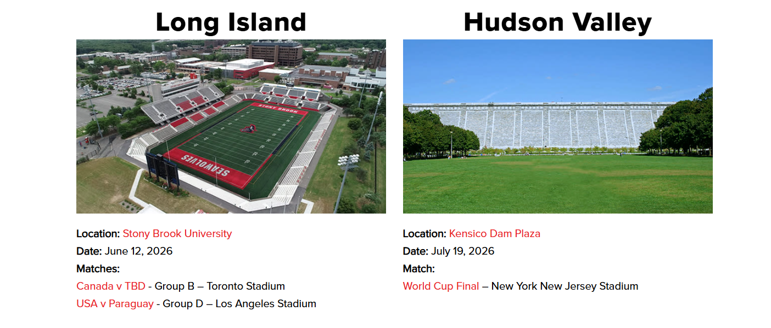
Regional Events
Watch Parties
Stony Brook: June 12
Hudson Valley: July 19 (final match)
Airshow
Jones Beach: July 5 and 6

Slide 48
Risks and Hospital Impacts
Risks
Hospital Impacts
Geopolitical tensions
Dignitaries / service members
Special pathogens
High heat / severe weather
Large widespread events
Transportation disruptions
Infrastructure impacts
Isolation requirements
Mass casualty
Security / language issues
Notes:
Mention soccer hooligans
Address languages potentially a concern for emergency departments

Slide 49
FIFA Additional Considerations
Languages spoken by teams
Portuguese, Arabic, Berber, French, Norwegian, Spanish, German
Wolof (Senegal) and other indigenous languages in Ecuador, Panama, Norway
Variety of immigrant languages in France and Germany
Transportation impacts
42nd Street closed river to river ahead of matches to facilitate player and dignitary movement from NYC to NJ
5th and 6th Avenues closures
Lincoln Tunnel designated for FIFA movement
Ferry and train service between NYC and NJ

Slide 50
FYI: Previous World Cups
Potential Patients
Drug overdoses / alcohol-related incidents
Crowd related injuries, dehydration / heat exposure
Athlete health / mental health
Care Considerations
Culturally sensitive care
Unfamiliarity with American health care system / payments
Medication refills for travelers (outpatient) / legal vs illegal substances
Other Issues
Human trafficking
Repatriation / legal issues related to ongoing care

Slide 51
International Naval Review Additional Considerations
Logistics
Dedicated command center: city and state representation
~50 naval vessels / ~50 tall ships
~100 to 125 aircraft
~27,000 service personnel
50+ participating countries
Navy Bureau of Medicine and Surgery (BUMED)
Requirements for notification of hospitalization of service members
EMS
Coverage for 15 miles of waterfront

Slide 52
Lines of Effort

Slide 53
Briefings
EPCCs
Future health care coalition meetings
CMO / CNO forums
Others?

Slide 54
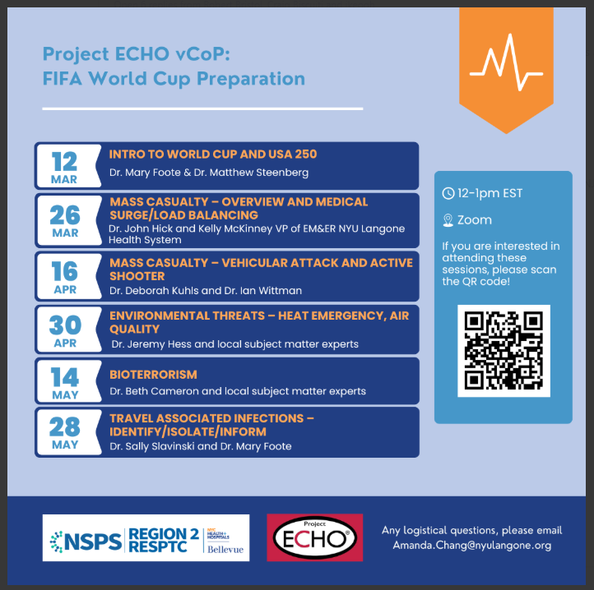
Bellevue: Project ECHO Trainings
Series focusing on FIFA World Cup Preparation
Topics
Mass Casualty
Environmental Threats
Bioterrorism
Travel Associated Infections
For more information contact:
Amanda Chang
amanda.chang@nyulangone.org

Slide 55
Additional Trainings
NJ Department of Health
GNYHA
RESPTC
Other New Jersey offerings
Next Steps
Gathering information
Deconflict topics
Socialize widely

Slide 56
FIFA Summits
Format
Half-day sessions
Education
Facilitated discussion
Topics
May 11: Trauma
May 20: Burn
May 27: Mass Decontamination

Slide 57
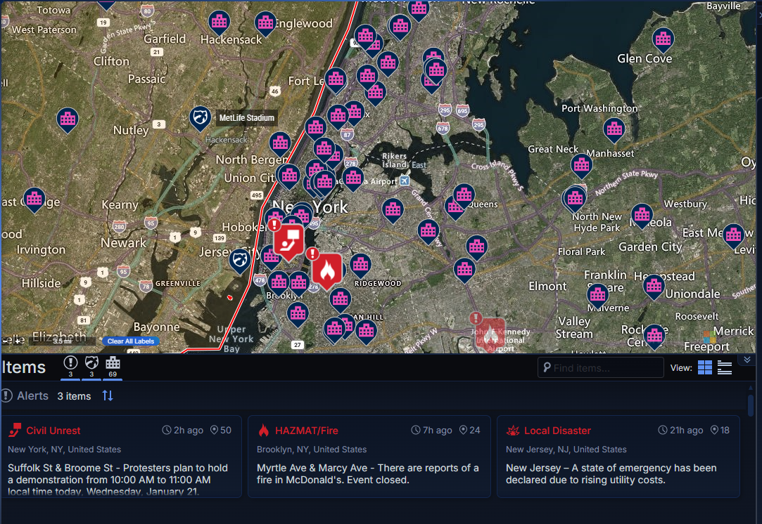
Sit Stat Risk Notifications
Track activities around FIFA and July 4 event locations
Sign up for automatic push notices regarding risk events near selected locations
In development

Slide 58
Questions?

Slide 59
Thank you
Andrew Dahl
Vice President, Emergency Preparedness and Response
Phone: 212-258-5314
Email: adahl@gnyha.org
Lisa Fenger
Assistant Director, Emergency Preparedness and Response
Phone: 212-506-5432
Email: lfenger@gnyha.org
Nicole Ziogas
Assistant Director, Emergency Preparedness and Response
Phone: 212-554-7728
Email: nziogas@gnyha.org

Slide 60
Resources
FIFA Schedule: https://nynjfwc26.com/schedule/
FIFA Venues: https://nynjfwc26.com/fan-festival/
Rockefeller Center Event: https://www.rockefellercenter.com/events/world-cup-2026/
FIFA FAQs: https://nynjfwc26.com/faq/
Sail4th 250: https://sail4th.org/schedule
Department of the Navy: https://www.navy.mil/Press-Office/Press-Releases/display-pressreleases/Article/4380385/save-the-date-july-4-2026/
July 3 Times Square Ball Drop: https://america250.org/news/america250-announces-celebration-of-america-turning-250-on-new-years-eve-in-times-square/
Fleet Week (Intrepid Museum): https://intrepidmuseum.org/save-date-fleet-week-july-4-8-2026
FourLeaf Air Show https://www.fourleafairshow.com/
New York State Events: https://www.iloveny.com/fifa-world-cup/community-viewing-events/

Slide 62
Medical Surge and Response Exercise
Healthcare Coalition Meeting #2
March 10, 2026

Slide 63
Overview: MRSE Exercise Details
Functional Exercise testing a required 10% of licensed beds for surge of patients into our collective healthcare system
Last year’s number was 1500 patients
This year we will aim for 2500 to 3000 patients to better test to failure
ASPR requires key objectives:
Information Sharing & Communication
Resource Needs (supplies, equipment, EMS)
Patient Distribution/Bed Types
Successful Coordination

Slide 64
Coalition Objectives
Objective #1: Demonstrate and educate hospitals and partners on the initial response for ESF-8 and hospital notification.
How we intend to achieve this:
Mock NYCEM led ESF-8 call
Hospital Ask
Attend and observe call for situational awareness and learning
Objective #2: Test the NYC HCC response to mass casualty incident in accordance with facility mass casualty plans and in coordination with OCME.
How we intend to achieve this:
Scenario Complexities
6 incidents, coordinated attacks
Incidents across all 5 boroughs
Greater patient counts than last year
Hospital Ask:
Play as realistically as possible after the April 20th call
Use patient manifests to test internal mass casualty plans and other necessary protocols

Slide 65
Coalition Objectives
Objective #3: Assess transportation capacity through engaging vendors and internal resources to understand gaps.
How we intend to achieve this:
Transport questions to be included in the patient intake and load balancing portion between parts 1 and 2
Hospital Ask:
Hospitals should contact contracted vendors with their patient transfer needs and establish a delta of resources still needed to share for evaluation purposes
Hospitals should ask vendors to project availability for July 5th, 2026 specifically given some resources may be deployed for other large-scale events at this time
Objective #4: Examine effectiveness of inter-hospital coordination, including transfer needs and load-balancing strategies through the Hospital Coordination Call
How we intend on achieving this:
Coordination via the Hospital Coordination Call
Visual Dashboard of reported census and patient intake information due April 23rd EOD
Hospital Ask:
Load balancing and transfer needs to be determined prior to Hospital Coordination Call (April 24th)
Notes:
Objective 4 up for debate. Urgent care and nexus of that, patient load and patients out more quickly to connect with LTC

Slide 66
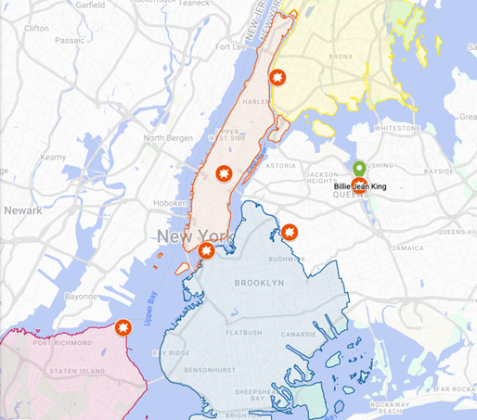
Scenario
July 5th, FIFA World Cup, Sail 250, International Naval Review, post 4th of July madness, Yankees home game
Incident 1: Rockefeller Center Fan Village
Incident 2: Brooklyn Bridge Park/DUMBO
Incident 3: Billy Jean King National Tennis Center
Incident 4: Yankee Stadium
Incident 5: Ferryhawks Stadium
Incident 6: Knockdown Center
Other scenario details
Heat Advisory issued through the 2000 HRS today.
Max Heat Index: 96
Max Temp: 92
42nd Street closure river to river
5th and 6th Avenue closure
Lincoln tunnel potential closure

Slide 67
Patient Count and Breakdown
Target Number from Guidance: 2500-3000 patients​
Distributed from six target sites​
FDNY will decide distribution/destination hospitals​
Red and Orange patients would come off scene within one hour​
Yellow and Green patients within two hours​

Slide 68
Key Dates and Gameplay
April 20 (11am – 12pm)
Part 1
Scenario Briefing (ESF – 8 Command Element Call)
3.5 days to complete internal tasks
April 24 (10am – 12pm)
Part 2
Hospital Operations Coordination Call
2-hour, hybrid exercise
April 24 – May 1
Part 3
Post-exercise survey
9 days to complete
Complete Part 1 Survey

Slide 69
Part 1: April 20 to April 24
Game Time: July 5, 2026, incident occurs at 4:00pm
Call occurs +90 minutes of incident – Game time: 5:30 pm
Real Time Activity: April 20, 11am via Zoom (30 minutes)
“Fishbowl Webinar”, Intended to be scenario introduction and education on process
Lead by NYC Emergency Management
Involves: NYCEM, DOHMH, OCME, FDNY, GNYHA, H+H
Asynchronous, internal gameplay: 3.5 days to accomplish tasks
Key Tasks
Evaluate Census and Rapid Discharge Patients in Anticipation of Surge
Receive, Triage, and Disposition Surge of ED Patients (local)
Determine transfer needs or excess capacity availability
Outputs of Part 1
Completed Survey with bed capacity, needs for transfers, bed availability, transfer capabilities
Notes:
Hospitals to receive Patient Manifest

Slide 70
Part 2: April 24
Hospital Coordination Call
Game Time: July 5th, 2026, 10:00pm
Real Time Activity: April 24, 10:00am, Zoom (2 hours)
Health System & Independent Hospital Representatives: Patient Placement, Clinical Leader, Emergency Management Leader
We request a single speaker for reporting out
Key Tasks
Agency situation update
Hospitals outline needs for admitted patient placement
Hospital discuss capacity for transferring patients in
Recognize any outstanding needs

Slide 71
Part 2: Hospital Coordination Call
Health Systems:
Systems must designate a key representative from their clinical leadership, bed placement/transfer center, and emergency management​
Other representatives may listen-in and provide clarifying context​ to colleagues
Independent Hospitals:
Must designate same key representatives​
While there may be three representatives to support the various operations, only one will report out on patient transfer needs
All other entities will be invited to observe virtually

Slide 72




New York City Health Care Coalition
Medical Response & Surge Exercise (MRSE) 2026 FIFA World Cup, Sail 250, America 250
In Partnership
Monday, April 20, 2026 – Friday, April 24, 2026
This year’s MRSE will leverage a complex coordinated attack scenario related to the upcoming FIFA World Cup, International Naval Review (INR), and America 250 celebrations. This exercise will produce thousands of patients, forcing hospitals to triage and treat patients, and evaluate needs for resources and patient transfer.
“Real-World” Date & Time | Activity | Key Tasks | Gameplay Date & Time
April 20 10:30 AM | Mass Notification Alerts Sent | Receive Alerts and Ready your Teams Pull initial census data for gameplay | July 5 3 PM
April 20 11 AM – 12 PM | STARTEX NYC Health & Medical ESF-8 Leadership Call | Listen to ESF-8 report-out. Receive Scenario Details | July 5 4 PM
April 20 – April 23 | Hospitals Work On Key Tasks | Perform Rapid patient discharge Receive Patient Manifest Triage & Disposition Patients Load-balance patients between facilities (if applicable) Work with your transportation assets for transfers Submit census data and identified transfers to survey by 4pm on April 23 | July 5 1:15 PM – 6 PM
April 24 10 AM – 12 PM | Hospital Coordination Call ENDEX | Gather teams into a “conference room” and login to the Hospital Coordination Call with one identified spokesperson Report-out on facility transfer needs for capacity Discuss transfer needs and work collectively to determine patient placement Participate in post-gameplay Hotwash | July 5 6 PM – 8 PM
April 24 – April 28 | Complete & Submit MRSE Survey & Forms | Complete post-exercise survey and feedback survey Participate in After-Action Meeting | N/A

Slide 73
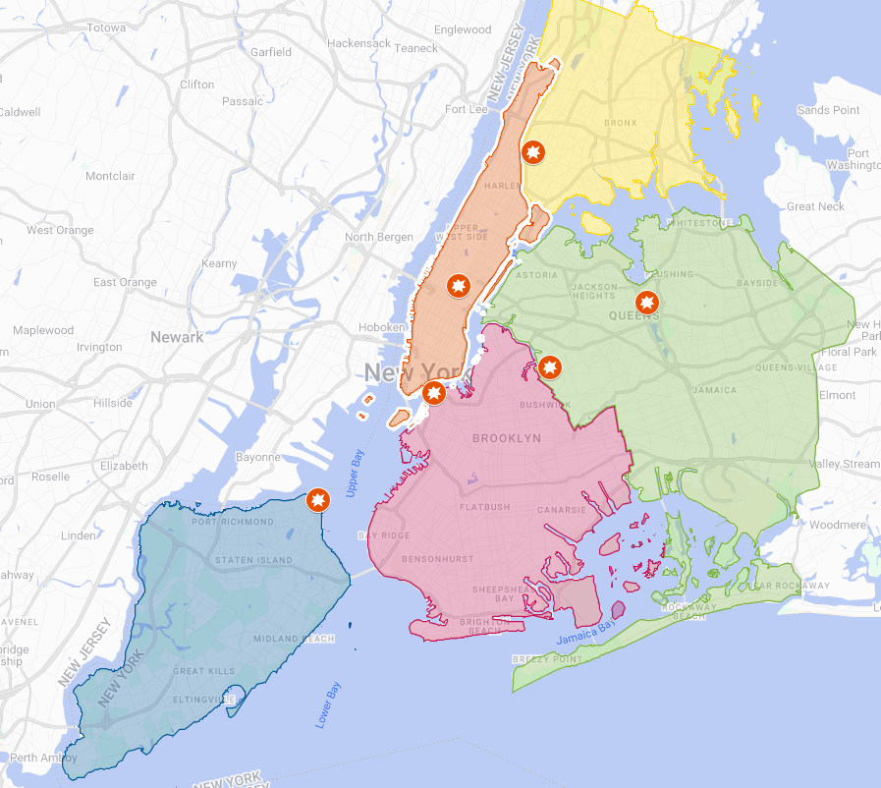
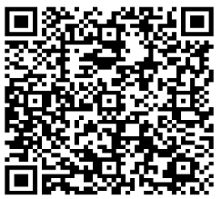
New York City MRSE – April 20-24, 2026
Pre-STARTEX Scenario Update – Saturday, July 5, 2026 – 12 PM
EXERCISE…Amidst a heat wave in New York City, breaking news of multiple, coordinated incidents are unfolding tied to the FIFA World Cup, Sail 250, and July 4th events…early reports indicate thousands of spectators and attendees may be injured, with an estimated 3,000 patients surging into healthcare facilities citywide…numerous fatalities have also been reported…officials are continuing to assess the situation as it develops… stay tuned for updates on this developing situation…EXERCISE
Scenario Locations
Manhattan – FIFA Fan Experience Zone @ Rockefeller Center Active Shooter Brooklyn – Tall Ships @ Brooklyn Bridge Park Vehicle Ramming and Active Shooter Queens – FIFA Fan Fest @ Billie Jean King Tennis Center Active Shooter Queens – FIFA Party @ Knockdown Center Explosives and Fire Bronx – Yankee’s Game @ Yankee Stadium Crowd Stampede due to reported incident Staten Island – FIFA Fan Fest @ SI Ferryhawks Stadium Active Shooter
Process for Hospital Gameplay
Hospitals and Health Systems will follow this guidance and complete between April 20-23 (for use during participation on April 24): Obtain Hospital Census (System)* ↓ Evaluate Rapid Discharge Abilities (Locally) ↓ Receive, Triage, and Disposition Surge of ED Patients (Locally) ↓ Health Systems: Load-balance between hospital facilities ↓ Determine transfer needs or excess capacity availability (System) *Census should be a snapshot of your hospitals at 11 AM on April 20. Census will be utilized for the entire duration of exercise play.
Assumptions & Out Of Play
GNYHA Convened Chief Executives Players have been empowered by their leadership on patient transfer decisions. Staff Travel Mass transit is running and driving is permitted with a valid hospital ID, as per NYPD. Ambulance Movement Ambulances can cross boroughs via roadway (except for Brooklyn Bridge); patients can be transferred; patients can be discharged. Mass Decontamination Out of play for the MRSE; only bed capacity, coordination, and transfers are being tested.
Feedback Survey
Exercise Scenario
For Training
Purposes Only

Slide 74
Questions?
Jade Smart
NYC DOHMH
jsmart@health.nyc.gov
Asad Ghafoor
NYC DOHMH
mghafoor@heath.nyc.gov
Andrew Dahl
GNYHA
adahl@gnyha.org

Slide 75

From Preparedness to Recovery: Empowering Communities at Every Phase of the Disaster Lifecycle

Slide 76

AGENDA
Introduction:
Enhancing long-term emergency planning and fostering collaboration between public health organizations and the community throughout the disaster lifecycle.

Slide 77

THE POWER OF being invited to the table

Slide 78

Create inclusive spaces
Start with listening – Before setting an agenda, understand the community’s needs, concerns, and aspirations. This builds trust and ensures the conversation is relevant
Share power, not just information – Involve community members in decision-making, not just in feedback sessions. Give them real influence over outcomes.
Celebrate diversity of perspectives – Encourage participation from people with different backgrounds, experiences, and expertise.
Follow through – show how community input shapes actions. This reinforces trust and keeps people engaged.

Slide 79
The disaster lifecycle
Mitigation – focuses on reducing loss of life and property by minimizing the impact of disasters and emergencies. It involves actions to prevent emergencies, decrease their likelihood, and lessen damage from unavoidable events.
Preparedness – is an ongoing cycle that involves planning, organizing, training, equipping, exercising, evaluating, and making necessary corrections.
response – This phase refers to the actions taken during a catastrophic disaster or emergency. Its primary goals are to save lives, minimize economic losses, and mitigate the long-term impact of emergencies. This phase involves coordinating and managing resources using the Incident Command System.
Recovery – involves actions taken after an emergency to restore essential community functions and stabilize the area. It begins once the immediate threats to life have passed. The main goal is to return the affected area to normalcy by restoring basic services and repairing damage.
Notes:
Mitigation Examples - The establishment of building codes and zoning requirements or the creation of defensible space around homes to protect them from wildfire are examples of mitigation efforts.
Preparedness Examples - Training and exercise plans are fundamental to preparedness, focusing on ensuring readiness to respond to all types of hazards, incidents, and emergencies. These plans enhance a community’s capacity to effectively respond when a disaster occurs. Typical preparedness measures include developing mutual aid agreements and memorandums of understanding, training response personnel and concerned citizens, conducting disaster exercises to reinforce training and assess capabilities, and implementing all-hazards education campaigns.
Response Examples – Response actions may include activating the emergency operations center, evacuating at-risk populations, opening shelters and providing mass care, delivering emergency rescue and medical assistance, firefighting, and conducting urban search and rescue operations.
Recovery Examples - Key recovery activities include removing debris, providing financial assistance, rebuilding infrastructure, and caring for displaced people and animals.

Slide 80

ENGAGING THE Community
In 2015, the Health Department’s Office of Emergency Preparedness and Response established the Community Preparedness Program (CPP) to recognize the vital role CFBOs play during emergencies.
The CPP adopts a sector-based strategy, concentrating on 3 of the 11 sectors recommended by the Centers for Disease Control (CDC): Human Services, Faith-Based Organizations, and Community Leadership, to enhance Public Health Emergency Preparedness (PHEP) capabilities tailored to community readiness and recovery.
Since the launch of the CPP, various emergency planning strategies have been implemented. By empowering sectors such as human services, faith-based organizations, and community leadership—who collaborate closely with community and faith-based organizations (CBFOs) as well as hyperlocal Community Emergency Networks (CENs)—public health organizations can better support essential partners in emergency preparedness, response, and recovery. This collaboration strengthens the response capabilities of CFBOs and helps reduce the long-term health impacts on communities that are disproportionately affected by disasters.
Notes:
11 Sectors
Businesses
**Community Leadership**
**Cultural and Faith-based**
Education and Childcare settings
Emergency Management
**Healthcare**
Housing and Sheltering
Media
**Mental/Behavioral Health**
**Human Services/Social Services**
Senior Services

Slide 81
mitigation
Provide long-term funding to support sectors that engage with Community and faith-based organizations.
Allocate dedicated personnel and resources to support emergency planning that focuses on long-term community needs.
Establish emergency response contracts that facilitate rapid integration of CFBOs during ICS activations.
Redesign preexisting government contracts with CFBOs to include emergency response objectives.

Slide 82
Preparedness
Fund sectors to prepare CFBOs for emergency response.
Implement bi-directional feedback models to integrate community-driven solutions into preparedness and response.
Integrate a Community Engagement Emergency Response Group within public health incident command structures.
Create a framework to integrate community recovery strategies into post-emergency programming.

Slide 83
recovery
Incorporate community recovery strategies into all public health programs that engage with the community.
Provide funding to help affected communities recover and address historical health inequities exacerbated by public health emergencies.

Slide 84
response
Activate Community Engagement Emergency Response Group.
Collaborate with CFBOs during emergencies to enhance city-wide disaster response.
Leverage pre-established CFBO contracts during emergency activations.
Begin community recovery planning to ensure a seamless response after ICS deactivation.

Slide 85
The power of inclusion
The power of including community partners in emergency planning throughout the disaster lifecycle leads to diverse, engaged, and thriving partnerships united by a common goal to mitigate the long-term impact of disasters on NYC residents. It is not just a moral imperative; it is a driving force for successful emergency planning across sectors.

Slide 86

THANK YOU
Lou Rivera, MPA – Director of Community Engagement & Response
DOHMH – Office of Emergency Preparedness & Response, Bureau of Healthcare and Community Readiness
646-799-4740
lrivera10@health.nyc.gov

Slide 87
H5N1 Supplemental Activities
Mary Foote, MD, MPH, FIDSA March 2026

Slide 88
Overview
Related to H5N1 and emerging respiratory pathogens preparedness and response:
Design a deliverable to address facility-specific needs related to emerging respiratory pathogen preparedness and response
Participate in and complete a mystery patient drill (MPD)

Slide 89
Activity 1: Design a Deliverable around emerging respiratory pathogen preparedness and response
Example activities:
Develop or conduct frontline staff training on how to identify, isolate, and inform for novel flu
Laboratory support initiatives or purchases
Isolation pod purchases
Other activities related to H5N1 and emerging respiratory pathogen preparedness

Slide 90
Activity 2: Avian Flu Mystery Patient Drill
Overview
Partnership with the Bellevue/Region 2 RESPTC to conduct standardized avian flu drills at clinical sites across HHS Region 2 (NYC, New York, New Jersey, and USVI)
Similar to previous citywide drills conducted in 2015 (Ebola/measles) and 2019 (MERS)
Goals
To help sites assess the ability of hospitals and clinics to rapidly and safely identify, isolate, and inform when a patient presents with potential Avian Flu (H5N1)
To provide actionable feedback via an after-action report

Slide 91
Mystery Patient Drill Cont.
One drill per facility
If no ED, we can coordinate with you on alternate drill site/activity
A trained standardized patient will conduct drill
ExPlan with EEG will be provided to “trusted agent” (generally EPC), prior to drill
After the drill, vendor* will provide you with an AAR
Deliverable
Coordinate with vendor to schedule drill at preferred time/date
Be available by phone during scheduled date/time
Submit completed improvement plan to DOHMH for each AAR for payment
*Program for Medical Education Innovation and Research (PrMEIR) at NYU Grossman School of Medicine (NYUGSOM)

Slide 92
Nuts and Bolts
Contract amendment should be sent out shortly
Submit Design a Deliverable proposals and deliverable documentation to Summer Williams swilliams15@health.nyc.gov
For questions/concerns re. Mystery Patient Drill activity, contact Mary Foote mfootemd@health.nyc.gov and Nang Kyaw nkyaw@health.nyc.gov
Questions?

