Slide 1
FIFA World Cup Updates
April 7, 2026

Slide 2
FIFA: Three Areas of Focus
Planning
Situational Awareness
Preparedness

Slide 3
Planning Coordination
NYCEM Interagency Steering Committee Call
Biweekly
EOC activation for FIFA World Cup and summer events
FIFA NYC Health & Medical Steering Committee
FIFA and Sail250 planning updates
FIFA Medical and Public Health Workgroup
Joint briefings for NY and NJ

Slide 4


Situational Awareness
FIFA World Cup Digest
  Periodic summary of FIFA-related items of interest
FIFA World Cup Update
  Specific updates on single topics
GNYHA Website
  FIFA World Cup – GNYHA

Slide 5
Preparedness
In-person half-day hospital summits
Topics relevant to FIFA preparedness activities
Agenda
  Educational portion
  Facilitated discussion
Tentative Date | Topic | Contact
May 20 | Burn | Nicole Ziogas
May 27 | Mass Decontamination | Lisa Fenger
TBD | Trauma | Andrew Dahl

Slide 6
Thank you
Andrew Dahl​
Vice President, Emergency Preparedness and Response​
Phone: 212-258-5314​
Email: adahl@gnyha.org​
​
Lisa Fenger​
Assistant Director, Emergency Preparedness and Response​
Phone: 212-506-5432​
Email: lfenger@gnyha.org​
​
Nicole Ziogas​
Assistant Director, Emergency Preparedness and Response​
Phone: 212-554-7728​
Email: nziogas@gnyha.org​

Slide 7
Medical Surge and Response Exercise
Annual EM Conference
April 7, 2026

Slide 8
Overview: MRSE Exercise Details
Functional Exercise testing a required 10% of licensed beds for surge of patients into our collective healthcare system
  Last year’s number was 1500 patients
  This year we will aim for 2500 to 3000 patients to better test to failure
ASPR requires key objectives:
  Information Sharing & Communication
  Resource Needs (supplies, equipment, EMS)
  Patient Distribution/Bed Types
  Successful Coordination

Slide 9
Coalition Objectives
Objective #1: Demonstrate and educate hospitals and partners on the initial response for ESF-8 and hospital notification.
  How we intend to achieve this:
    Mock NYCEM led ESF-8 call
  Hospital Ask
    Attend and observe call for situational awareness and learning
Objective #2: Test the NYC HCC response to mass casualty incident in accordance with facility mass casualty plans and in coordination with OCME.
  How we intend to achieve this:
    Scenario Complexities
      6 incidents, coordinated attacks
      Incidents across all 5 boroughs
      Greater patient counts than last year
  Hospital Ask:
    Play as realistically as possible after the April 20th call
    Use patient manifests to test internal mass casualty plans and other necessary protocols

Slide 10
Coalition Objectives
Objective #3: Assess transportation capacity through engaging vendors and internal resources to understand gaps.
  How we intend to achieve this:
    Transport questions to be included in the patient intake and load balancing portion between parts 1 and 2
  Hospital Ask:
    Hospitals should contact contracted vendors with their patient transfer needs and establish a delta of resources still needed to share for evaluation purposes
    Hospitals should ask vendors to project availability for July 5th, 2026 specifically given some resources may be deployed for other large-scale events at this time
Objective #4: Examine effectiveness of inter-hospital coordination, including transfer needs and load-balancing strategies through the Hospital Coordination Call
  How we intend on achieving this:
    Coordination via the Hospital Coordination Call
    Visual Dashboard of reported census and patient intake information due April 23rd EOD
  Hospital Ask:
    Load balancing and transfer needs to be determined prior to Hospital Coordination Call (April 24th)
Notes:
Objective 4 up for debate. Urgent care and nexus of that, patient load and patients out more quickly to connect with LTC

Slide 11
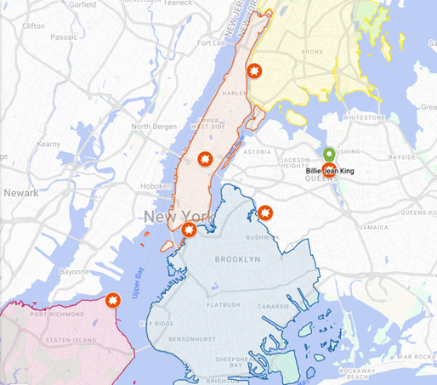
Scenario
July 5th, FIFA World Cup, Sail 250, International Naval Review, post 4th of July madness, Yankees home game
  Incident 1: Rockefeller Center Fan Village
  Incident 2: Brooklyn Bridge Park/DUMBO
  Incident 3: Billy Jean King National Tennis Center
  Incident 4: Yankee Stadium
  Incident 5: Ferryhawks Stadium
  Incident 6: Knockdown Center
Other scenario details
  Heat Advisory issued through the 2000 HRS today.
    Max Heat Index: 96
    Max Temp: 92
  42nd Street closure river to river
  5th and 6th Avenue closure
  Lincoln tunnel potential closure

Slide 12
Patient Count and Breakdown
Target Number from Guidance: 2500-3000 patients​
  Distributed from six target sites​
Patients will be distributed amongst HCC facilities with consideration to incident locations
  Red and Orange patients would come off scene within one hour​
  Yellow and Green patients within two hours​

Slide 13
Key Dates and Gameplay
April 20 (11am – 12pm)
Part 1
Scenario Briefing (ESF – 8 Command Element Call)
3.5 days to complete internal tasks
April 24 (10am – 12pm)
Part 2
Hospital Operations Coordination Call
2-hour, hybrid exercise
April 24 – May 1
Part 3
Post-exercise survey
9 days to complete
Complete Part 1 Survey

Slide 14
Part 1: April 20 to April 24
Game Time: July 5, 2026, incident occurs at 4:00pm
  Call occurs +90 minutes of incident – Game time: 5:30 pm
Real Time Activity: April 20, 11am via Zoom (30 minutes)
  “Fishbowl Webinar”, Intended to be scenario introduction and education on process
  Lead by NYC Emergency Management
  Involves: NYCEM, DOHMH, OCME, FDNY, GNYHA, H+H
Asynchronous, internal gameplay: 3.5 days to accomplish tasks
Key Tasks
Evaluate Census and Rapid Discharge Patients in Anticipation of Surge
Receive, Triage, and Disposition Surge of ED Patients (local)
Determine transfer needs or excess capacity availability
Outputs of Part 1
Completed Survey with bed capacity, needs for transfers, bed availability, transfer capabilities
Notes:
Hospitals to receive Patient Manifest

Slide 15
Part 2: April 24
Hospital Coordination Call
Game Time: July 5th, 2026, 10:00pm
Real Time Activity: April 24, 10:00am, Zoom (2 hours)
  Health System & Independent Hospital Representatives: Patient Placement, Clinical Leader, Emergency Management Leader
  We request a single speaker for reporting out
Key Tasks
Agency situation update
Hospitals outline needs for admitted patient placement
Hospital discuss capacity for transferring patients in
Recognize any outstanding needs

Slide 16
Part 2: Hospital Coordination Call
Health Systems:
  Systems must designate a key representative from their clinical leadership, bed placement/transfer center, and emergency management​
  Other representatives may listen-in and provide clarifying context​ to colleagues
Independent Hospitals:
  Must designate same key representatives​
While there may be three representatives to support the various operations, only one will report out on patient transfer needs
All other entities will be invited to observe virtually

Slide 17




New York City Health Care Coalition
Medical Response & Surge Exercise (MRSE) 2026 FIFA World Cup, Sail 250, America 250
In Partnership
Monday, April 20, 2026 – Friday, April 24, 2026
This year’s MRSE will leverage a complex coordinated attack scenario related to the upcoming FIFA World Cup, International Naval Review (INR), and America 250 celebrations. This exercise will produce thousands of patients, forcing hospitals to triage and treat patients, and evaluate needs for resources and patient transfer.
“Real-World” Date & Time | Activity | Key Tasks | Gameplay Date & Time
April 20 10:30 AM | Mass Notification Alerts Sent | Receive Alerts and Ready your Teams Pull initial census data for gameplay | July 5 3 PM
April 20 11 AM – 12 PM | STARTEX NYC Health & Medical ESF-8 Leadership Call | Listen to ESF-8 report-out. Receive Scenario Details | July 5 4 PM
April 20 – April 23 | Hospitals Work On Key Tasks | Perform Rapid patient discharge Receive Patient Manifest Triage & Disposition Patients Load-balance patients between facilities (if applicable) Work with your transportation assets for transfers Submit census data and identified transfers to survey by 4pm on April 23 | July 5 1:15 PM – 6 PM
April 24 10 AM – 12 PM | Hospital Coordination Call ENDEX | Gather teams into a “conference room” and login to the Hospital Coordination Call with one identified spokesperson Report-out on facility transfer needs for capacity Discuss transfer needs and work collectively to determine patient placement Participate in post-gameplay Hotwash | July 5 6 PM – 8 PM
April 24 – April 28 | Complete & Submit MRSE Survey & Forms | Complete post-exercise survey and feedback survey Participate in After-Action Meeting | N/A

Slide 18
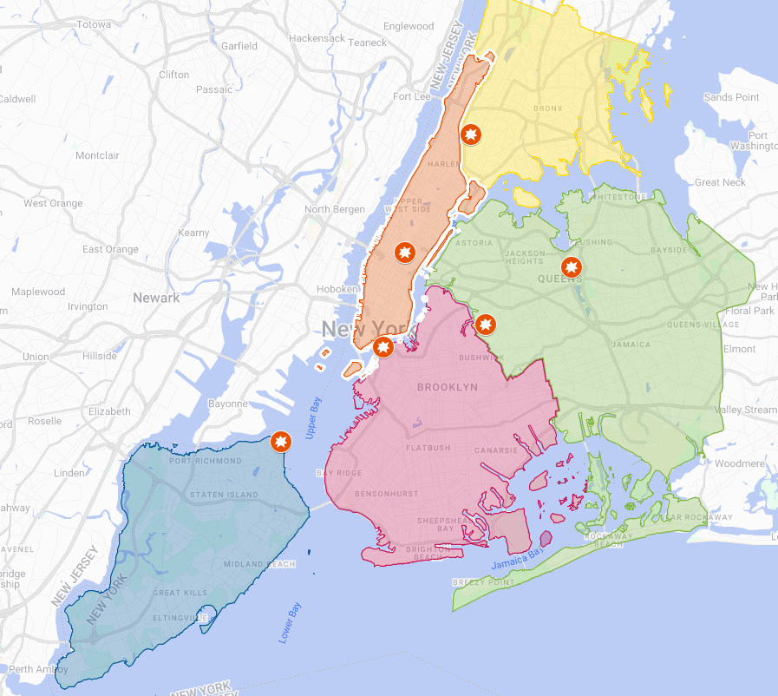
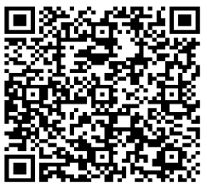
New York City MRSE – April 20-24, 2026
Pre-STARTEX Scenario Update – Saturday, July 5, 2026 – 12 PM
EXERCISE…Amidst a heat wave in New York City, breaking news of multiple, coordinated incidents are unfolding tied to the FIFA World Cup, Sail 250, and July 4th events…early reports indicate thousands of spectators and attendees may be injured, with an estimated 3,000 patients surging into healthcare facilities citywide…numerous fatalities have also been reported…officials are continuing to assess the situation as it develops… stay tuned for updates on this developing situation…EXERCISE
Scenario Locations
Manhattan – FIFA Fan Experience Zone @ Rockefeller Center Active Shooter Brooklyn – Tall Ships @ Brooklyn Bridge Park Vehicle Ramming and Active Shooter Queens – FIFA Fan Fest @ Billie Jean King Tennis Center Active Shooter Queens – FIFA Party @ Knockdown Center Explosives and Fire Bronx – Yankee’s Game @ Yankee Stadium Crowd Stampede due to reported incident Staten Island – FIFA Fan Fest @ SI Ferryhawks Stadium Active Shooter
Process for Hospital Gameplay
Hospitals and Health Systems will follow this guidance and complete between April 20-23 (for use during participation on April 24): Obtain Hospital Census (System)* ↓ Evaluate Rapid Discharge Abilities (Locally) ↓ Receive, Triage, and Disposition Surge of ED Patients (Locally) ↓ Health Systems: Load-balance between hospital facilities ↓ Determine transfer needs or excess capacity availability (System) *Census should be a snapshot of your hospitals at 11 AM on April 20. Census will be utilized for the entire duration of exercise play.
Assumptions & Out Of Play
GNYHA Convened Chief Executives Players have been empowered by their leadership on patient transfer decisions. Staff Travel Mass transit is running and driving is permitted with a valid hospital ID, as per NYPD. Ambulance Movement Ambulances can cross boroughs via roadway (except for Brooklyn Bridge); patients can be transferred; patients can be discharged. Mass Decontamination Out of play for the MRSE; only bed capacity, coordination, and transfers are being tested.
Feedback Survey
Exercise Scenario
For Training
Purposes Only

Slide 19
Questions?
Jade Smart
NYC DOHMH
jsmart@health.nyc.gov
Asad Ghafoor
NYC DOHMH
mghafoor@heath.nyc.gov
Andrew Dahl
GNYHA
adahl@gnyha.org

Slide 20
NYCHCC
Strategic Plan Implementation
Conference Update
April 07, 2026
Office of Emergency Preparedness and Response
Bureau of Healthcare and Community Readiness
Healthcare Systems Readiness Unit

Slide 21
HPP Funding & New Executive Director
HPP BP3 Continuation Guidance received from ASPR on Monday, 3/23
Workplan (including budget) due May 8th
Level funding ~ $7.2M
Hired in February and processing
NYC HCC Strategic Plan
Sent to NYCHCC on 3/6/26
2 documents:
  Strategic Plan – covers background and methodology of how it was developed
  Implementation Plan – Provides roadmap of specific activities and recommendations to further develop the NYC HCC over the coming years
Held Governance Taks Force Kickoff meeting on Wed, March 25th

Slide 22
Strategic Plan: Short-Term Actions
  Priority 1: Clarify and Strengthen Coalition Coordination Structures
    Establish a Governance Task Force
    Finalizing information needed for BP3 application, including task forces and budget
    Establish Governance Board, revamp HCC coordination mechanisms, and define roles & responsibilities across emergency management cycle
  Priority 2: Enhance Communications and Information Sharing
    Establish an Information Sharing Task Force
    Develop an Information Sharing Plan to standardize information sharing procedures
  Priority 3: Prepare for Emerging Threats and Hazards
    Identify priority vulnerabilities/hazards and integrate into preparedness activities
  Priority 4: Improve Resource Reallocation and Sharing Across Health Care Partners
    Establish a Resource Management Task Force
    Assess existing resource-sharing agreements, stockpiles, and coordination
    Develop a Resource Management Plan to formalize frameworks for reallocation, tracking, and distribution of critical health care resources
Notes:
Strategic Priority 5: Strengthen Administrative Sustainability doesn't have any short-term actions

Slide 23
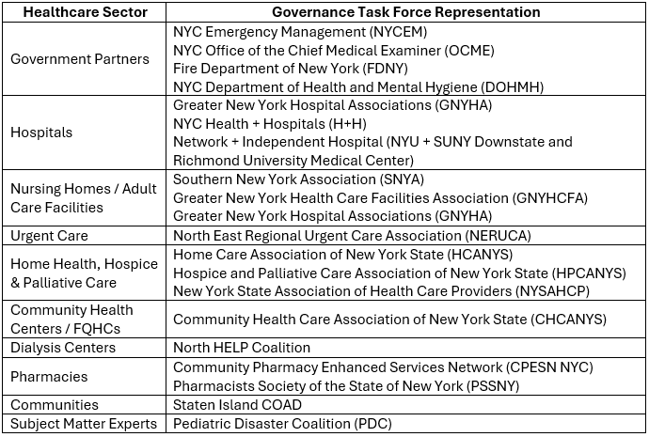
Governance Task Force Membership

Slide 24
Task Forces for BP3
  Established by Strategic Plan
  1) Governance Task Force
  Responsible for guiding the implementation of Strategic Priority 1 (Clarify and Strengthen Coalition Coordination Structures), including the Governance Board formation and charter update.
  2) Information Sharing, Tech & Comms Task Force
  Responsible for guiding the implementation of Strategic Priority 2 (Enhance Communications and Information Sharing), including developing the Information Sharing Plan and NYCHCC Comms protocols and drills.
  3) Resource Management Task Force
  Responsible for guiding the implementation of Strategic Priority 4 (Improve Resource Reallocation and Sharing Across Health Care Partners), including developing the Resource Management and Allocation of Scarce Resources Plans.
  Additional Task Forces (voted on by Gov TF)
  1) Event Planning Task Force
  Responsible for organizing three Coalition meetings, one conference, and other gathers, as determined by task force members. This task force replaces the Borough Coalition model.
  2) Training and Exercise Task Force
  Responsible for developing all Coalition trainings and exercises, as well as addressing workforce safety, resilience, and emergency readiness through the creation of reference materials for workforce trainings.
  3) Response Planning Task Force
  Responsible for developing coordinating medical surge support plans and supporting the implementation of action points under Strategic Priority 3 (Prepare for Emerging Threats and Hazards).

Slide 25
Task Forces Assignments
Approach Selected by Gov Task Force
HCC members are assigned to participate in 2-4 task forces (exact number TBD)
All HCC members will be asked (via survey) to:
  Select their 1st, 2nd, 3rd and 4th choice for task force assignments.
  Nominate representative(s) from their organization to participate in each task force, based on expertise needed.
  Governance Task Force finalizes assignments based on preference (where possible) and expertise, while considering diverse representation
  The Governance Task Force will also finalize a processes for:
  Regular HCC-wide updates on task force activities
  Ensuring all HCC members have opportunities to provide feedback on task force outputs

Slide 26
Next Steps
Governance Task Force to meet again on 4/14 to discuss our BP3 budget
Task Force Assignment Survey following above
Future Governance Task Force Meetings:
  Define how task forces will function (internal structure, meeting frequency, roles and responsibilities, report outs to full HCC, SOWs for each task force)
  Review and update 2019 NYCHCC Coalition Charter (current coalition coordination mechanisms and decision-making pathways)
  Re-establish Governance Board (clarify authorities, streamline coordination, and strengthen alignment with NYC’s emergency management framework )
Governance Task Force will disband and be replaced by a permanent Governance Board
Notes:
Wrap up, next steps, and next meeting

Slide 27


The Emergency Management Evolution of Hospice and Palliative Care in the NYC Region:
From Passive Observation to Full Participation
NYCHCC Annual Emergency Management Conference
April 7, 2026

Slide 28
Presenters:
Jeanne Chirico, MPA President and CEO
Eva Cohen, BSW
Director of Regulatory and Community Affairs

Slide 29

What We Do and Why It Matters
What We Do
Hospice = end-of-life, interdisciplinary, comfort-focused care
Palliative care = symptom management at any stage of serious illness
Delivered where patients live: home, nursing homes, assisted living, hospitals, free standing General In-Patient and/or Residential hospice facilities.
Why This Matters
Reduce unnecessary hospital utilization
Provide psychosocial, spiritual, and bereavement support
Hospice patients are among the most vulnerable during crises
Community-based providers are critical to system resilience

Slide 30
Who We Are:
NYC Footprint
Calvary Hospice | Bronx, Kings, Nassau, New York, Queens, Rockland, Westchester
Caring Hospice | Kings, Queens
Hospice of New York | Bronx, Kings, New York, Queens,
Jansen Hospice and Palliative Care | Bronx
MJHS Hospice and Palliative Care, Inc. | Bronx, Kings, Nassau, Queens, New York
Northwell Health -Staten Island University Hospital Hospice -Hospice Care Network (HCN) | Richmond, Kings Suffolk, Nassau, Queens
VNS Health VNSNY Hospice and Palliative Care | Bronx, Kings, New York, Queens, Richmond

Slide 31
The 5-Year Evolution
Observation
Understanding
Direction
Integration
*Leadership
*ongoing

Slide 32
Where It All Began
Early State
Limited visibility in emergency management
Participation largely observational
Focus on:
Learning emergency management language and acronyms
Understanding structures
Identifying where hospice fits
Key Insight
“We had a seat in the room—but not yet a defined role.”

Slide 33
BP4: July 1, 2022 – June 30, 2023
Hospice & Palliative Care Emergency Preparedness Capacity Assessment
Identification of provider strengths and gaps
Results used to guide future deliverables
Coalition meetings and early LTCExP exposure

Slide 34
BP5:
July 1, 2023 – June 30, 2024
Emergency Preparedness Fall Forum
Reviewed Results of NYC hospice & palliative care capacity survey
Introduced topic of home visitor safety to providers
First hospice‑specific discussion‑based exercise introduced
Emergency Preparedness Spring Forum
Review of NYS DOH Emergency Preparedness Regulations (Carla Braveman)
Reviewed Inaugural Tabletop (TTX) for Hospice & Palliative Care Providers (Pat Anders)
Promoted Webinar: Optimizing Safety of Home Visiting Staff (RBC)
Additional activities:
LTCExP participation
NYCHCC & ESF‑8 meetings
NYCHCC Annual Emergency Management Conference (virtual)

Slide 35
BP1: July 1, 2024 – June 30, 2025
Joint Home Care and Hospice Associations Emergency Management Forums
Fall: Value of Cross‑Sectional Partnerships
  (SI COAD)
Spring: Cybersecurity expert panel
Cybersecurity Partner panelists included:
VNS Health
OneGroup
Custom Computer Specialists
CISA
RBC Consultants
Master Exercise Practitioners

Slide 36

BP1: Systems, Data & Exercises
Enhanced cross‑sector communication through web integration
Review and update of:
  HCS emergency contacts
  HPCANYS Emergency Management manual contact list
Data married and entered into HPCANYS electronic platform
Merged contact list shared with NYC DOH for improved communication
NYC DOH‑sponsored Long Term Care Functional Exercise (LTCExP)
Attended (in-person) Annual NYCHCC Emergency Management Conference

Slide 37
BP2: July 1, 2025 – June 30, 2026
Focus Areas
Infectious disease readiness
PPE protection and workforce safety
Exercise designed by and for hospice and palliative care providers
Strengthened partnerships across ESF‑8 and emergency management PARTNERS

Slide 38
BP2: Emerging Infectious Disease Toolkit
Identify • Isolate • Inform
Toolkit Webinar One
Introduction to the National Special Pathogen System (NSPS)
Overview of emerging infectious diseases
Toolkit Webinar Two
Best Practices Virtual Panel
MJHS, Northwell, HCN, Calvary, Buffalo
Industry resource links
Provider‑shared downloadable tools

Slide 39
BP2: Engagement & Forums
Joint Associations Fall Forum
NYCEM Part One: Community Engagement Bureau:
Integration with the Home Care and Hospice sectors
Joint Associations Spring Forum
NYCEM Part two: Response, Planning, and Resilience Bureau-Health and Medical Unit:
NYCHCC & ESF‑8 meetings
Preparing and Responding to Incidents that Impact the Home Care and Hospice sectors

Slide 40
BP2: Workforce Protection Initiatives
N95 Mask Deliverable
Needs assessment
Purchase
Distribution based on assessed need
N95 Fit Testing: Train‑the‑Trainer
Needs assessment
Vendor identification
Training sessions tailored to provider needs

Slide 41

BP2: Exercises & Capacity Building
Discussion‑Based Exercise: Operation Novel Plan
  April 30, 2026
  Designed specifically for hospice & palliative care providers
  Collaborating with NSPS subject matter expert and IMS
Hospice & Palliative Care Bed Capacity Survey
Continued Meeting participation- NYCHCC and ESF‑8

Slide 42
Where We Are Now
Current State
Designing and leading hospice‑specific emergency initiatives
Key Insight
“We are no longer adjacent to emergency response—we are embedded within it.”

Slide 43

Lessons Learned
Emergency preparedness is a shared responsibility
Inclusion must be intentional
Hospice and palliative care providers bring unique value
Hospice multi-disciplinary teams are “boots on the ground” and knowledgeable about the neighborhoods they serve
Education and repetition builds confidence and strengthens Preparedness
Relationships improve Readiness
Collaborations expand Capacity
Emergency preparedness is a shared responsibility. Working together equals a coordinated, effective Response

Slide 44

Questions

