Slide 1
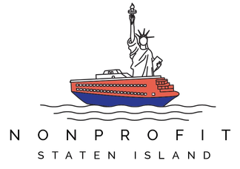
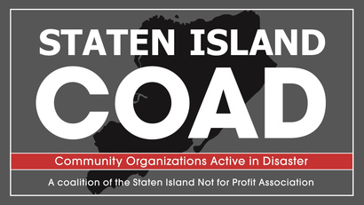


ADDRESSING CLIMATE IMPACTS ON PUBLIC HEALTH
FROM COMMUNITY CONDITIONS TO HEALTH SYSTEMS

Slide 2
THIS AFTERNOON’S DISCUSSION
1. Climate, Community & Health Systems (SI COAD)
Grounding in local impacts and coordination
2. Public Health Perspective & Initiatives (DOHMH)
Climate, health, and systems-level strategy
3. Community & Behavioral Health (PCW)
Lived experience and SDOH impacts
4. System Stress Test (Medical Ecosystem)
Winter storm response + key takeaways
5. Looking Ahead
Where we’re focusing as a coalition
Notes:
“We’ll start with what we’re seeing locally across climate, community, and health systems—then move into public health, community experience, and a real-world example of how this plays out under stress, before closing with where we’re headed.”

Slide 3
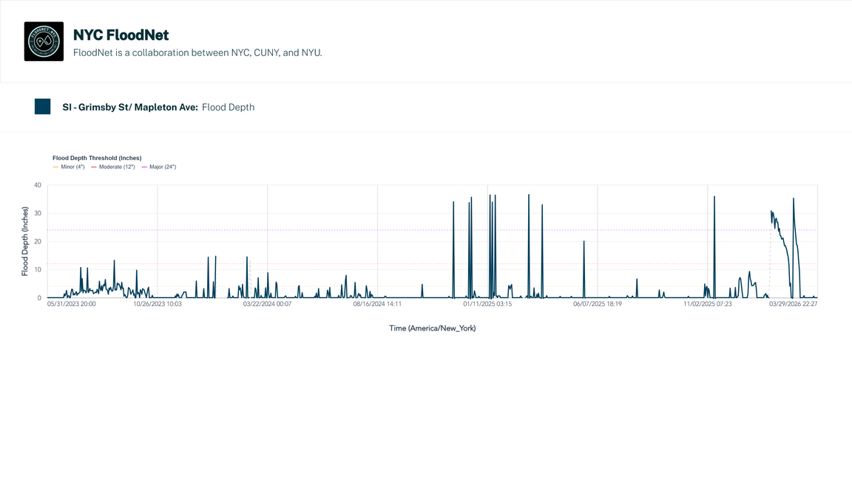
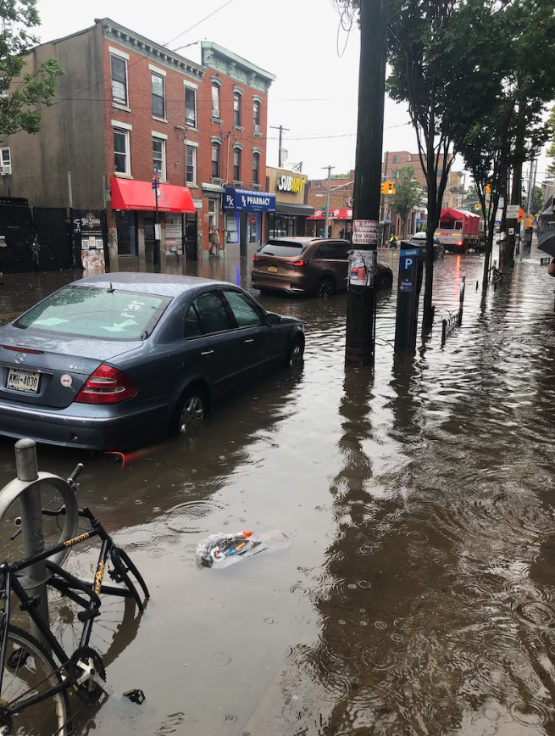
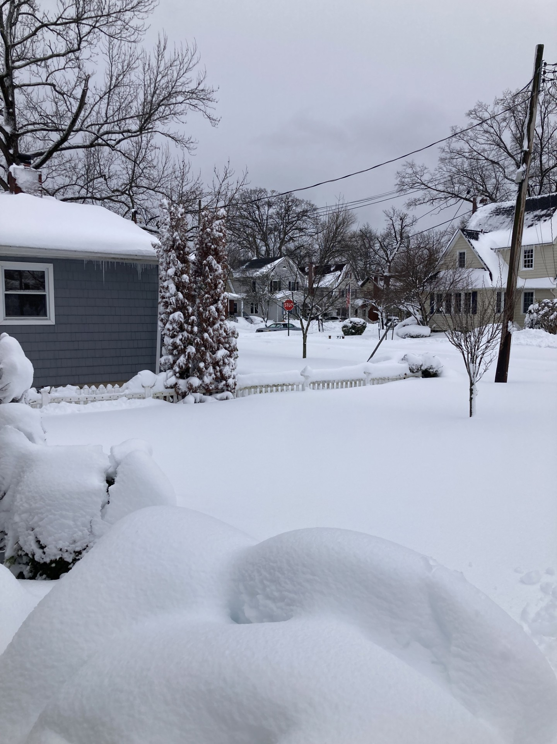
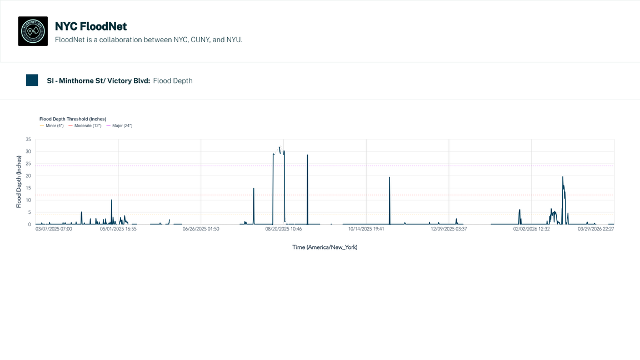
  Extreme temps → older adults, chronic conditions, isolation
  Air quality → asthma, respiratory strain
  Flooding → housing damage → mold exposure
  Storms → disrupted care, missed treatment, mobility issues
CLIMATE IMPACTS IN COMMUNITY.
Notes:
Across Staten Island, we’re seeing:
extreme temperature events directly impacting older adults and those with chronic conditions, especially when isolation is a factor (may be under-resourced, unaware of resources available);
air quality issues and alerts with increasing frequency, exacerbating asthma and other respiratory issues (which my colleague Adrienne is going to talk a bit more about...);
flooding that leads to housing damage, which leads to longer-term concerns;
and storms that disrupt access to care—whether that’s missed appointments, delayed treatment, or mobility challenges.
...and of course there are mental health implications across the board. increased anxiety, increase in economic pressure...
So climate isn’t sitting in a separate category—it’s actively driving health outcomes and influencing how and when people access care.
When we zoom in locally, those impacts become very specific.
During extreme heat or cold, we still see gaps in access to available spaces and overlooked accessible and trusted by the people who need them.
These aren’t isolated issues—they’re patterns. And they’re shaping health in very real ways.
We’re seeing flooding that isn’t always fully captured in official reporting—but we’re hearing about it directly from residents and partners, and increasingly through tools like FloodNet.
That’s shifting how we think about downstream impacts—especially mold, and what that means for long-term respiratory health.
We saw snowstorms leave already-homebound seniors without their regular meal deliveries, public housing communities lose access to mobile pantries many depend on, IDD residences left on unplowed streets with staff snowed in for 36+ hour shifts and medically vulnerable residences no access to transport over that same time should it be needed.
We’re seeing mental health crises that surface during an extreme weather event where individuals may need to be transported off-island for care, which adds complexity and delay in general, but is that much more difficult with compromised transportation options

Slide 4
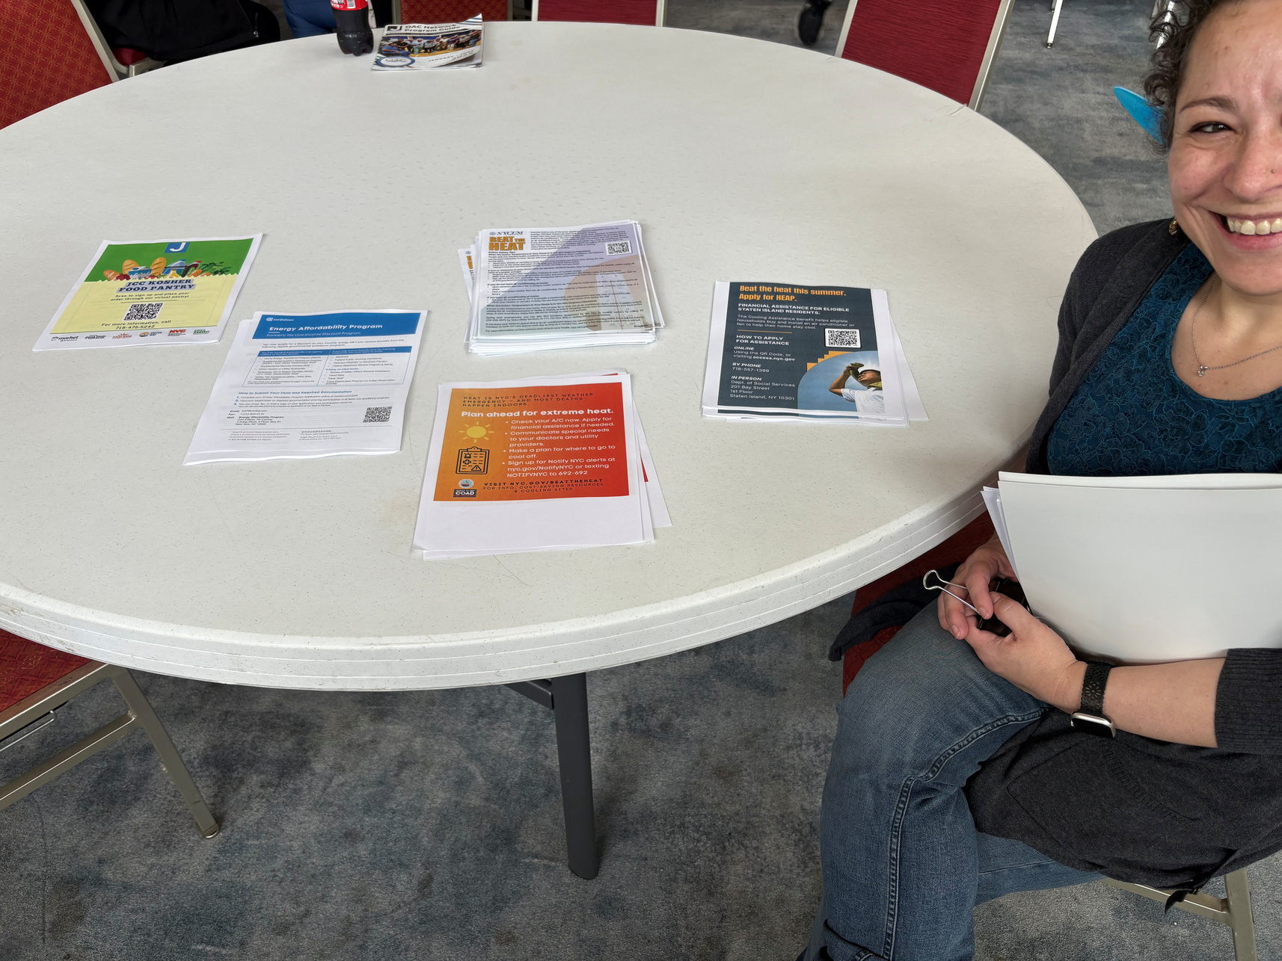
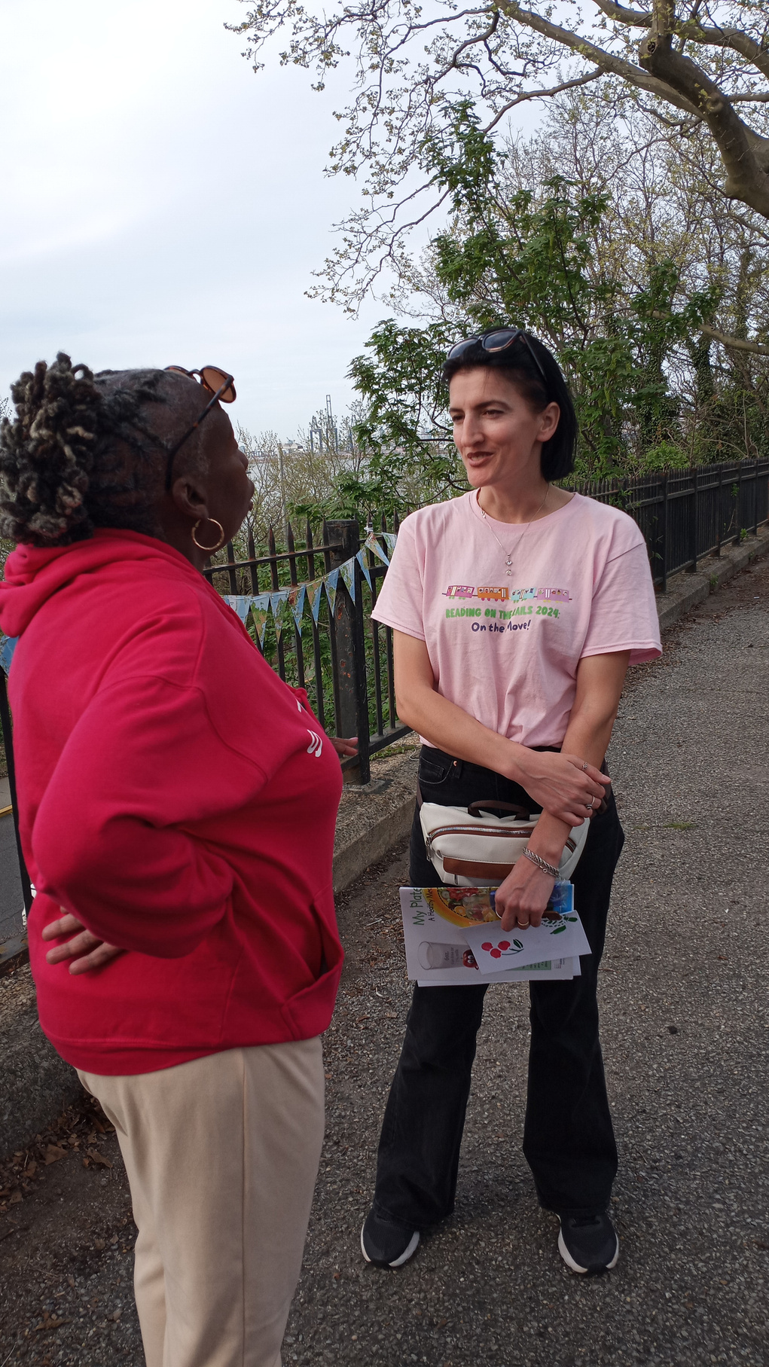
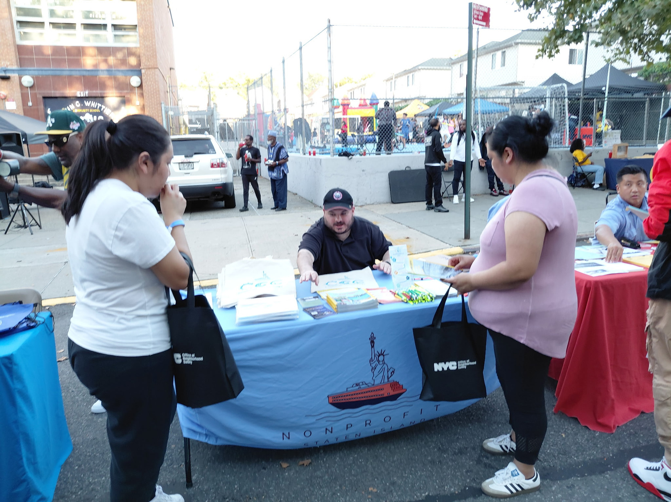
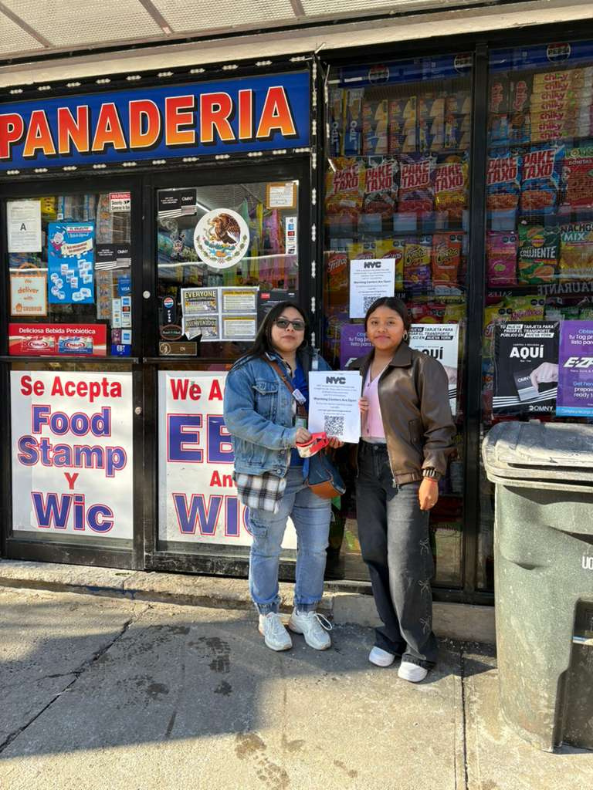
  Extreme temps → outreach, cooling access, trusted messengers
  Air quality → education, resource distribution, awareness
  Flooding → resident reports, emerging data (FloodNet), mold concerns
  Storms → coordination, access support, continuity of care
WE’RE NOT JUST PREPARING FOR CLIMATE CHANGE. WE’RE RESPONDING TO IT.
Notes:
This isn’t theoretical for us anymore—this is already shaping how people experience health day to day.
“So this is what response actually looks like for us on the ground.
It’s not just alerts or systems—it’s outreach, it’s conversations, it’s resource distribution, it’s coordination.
And importantly, it’s also how we’re learning—through residents, through partners, and increasingly through data—that helps us understand where impacts are deeper than what’s officially captured.”

Slide 5
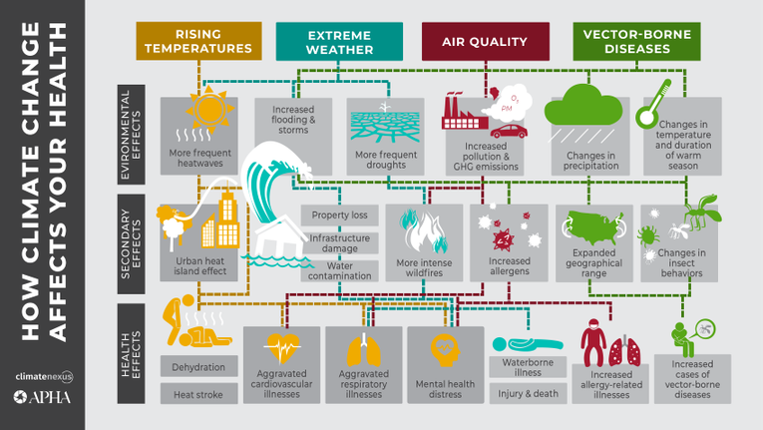
CLIMATE IMPACTS ARE SHOWING UP ACROSS HEALTH SYSTEMS
HOW THIS IS SHOWING UP
  Patients sometimes arriving later, with more complex needs
  Repeat visits tied to challenges not resolved upstream
  Behavioral health strain linked to instability + isolation
WHAT THIS TELLS US
  Observable patterns emerging; not one-off cases
  Many drivers sit outside the clinical setting
  “Non-medical” factors are influencing health outcomes
WHAT IT CREATES
  Added pressure across parts of the system
  Limits to what any one provider or sector can address alone
  A growing need for cross-sector coordination
“How Climate Change Affects Your Health“
American Public Health Association (APHA)
Notes:
“So if we step back from what we’re seeing in communities—
this is where it starts to show up across health systems.”
“Some of this may resonate more or less depending on where you sit—but these are the kinds of patterns we’re hearing from partners and paying close attention to.”
And:
“This isn’t to say we’re seeing uniform trends across the board—but these are signals that are worth paying attention to as conditions shift.”
Section 1:
“We’re seeing patients arriving later, often with more complex needs…
repeat visits tied to issues that aren’t actually resolved upstream…
and increasing behavioral health strain linked to instability and isolation.”
Section 2:
“And importantly, these aren’t isolated cases—they’re patterns.
Many of the drivers sit outside the clinical setting, but they’re shaping outcomes inside it.”
Section 3:
“What that creates is increased system strain—but also a limitation.
No one part of the system can address these issues on its own.”
👉 (small beat)
“Which is where coordination becomes really critical.”

Slide 6
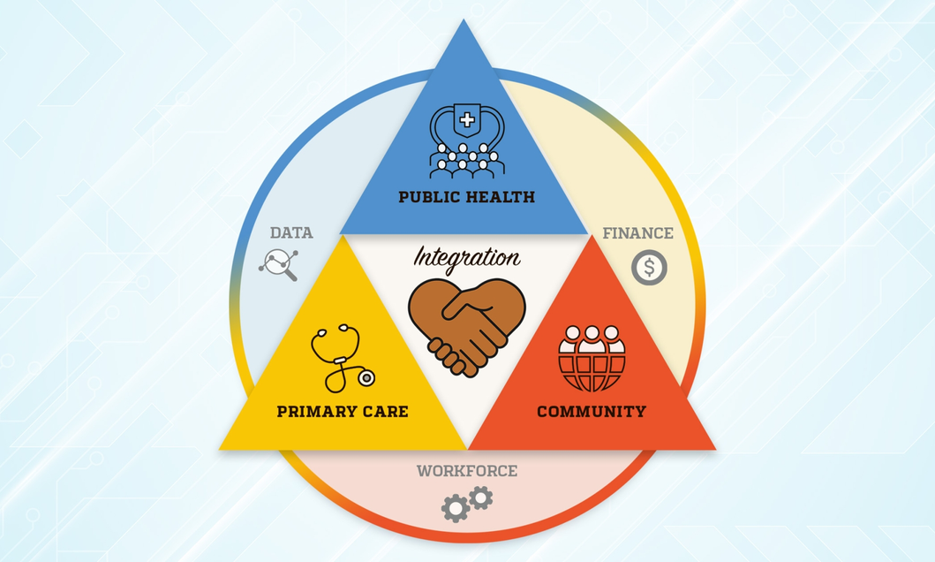
COORDINATION IS CARE
THE ECOSYSTEM RESPONDING IN OUR COMMUNITIES
  Community partners → early signals, trusted access, wrap-around/SDOH supports
  Healthcare systems → treatment, stabilization
  Public health → data, planning, scale
CHALLENGING REALITIES
  Information doesn’t move across systems
  Community conditions aren’t fully visible
  Response happens in silos
COORDINATION STRATEGIES
  Shared awareness across partners
  Clear communication pathways
  Relationships in place before crisis moments
“New policy analysis offers pathways for collaboration across primary care, public health, and community-based organizations”
John Hopkins Bloomberg School of Public Health
Notes:
“So if this is how climate impacts are showing up across health systems—
the question becomes: how do we actually respond to that effectively?”
“There’s a growing body of work that really emphasizes the need for stronger alignment across community-based organizations, healthcare systems, and public health…”
(quick gesture to visual)
“…and what we’re seeing locally is exactly why that matters.”
Section 1:
“Each part of the system plays a different role.
Community partners are often the first to see what’s changing.
Healthcare systems are where impacts become acute.
Public health helps us understand and scale response.”
Section 2:
“Where this gets challenging is in the gaps between those systems.
When information isn’t moving…
when community conditions aren’t fully visible…
when response is happening in silos…”
Section 3:
“What we’ve seen through COAD is that coordination is what actually connects those pieces.
It’s not just about response in the moment—it’s about having the relationships, communication, and shared awareness in place ahead of time.”
Closing line (important):
“And that’s really the role coalition-based work is trying to play.”

Slide 7
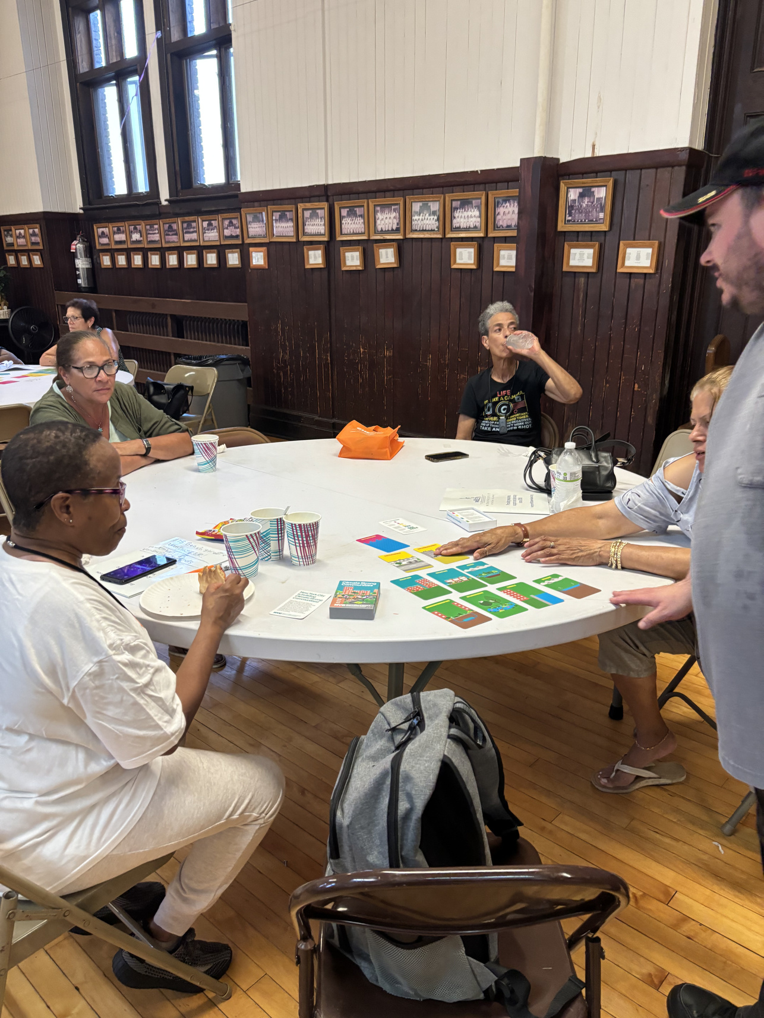
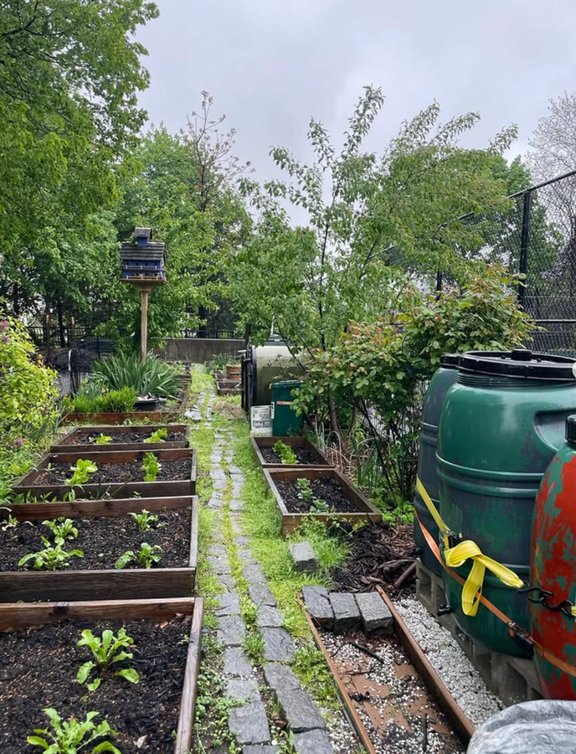
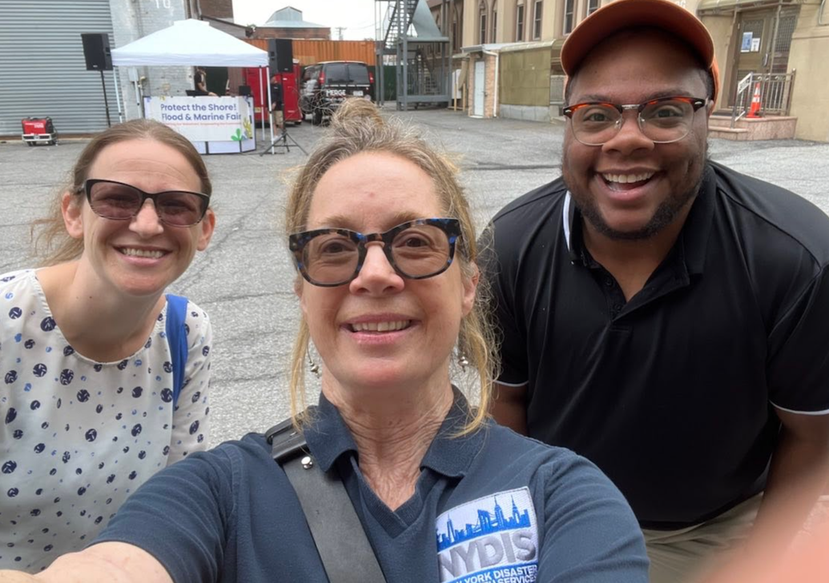

COORDINATION IN
ACTION
MAKING COMMUNITY CONDITIONS VISIBLE
CONNECTING COMMUNITY & CARE
WORKING ACROSS SYSTEMS
LEARNING & ADVANCING TOGETHER
  Direct outreach + resident conversations
  Real-time signals during activations
  Emerging data sources (FloodNet, community-informed insights)
  Partnerships addressing SDOH + behavioral health needs
  Alignment through Social Care Network + referral pathways
  Community-based outreach informing care and response
  Coordination with NYCEM, MOCEJ, city partners
  Cross-sector relationships (incl. utilities, business)
  Shared planning + response alignment
  Peer coalitions shaping climate + health work
  Housing, resilience, and community-led strategies
  Ongoing adaptation based on what’s working
Notes:
“So this is what that coordination starts to look like in practice.”
Block 1 — Making community conditions visible
“A big part of this work is simply making community conditions more visible—
in ways that systems can actually respond to.”
“That happens through direct outreach and conversations—
a lot of that through our Climate Corps—where we’re hearing directly from residents.”
“It also happens in real time during activations—
through COAD communications, partner reporting, and information sharing across the network.”
“And increasingly, through data—whether that’s tools like FloodNet
or other efforts to better capture what’s happening on the ground.”
👉 (This is where you can casually drop examples: cooling towels, pop-ups, etc.)
Block 2 — Connecting community & care
“We’re also seeing this work take shape through stronger connections between community and care.”
“That includes partnerships addressing things like food access, behavioral health, and other social drivers of health—
areas where climate impacts are showing up very directly.”
“Through efforts like the Social Care Network, there’s increasing alignment
and clearer referral pathways between community-based organizations and healthcare systems.”
“And importantly, community-based outreach is not just supportive—
it’s informing how care and response need to happen.”
👉 (You can nod to gardens, workshops, etc. here—lightly)
Block 3 — Working across systems
“At the same time, we’re continuing to strengthen coordination across systems—
working closely with NYCEM, MOCEJ, and other city partners.”
“And also building relationships beyond the traditional space—
including utilities and business partners.”
“Because these impacts—and the response—don’t sit neatly in one sector.”
Block 4 — Learning & advancing together
“And we’re not doing this in isolation—
we’re learning alongside peer coalitions who are pushing this work forward in different ways.”
“Whether that’s around housing, resilience planning, or community-led strategies—
there’s a lot of shared learning happening.”
“And we’re constantly adapting based on what’s actually working on the ground.”
Bottom line (slow this down slightly)
“At the end of the day, what this is really about is taking what we’re seeing in communities—
and translating that into something systems can respond to, together.”
Transition to DOH
“But doing that consistently—and at scale—
is where public health leadership becomes critical.”
👉 (handoff)

Slide 8

SCALING THIS WORK IN PUBLIC HEALTH
Community insight identifies emerging risks.
Coordination surfaces gaps and opportunities.
Public health translates this into data, strategy, and scale.
Connecting community experience with public health systems is essential.
Notes:
“What we’ve been describing is what this looks like on the ground—
how climate impacts are showing up, and how coordination is starting to take shape.”
“But scaling that into something that’s consistent, informed, and sustainable—
is where public health leadership becomes critical.”
(slight pause)
“The ability to connect what’s happening in communities with data, strategy, and broader systems…”
👉 (gesture lightly)
“…is what makes this work actionable at a larger scale.”
FINAL LINE (HANDOFF)
“So I want to turn it over to [DOH Name] to talk about how this is taking shape at the city level—particularly through the Climate Health Survey and broader public health work.”

Slide 9








2026
Climate Survey
Office of Emergency Preparedness & Response
NYC Department of Health & Mental Hygiene
Eddy Pierre
Sarah Maloney
Notes:
Introductions~

Slide 10
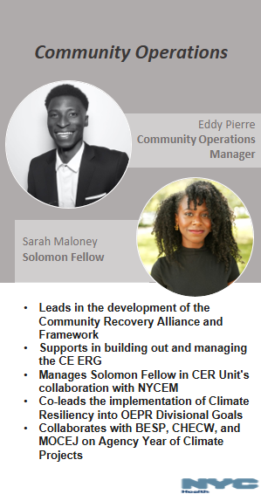
Community Operations,
Health Department's Office of Emergency Preparedness and Response (OEPR)

Slide 11
ADDRESSING THE PROBLEM
The City lacks CFBO perspectives on how hyperlocal climate emergencies are affecting communities
No centralized dataset exists to capture CFBO insights on climate impacts
Extreme weather is worsening! We want to hear from you!
Community‑driven solutions are essential, and CFBOs are trusted partners who can help identify gaps, shape interventions, and strengthen preparedness for those most at risk.
Notes:
Extreme weather events- flooding, winter storms, heat are increasing in NYC. These are affecting everyday lives and are caused by climate change + ^ global temperatures. (highlight Ida flooding, recent snow storms, air quality) -- every time it rains in NYC there is a zipcode under flood watch. RAINFALL CASUING INFRASTRUCTURE ISSUES .. purpose is get organizations help us find solutions .
i.e snowstorm;; people with disability + accessibility issues;; city cleared roads but not sidewalks. -- having a child with stroller, eldery, etc very difficult to get around
We need to make sure our most vulnerable populations have support they need and we want to leverage relationships with community partners/hyper local orgs/faith based institution on how to best minimize these issues that are being created directly from climate change.

Slide 12

To collect input from Community-Based and Faith-Based Organizations (CFBOs) and other local groups on how climate change and extreme weather affect their operations, communities, and priorities.
Identify needs, gaps, and opportunities for resilience support and potential funding.
Creation of Communities for Climate Health Coalition (CCC)
Vision
Notes:
Read off slide

Slide 13

13
What is Climate Resiliency?
  Climate Resiliency is a concept to describe how well people or ecosystems are prepared to bounce back from certain climate hazard events. The formal definition of the term is the "capacity of social, economic and ecosystems to cope with a hazardous event or trend or disturbance"
Notes:
This section is to better understand how your organization takes climate resiliency into consideration.
Theme of this survey is climate resiliency ...

Slide 14
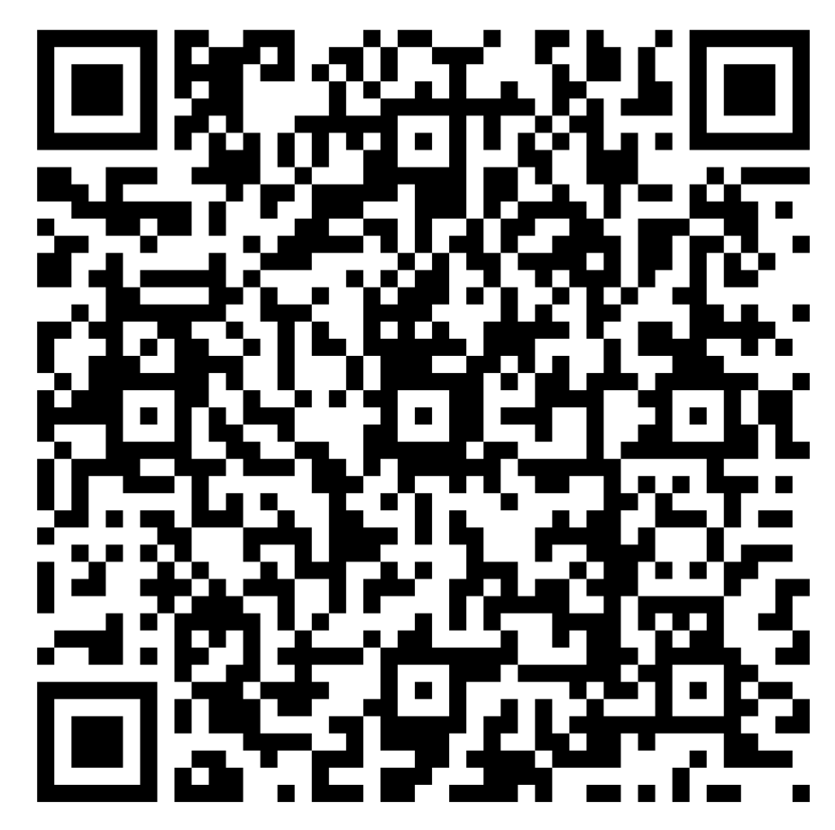
Survey
This survey will be used to help guide DOHMH staff, currently working on climate-related work, incorporate CBOs and FBOs feedback to improve the city's climate initiatives.
This survey is an opportunity to gather data and inform DOHMH's climate resiliency work and give a voice to those who are actively present in their communities.
Notes:
We want to hear from you so if you can take time to scan this QR code
We didn’t want to just share this survey via email b/c we want to talk and give input. Explain why we are asking questions listed on the survey
As you're filling out the questions we will go through the survey with you

Slide 15

15
Section 1: Learning More About Your Organization
Notes:
This section is to learn more about your organization overall.
Question 1. Which Borough is your organization based in?
Question 2: How big is your organization in terms of official staffing? (This does not include volunteers)
Question 3: Please select the area(s) of focus for your organization based on the list below:
Public health
Emergency prepardness & response
Equity and social jusice
Accessibility
Food security
Environmental/green/natural areas
Sports/Athletics
Education
Faith Based
Question 4: Who are your collaborative partners in your community?
(end of section)

Slide 16
What borough is your Organization based in?
How big is you Organization in terms of support & staffing?
What is your Organization listed as?
Please select the area(s) of focus for your Organization based on the list

Slide 17

17
Section 2: Defining Climate Resiliency in Your Community
Notes:
We've given general def of CR, we'd like to get your thoughts on CR in your community.
whether your org focus on childcare, soup kitchens, animals ~~we'd like to hear from orgs on the ground and center all orgs that work in the hyper local space.

Slide 18
Based on this survey's definition, is protecting your community against climate hazards a priority for your organization?
18
Based on your last response, are there barriers preventing your organization from prioritizing Climate Resiliency?
Notes:
Purpose: we don’t want to make assumptions about org; even if it isn't there is still a role that can be played here.
We want to follow the core values of CE which is hearing from you and collaboration.
We recognize that for a lot of these orgs, they may not have the capacity to work on Climate but there is still a role to play/work can be helpful/critical
Get a sense of what orgs, whether they have CR as a priority directly or indirectly ~~ NO WRONG ANSWERS

Slide 19

19
Section 3: How Climate Change Shapes the Communities You Serve

Slide 20
How does climate change affect the communities you serve and/or influence your organizations work?
Based on your previous response, how is your organization responding to this in programming?

Slide 21


21
Section 4: The City's Role in Supporting Communities During Climate Events

Slide 22
Is the city doing enough to counteract climate change?
What does your organization wish the City would do better to address climate issues?

Slide 23

Communities for Climate Health
Coalition (CCC)
  To build ongoing climate partnerships with community- and faith-based organizations and prompt responsive action from city agencies
  Insights from the survey will inform funding proposals, resilience planning, and targeted programming, and the CER team will use the data to share recommendations on agency climate initiatives.
    Public recognition
    Networking and partnership building
    Newsletter
    Consultation with DOHMH

Slide 24



Thank you
Eddy Pierre epierre3@health.nyc.gov

Slide 25
GROUND THIS WORK IN COMMUNITY EXPERIENCE
Community partners are seeing climate impacts every day.
Climate and health impacts are experienced through SDHO.
Behavioral health reflects instability, stress, and access gaps.
Understanding lived experience is essential to shaping effective response.
Notes:
“What we’ve been describing is what this looks like on the ground—
how climate impacts are showing up, and how coordination is starting to take shape.”
“But scaling that into something that’s consistent, informed, and sustainable—
is where public health leadership becomes critical.”
(slight pause)
“The ability to connect what’s happening in communities with data, strategy, and broader systems…”
👉 (gesture lightly)
“…is what makes this work actionable at a larger scale.”
FINAL LINE (HANDOFF)
“So I want to turn it over to [DOH Name] to talk about how this is taking shape at the city level—particularly through the Climate Health Survey and broader public health work.”

Slide 26
Climate Change and Public Health
Collective responses to local threats

Slide 27
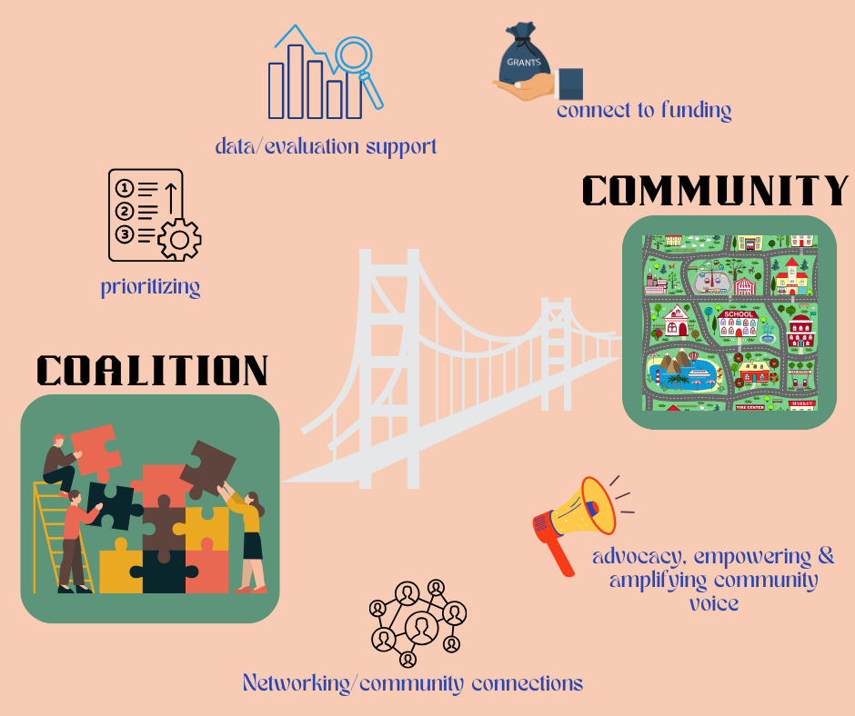
Partnerships for Community Wellness
A public health nonprofit working to address systemic issues that contribute to poor health outcomes.

Slide 28
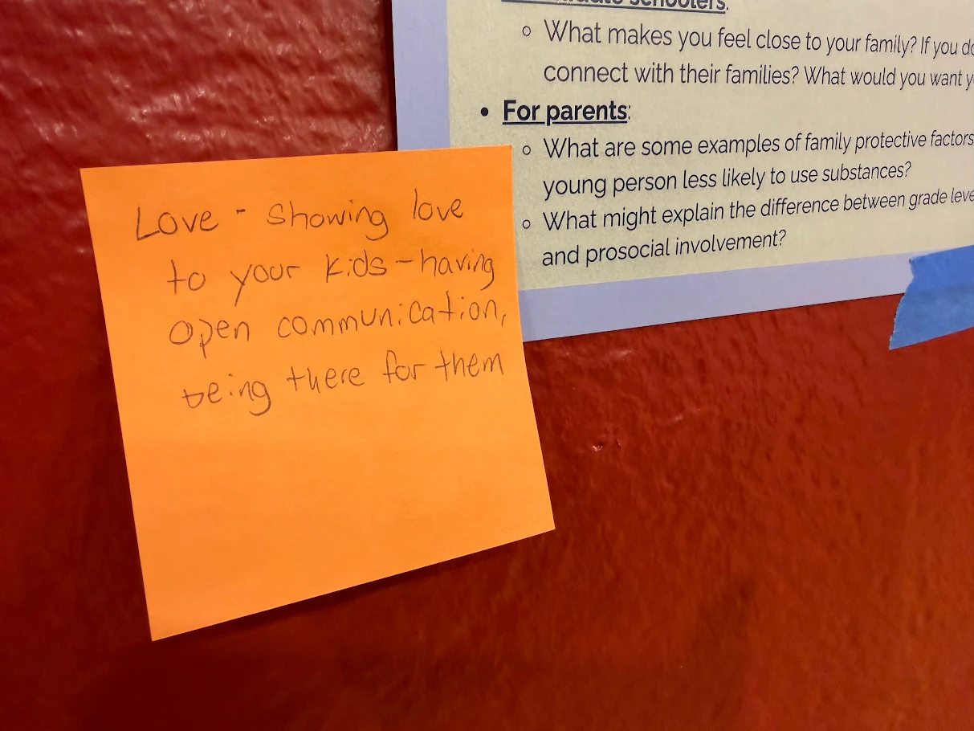
What We Do
Coalition Building
Project Planning & Management
Training & Capacity Building
Communication and Health Education
Positive Youth Development
Data Collection and Evaluation
Advocacy
Fiscal Pass through - Contract Management

Slide 29
Values and Guiding Principles
Prioritize Population Level/ Structural Impact
Data-Driven
Build Stakeholder Capacity
Prioritize Lived Experience
Collaborative Leadership
Community-rooted
Partnerships
Center health equity
Build on existing momentum (where possible)
Agency
Course correct when necessary

Slide 30
Partnerships Priority Areas
Maternal & Child Health
Emerging Public Health
Behavioral Health
Healthy Mommas, Healthy Families
Birth Justice Defenders
Child Wellness Initiative
Climate Justice
Emergency Response
Vaccine Hesitancy
TYSA
Suicide Prevention Task Force

Slide 31
Climate Justice
A framework that positions climate change as a moral, social, and political issue rather than just environmental.
An acknowledgment that those most harmed by climate change are those who are the least responsible in contributing to the issues.

Slide 32
Staten Island Context
Geographic
  SI Expressway/Maritime Corridor
  Proximity to Elizabeth NJ (downwind)
  Coastal Vulnerability
Socioeconomic
  North Shore neighborhoods decades of disinvestment
  Poor health outcomes
  Social Determinants of Health
    Housing availability and quality
    Food Access
    Transportation

Slide 33
Climate Hazards
Asthma is exacerbated by poor air quality that it is a result of pollution, heat, flooding, and older housing stock.
  Canadian Wildfire 2023 (ER Visits in NYC doubled)
  Heat Waves tighten air passages
  Increase ground level ozone (smog)
  Flooding & humidity leads to mold and mildew
Climate events also result in poor behavioral health outcomes.
SUD Spikes - stress induced increases in substance us,
Psychological Toll - Rising rates of climate-related anxiety and PTSD

Slide 34
Collective Response
TYSA - Behavioral Health Coalition - Building resilience and coping skills. YCs exploring intersection of behavioral health with social and political conditions
Child Wellness Initiative - Collective working to reduce the burden of chronic disease.
Mayors Office of Environmental and Climate Justice - Place-based convenings to identify climate vulnerabilities and prioritize potential projects. Focus on Port Richmond and Stapleton
1115 Medicaid Waiver - Social Care Networks

Slide 35

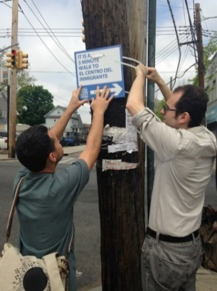

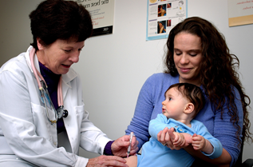

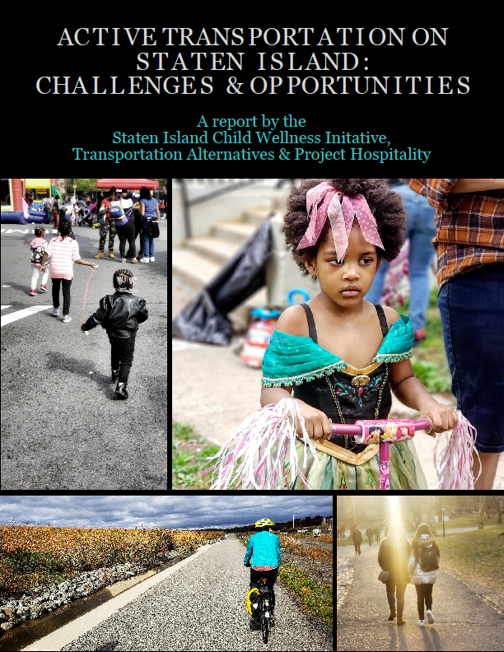
COMMUNITY
SCHOOL
CLINICAL
Cross Sectoral Partners
Food Access
Built Environment Changes
Home Assessment and Remediation
Smoke-Free Housing
Wellness Councils
Program Scale – Open Airways, Garden to Café
School Gardens
Parent Education
Youth Empowerment
Asthma QI Initiative
Asthma Flip Chart
Pediatric Toolkits and Training
EMR Support

Slide 36
Thank You
Adrienne Abbate, MPA
Executive Director
adrienne@partnerships.nyc
718-226-0256

Slide 37
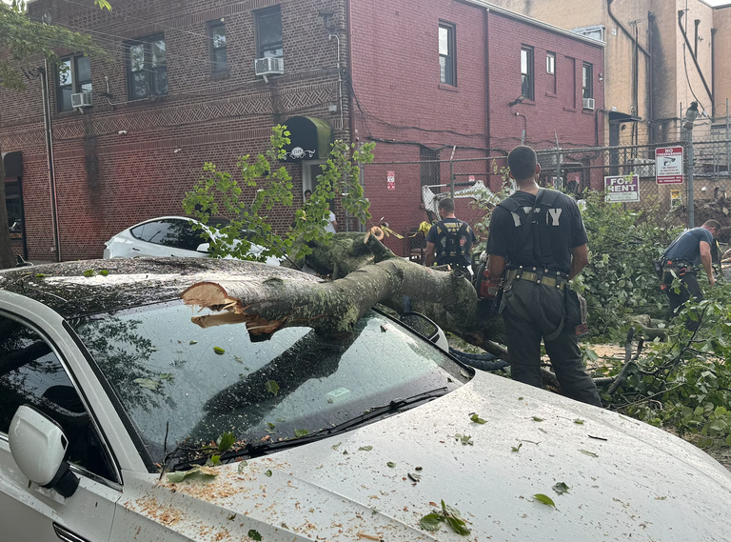
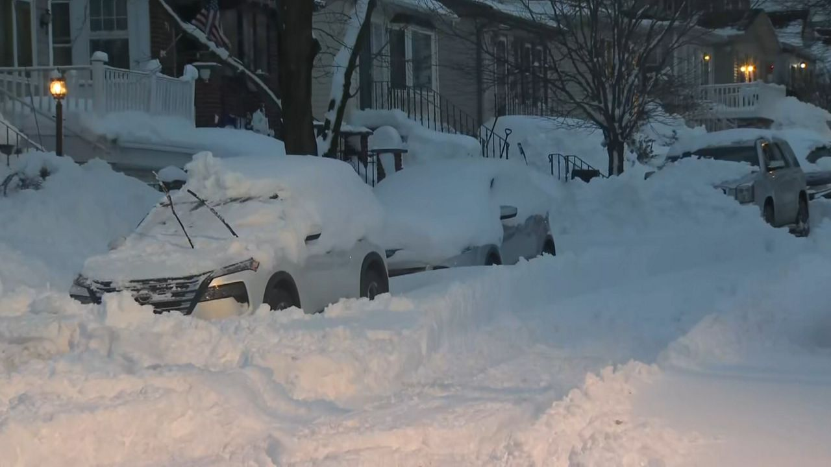


WHEN THE SYSTEM IS STRESS-TESTED
When climate, community, and health systems intersect in real time, coordination moves from conceptual to operational.
Notes:
“So we’ve talked about how climate impacts are showing up—
and how they’re affecting both health outcomes and community conditions…”
“And we’ve heard how that’s being understood at a systems level, and experienced on the ground.”
👉 (nod to DOH + PCW)
“What I want to do now is bring those pieces together—
and show what this looks like when the system is under stress.”
“Because this is where coordination is no longer theoretical—
it’s operational.”

Slide 38
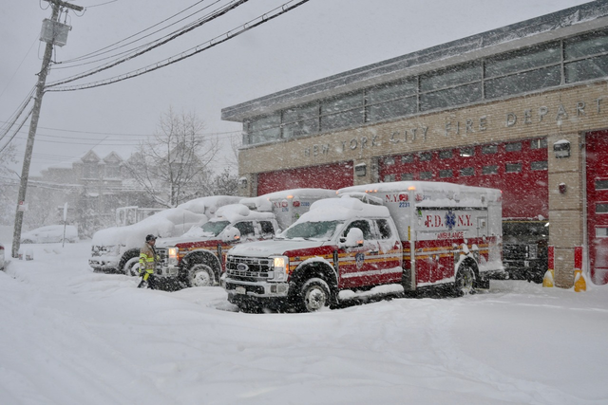
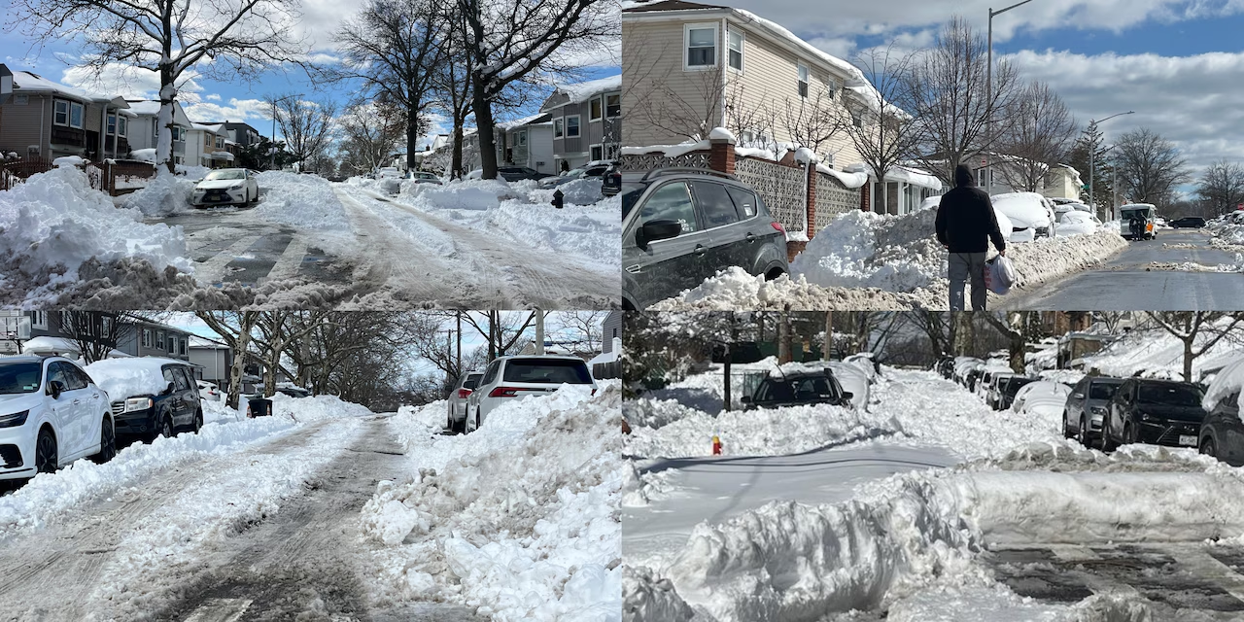
OUR MOST RECENT STRESS TEST
FEBRUARY 2026 BLIZZARD
  Snowfall approaching 2–3 feet across Staten Island
  Wind gusts near 60 mph → drifting snow, downed trees, outages
  Facilities inaccessible due to delayed plowing and snow buildup
  Next-day travel nearly impossible → staffing and patient/client services impacted
ACCESS TO CARE, AND ABILITY TO DELIVER IT, WAS DISRUPTED ACROSS THE SYSTEM
Notes:
“During this past winter storm, what became clear very quickly is that this wasn’t just a weather event—
it was a stress test across the entire system.”
“This was one of the most significant winter events Staten Island has seen in recent memory.”
“We saw snowfall totals approaching 2 to 3 feet across the borough—
with wind gusts close to 60 miles per hour.”
“What that meant, in practice—
was snow drifting several feet high against buildings,
facilities that couldn’t be accessed because plowing was delayed…”
“And essentially no viable travel options for a period of time—
which directly impacted staffing and client services.”
👉 (small pause)
“So this wasn’t just a weather event—
it disrupted both access to care and the ability to deliver it across the system.”
- saw this with CBOs and education settings - maybe to be expected... mobile food pantries and services canceled deliveries, only 30% of our students went to school the next day as compared to over 60% attendance reported in other boroughs. but importantly for this context, it became very clear very quickly during the storm itself this wasn’t just a weather event—
it was a stress test across the entire system.”
“We had patients unable to access dialysis,
facilities managing staffing shortages because people couldn’t get in…”
“Coordination was happening—partners communicating, escalating needs…”
Nursing homes - 3 patients ‘stuck’; 1 patient unable to access dialysis
IDD provider concerned about staff stuck for 48hrs, unprepared for 72 – bumped to top of DSNY list for maintenance clearing
Both hospitals had need for staff transport.
“And much of that response relied on real-time problem solving—
and last-minute solutions like National Guard transport, which we benefited from, again, full circle, thanks to the strength of existing relationships, particularly with Trusted Sources and across sectors.

Slide 39
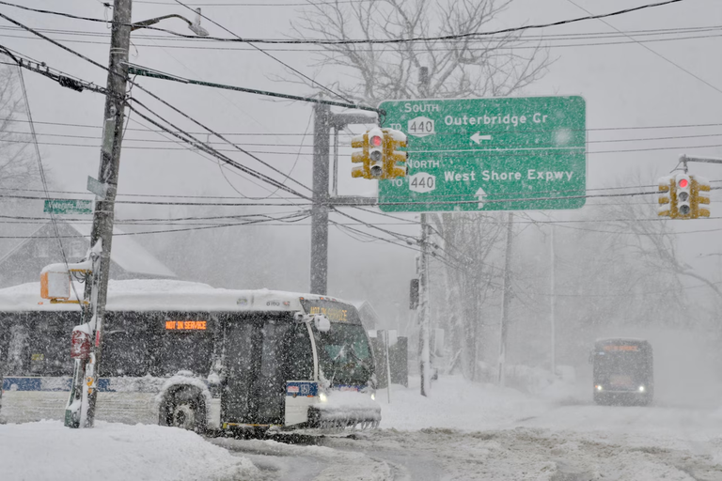

  Transportation is a core dependency across the healthcare ecosystem
  No shared, scalable system for patients or essential staff
  Limited real-time visibility into needs across partners
  Strong relationships enabled response—but much was reactive
CRITICAL DEPENDENCIES EXPOSED
Notes:
“What this really revealed is that transportation is not a side issue—
it’s a core dependency across the entire healthcare ecosystem.”
“There’s no shared, scalable system - at least in our borough - for moving patients or essential staff during these events.”
“And while coordination did happen—
it relied heavily on relationships and quick thinking…”
“Not on systems that were already built to support that response.”

Slide 40
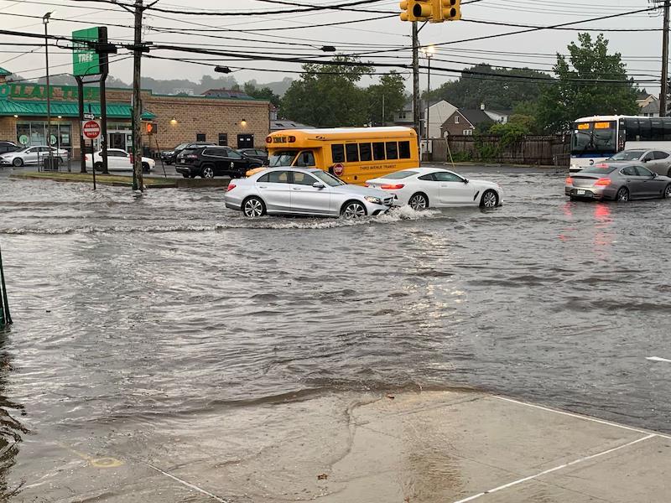
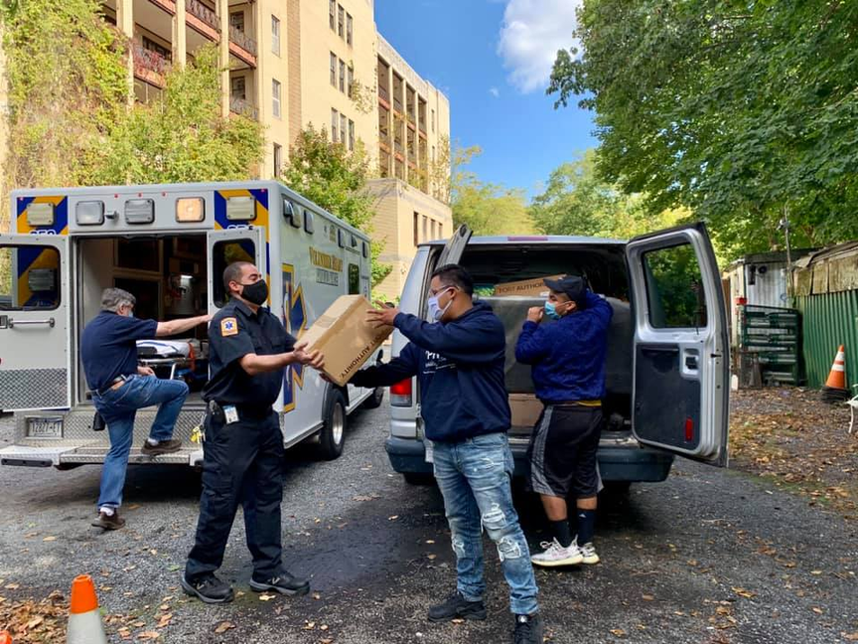
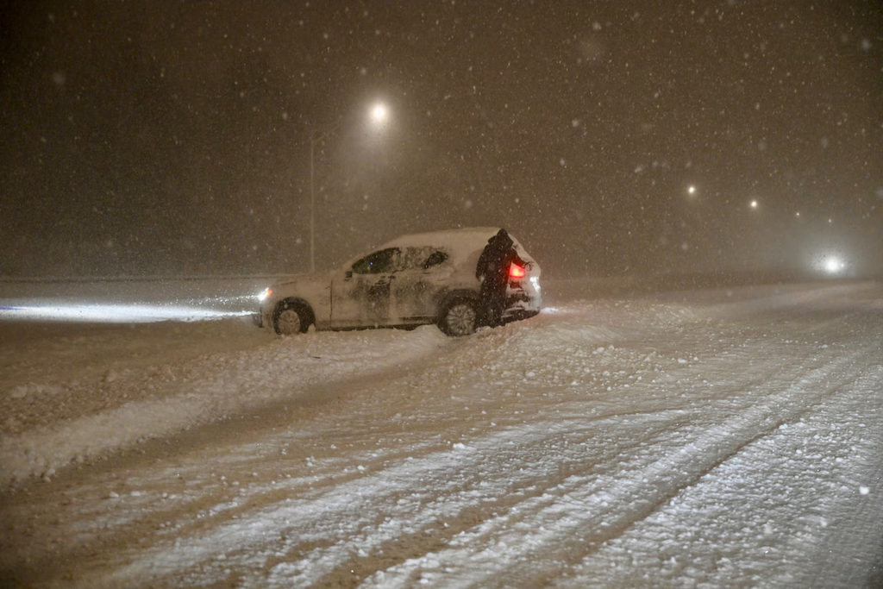
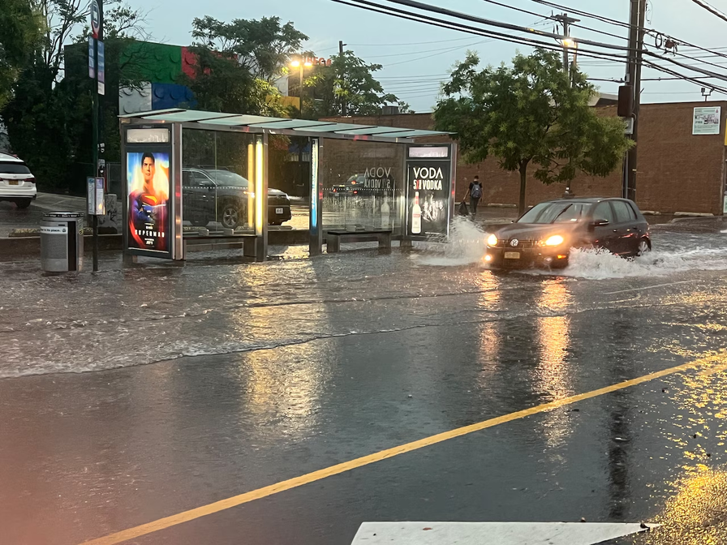
STRENGTHENING RESPONSE IN SI
TRANSPORTATION AS CORE INFRASTRUCTURE
MAINTAINING & REBUILDING PARTNERSHIPS
IMPROVING VISIBILITY & COMMUNICATION
APPLYING LESSONS LEARNED YEAR-ROUND
  Strengthening healthcare–transport partnerships
  Exploring MOUs and shared protocols
  Planning for patients and staff movement
  Prioritizing trusted cross-sector relationships
  Re-engaging key response partners
  Navigating shifting policies and capacity
  Strengthening real-time information sharing
  Clarifying activation communication pathways
  Elevating local conditions in response
  Planning for heat, flooding, and storms
  Integrating into ongoing preparedness work
  Moving toward more intentional coordination
Notes:
“So for us, this isn’t about having a solution coming out of one storm—
it’s about where we’re focusing as a coalition moving forward.”
“And a lot of this is shaped by what we experienced during the winter activation,
and what we know is coming with heat, flooding, and other events.”
🟦 TRANSPORTATION AS CORE INFRASTRUCTURE
“The biggest takeaway—and I think the clearest one—is transportation.”
“We’re starting to treat transportation as core infrastructure for healthcare continuity—
not something separate from the system.”
“That means looking at how we strengthen partnerships between healthcare providers and transportation partners—
not just in the moment, but ahead of time.”
“There’s been some work at the state level looking at models like pre-established agreements—MOUs between providers and transportation partners—
and while those aren’t simple to implement, they start to point us in the right direction.”
“And importantly, this isn’t just about patients—
it’s also about essential staff.
We saw clearly that if staff can’t get in, the system can’t function.”
🟦 MAINTAINING & REBUILDING PARTNERSHIPS
“Another major focus for us is relationships.”
“We’ve spent a lot of time this year strengthening engagement across the CBO network—
updating contacts, building participation, making sure communication lines are active.”
“And now, particularly through the Medical Ecosystem work, we’re thinking about how we maintain and deepen relationships with what we often call ‘trusted sources’—
the partners who show up consistently and help carry information and response forward.”
“At the same time, we’re also looking at where we need to re-engage key partners—
especially providers who are essential in moments like this but may not always be at the table day-to-day.”
“And all of this is happening in the context of shifting policies, funding, and organizational capacity—
which directly affects who’s able to participate and how.”
🟦 IMPROVING VISIBILITY & COMMUNICATION
“Visibility is another big piece.”
“During the storm, a lot of what worked came from real-time information sharing—
partners flagging transportation issues, facility access challenges, staffing gaps…”
“But that visibility isn’t always consistent, and it’s not always structured.”
“So we’re looking at how to strengthen real-time information flow across partners,
and clarify communication pathways during activations—
so it’s clear who is sharing what, and where that information is going.”
“And importantly, making sure that what’s happening locally—
especially in Staten Island—is actually reflected in broader response conversations.”
🟦 APPLYING LESSONS YEAR-ROUND
“And finally, this isn’t just about winter storms.”
“We’re already seeing similar system strain during extreme heat events—
whether that’s around cooling access, health impacts, or staffing.”
“And the same goes for flooding and heavy rain—
disruptions in travel, access to care, and service delivery.”
“So the focus is really on taking what we’ve learned here
and integrating it into year-round preparedness—
not treating these as isolated events.”
Soft Closing Line (IMPORTANT — don’t rush)
“So this is less about having a fully built solution—
and more about where we’re intentionally focusing as a coalition…”
“and how we continue building toward more coordinated, more visible, and more reliable response across systems.”

Slide 41
WHAT THIS MEANS FOR ALL OF US
Climate impacts are increasing pressure across systems
Community, healthcare, and public health are all responding
“New policy analysis offers pathways for collaboration across primary care, public health, and community-based organizations”
John Hopkins Bloomberg School of Public Health
Coordination is what connects that response
Meeting this moment requires these systems to work together intentionally and consistently.
Notes:
“What we’ve talked about today—
from community conditions, to system impacts, to real-world response—
all points to the same thing.”
“Climate impacts are increasing pressure across all of our systems.”
“Community organizations, healthcare providers, and public health—
we’re all responding to that in different ways.”
“And coordination is what connects that response.”
👉 (small pause)
“The difference is whether that coordination is happening reactively—
or whether we’re building it intentionally, and sustaining it over time.”
Optional last line (if it feels right in the room):
“And that’s really the work ahead—for all of us.”

Slide 42
THANK
YOU
MICHELLE BASCOME
Director of Programs & Development, Nonprofit SI/ Director, SI COAD
MICHELLE@NONPROFITSTATENISLAND.ORG
EDDY PIERRE
Community Operations Manager; DOHMH - Bureau of Healthcare and Community Readiness (BHCR), OEPR
epierRE3@HEALTH.NYC.GOV
ADRIENNE ABATTE
EXECUTIVE DIRECTOR, PARTNERSHIPS FOR COMMUNITY WELLNESS
adrIENNE@PARTNERSHIPS.NYC

