Slide 1
Using AI in Designing Mass Casualty Drills
Presented By: Miguel Barrios, MD
Clinical Assistant Professor | SUNY Downstate
Disaster Preparedness Fellow
Emergency Administration Fellow

Slide 2
NO CONFLICTS OF INTEREST

Slide 3


Background
Notes:
As we are moving forwarding. Technology is advancing. In order to maintain current practice it is important to embrace where techonology is moving and this is AI.
These are various AI platforms that can be used, but I specifically have used Chat GPT

Slide 4
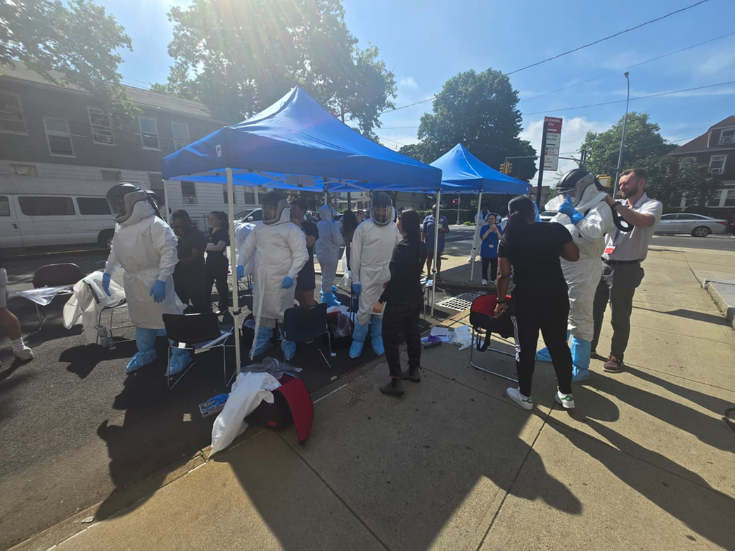
What can I use AI for?
  Design realistic scenarios
  Create patient profiles
  Design tabletops
  Quality assurance tools

Slide 5




Benefits of AI
Improved scalability
Increased realism and customizability
More Efficient
Can create lists of patient profiles from 100's-1000's of patients
Can create high fidelity scenarios
Rapidly make changes based on audience
Manually designing a drill and patient profiles can be time intensive

Slide 6
Tips and Tricks
Be specific in what you ask
Provide maximum background information
Build complexity in step-wise manner
Perform manual and AI quality assurance passes
Save earlier versions
Notes:
Do not trust the output from AI. Must perform own quality to review to ensure accuracy and the output is what is desired.
• Use structured prompts
• Perform multiple QA passes
• Align with protocols
• Continuously refine datasets

Slide 7
Limitations of AI
Doesn’t replace clinical judgment
Requires validation
Potential Inconsistencies
Notes:
• Requires validation
• Potential inconsistencies
• Needs domain expertise
• Not a replacement for clinical judgment

Slide 8

Notes:
Example of generic ask and see what is the outcome

Slide 9
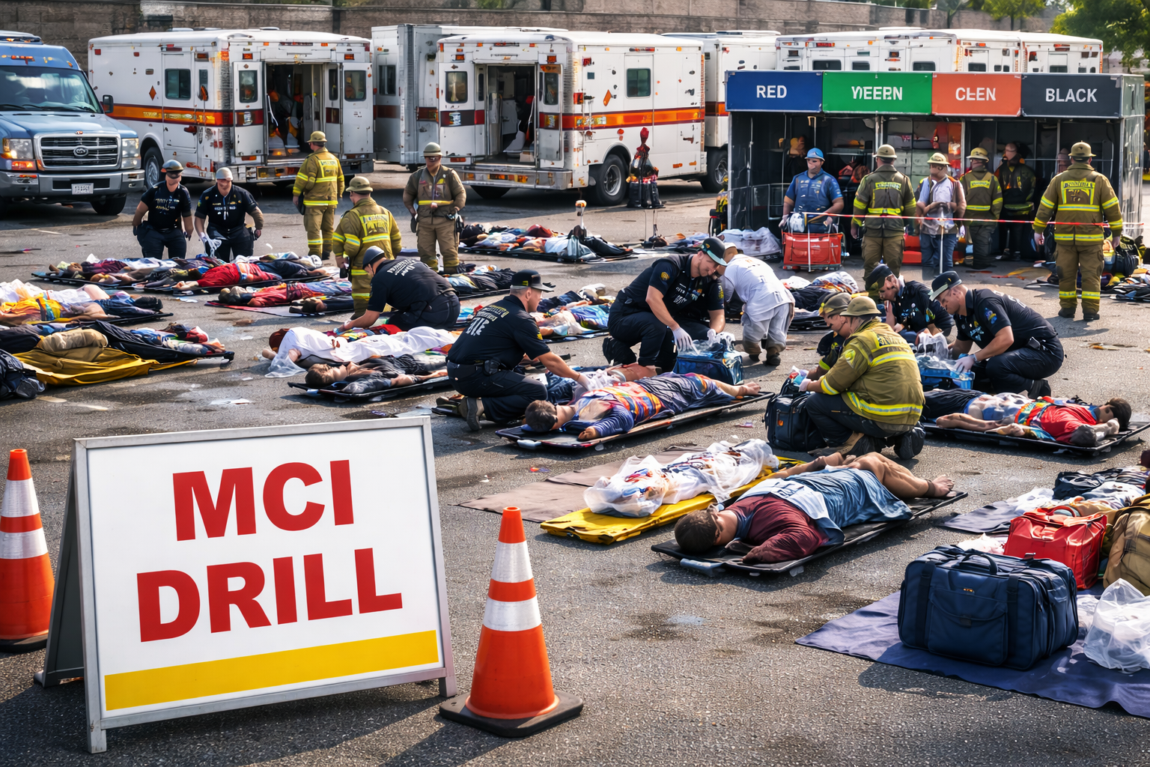
Notes:
So the image was very complicated and did a bad job at creating an imaging.
What can people spot as things that are wrong.
- all faces are messed up
- anatomy appears to be wrong
- including triage colors but are misspelled and mislabelled

Slide 10
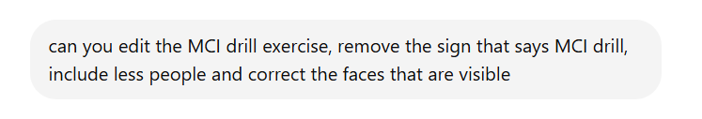

Slide 11


Slide 12
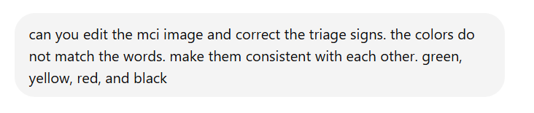

Slide 13


Slide 14
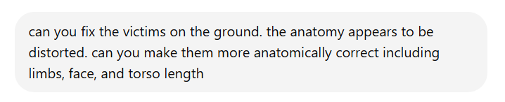

Slide 15

Notes:
i think this is the most realistic image with the least amount of mistakes, but you can keep on going more and more.
like why is the paramedic bending over no one.
the mess of ambulances in the background that appear to merge into each

Slide 16
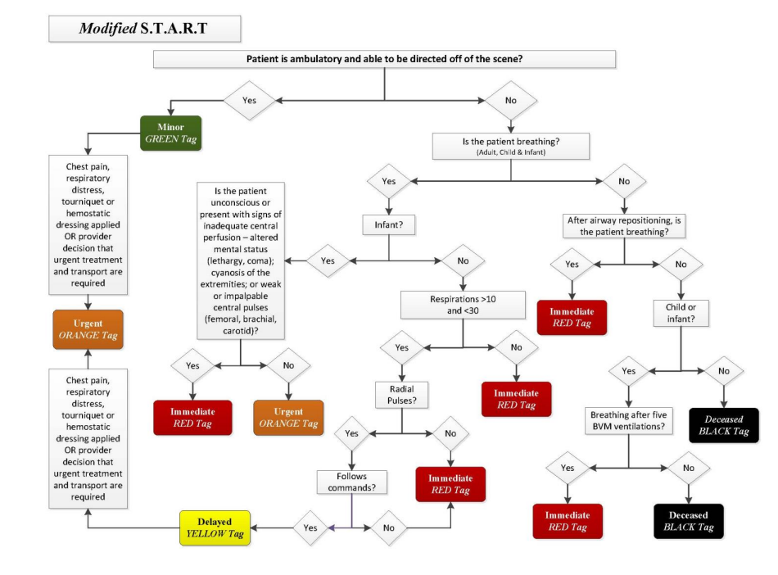
Drill Design
  Background information
    What is it that you want to do?
  Provide any specific criteria for creation of patients
    REMAC modified START triage guidelines
Notes:
I am creating a Mass casualty disaster drill and I would like to create realistic patient profiles with age, gender, vitals, injury patterns, and REMAC START criterias.
Core Components of Patient Profiles
Demographics (age, gender, language)
• Vitals (HR, RR, BP, O2, Temp, GCS)
• Injury patterns
• HPI & Physical Exam
• Triage category

Slide 17
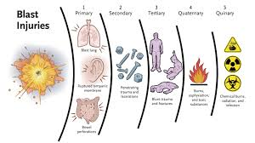
Set the Scenario
  Provide information about the scenario
    ie. explosion at MSG
  Give examples of injuries you would like to see
    Blast, Burns, Traumatic (trampling)
  Define percentage of each triage color
Notes:
• Define incident type (blast, fire, radiation)
• Set patient volume
• Define triage distribution
• Include special populations

Slide 18
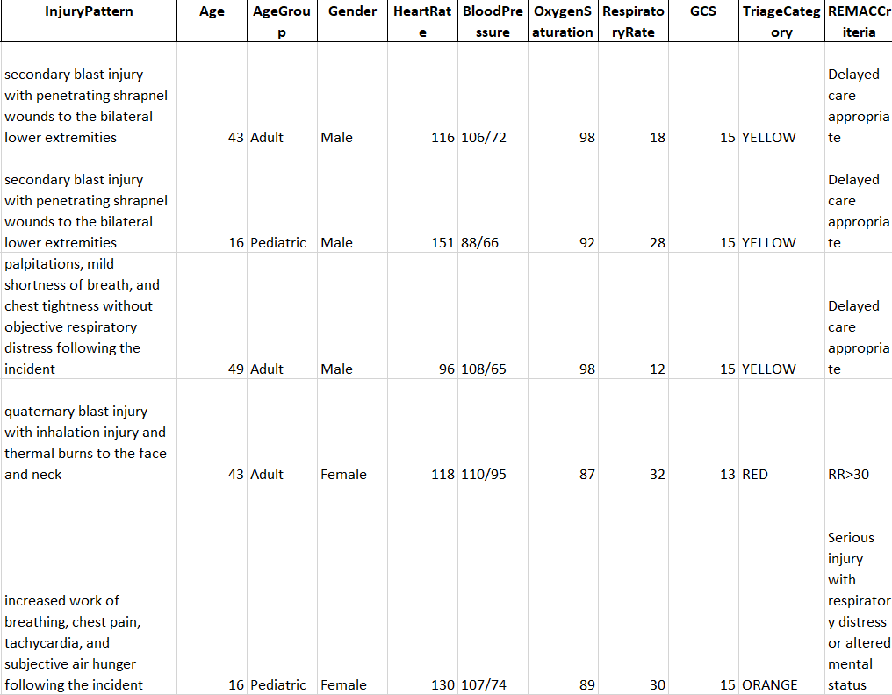
First AI Output
  Ensure Clinical Accuracy
  Review the injury pattern, age, vitals, triage criteria
  First manual quality assurance. Do you agree with the output
  Do you want more variability? Changes to injury patterns? Do the vitals make sense?
Notes:
Ensuring Clinical Realism
• Align vitals with injuries
• Match HPI with physical exam
• Avoid contradictions
• Ensure triage accuracy
• Prompt AI with structured requirements
• Include triage rules (e.g., START/REMAC)
• Specify injury mechanisms
• Generate CSV outputs
output TM rupture of the lower extremities
has a difficult time producing an output for hundreds-thousands of patients at the same time

Slide 19
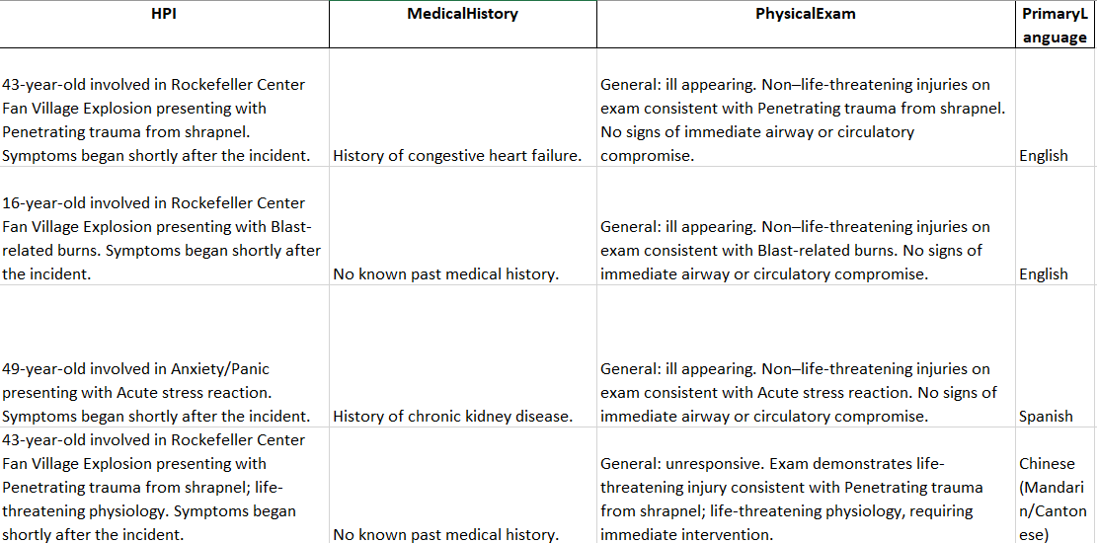
Add Layers of Complexity
  Do you want an HPI, physicial exam, patient course
  Include vulnerable populations
    language barriers
    socioeconomic status
    Age
    Mental health
Notes:
• Add environmental factors (heat, radiation)
• Include language diversity
• Add arrival modes
• Simulate ED course

Slide 20
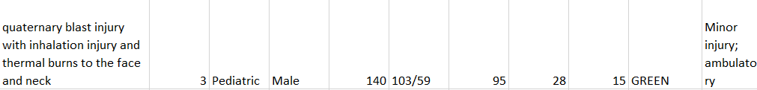
Perform QA After Every Change
  Avoid making too many changes without confirming accuracy
  Once too many inaccuracies are imbedded it becomes harder to correct
    snowball effect
  Save earlier versions
Notes:
QA
• Cross-check injury ↔ vitals ↔ triage
• Validate GCS consistency
• Ensure narrative coherence
• Run iterative refinements

Slide 21
FINAL OUTPUT
  Keep making changes until you are satisfied with the final output

Slide 22
Thank You Very Much!
miguel.barrios@downstate.edu

Slide 23
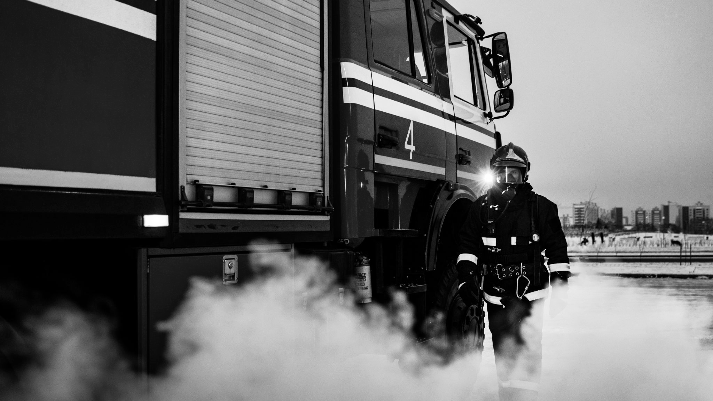
Augmented Response:
How Civic Tech Platforms Are Rewiring Emergency Management

Slide 24
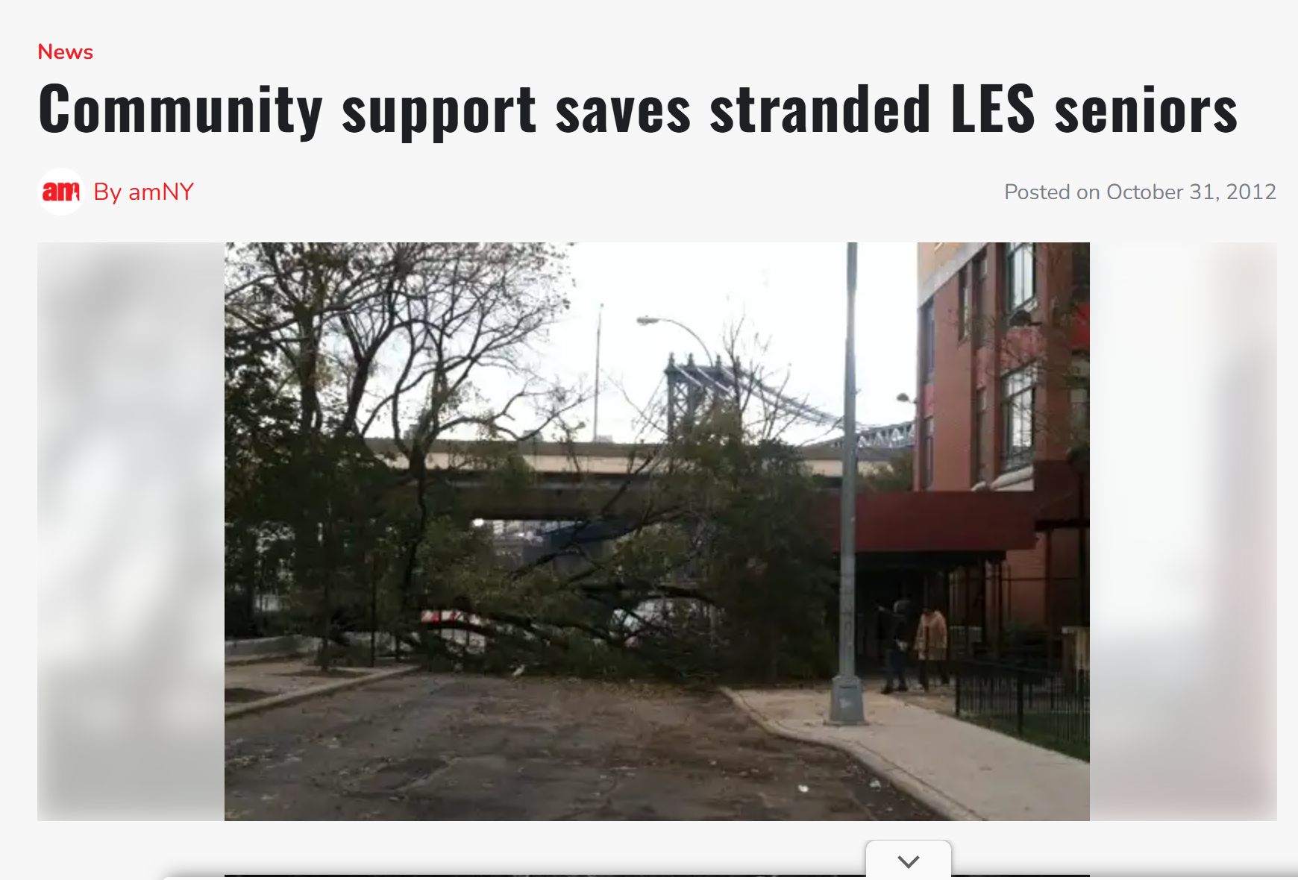
Story…
Source: https://www.amny.com/news/two-bridges-community-rallies-to-help-trapped-senior-citizens/

Slide 25
Disaster response is no longer just about institutions.
It’s about platforms.

Slide 26
01
About Me

Slide 27
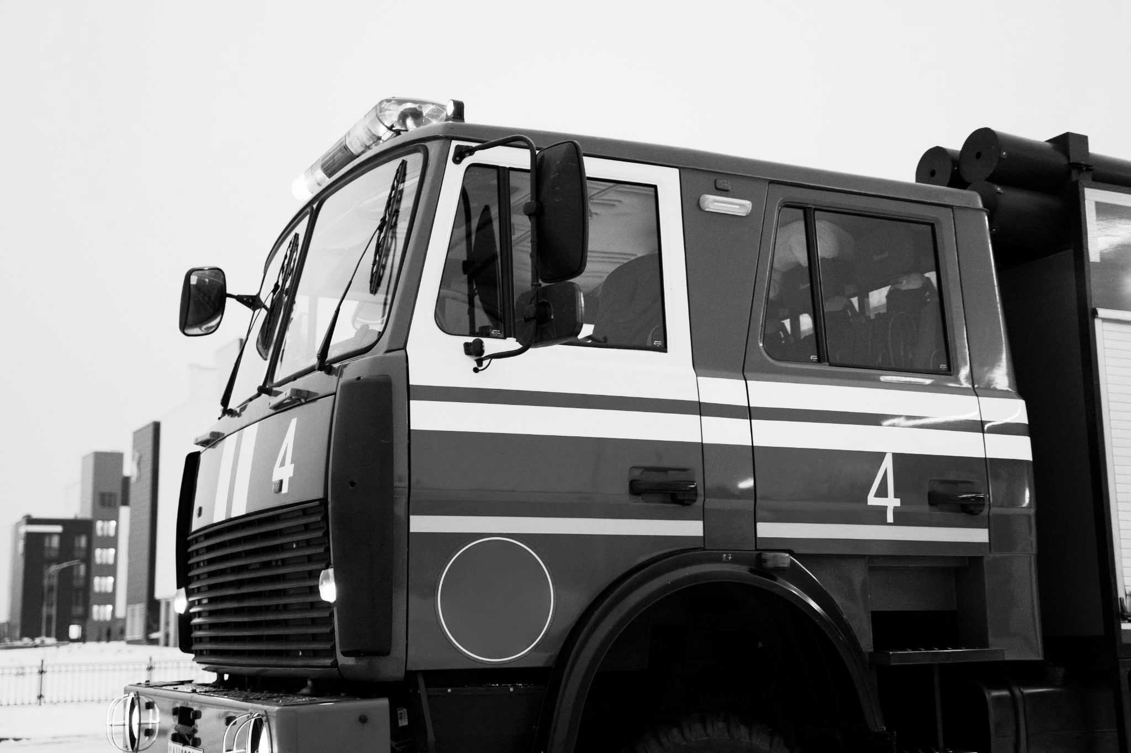

Temitayo Ifafore-Calfee is a public health and humanitarian leader with over 20 years of experience advancing health system resilience and recovery in crisis-affected settings.
She most recently served as a Division Chief at U.S. Agency for International Development, where she led initiatives to strengthen partnerships between governments, communities, and the private sector to improve health outcomes.
Her work spans major global emergencies, including the Ebola epidemic in West Africa and COVID-19 recovery efforts across Southern Africa.
She holds a Masters degree in public health from University of Michigan and a bachelor's Degree from Yale University.

Slide 28
The most resilient systems are the ones that can respond at the speed of need.

Slide 29
02
About Recovers

Slide 30
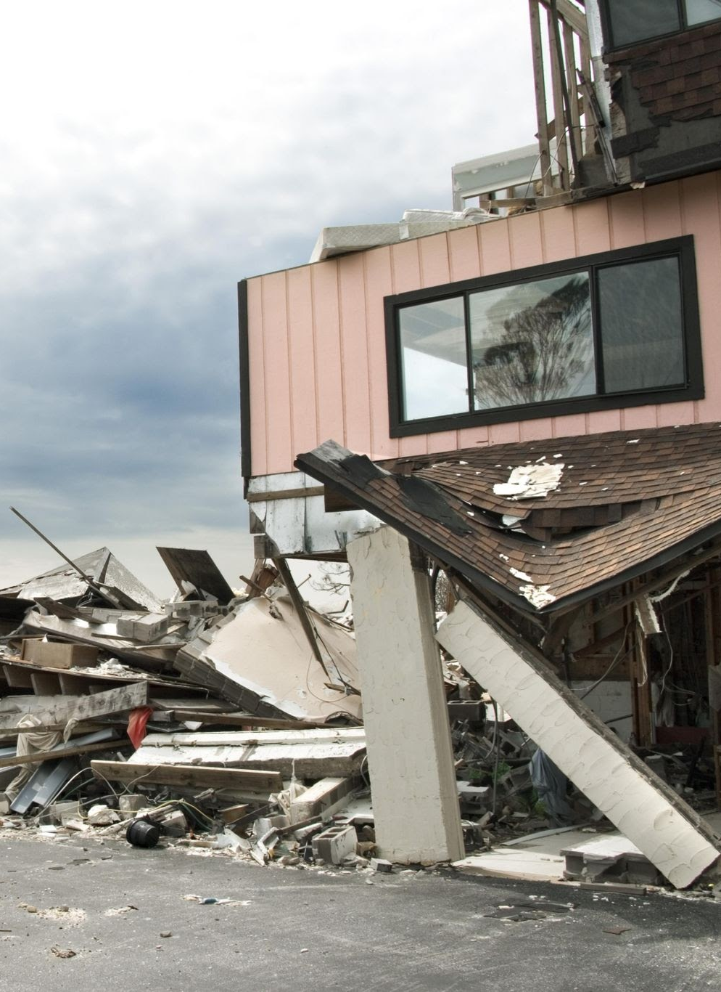
A Simple Framework:
3 Ways Technology Powers Disaster Response
2.
1.
3.
C2G
G2C
Citizen → Government
Government → Citizen
C2C
Citizen → Citizen

Slide 31

Recovers
Since 2012, Recovers.org has helped hundreds of communities around the world recover from disasters. The new platform, Recovers.org 2.0, brings modern software and organizing tools to the challenge of rebuilding communities to be stronger and more resilient. We provide a toolkit for local control, by local community organizers. You are the experts!
A website for each community to manage donations, organize volunteers, and meet the needs of residents.
Volunteer Management
Donation Databasing
Information Hub
Case Management

Slide 32
03
Demo Step-by-step

Slide 33
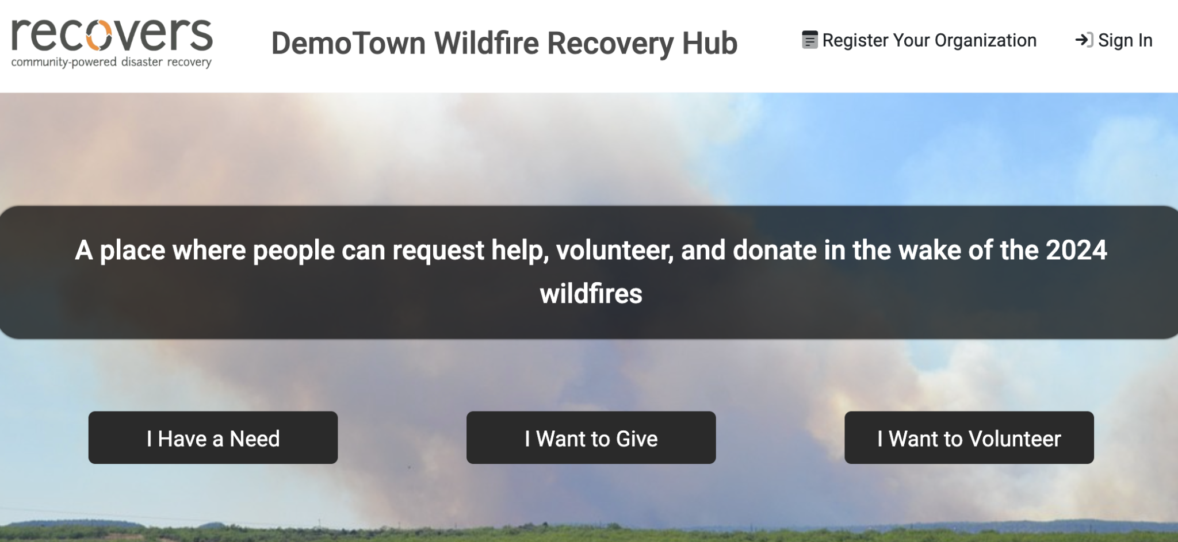

Slide 34
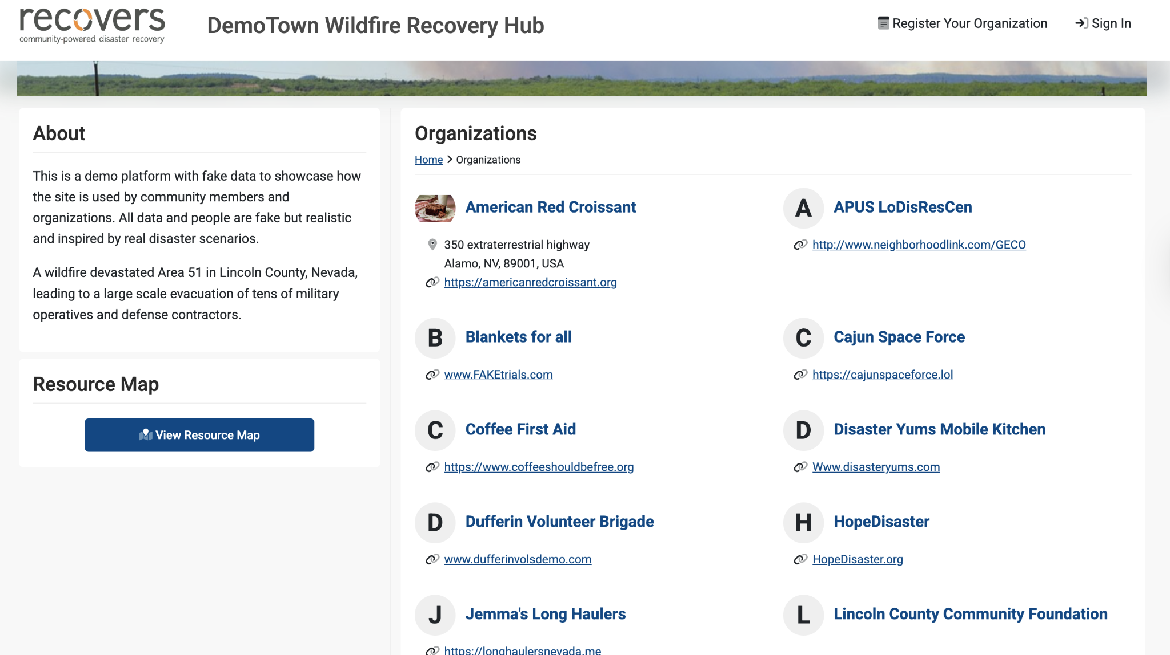

Slide 35
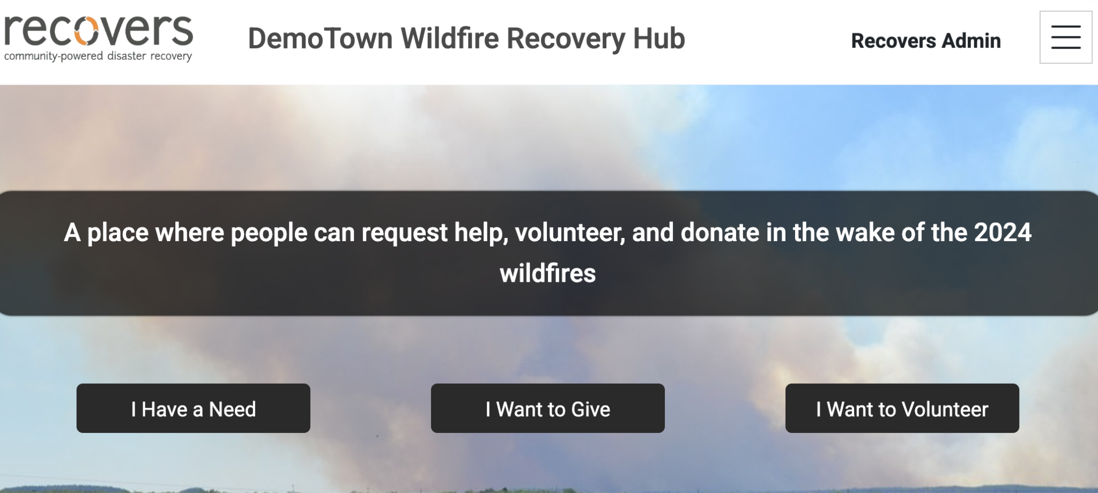

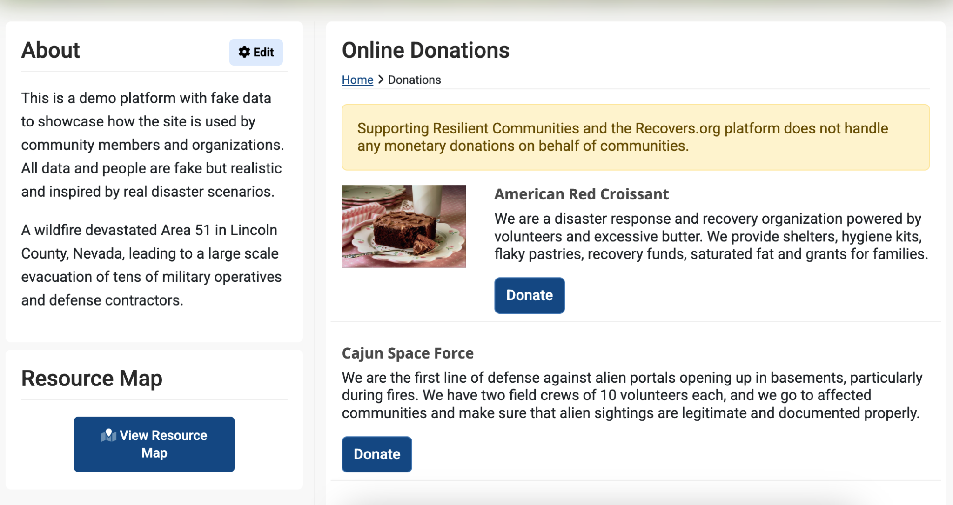
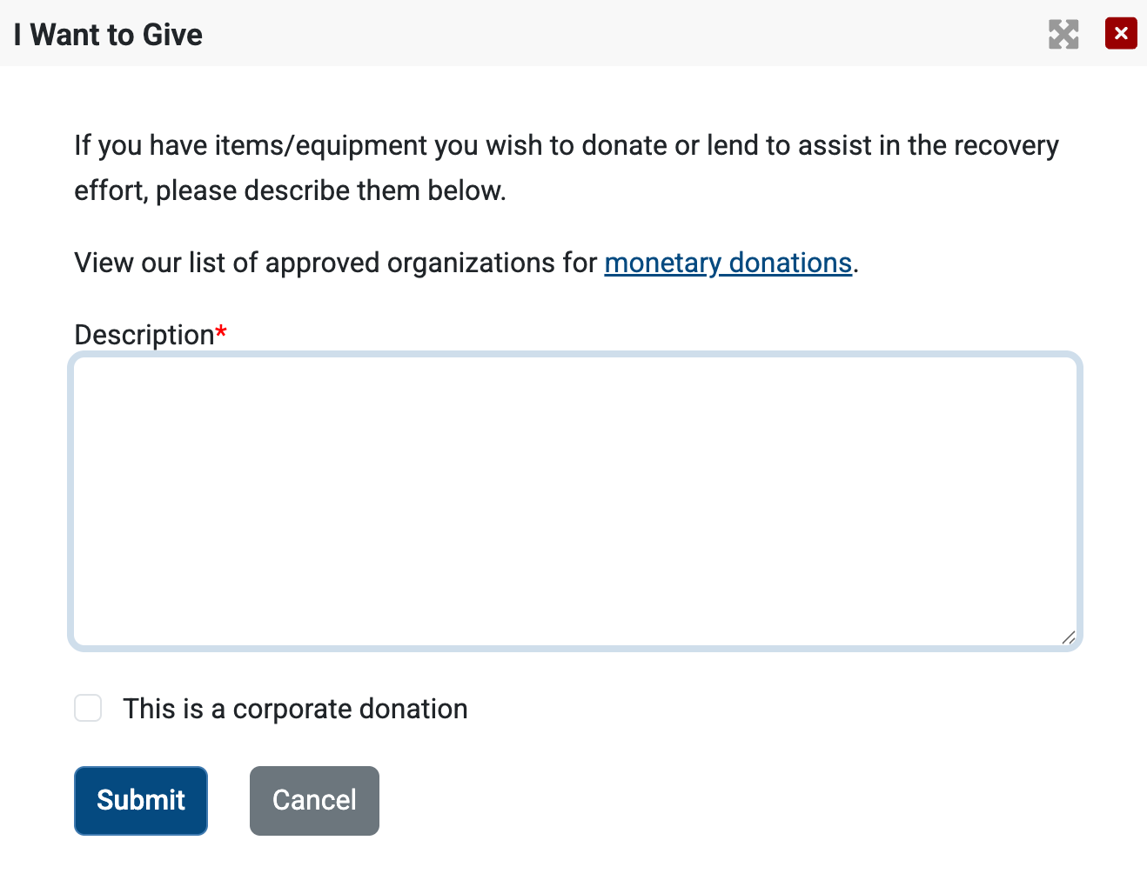

Slide 36

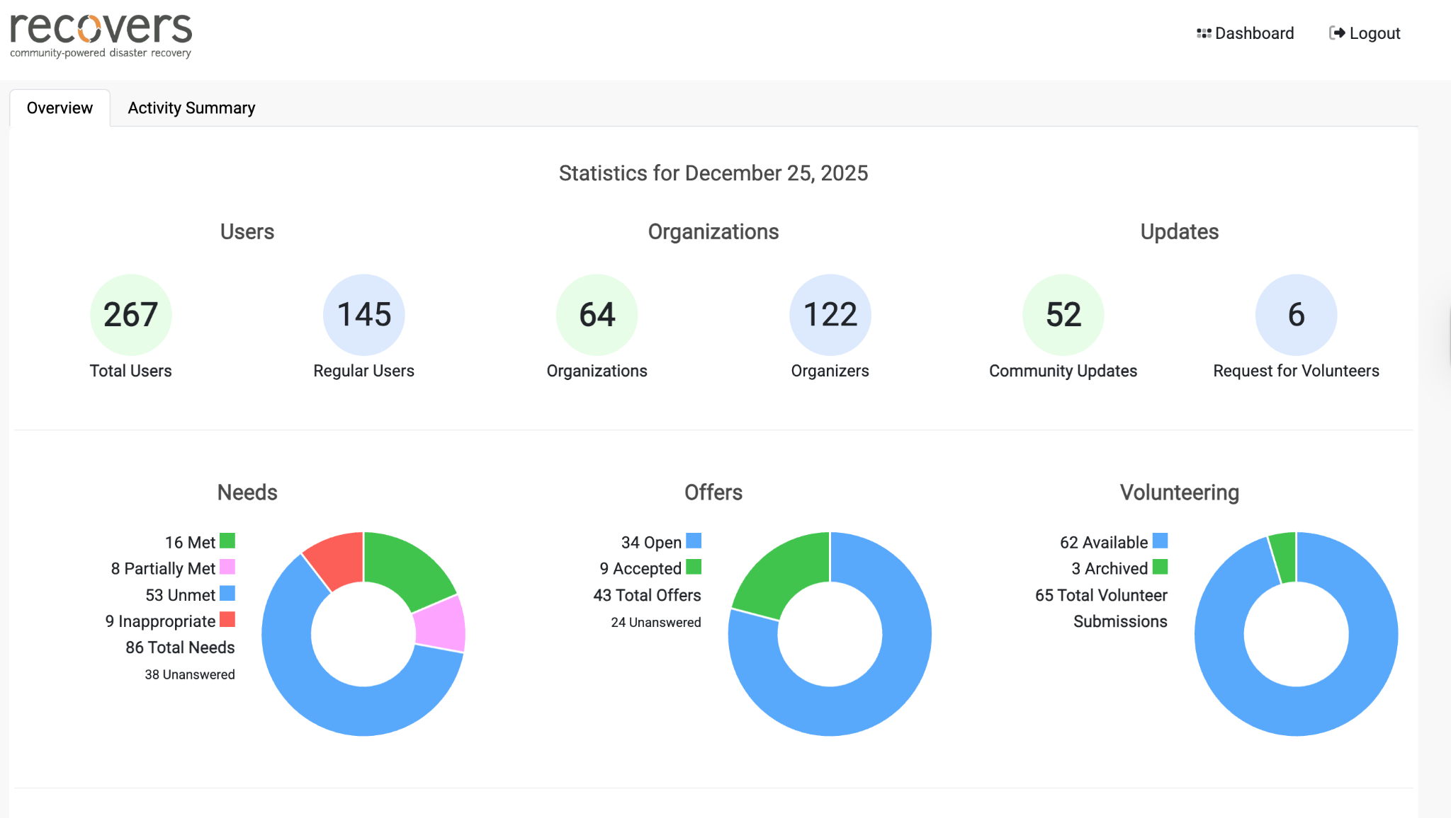
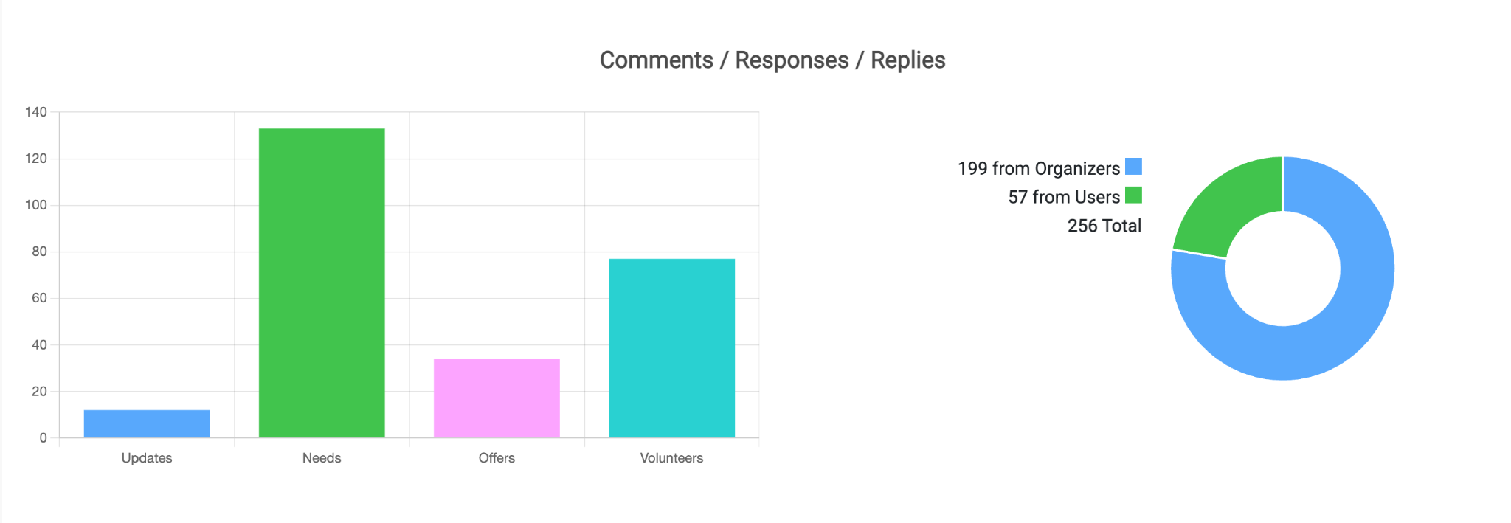
Mercury is the closest planet to the Sun and the smallest one of them all

Slide 37
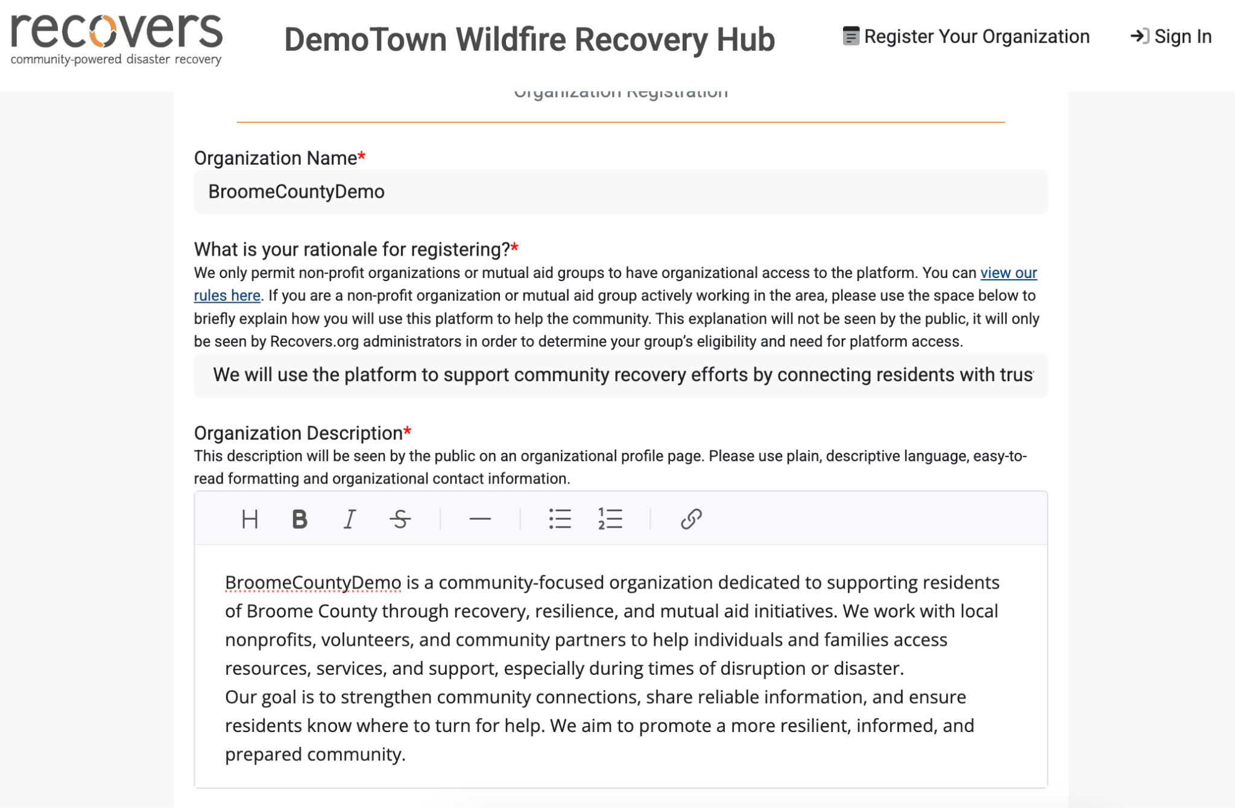
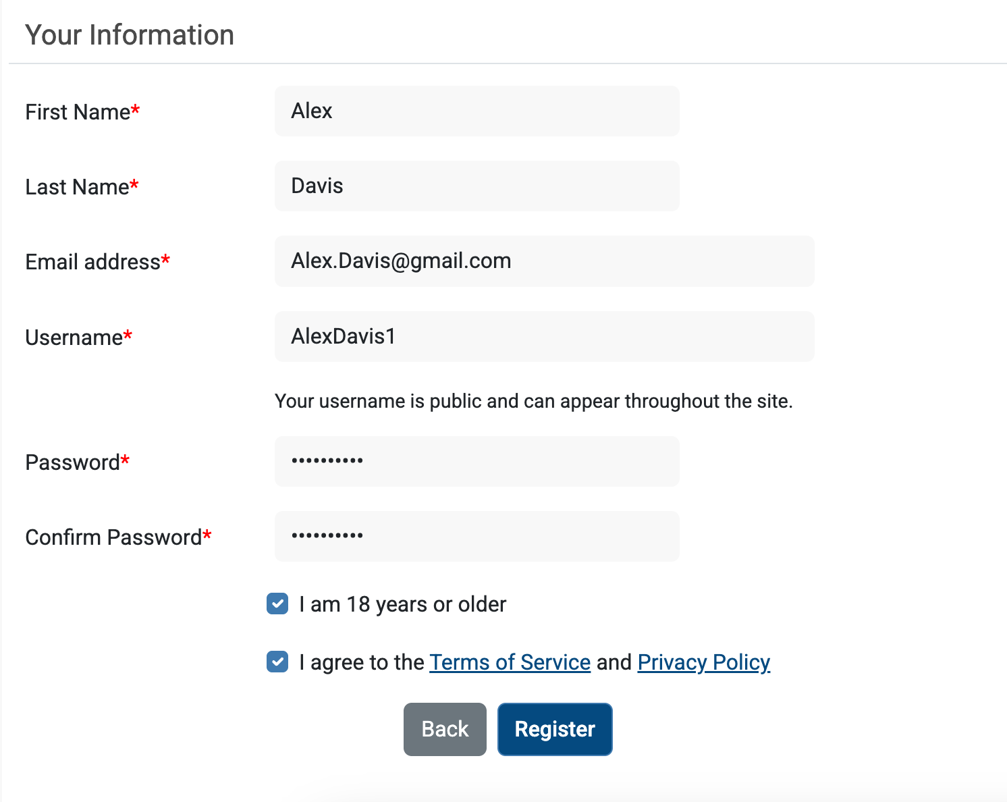
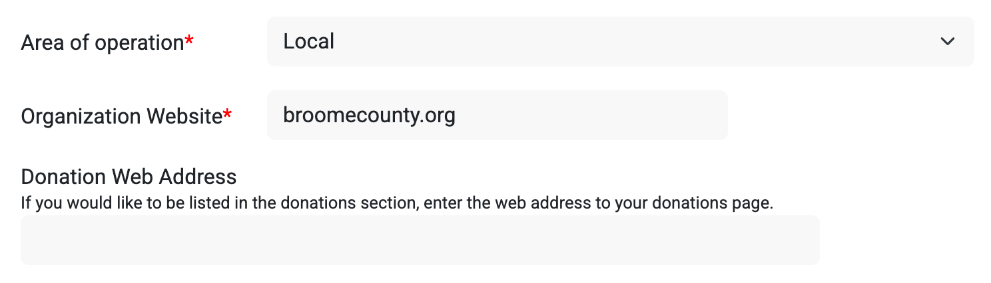
Username: AlexDavis1
Password: HelloAlex1

Slide 38
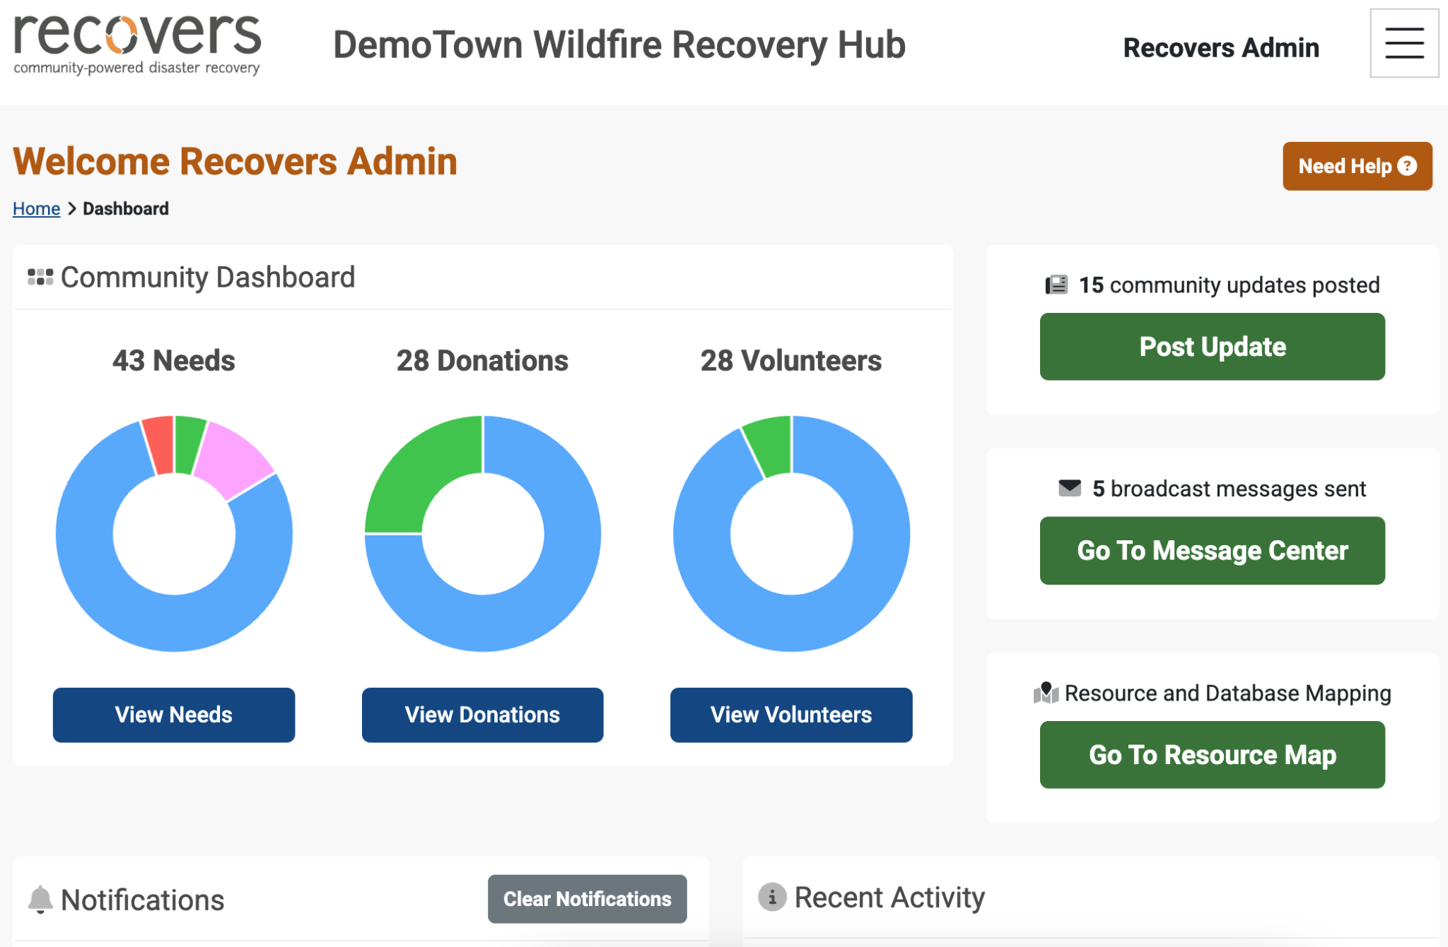

Slide 39
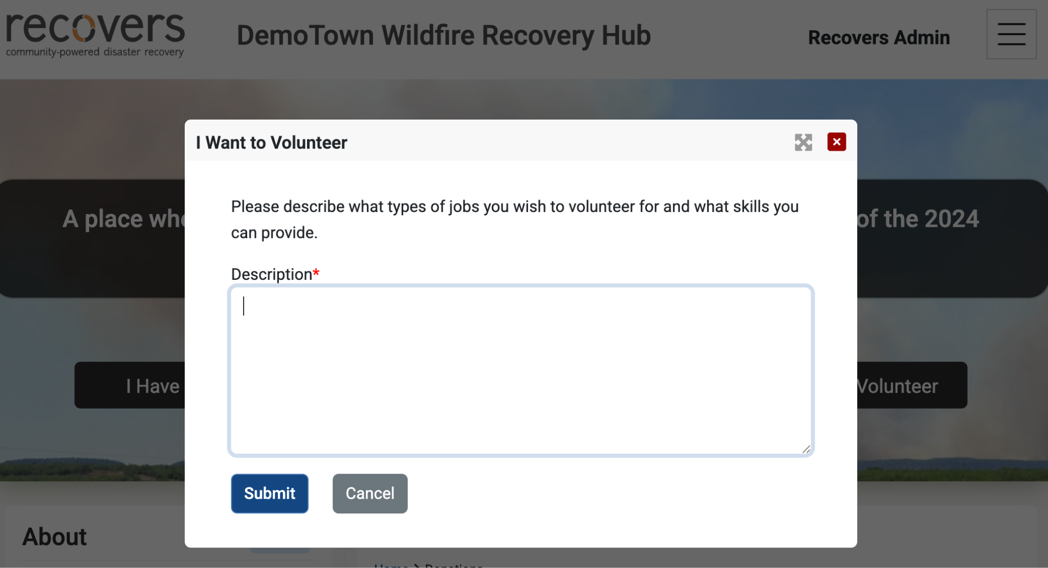
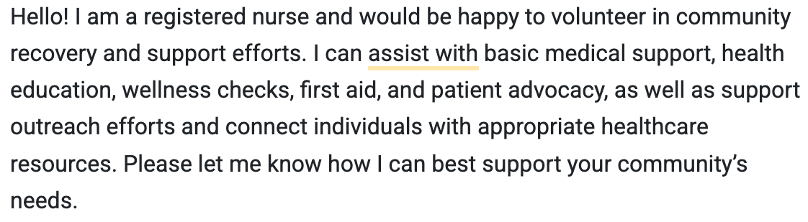

Slide 40
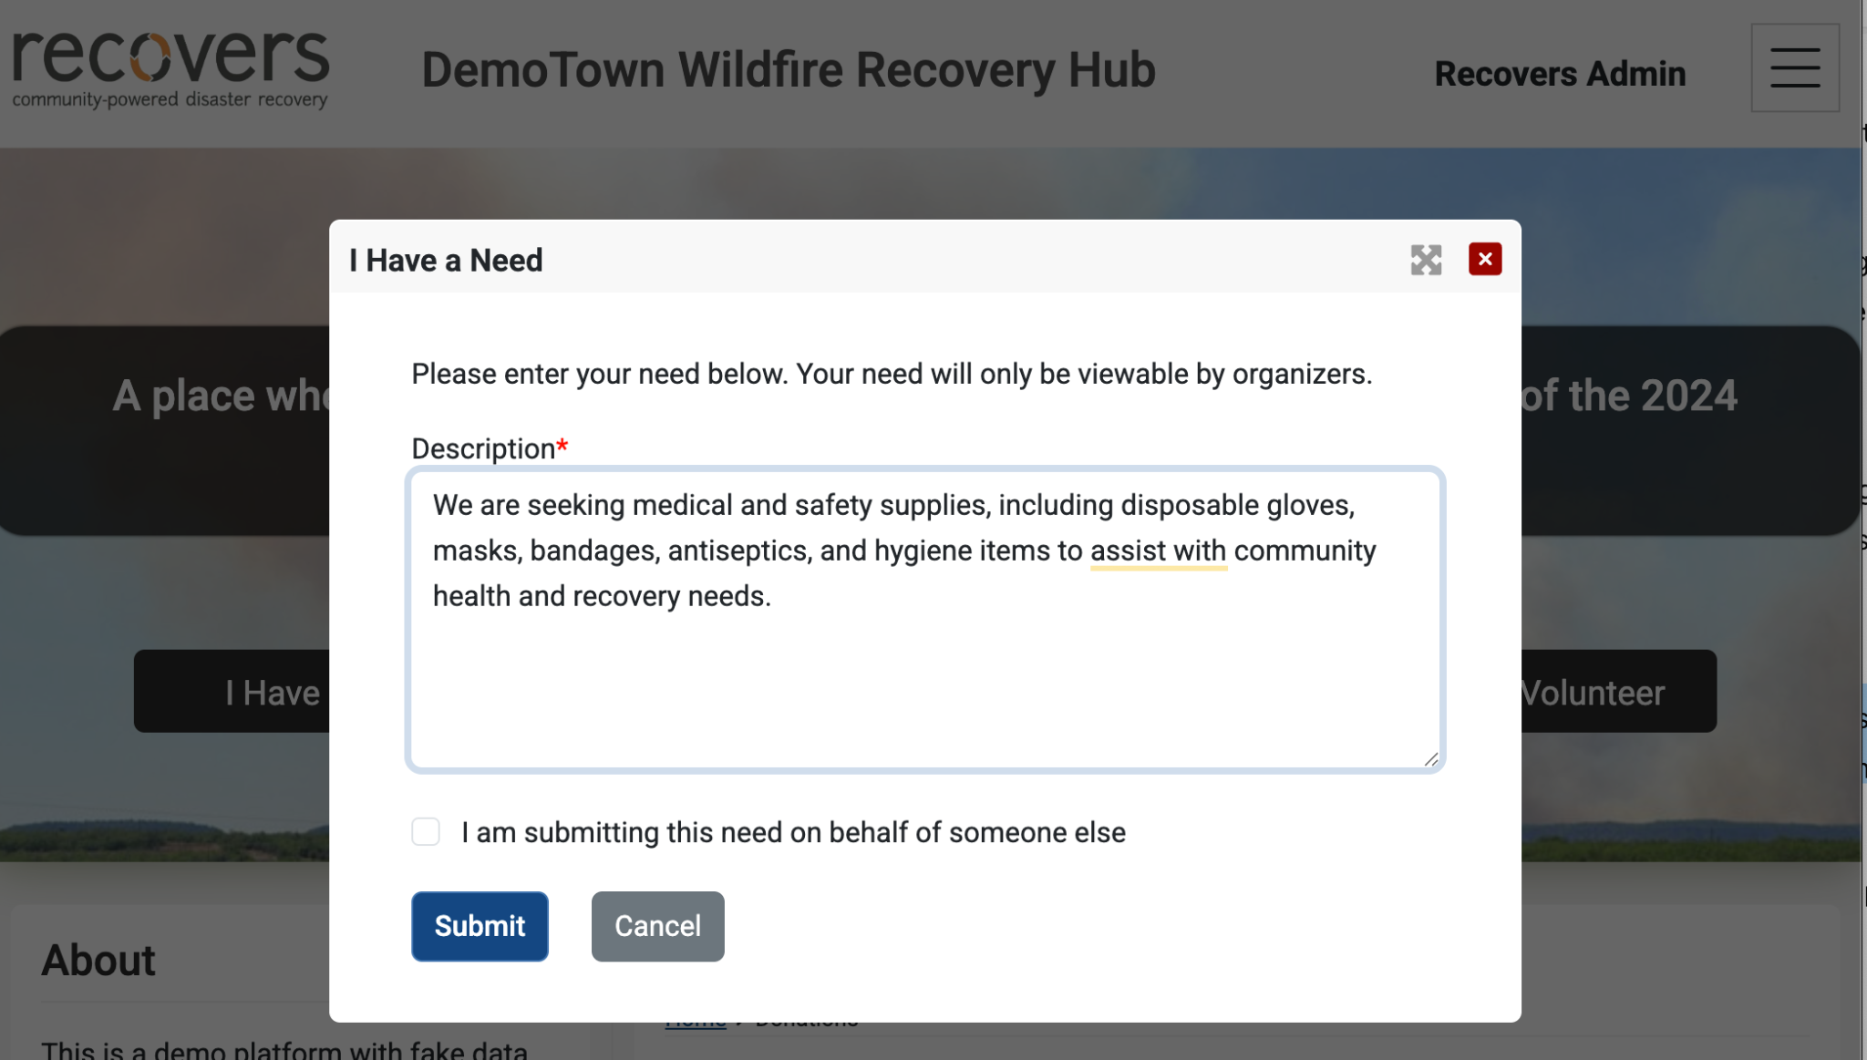

Slide 41
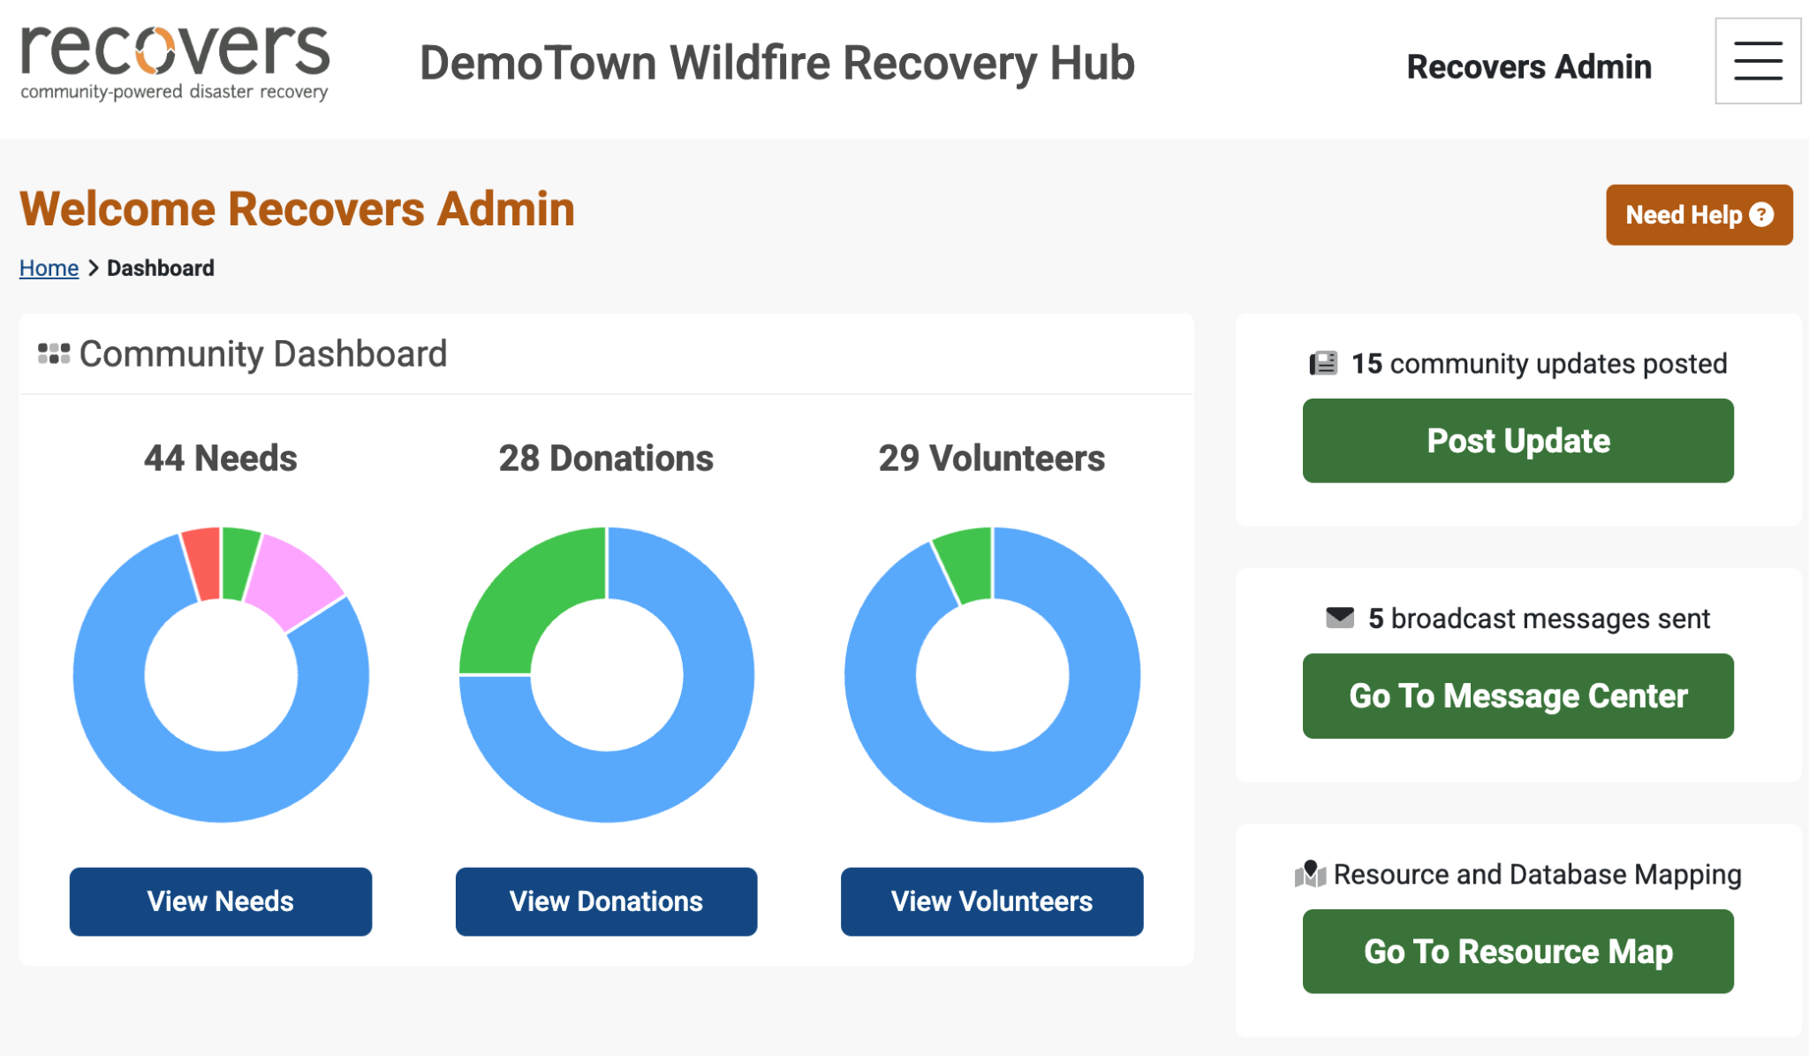

Slide 42
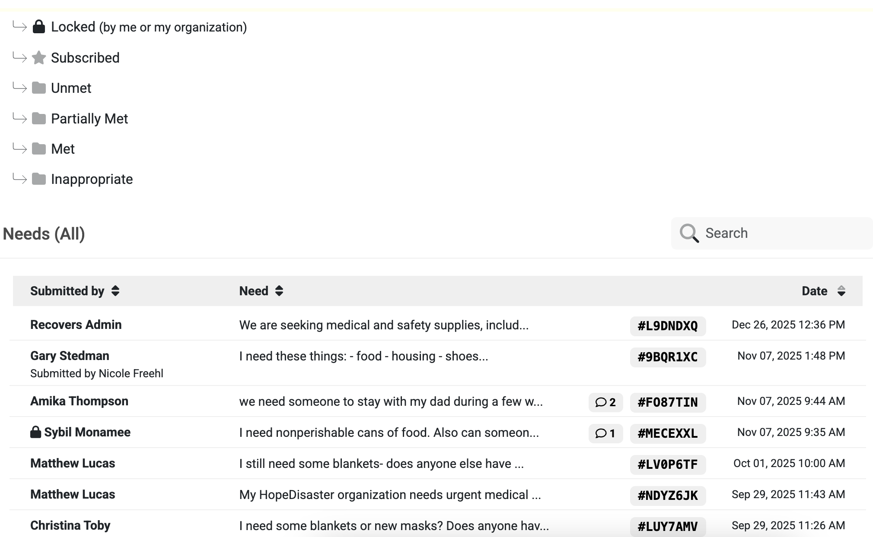
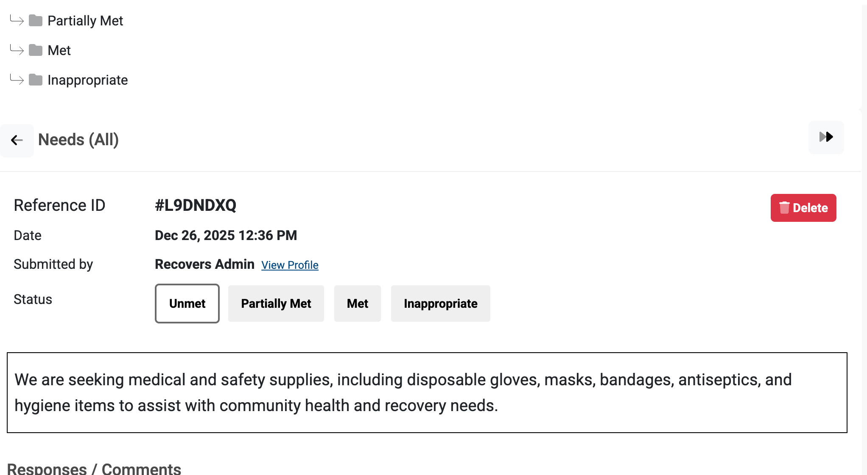

Slide 43
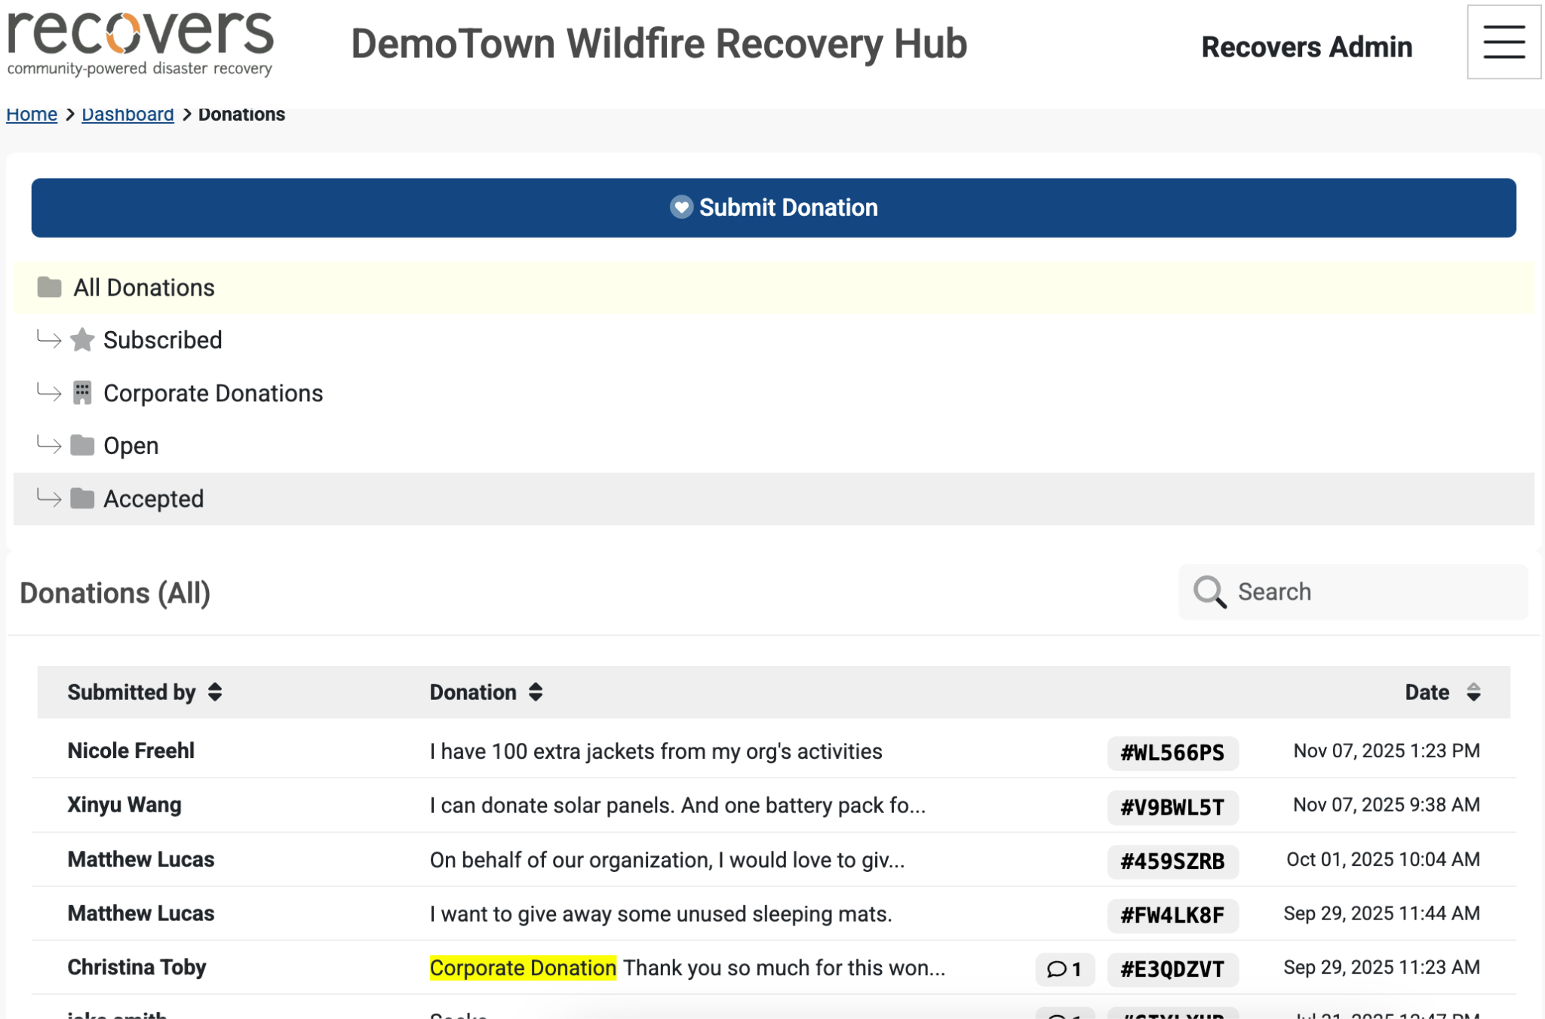
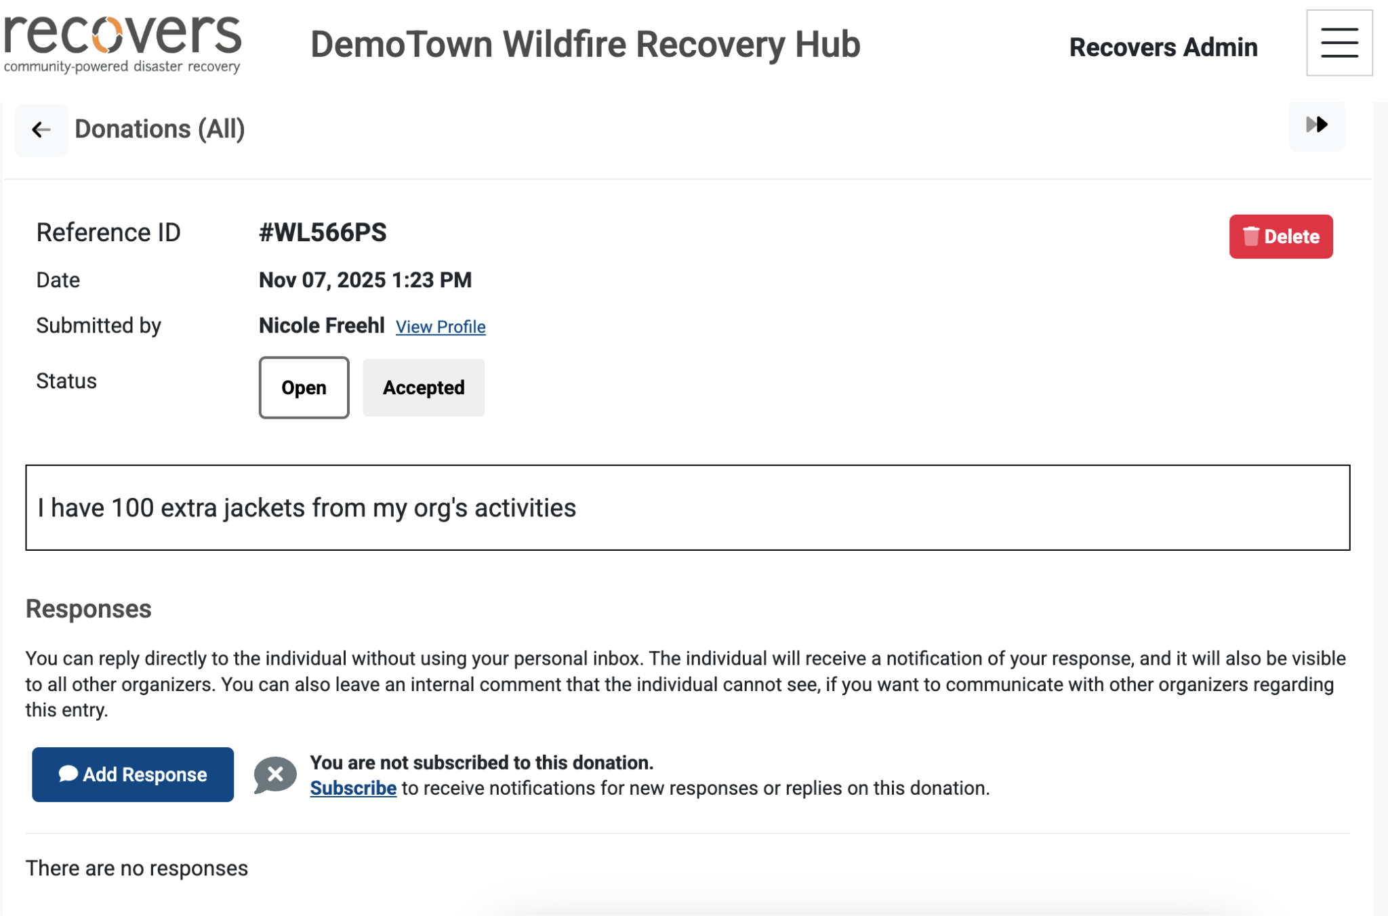

Slide 44
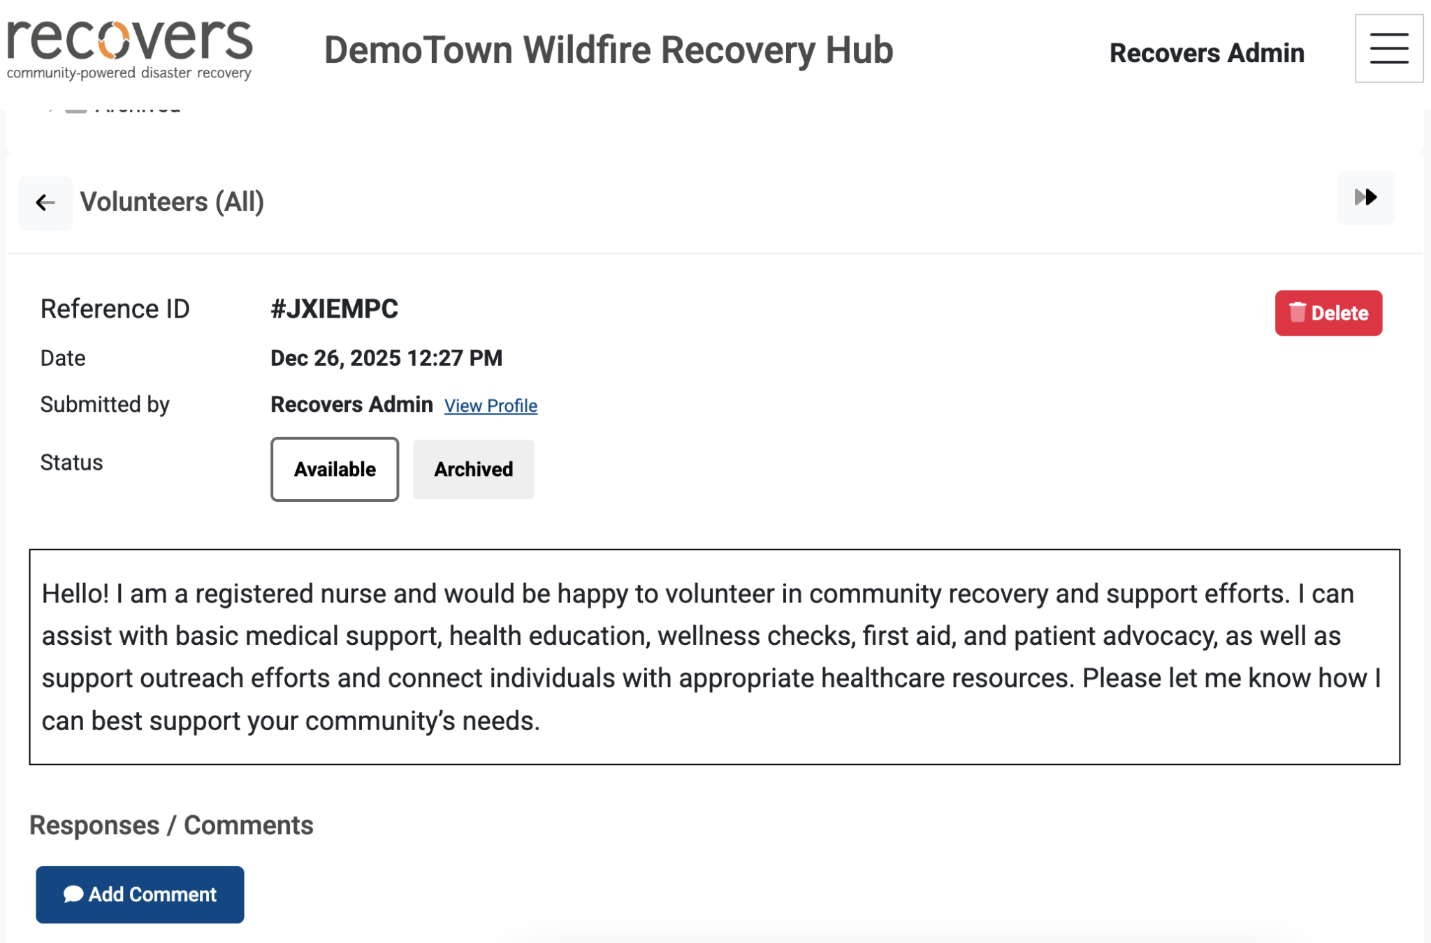

Slide 45
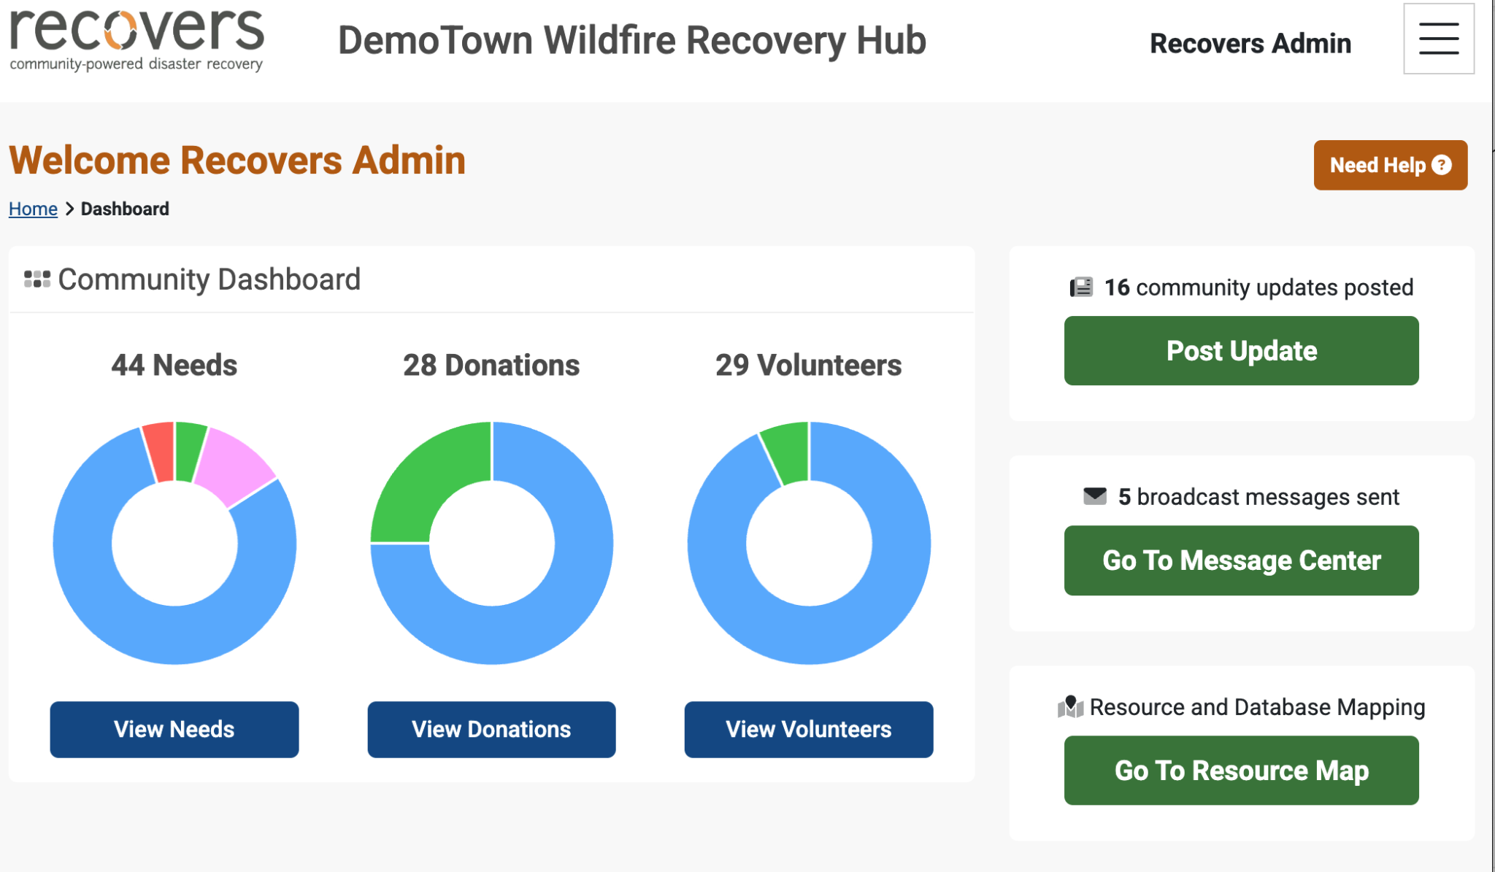

Slide 46
04
The Guardrails

Slide 47
“Vulnerable people don’t have to have vulnerable data”

Slide 48
Free vs Open Source

Slide 49
Data owned by community

Slide 50
Create your community today!
home.recovers.org

Slide 51
Thank you
Temitayo Ifafore-Calfee, MPH, PMP
support@recovers.org

Slide 52
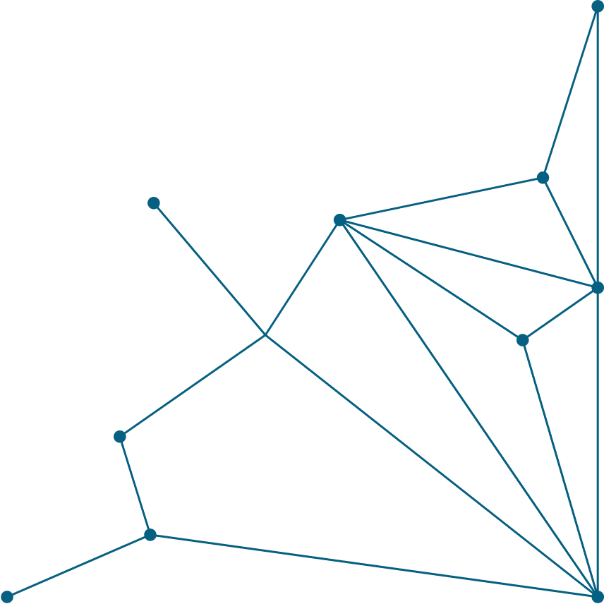






Predict, Prepare, Prevail:
How AI is Rewriting Emergency Preparedness
Presented by: Charles Sabo, MPH, CHEP, EMT-B

Slide 53

Charles “CJ” Sabo, MPH, CHEP, EMT-B
Manager, Emergency Management
The Hospital and Health System Association of Pennsylvania (HAP)
EM Consultant
HAPevolve / Health Care Preparedness Solutions
Education
  Master’s Degree in Public Health, University of West Florida
  Alumnus of the US Dept of Homeland Security Center for Domestic Preparedness, Anniston, AL
  Current Master Exercise Practitioner Program (MEPP) student (eventually?)

Slide 54

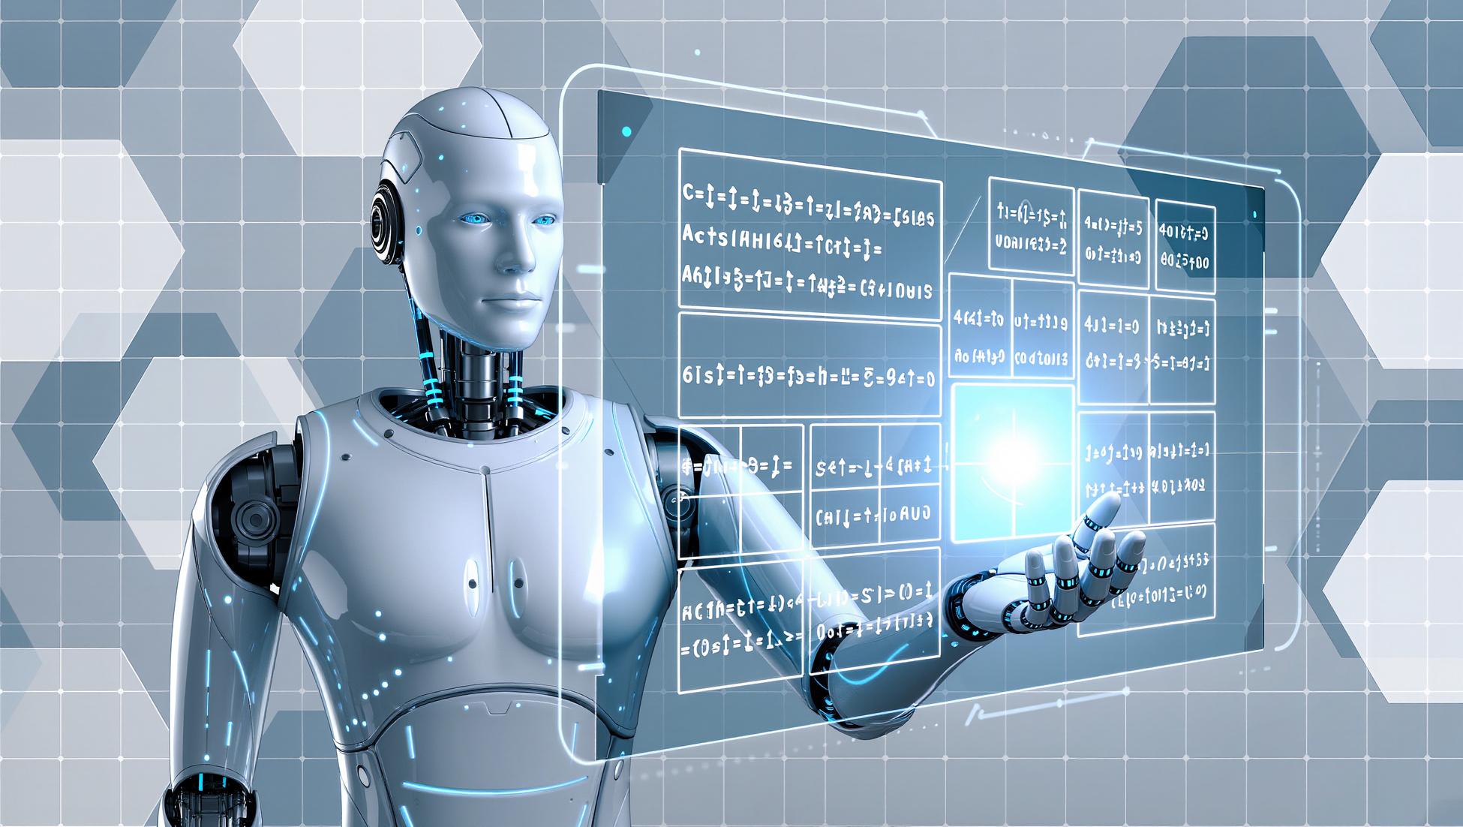

Session Goals
  Examine the benefits and operational processes associated with the use of artificial intelligence (AI) and machine learning.
  Present real-world use of AI and machine learning within healthcare settings.
  Evaluate the ethical and operational risks as well as challenges associated with AI adoption.
  Explore anticipated future applications of AI in healthcare emergency management.

Slide 55



Types of
Artificial Intelligence
Narrow (Weak) AI
This focuses on performing specific, predetermined tasks extremely well within certain boundaries/rules. Examples are Siri or Alexa.
General AI
Important note: AI is advancing faster than initially thought it would by experts.
It is a theoretical form of AI that matches or exceeds human intelligence across virtually all cognitive tasks. Unlike narrow AI (ANI) designed for specific tasks, AGI can generalize knowledge, learn autonomously, solve novel problems, and adapt to unfamiliar situations similar to a human.
Notes:
AI continues to advance rapidly, and it is becoming increasingly important to understand the different types that exist and how they compare and contrast.
The first category we'll discuss is Narrow AI, also known as Weak AI. This focuses on performing specific, predetermined tasks extremely well within certain boundaries and rules.
Some common examples include voice assistants (like Siri or Alexa), systems used to recommend movies or products, and engines for playing chess or other games at an advanced level.
While incredibly skilled in their specific areas, Narrow AI systems lack the broad intelligence and reasoning capabilities of humans across multiple subject areas. The tools we use now can engage in dialogues, answer questions, and perform tasks.
Conversational phrases (like “I’m curious about,” “I’m thinking through,” and “Ok, let me see”) are being included in responses to create an illusion of complexness and thought. But for the most part, these responses are based on pre-programmed scripts or simple pattern matching. So, in other words, these tools aren’t really ‘thinking’ in the same sense as how humans do.
In the middle of the spectrum is General AI, which is often referred to as "Strong AI" or Human-Level AI. AGI would be able to replicate human-like thought (including reasoning, problem solving, perception, learning, and language comprehension). These systems and tools theoretically could also feature emotional capabilities (like empathy) akin to those of a human. They might even be able to grasp the meaning behind what they’re doing.
As of now, General AI is still theoretical with no clear examples achieved yet. However, this remains an ambitious goal of AI research with some enthusiastic individuals, like Elon Musk or Sam Altman, anticipating a major breakthrough sooner rather than later.
Expert predictions have shifted from 2050-2060 to the late 2020s (e.g., 2028-2030) due to rapid advancements in Large Language Models (LLMs).

Slide 56
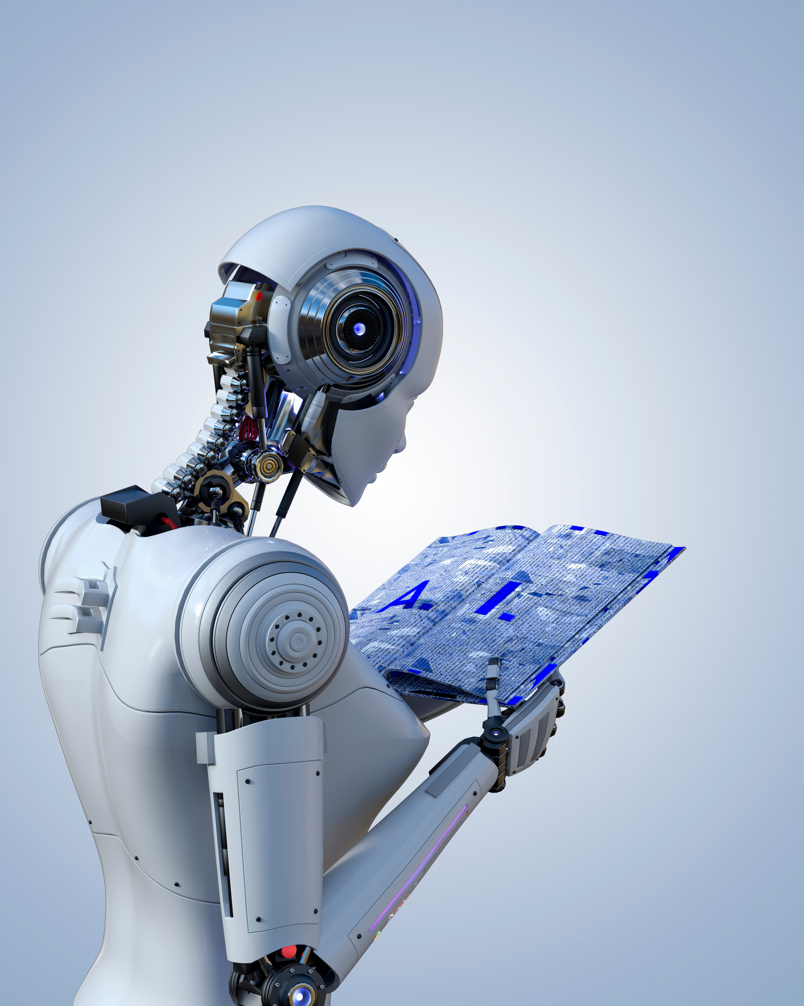
Benefits of
Machine Learning in EM
Predictive Risk Awareness
Real-Time Decision Support
ML can analyze historical data, weather patterns, patient trends, and regional risks to forecast emergencies before they happen.
During an incident, ML can process massive data streams (EHRs, EMS feeds, public health data) and provide actionable insights in real time.
Notes:
- Predict patient surge during flu season or pandemics
- Anticipate supply shortages or staffing gaps
- Identify facilities at higher risk during severe weather
This shifts emergency management from reactive → proactive.
- Recommend resource allocation (beds, ventilators, staff)
- Identify bottlenecks in patient flow
- Support incident command with data-driven suggestions

Slide 57
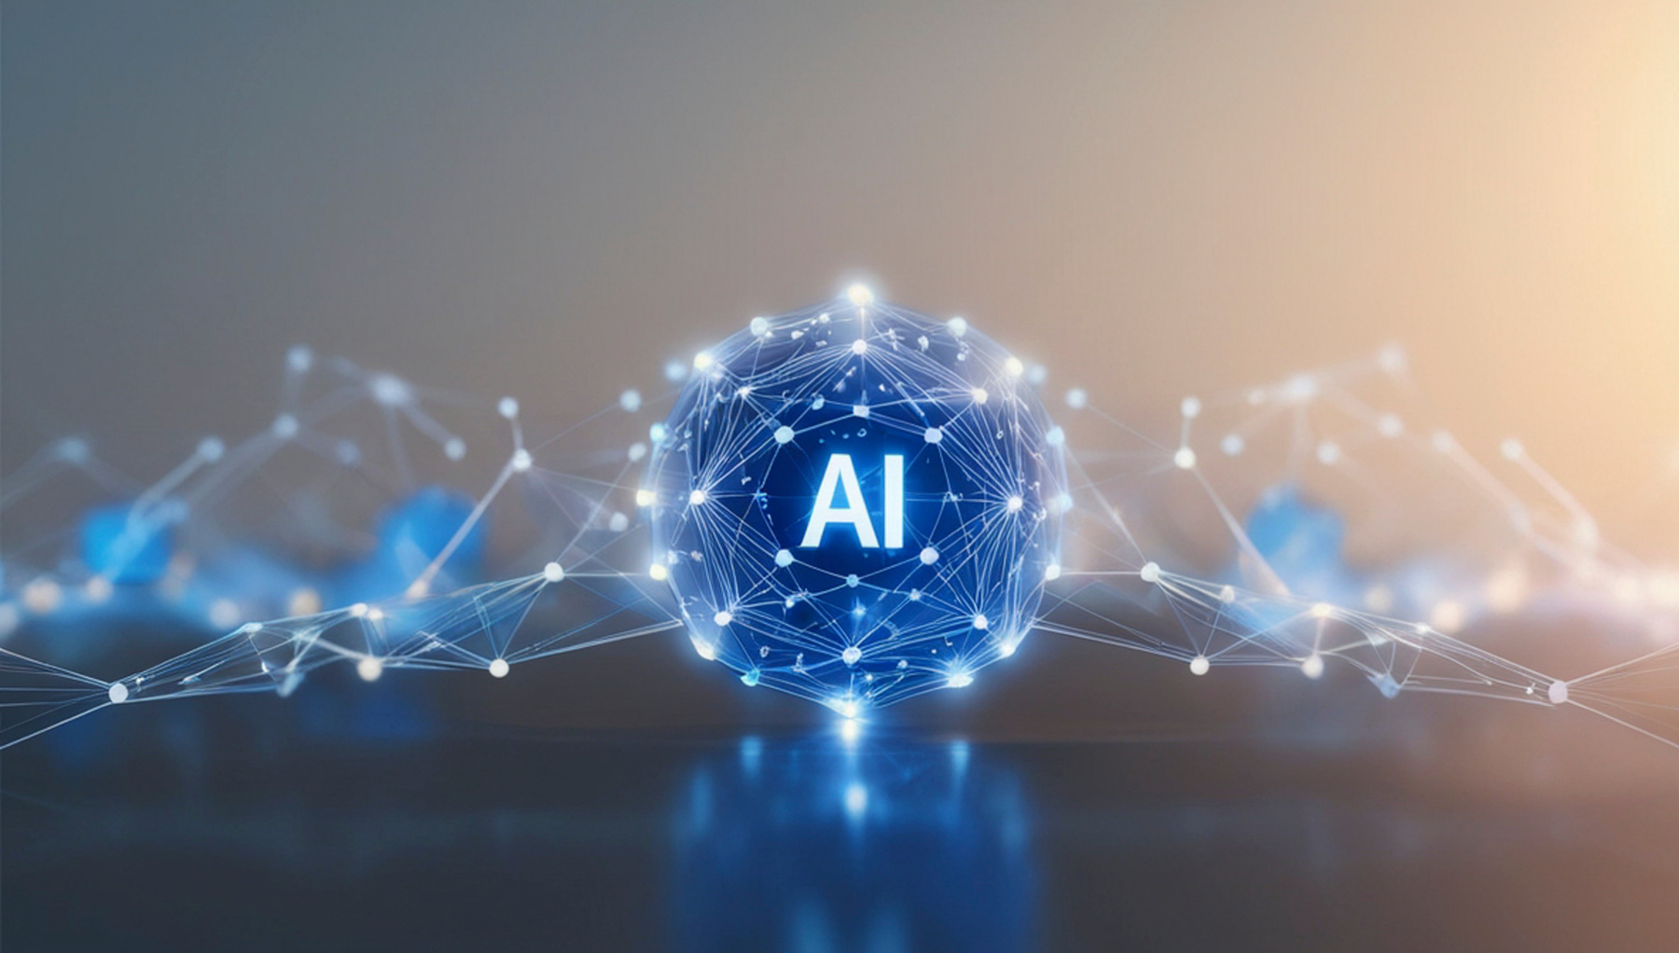

Benefits of
Machine Learning in EM
Enhanced Situational Awareness
Improve Resource Optimization
ML tools can aggregate and interpret multiple data sources simultaneously, giving leaders a clear, dynamic operating picture.
ML helps ensure the right resources are in the right place at the right time.
Notes:
-Detect anomalies (e.g., sudden spikes in ER visits).
-Monitor the regional healthcare system stress.
-Integrate with dashboards for coalition-wide visibility.
- Optimize staffing models based on predicted demand.
- Improve inventory management (PPE, medications).
- Reduce waste while maintaining readiness.

Slide 58

Benefits of
Machine Learning in EM
Faster & Smarter Communication
Training & Exercise Enhancement
Natural language processing (a branch of ML) can streamline communication.
ML can simulate complex, realistic emergency scenarios for training. Even teach it HSEEP-compliance.
Notes:
- Automate alerts and situation reports.
- Summarize incident data for leadership.
- Improve public messaging consistency and speed.
- Adaptive exercises that evolve based on participant decisions.
- Identification of gaps in plans and response capabilities.
- Data-driven after-action insights.

Slide 59
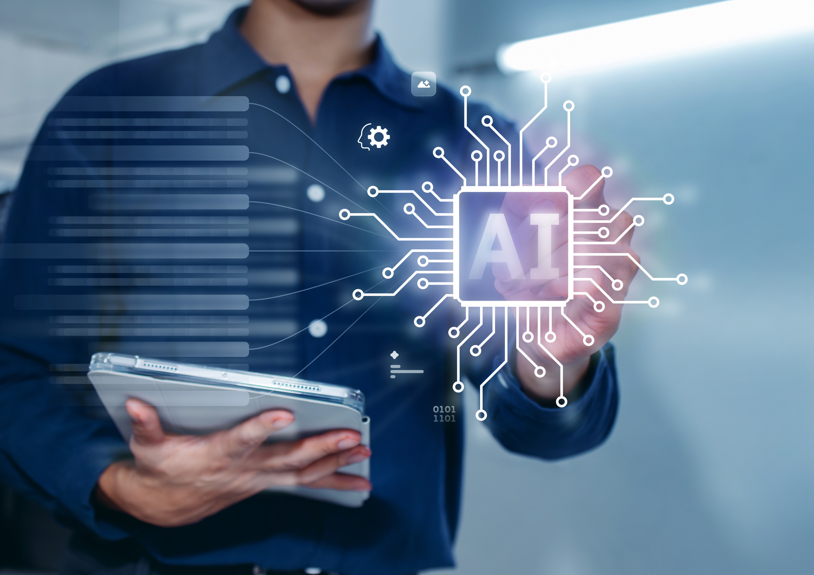
Benefits of
Machine Learning in EM
Continuously Improving
Strengthen Regional Coordination
ML systems improve over time by learning from past incidents.
ML can analyze patterns across multiple hospitals and agencies to support coalition-level decision-making.
Notes:
- Refine emergency plans based on real outcomes.
- Identify recurring weaknesses.
- Support evidence-based preparedness strategies.
- Predict regional surge and patient distribution needs.
- Support mutual aid planning.
- Enable shared situational awareness across systems.

Slide 60





Machine Learning Process
Get Data
Improve
Clean Data
Machine learning is a subset of artificial intelligence (AI) that enables computers to learn from data and make decisions or predictions without explicit programming. It involves training algorithms on large datasets to recognize patterns, allowing them to improve performance over time and apply learned patterns to new data.
Train Model
Prepare Data
Notes:
Much like the preparedness cycle we all know and love, machine learning has its own. The first step at the top is really major and the most important task; without it, you can’t do anything. Therefore, it is very important to have data in hand.
Step 1: Let’s take an example of a regional emergency management coalition that supports hospitals and healthcare facilities across a state. We need to build a database that includes facility information (bed capacity, ICU availability, staffing levels) and incident data (weather events, mass casualty incidents, supply shortages, EMS surge data).
We also collect external data such as weather forecasts, historical disaster impacts, and community vulnerability indicators.
Step 2: After collecting the data, clean it. In real-world emergency management, data is often incomplete, inconsistent, or delayed.
For example, hospital reporting systems may have missing bed counts, duplicate entries, or outdated resource availability. Weather data feeds may have gaps, and incident reports may contain inconsistent terminology.
Step 3: Once the data is cleaned, it needs to be prepared for the machine learning model.
In emergency management, this means transforming raw data into meaningful inputs (features). For example:
- Converting weather forecasts into risk scores (e.g., tornado probability index).
- Aggregating hospital capacity into regional surge levels.
- Creating variables like “patients per available bed” or “EMS response time trends.”
- Encoding categorical data (e.g., incident type: flood, fire, mass casualty)
Step 4: We select and train a machine learning model on the prepared data.
For an emergency management example:
- A model could predict hospital surge based on weather events and historical incident data
- Another model could forecast EMS demand during large-scale events
Step 5: After training the model, we need to evaluate how well it performs. This is basically the AAR process.
In emergency management, accuracy is critical because decisions impact lives.
Evaluation involves:
- Comparing predictions to actual outcomes (e.g., predicted vs. actual patient surge)
- Using metrics like accuracy, precision, recall, or error rates
- Testing the model under different scenarios (e.g., extreme weather events)

Slide 61
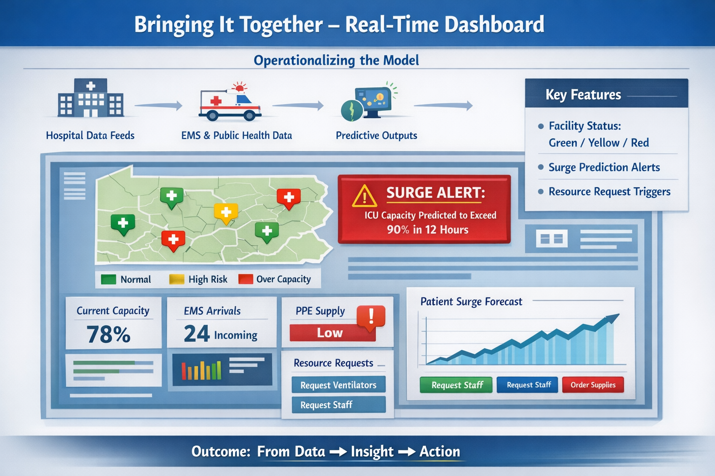
Notes:
Talk about all the inputs to put something like this together.
“Now that we’ve walked through the machine learning process, this is where everything comes together—operationalizing the model in a way that actually supports decision-making in real time.
What you’re looking at here is a live dashboard environment that integrates multiple data streams. On the left side, we have internal hospital data feeds—things like bed availability, ICU capacity, and staffing levels. We’re also pulling in EMS and public health data, which gives us a broader picture of what’s happening across the region.
On top of that, we layer predictive outputs from our models. This is where machine learning adds real value—not just showing us what’s happening now, but what’s likely to happen next.
If you look at the map, you’ll see facilities color-coded as green, yellow, or red. This gives incident command and regional partners an immediate visual of system stress. Instead of digging through spreadsheets, they can instantly identify which hospitals are approaching capacity.
One of the most powerful features is the predictive surge alert. In this example, the system is warning that ICU capacity is expected to exceed 90% within the next 12 hours. That kind of lead time is critical—it allows hospitals to activate surge plans, adjust staffing, or coordinate patient distribution before the situation becomes critical.
Below that, you’ll see operational metrics like EMS arrivals and PPE supply levels. These aren’t just informational—they’re actionable. When thresholds are met, the system can trigger resource requests, like additional staff or ventilators.
And that’s really the key takeaway here—this isn’t just a dashboard for awareness. It’s a decision-support tool.
It moves us from simply collecting data… to generating insight… to actually driving action.
And in emergency management, that shift—from reactive to predictive—can make all the difference in patient outcomes and system resilience.”

Slide 62

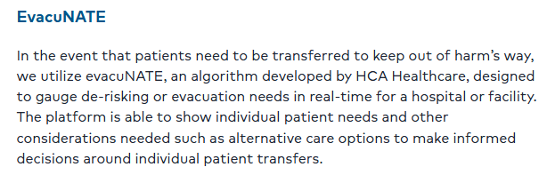
Use Cases Of AI Machine Learning
Notes:
Here is an example of a use case of machine learning regarding the evacuation of hospitals before potential hurricanes. HCA, one of HAPevolve's past clients, uses evacuNATE to de-risk and plan for patient movements. The system helps them make informed decisions on using real-time triage data.
The system helps them to evaluate what the census of patients is in a particular facility, and if that facility is in the potential path of the hurricane. They can then do some risk evaluation on what patients can be moved later, [and] what patients might be more resource intensive in terms of their support needs and might need to be evacuated earlier."

Slide 63
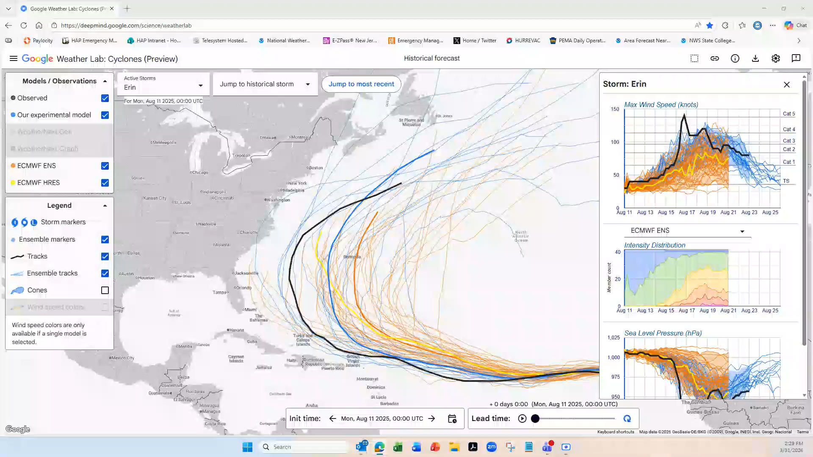
Use Cases Of AI
Google DeepMind WeatherLab
Notes:
Developed by Google DeepMind and Google Research, it is an experimental AI model designed specifically to forecast the path, intensity, and structure of tropical cyclones.
Released June 12, 2025. In testing on 2023-2024 storms, the AI's five-day forecasts placed cyclones on average 87 miles closer to their actual paths than the European Center for Medium-Range Weather Forecasts'.
Training Data: It was trained on historical reanalysis data and a specialized database containing records of nearly 5,000 cyclones from the past 45 years.
Probabilistic Approach: Instead of a single forecast, the AI generates 50 possible scenarios (ensembles) for a storm's development up to 15 days in advance.
Performance: In internal testing, the model outperformed traditional physics-based models (like the European Centre for Medium-Range Weather Forecasts' ensemble model) on five-day track forecasts.
Real-World Application: The National Hurricane Center (NHC) is partnering with Google to evaluate these live AI predictions alongside traditional methods to aid in decision-making.

Slide 64
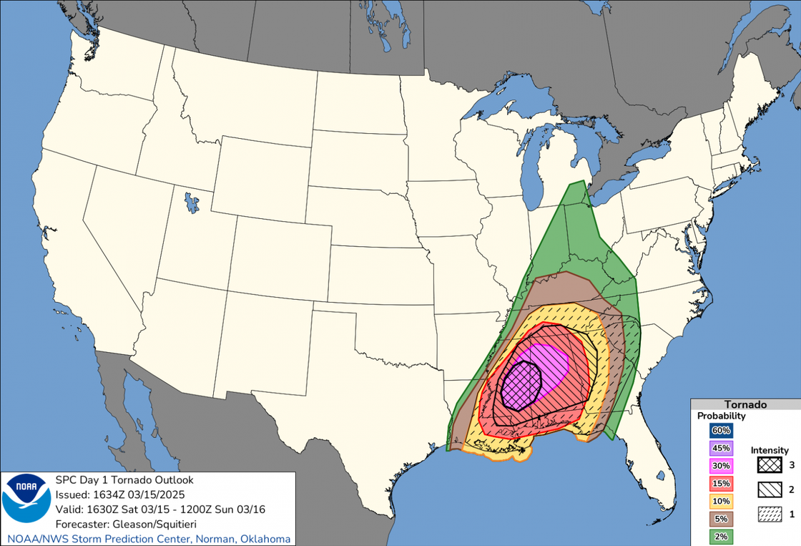
Use Cases Of AI Machine Learning
Convective Outlooks update by the NOAA Storm Prediction Center (SPC)
  Newer use of machine learning from NOAA with the ability to predict severe weather up to 8 days in advance
  Replaced the old “hatched areas” with conditional intensity groups (CIGs).
  Traditional risk levels will show likelihood, CIGs will display the possible intensity levels, and who is at greatest risk to receive the most extreme events, including hail, wind, or tornadoes.
Notes:
Another new release is the storm prediction centers convective outlooks. The NWS has really started to utilize AI, and it makes sense to as they collect so many data points over the years. Not to turn this presentation into a weather forecasting update, but this is a great example of utilize the predictive analytics of AI to determine not only a more refined probability range, but an intensity range as well.

Slide 65
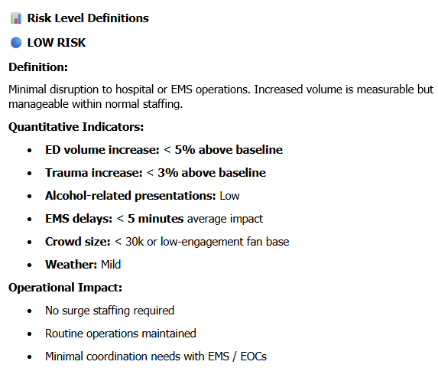
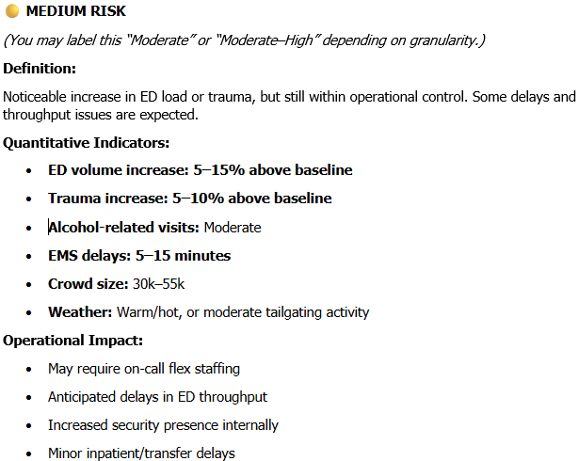
Current AI Use (FIFA)
Notes:
Now I want to get into some current day personal use case items. If you have not heard, we have FIFA coming in a few weeks. Much like NY/NJ has 8 matches, including a few playoff games and the championship. We are hosting a total of 6 matches including 1 playoff game, which happens to fall of the 4th of July, which is also America 250.
So again, machine learning is based off of data. Being hospital settings, we have a ton of data. So each quantitative indicator you see here is based on data points and then we were able to create a level of risk for the hospitals to plan off of. You can see the possible operation impacts that hospitals may do to based on the risk for the date.
Discuss some of the indicators. Trauma increase (what time is the game, traffic patterns (MVA’s), 4th of July, etc; alcohol related is it a rowdy crowd usually, is it a day game versus a night game or weekend; If it’s a cooler day versus a hot day what is the weather forecast.

Slide 66
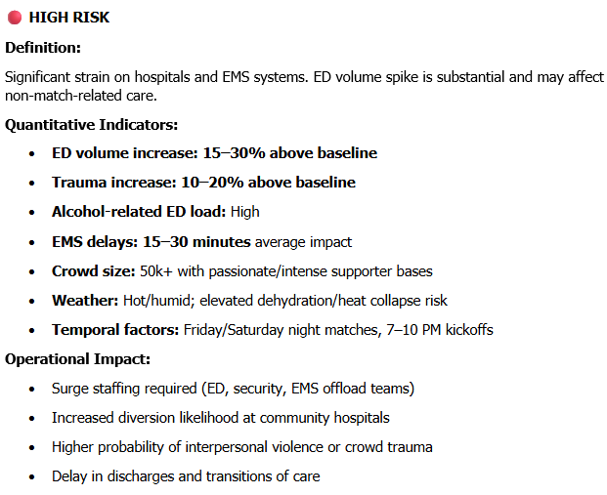
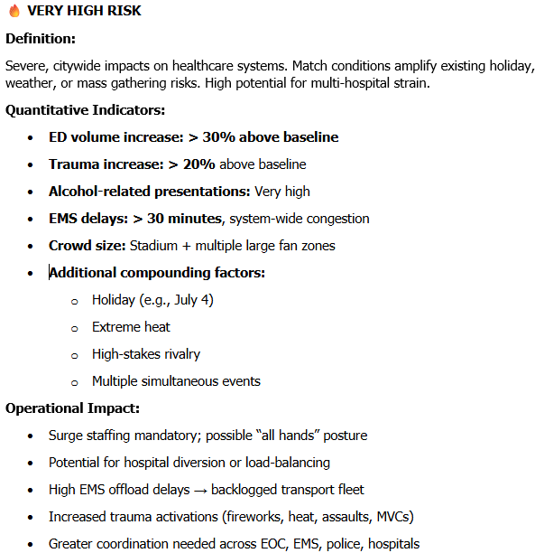
Current AI Use (FIFA)
Notes:
Now these games is when we will be expective more significant impacts when we see a high risk or very high risk. You can see ED volume increases at a peak severe flu season level or covid; higher than normal risk of trauma; is it a night game or a weekend game or both; based on the fan base is it expected to be rowdy or a sellout crowd (67,000+), are the temps hot and humid; then very high is all hands on deck sold out stadium large fan zones/marches, on a holiday

Slide 67
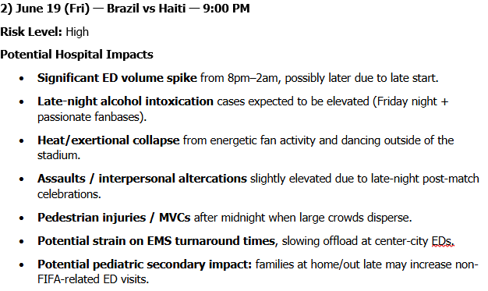
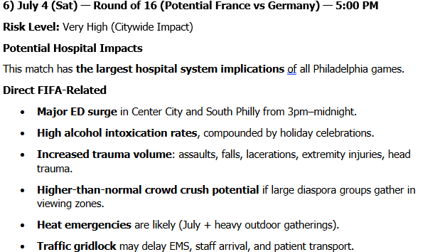
Current AI Use (FIFA)

Slide 68

Current AI Use (FIFA)
  These specific risk definitions don’t include the FIFA Fan Fest or the pre-game fan march.
  Once closer to game days, the impact levels will be re-run with updated NWS forecasted weather.
  Historical fan base “hooliganism is factored into risk definitions.

Slide 69

Current AI Use (FIFA)

Slide 70

Challenges of AI
What Gets in the Way
Data Silos Across Systems
Hospitals don’t operate on a single platform - data is spread across EHR’s, bed tracking, EMS platforms, supply chain tools, incident management systems.
Interoperability Challenges
Even when organizations want to share data, technical and policy barriers may exist.
Data Quality Issues
“Garbage in, garbage out” is especially true in this case.
Staff Trust in AI Outputs
Even the best model won’t be used if people don’t trust it.

Slide 71

Risks of AI
What Could go Wrong
Bad Data = Bad Decisions
AI models are only as good as the data behind their development.
Overreliance on Automation
When AI outputs look authoritative, there’s a tendency to trust them too much.
Lack of Transparency (“Black Box” Models)
Some models don’t clearly explain how they reach their conclusions, or they make up disasters for data.
Bias in Data and Outcomes
Historical data may reflect systemic biases.
Lacks Empathy
It lacks consciousness, empathy, and understanding of right and wrong.

Slide 72


Future of
Artificial Intelligence
AI is already starting to reshape healthcare emergency management—but the next wave will be far more predictive, automated, and system-wide. Here are some of the most impactful future uses:
Predictive Incident Forecasting
AI-Assisted Incident Command
AI will analyze weather, public health data, and social patterns to predict events before they happen
Real-time decision support tools will help Incident Command teams. Flag emerging risks, recommend resource allocations, operational strategies, etc.

Slide 73


Future of
Artificial Intelligence
Intelligent Resource Allocation
During emergencies, AI can: automatically match resources with available assets, coordinate assets, etc.
Automated Surge Capacity Modeling
Evacuation & Shelter-In-Place Optimization
AI will continuously model ED and inpatient demand using live data feeds. Staffing adjustments, predict surge, bed flow, etc.
ML can transform evacuation and shelter-in-place decision-making by analyzing patient acuity, resource availability, and real-time environmental risks to determine the safest course of action.

Slide 74


Future of
Artificial Intelligence
Real-Time Situational Awareness
AI-powered chatbots that can fuse data points, creating a live operating picture across an entire healthcare system or region.
Crisis Communication & Misinformation Control
Cyber Resilience & Threat Detection
AI tools will be able to step in and control rumors on social media or tailor messaging that comms can distribute.
AI will play a major role in identifying and responding to cyber threats. Threat detection, predict ransomware, etc.

Slide 75
5 Principles for Trusted AI in EM
01
02
03
04
05
Build collaboration before a crisis.
Start with purpose, not platform.
Keep humans in the loop.
Govern data and access.
Communicate clearly and honestly.
Notes:
First, we have to start with purpose, not platform.
It’s easy to get excited about new tools, dashboards, or algorithms—but technology should never drive the mission. Instead, we need to clearly define the problem we’re trying to solve. Is it predicting patient surge? Improving situational awareness? Supporting incident command decisions? When the purpose is clear, the technology becomes a solution—not a distraction.
Second, we must keep humans in the loop.
AI should support decision-making, not replace it. In emergency management, context matters—clinical judgment, operational awareness, and experience all play a critical role. The goal is to augment human expertise with better data and faster insights, not hand over control to an algorithm.
Third, we need to govern data and access.
Trusted AI depends on trusted data. That means having clear policies around who can access data, how it’s shared, and how it’s protected. Especially in healthcare, where privacy and security are paramount, strong governance builds both compliance and confidence.
Fourth, we must communicate clearly and honestly.
If users don’t understand how a model works—or its limitations—they won’t trust it. We need to be transparent about what the AI is doing, what data it’s using, and how confident it is in its predictions. Just as important, we have to communicate when it might be wrong.
And finally, we have to build collaboration before the crisis.
You can’t introduce AI tools for the first time during an incident and expect adoption. Trust is built through relationships—between hospitals, EMS, public health, and emergency management—long before an event occurs. When stakeholders are involved early, they’re far more likely to rely on those tools when it matters most.

Slide 76

Conclusion
Final Remarks
As you leave here, I encourage you to think about three things:
  Where can we be more proactive instead of reactive?
  How can we strengthen our partnerships before we need them?
  And how can we leverage data and emerging tools, like AI, to make faster, smarter decisions?

Slide 77

Register for Healthccare Preparedness Digest
Notes:
Talk about all the inputs to put something like this together.
“Now that we’ve walked through the machine learning process, this is where everything comes together—operationalizing the model in a way that actually supports decision-making in real time.
What you’re looking at here is a live dashboard environment that integrates multiple data streams. On the left side, we have internal hospital data feeds—things like bed availability, ICU capacity, and staffing levels. We’re also pulling in EMS and public health data, which gives us a broader picture of what’s happening across the region.
On top of that, we layer predictive outputs from our models. This is where machine learning adds real value—not just showing us what’s happening now, but what’s likely to happen next.
If you look at the map, you’ll see facilities color-coded as green, yellow, or red. This gives incident command and regional partners an immediate visual of system stress. Instead of digging through spreadsheets, they can instantly identify which hospitals are approaching capacity.
One of the most powerful features is the predictive surge alert. In this example, the system is warning that ICU capacity is expected to exceed 90% within the next 12 hours. That kind of lead time is critical—it allows hospitals to activate surge plans, adjust staffing, or coordinate patient distribution before the situation becomes critical.
Below that, you’ll see operational metrics like EMS arrivals and PPE supply levels. These aren’t just informational—they’re actionable. When thresholds are met, the system can trigger resource requests, like additional staff or ventilators.
And that’s really the key takeaway here—this isn’t just a dashboard for awareness. It’s a decision-support tool.
It moves us from simply collecting data… to generating insight… to actually driving action.
And in emergency management, that shift—from reactive to predictive—can make all the difference in patient outcomes and system resilience.”

Slide 78
Thank you
for Your Attention
Presented by: Charles Sabo, MPH, CHEP, EMT-B

