Slide 1


LESSONS LEARNED FROM THE TRIPLE-DEMIC: THE CCMC EXPERIENCE AND THE CHALLENGES OF MANAGING A PEDIATRIC RESPIRATORY SURGE
Matthew Harris MD, FAAP, FAEMS, EMT-P Medical Director, Clinical Preparedness Cohen Children's Medical Center
Northwell Health
All Contents Considered Proprietary and Confidential Information
CONFIDENTIAL – N.Y. Education Law § 6527;
N.Y. Public Health Law § 2805, J, K, L, M
N.Y. Public Health Law § 3006

Slide 2
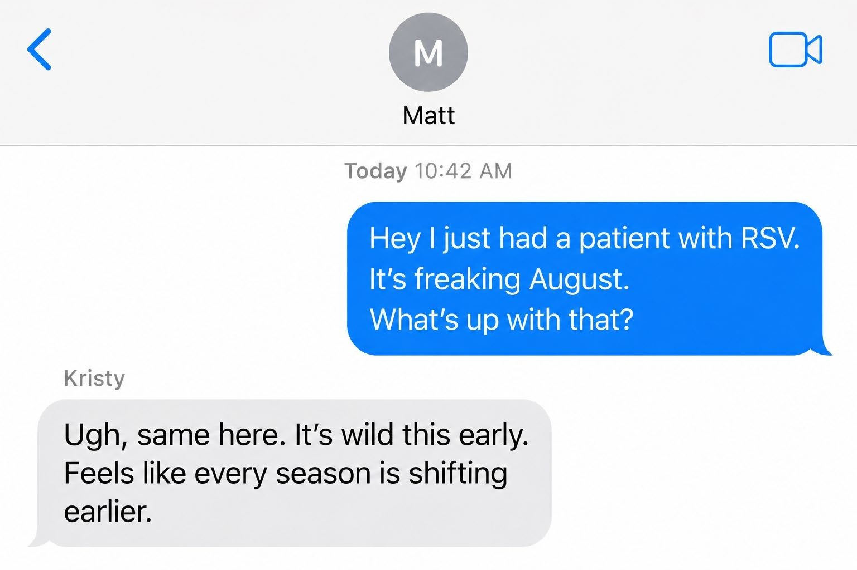
August 2022
All Contents Considered Proprietary and Confidential Information
CONFIDENTIAL – N.Y. Education Law § 6527; N.Y. Public Health Law § 2805, J, K, L, M; N.Y. Public Health Law § 3006

Slide 3
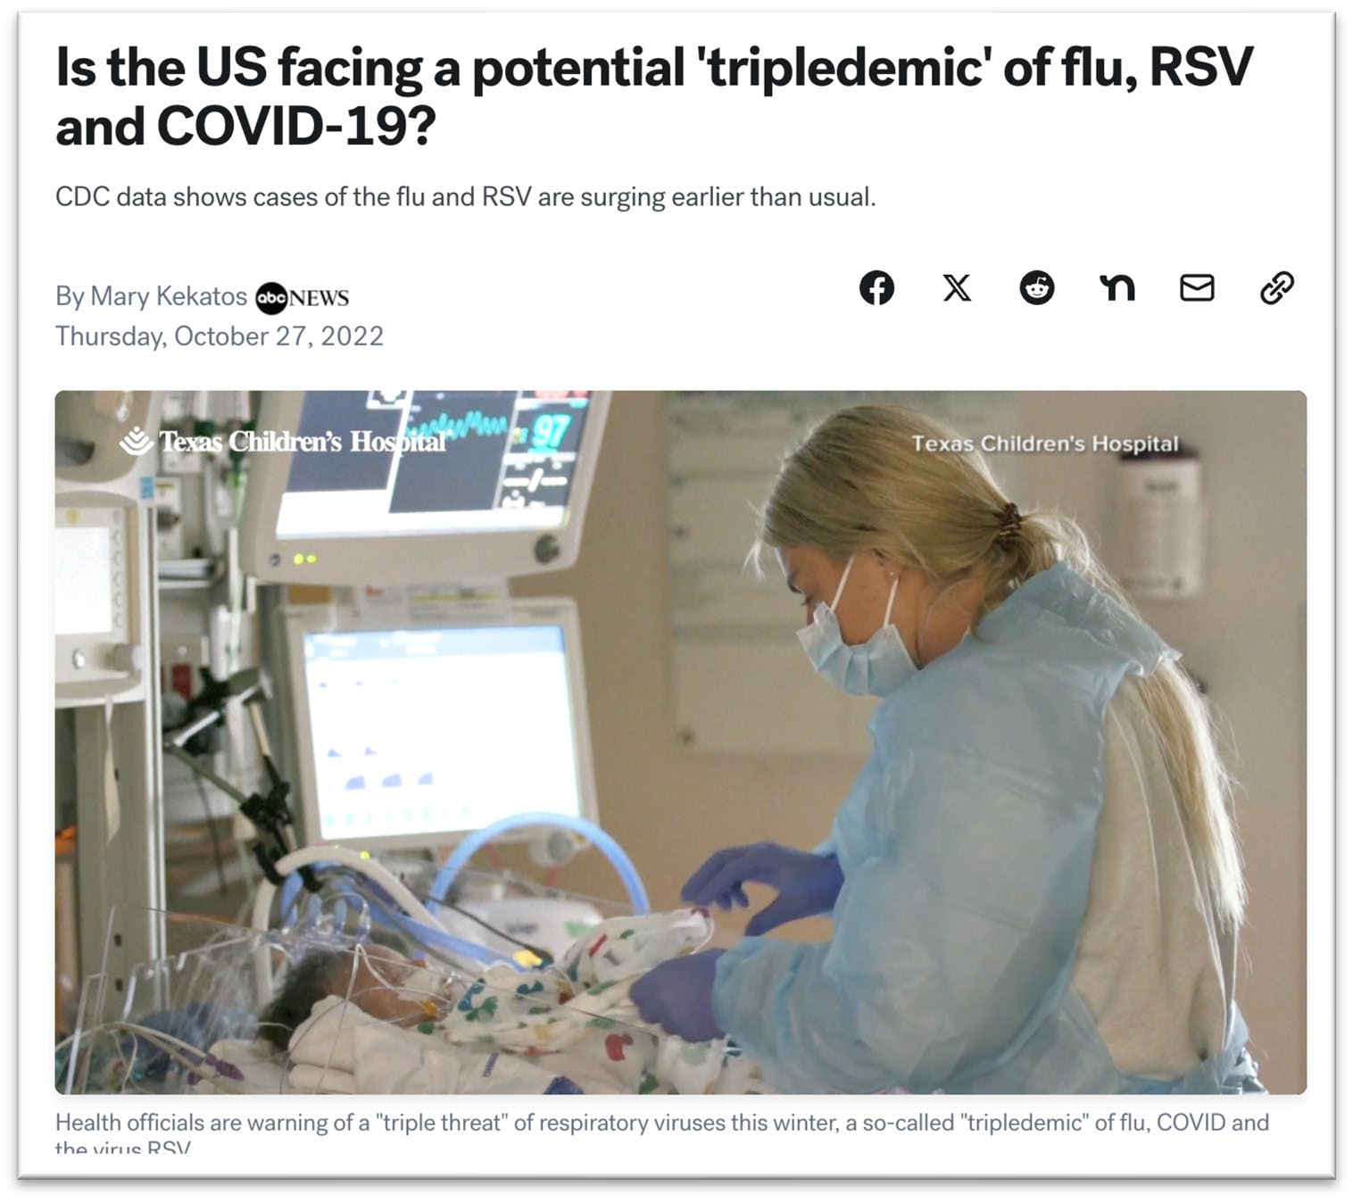
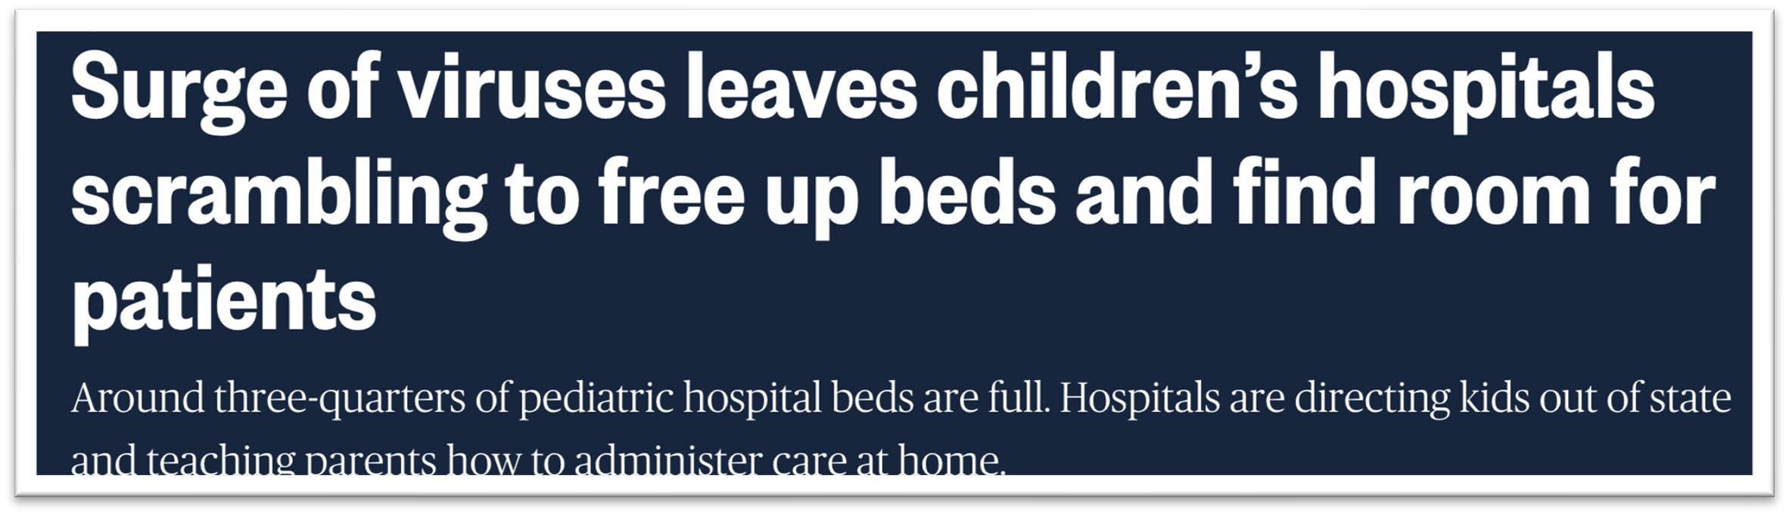
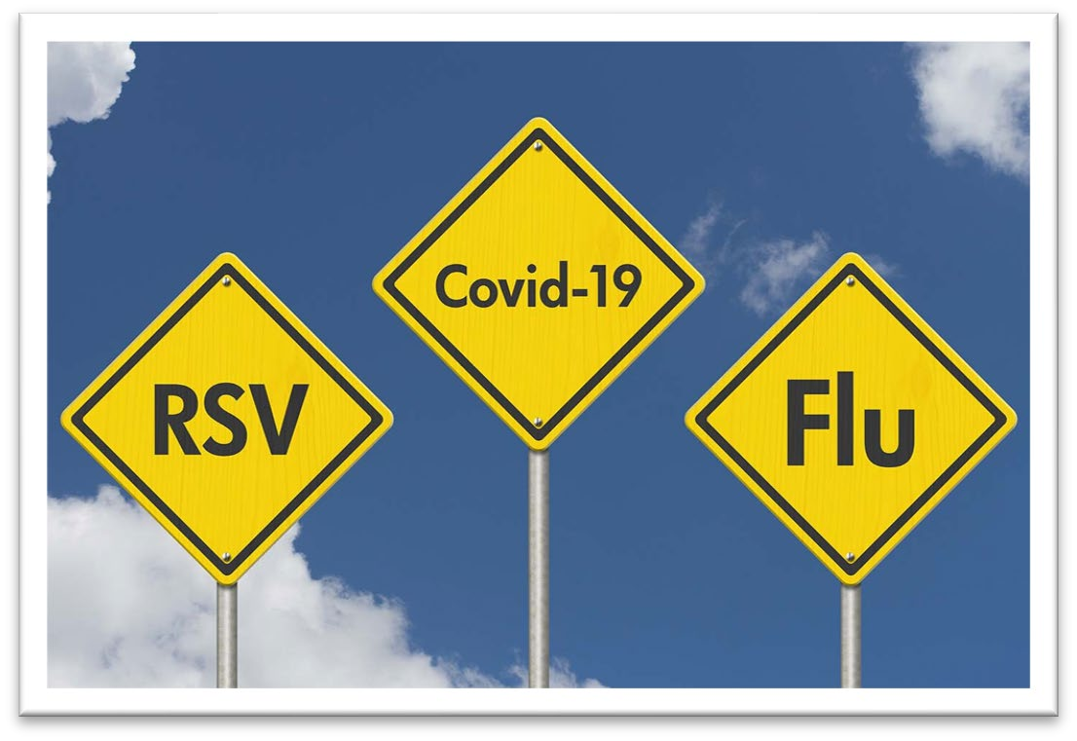
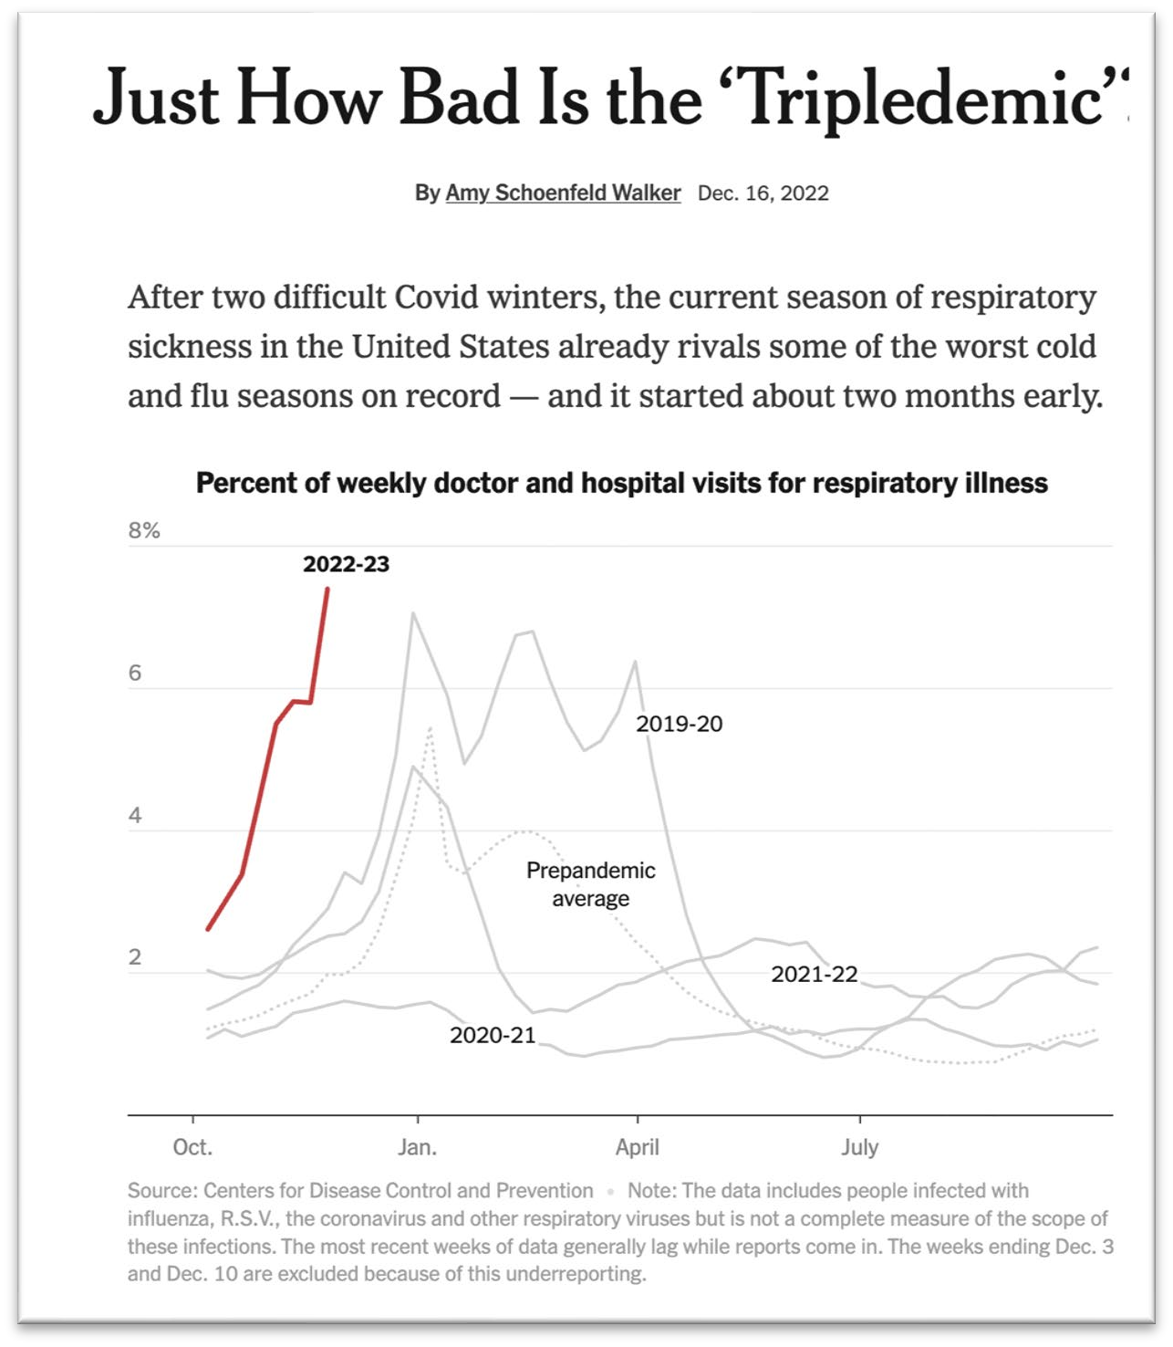
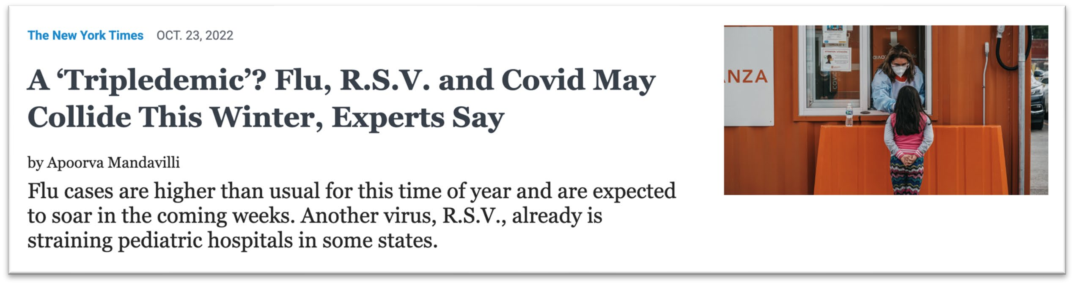
All Contents Considered Proprietary and Confidential Information
CONFIDENTIAL – N.Y. Education Law § 6527; N.Y. Public Health Law § 2805, J, K, L, M; N.Y. Public Health Law § 3006

Slide 4
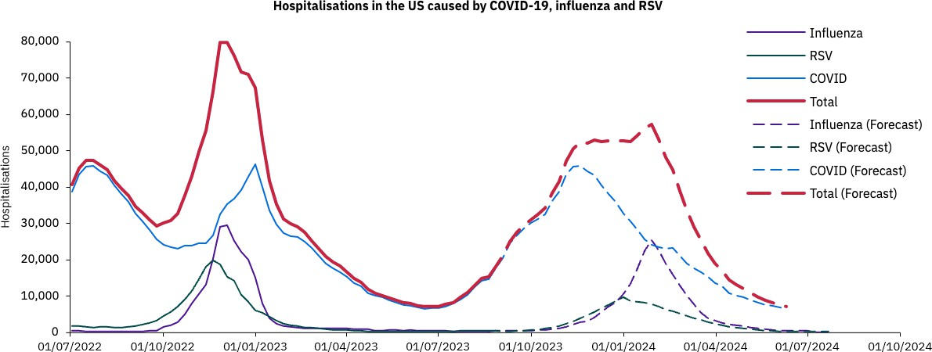
All Contents Considered Proprietary and Confidential Information
CONFIDENTIAL – N.Y. Education Law § 6527; N.Y. Public Health Law § 2805, J, K, L, M; N.Y. Public Health Law § 3006

Slide 5
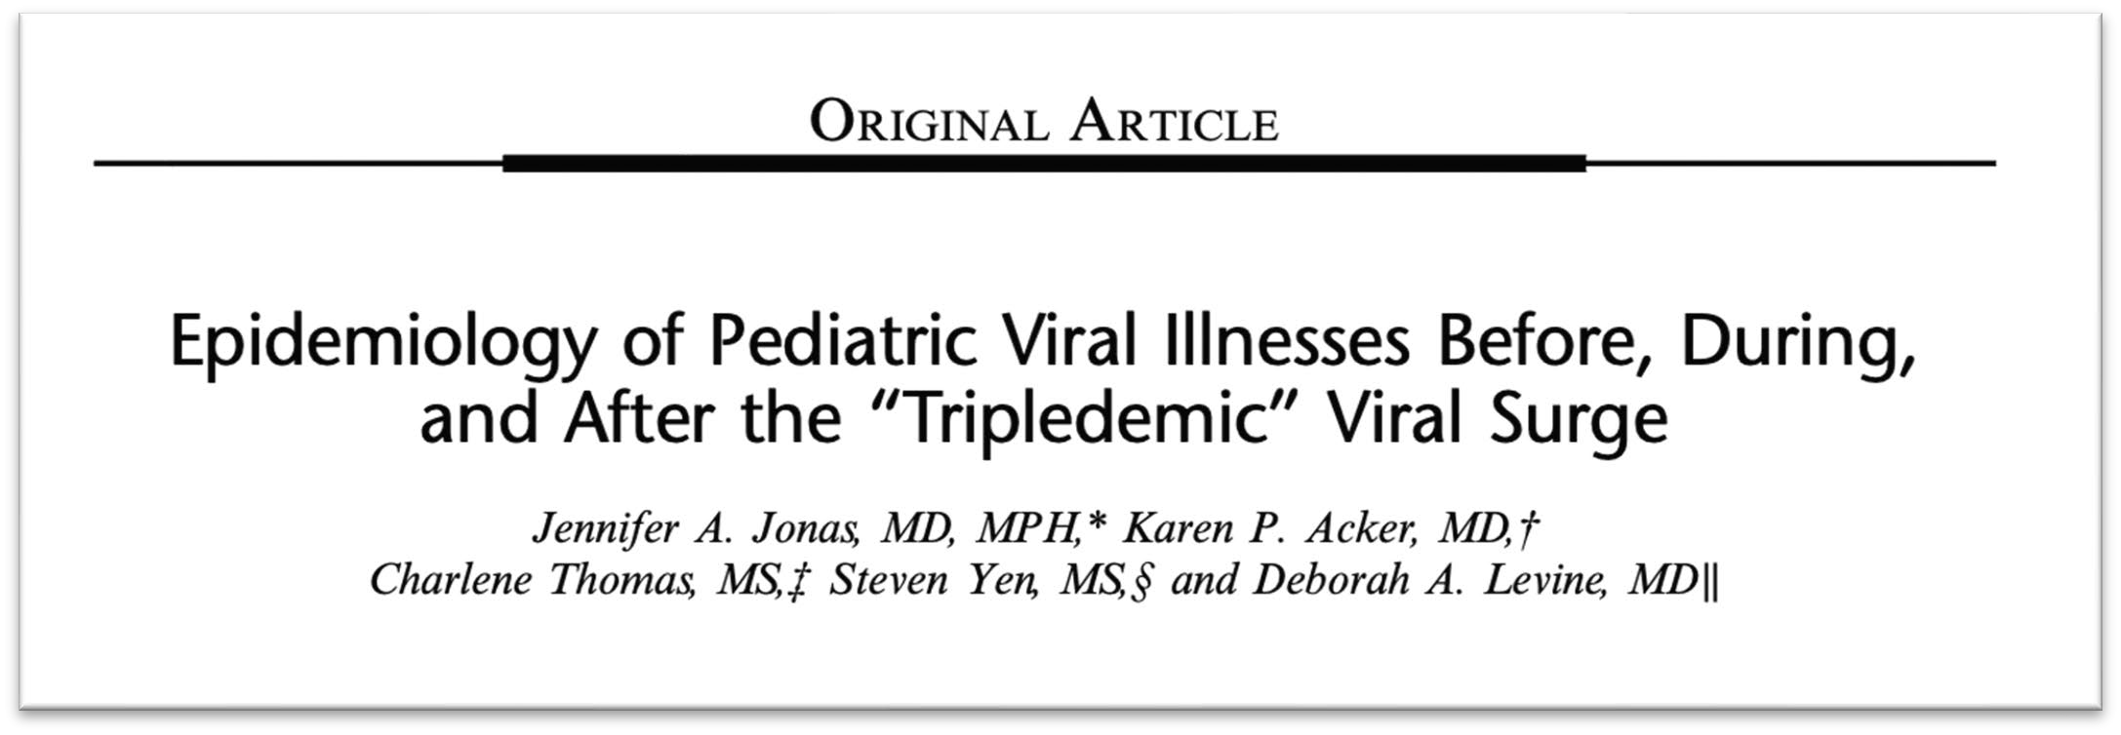
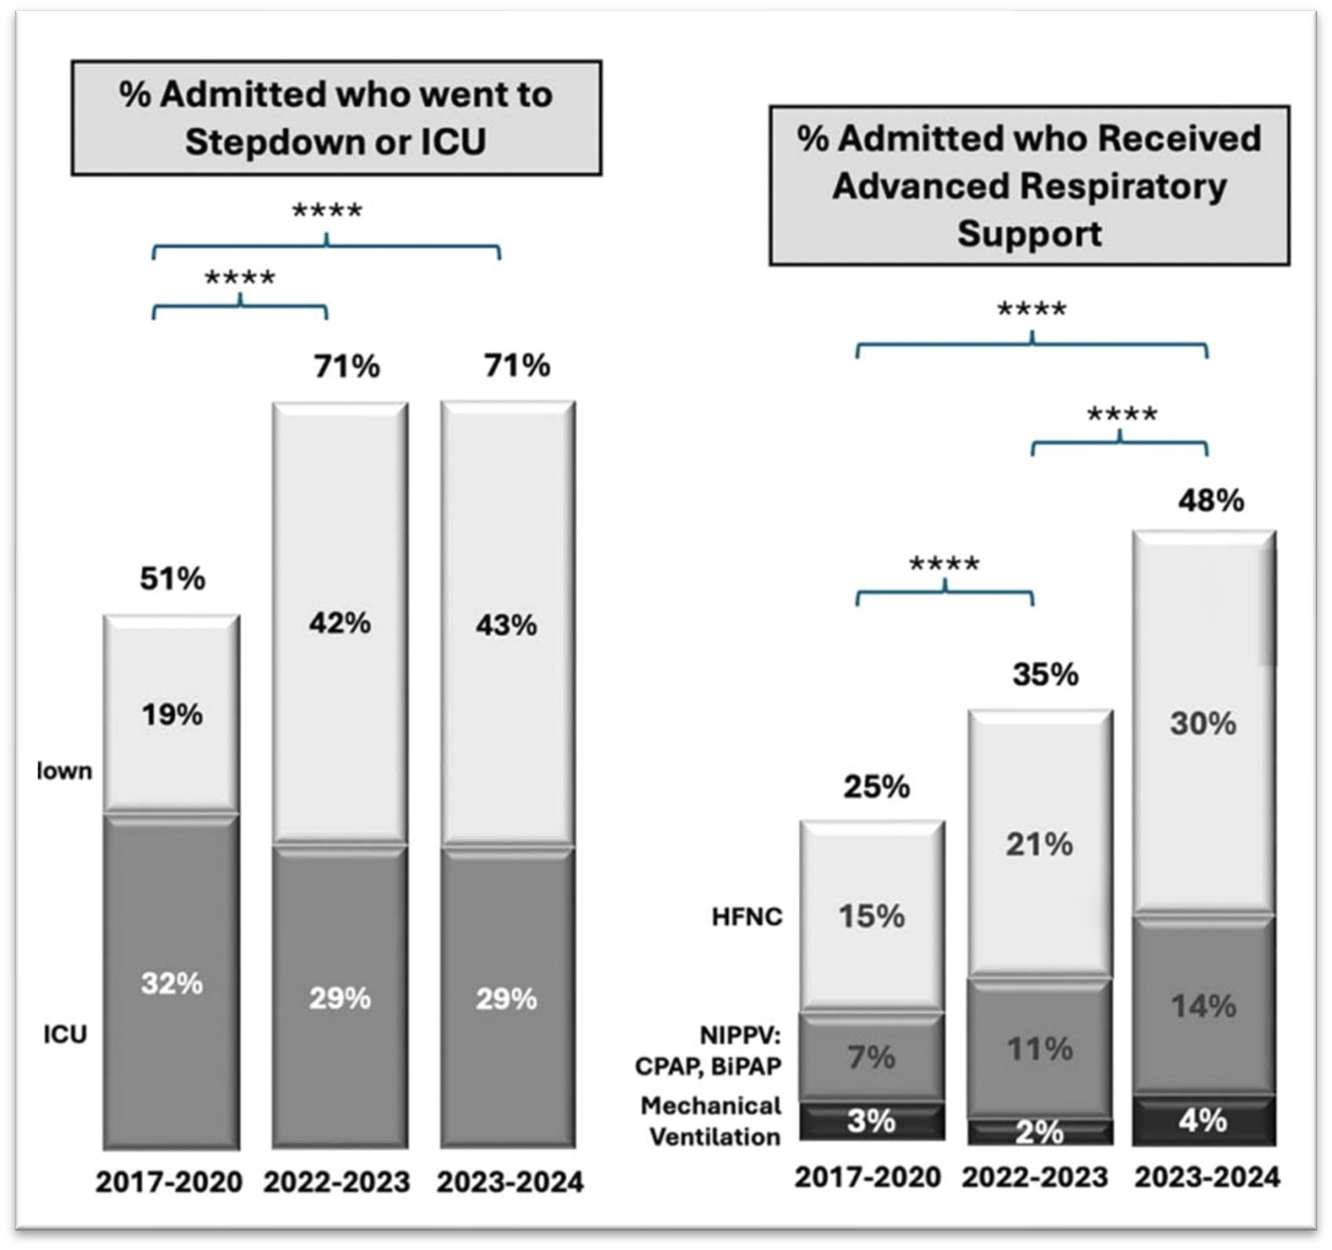
High Volume, High Acuity
Running out of Space
Running out of Supplies
Running out of Expertise
All Contents Considered Proprietary and Confidential Information
CONFIDENTIAL – N.Y. Education Law § 6527; N.Y. Public Health Law § 2805, J, K, L, M; N.Y. Public Health Law § 30056

Slide 6
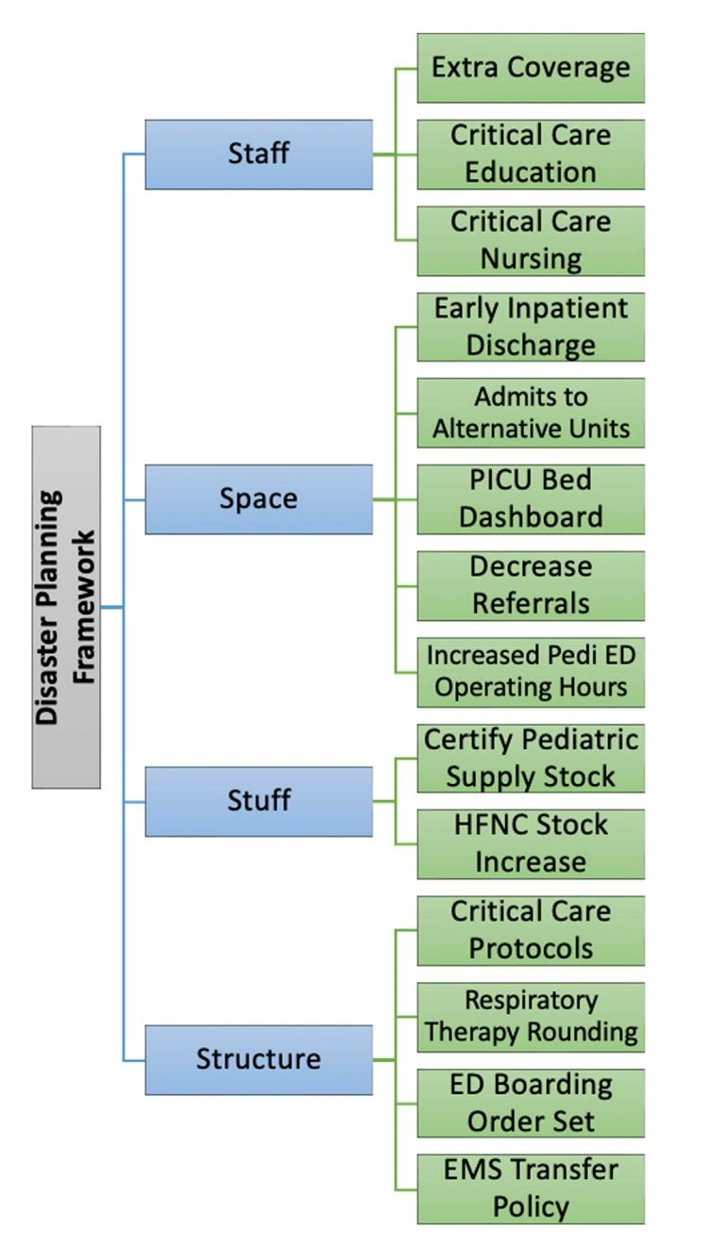
What makes this surge so different?
Post-covid, national divestment in pediatric resources /beds
Children's hospitals less experienced with incident command structure
Most pediatric acute care isolated to 'islands' of pediatric hospitals
Load balancing historically viewed as a 'pop off valve' for the mothership
Little formal coordination between health systems
  Pediatric MOCCs rare in the United States*

Slide 7
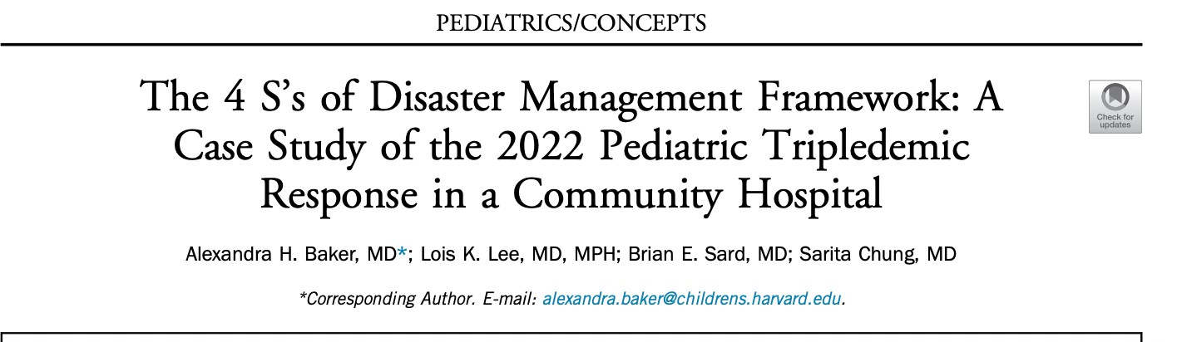
Staff, Space, Stuff, & Structure

Slide 8
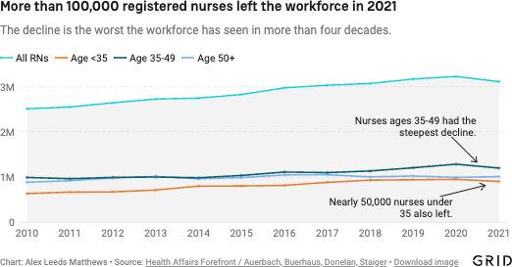
Staffing
Nursing Staff:
Thousands of nurses leave the workforce post-covid
Supply of pediatric travel nurses diminished
  $$$$$$$$$$
Supply >>>> Demand

Slide 9
Staffing: Support & Competencies
Nursing Physicians
Internal Flexstaff Pediatric Nurses
Adult Nurses as "functional nurses"
  Work under the supervision & direction of pediatric nursing
JIT for pediatric competencies
General Pediatricians hired to cover lower-acuity ED/UC visits
Emergency Medicine Physicians to supplement Peds EM
Increased Resident, Fellow, and ACP coverage

Slide 10
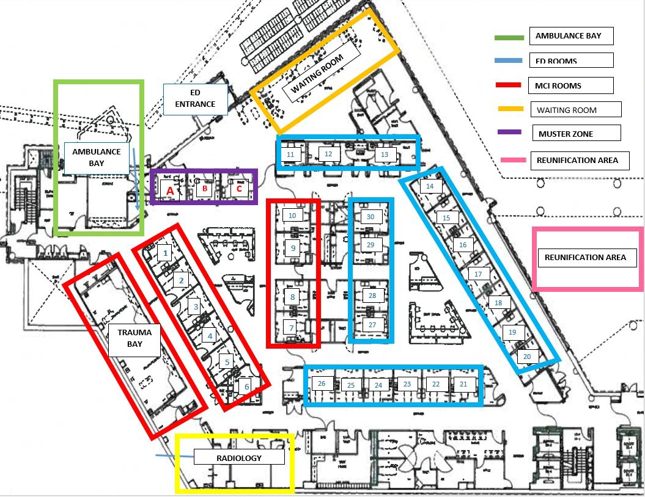
Space... Where do we put the patients?
Emergency Department
Challenges of a HUGE increase in emergency department volume
Increased number of ED boarders limits space to see new patients
High acuity spaces needed for high acuity patients
Lack of ED visitor poicy lead to tremendous ED waiting room volume and congestion
All Contents Considered Proprietary and Confidential Information
CONFIDENTIAL – N.Y. Education Law § 6527; N.Y. Public Health Law § 2805, J, K, L, M; N.Y. Public Health Law § 301006

Slide 11
Space... Where do we put the patients?
Emergency Department
Development of Split-flow model
  Emergency Department
  ED Annex (Urgent Care)
  Trial of tele-emergency medicine*
PIT (Provider in Triage) / waiting room
Extending outpatient urgent visits (+/-)
Impact of Transfers (Never say no hospital)
All Contents Considered Proprietary and Confidential Information
CONFIDENTIAL – N.Y. Education Law § 6527; N.Y. Public Health Law § 2805, J, K, L, M; N.Y. Public Health Law § 301016

Slide 12
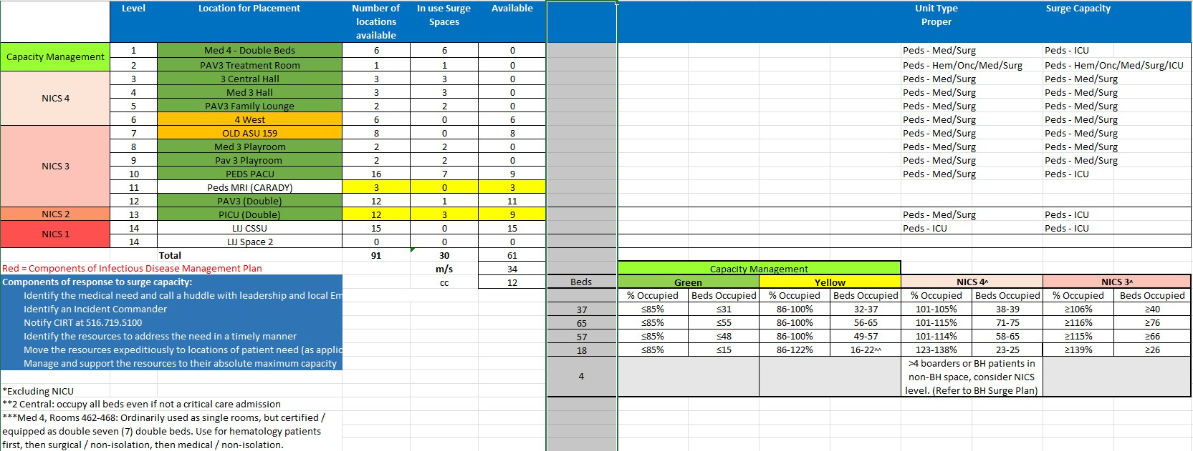
COHEN SURGE PLAN
Northwell Health®

Slide 13
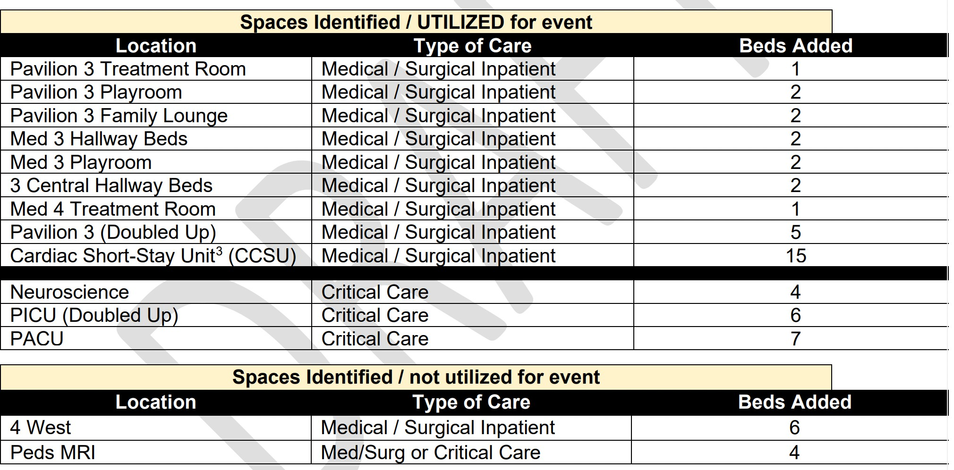
Space... Where do we put the patients?
21 Additional PICU beds
38 Additional Med/Surg beds
All Contents Considered Proprietary and Confidential Information CONFIDENTIAL – N.Y. Education Law § 6527; N.Y. Public Health Law § 2805, J, K, L, M; N.Y. Public Health Law § 301036

Slide 14
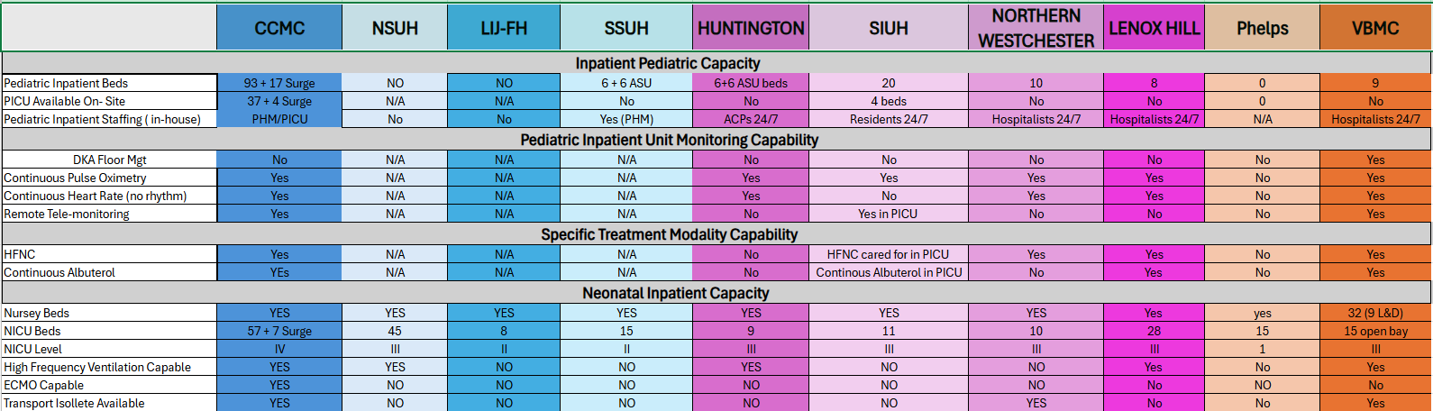
LOAD BALANCING/LEVEL LOADING
14
Northwell Health®

Slide 15
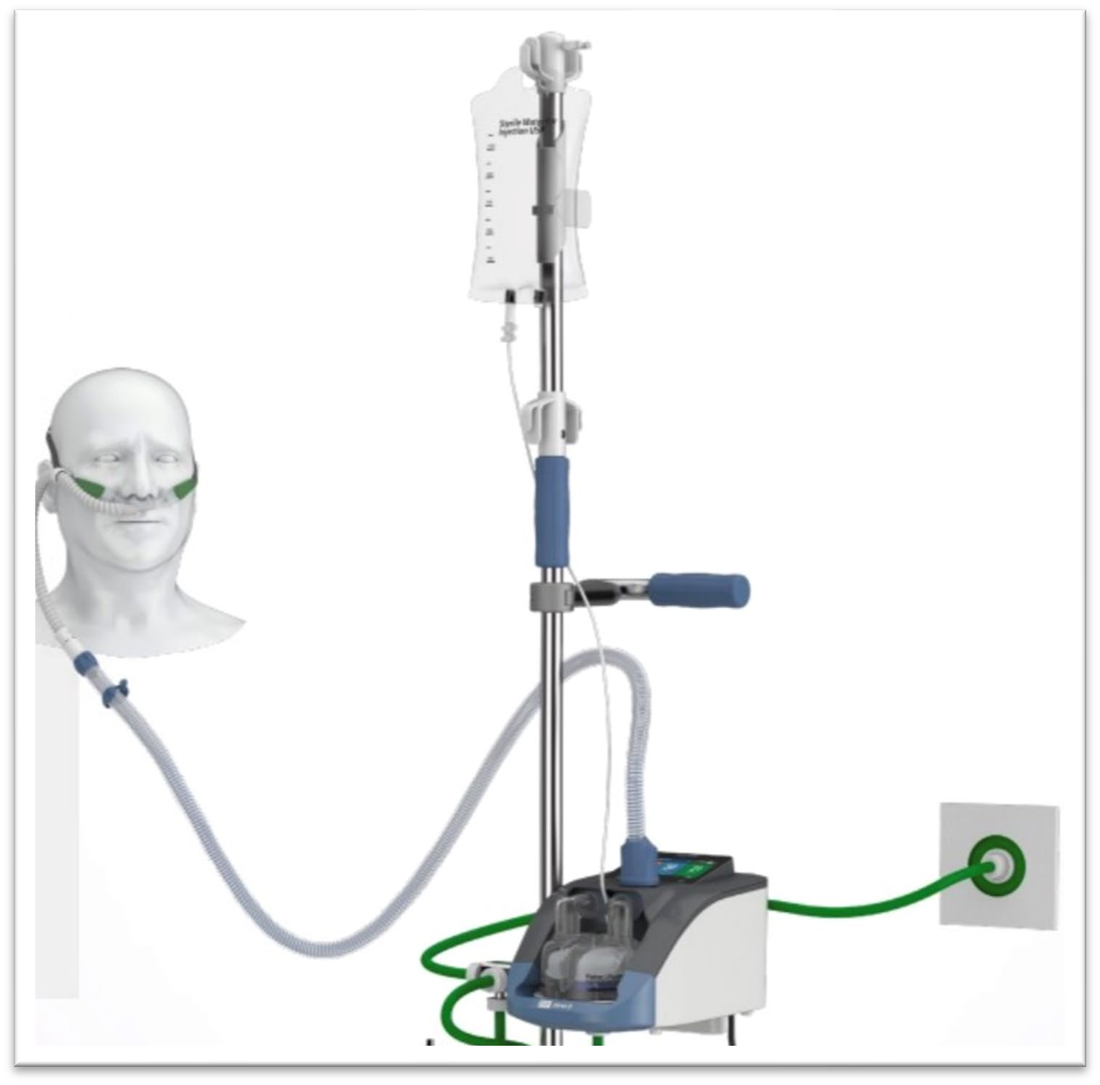
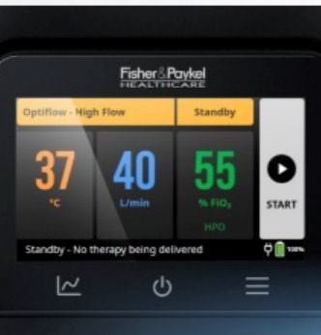
Optimizing PHM Care
Common Equipment
  HHFNC
Common Language
  RSS / BRSS
Patient selection & clinical escalation
  TPEWS/TELE-PICU
  (right patient for the right space)

Slide 16
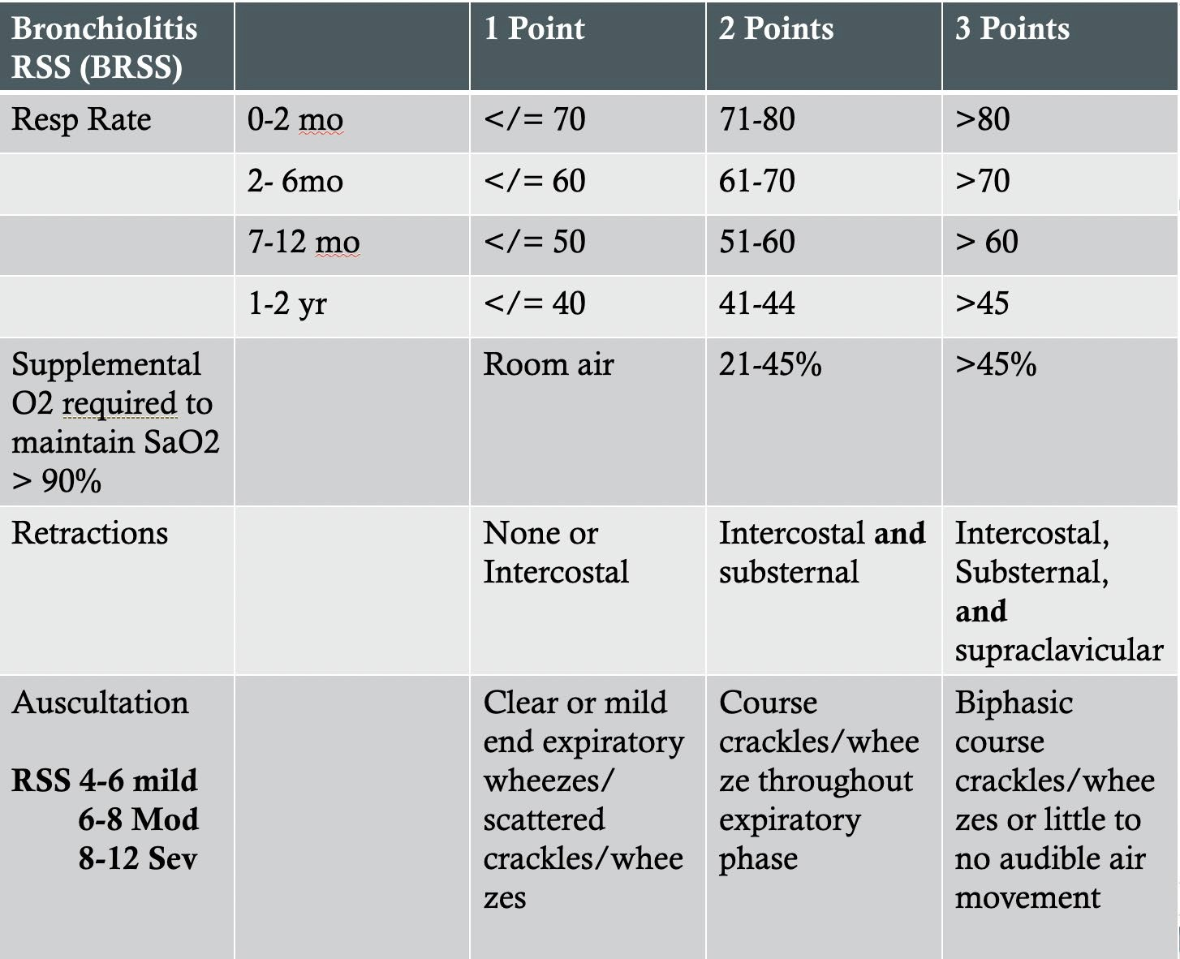
Optimizing PHM Care
Common Equipment
  HHFNC
Common Language
  RSS / BRSS
Patient Selection and Clinical Escalation
  TPEWS/TELE-PICU
  (right patient for the right space)

Slide 17
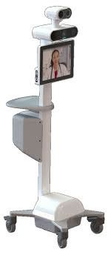
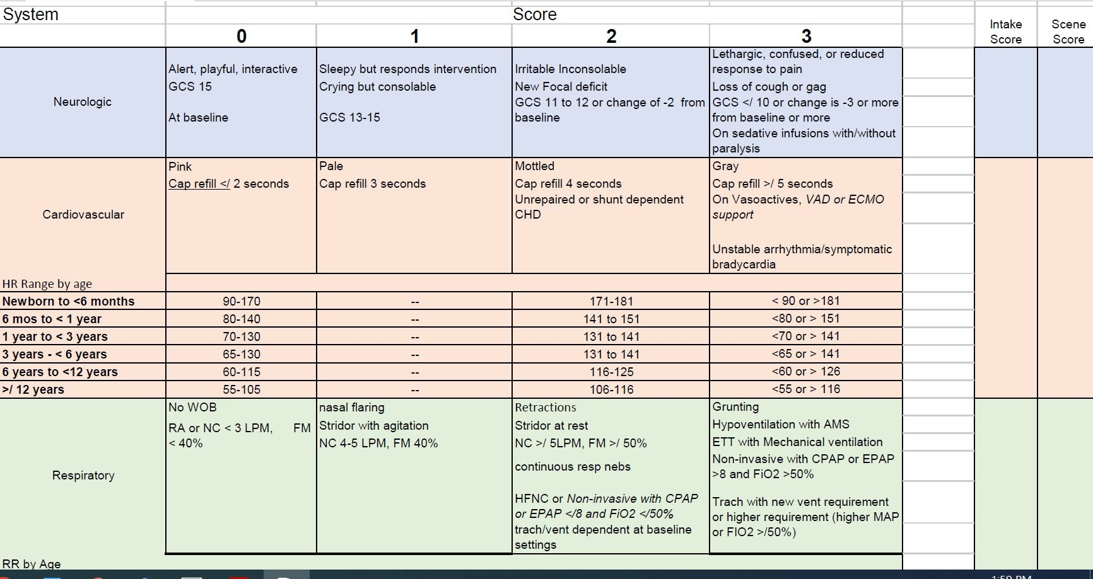
Optimizing PHM Care
Common Equipment
  HHFNC
Common Language
  RSS / BRSS
Patient Selection and Clinical Escalation
  TPEWS/TELE-PICU
  (right patient for the right space)

Slide 18
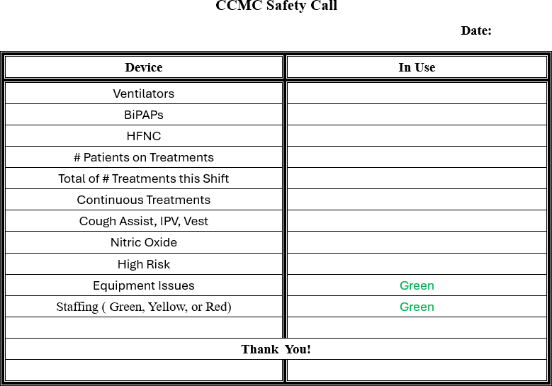
STANDARDIZING RESPIRATORY EQUIPMENT & DATA TRACKING
18
Renting/Borrowing Cribs & Beds
National Albuterol Shortage
Oxygen shortage?
Northwell Health®

Slide 19
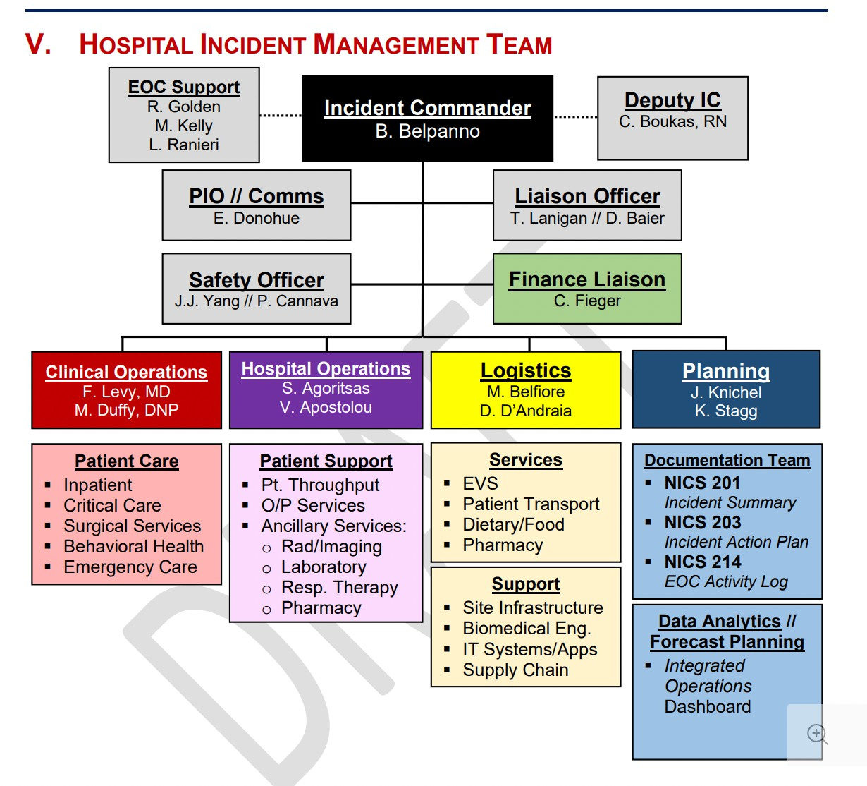
Structure – Breaking the ICS Glass
Early attempts to manage as 'normal operations' failed.
ICS, managing by objectives, allowed hospital leadership to return to their primary roles where possible
Engagement with Corporate EM to provide structure and JIT
All Contents Considered Proprietary and Confidential Information
CONFIDENTIAL – N.Y. Education Law § 6527; N.Y. Public Health Law § 2805, J, K, L, M; N.Y. Public Health Law § 301096

Slide 20
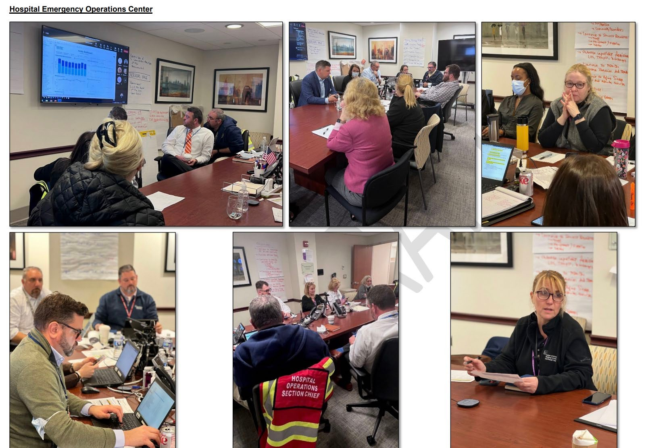
Structure – Engagement with Leadership
All Contents Considered Proprietary and Confidential Information
CONFIDENTIAL – N.Y. Education Law § 6527; N.Y. Public Health Law § 2805, J, K, L, M; N.Y. Public Health Law § 302006

Slide 21
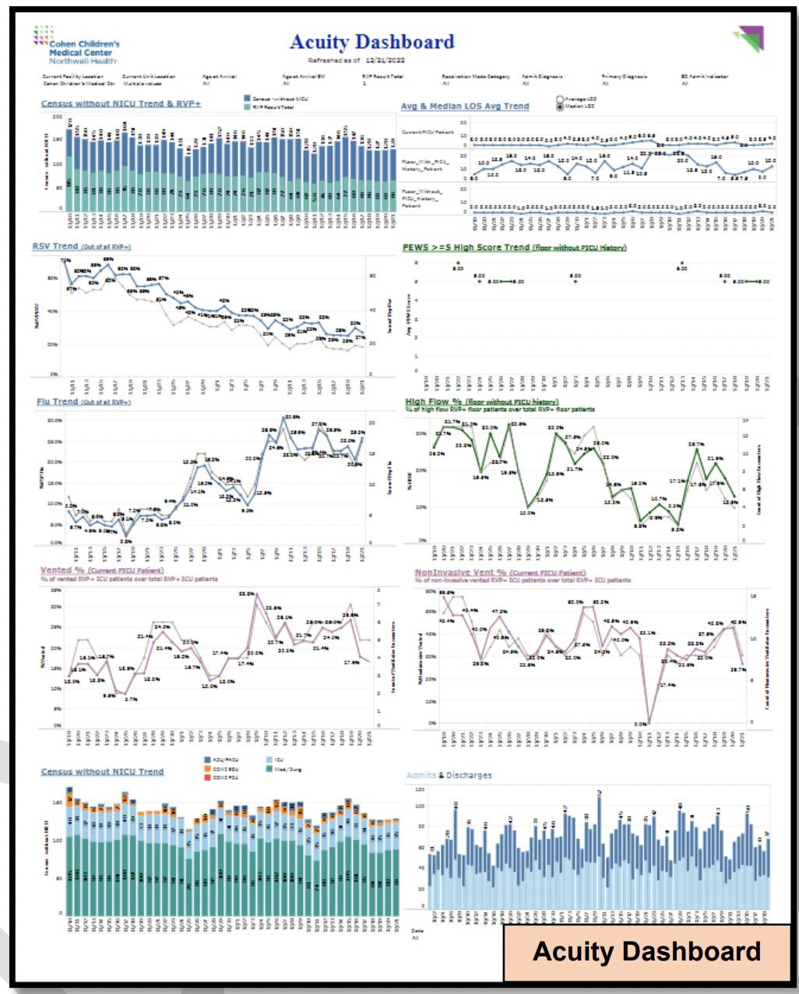
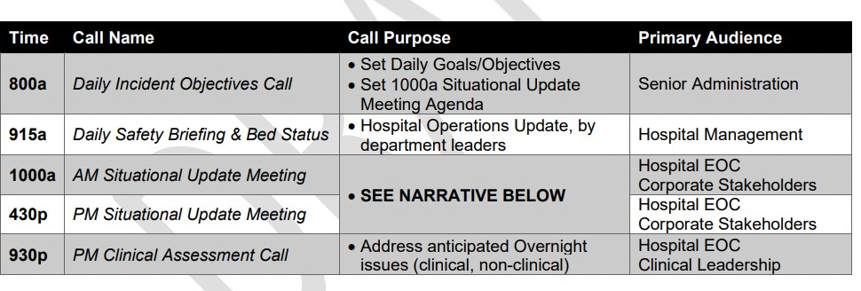
Structure – Data and Situtational Awarness

Slide 22
Regional Response – An Opportunity
Little (organized) coordination between health system
Informa conversations
  New York City Pediatric Disaster Coalition
  New York Pediatric Critical Care Consortium

Slide 23
Outside of NYC
Maryland – Critical Care Coordination Center (C4) established during early days of COVID to:
Identify patients in need of transfer
Identify available beds/resources
Facilitate Acceptance and Transfer
Oct 2021 – Established the C4P (Pediatrics)
24 hour hotline
Paramedic, PEM/PICU Physician
Maryland requires participation and data delivery (i.e., HERDS)

Slide 24
C4P
Pediatric Calls
200
180
160
140
120
100
80
60
40
20
0
2022-22
2022-23
2022-24
2022-25
2022-26
2022-27
2022-28
2022-29
2022-30
2022-31
2022-32
2022-33
2022-34
2022-35
2022-36
2022-37
2022-38
2022-39
2022-40
2022-41
2022-42
2022-43
2022-44
2022-45
2022-46
2022-47
2022-48
2022-49
2022-50
2022-51
2022-52
2023-1
2023-2
2023-3
2023-4
2023-5
2023-6
2023-7
2023-8
2023-9
2023-10
2023-11
2023-12
2023-13
2023-14
2023-15
2023-16
2023-17
Peds Calls

Slide 25





C4P
MD -1415
Total Calls 1483
Average age: 4 years
Disposition
  Transfer (72%)
  Managed in Place (26%)
  Other (2%)
DC -6
DE -2
WV -11
VA -12
PA - 3
NY -1

Slide 26

Wrapping Up
Children's Hospitals (and systems of care) more versatile
  Still room for improvement
Pediatric Readiness in Emergency Departments more important than ever!
We still lack formal interoperability between systems
Remember the 4 S's (Staff, Stuff, Space, and Structure

Slide 27
Thank you
Questions?
Mharris13@northwell.edu

Slide 28
MCI Level C: Aircraft Incident
NYC Health + Hospitals/Elmhurst

Slide 29
Incident Overview

Slide 30
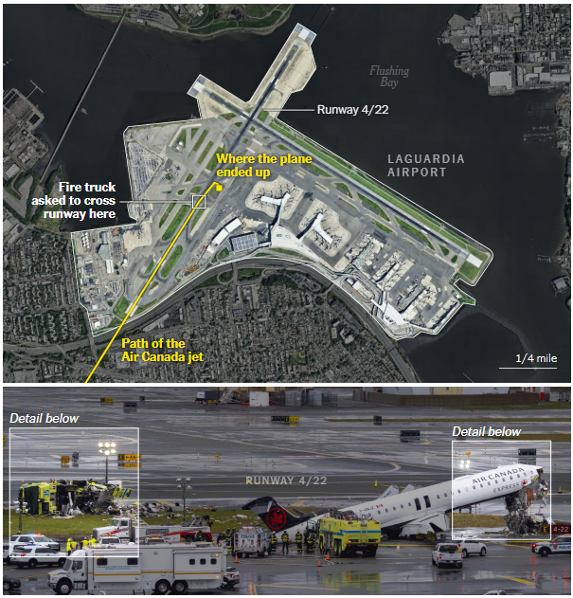
Incident Summary
Sunday, March 22
Arriving Air Canada Jet crashed into Port Authority aircraft rescue and firefighting vehicle on way to respond to another incident.
The New York Times

Slide 31
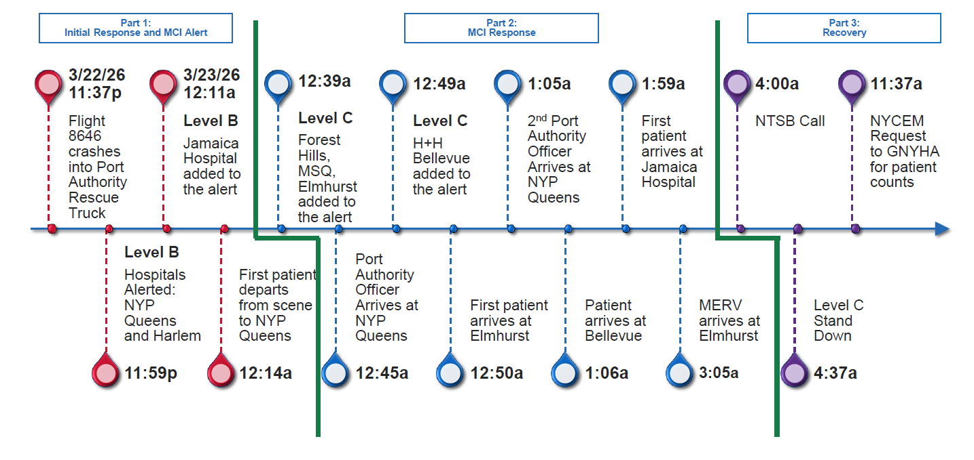

Slide 32
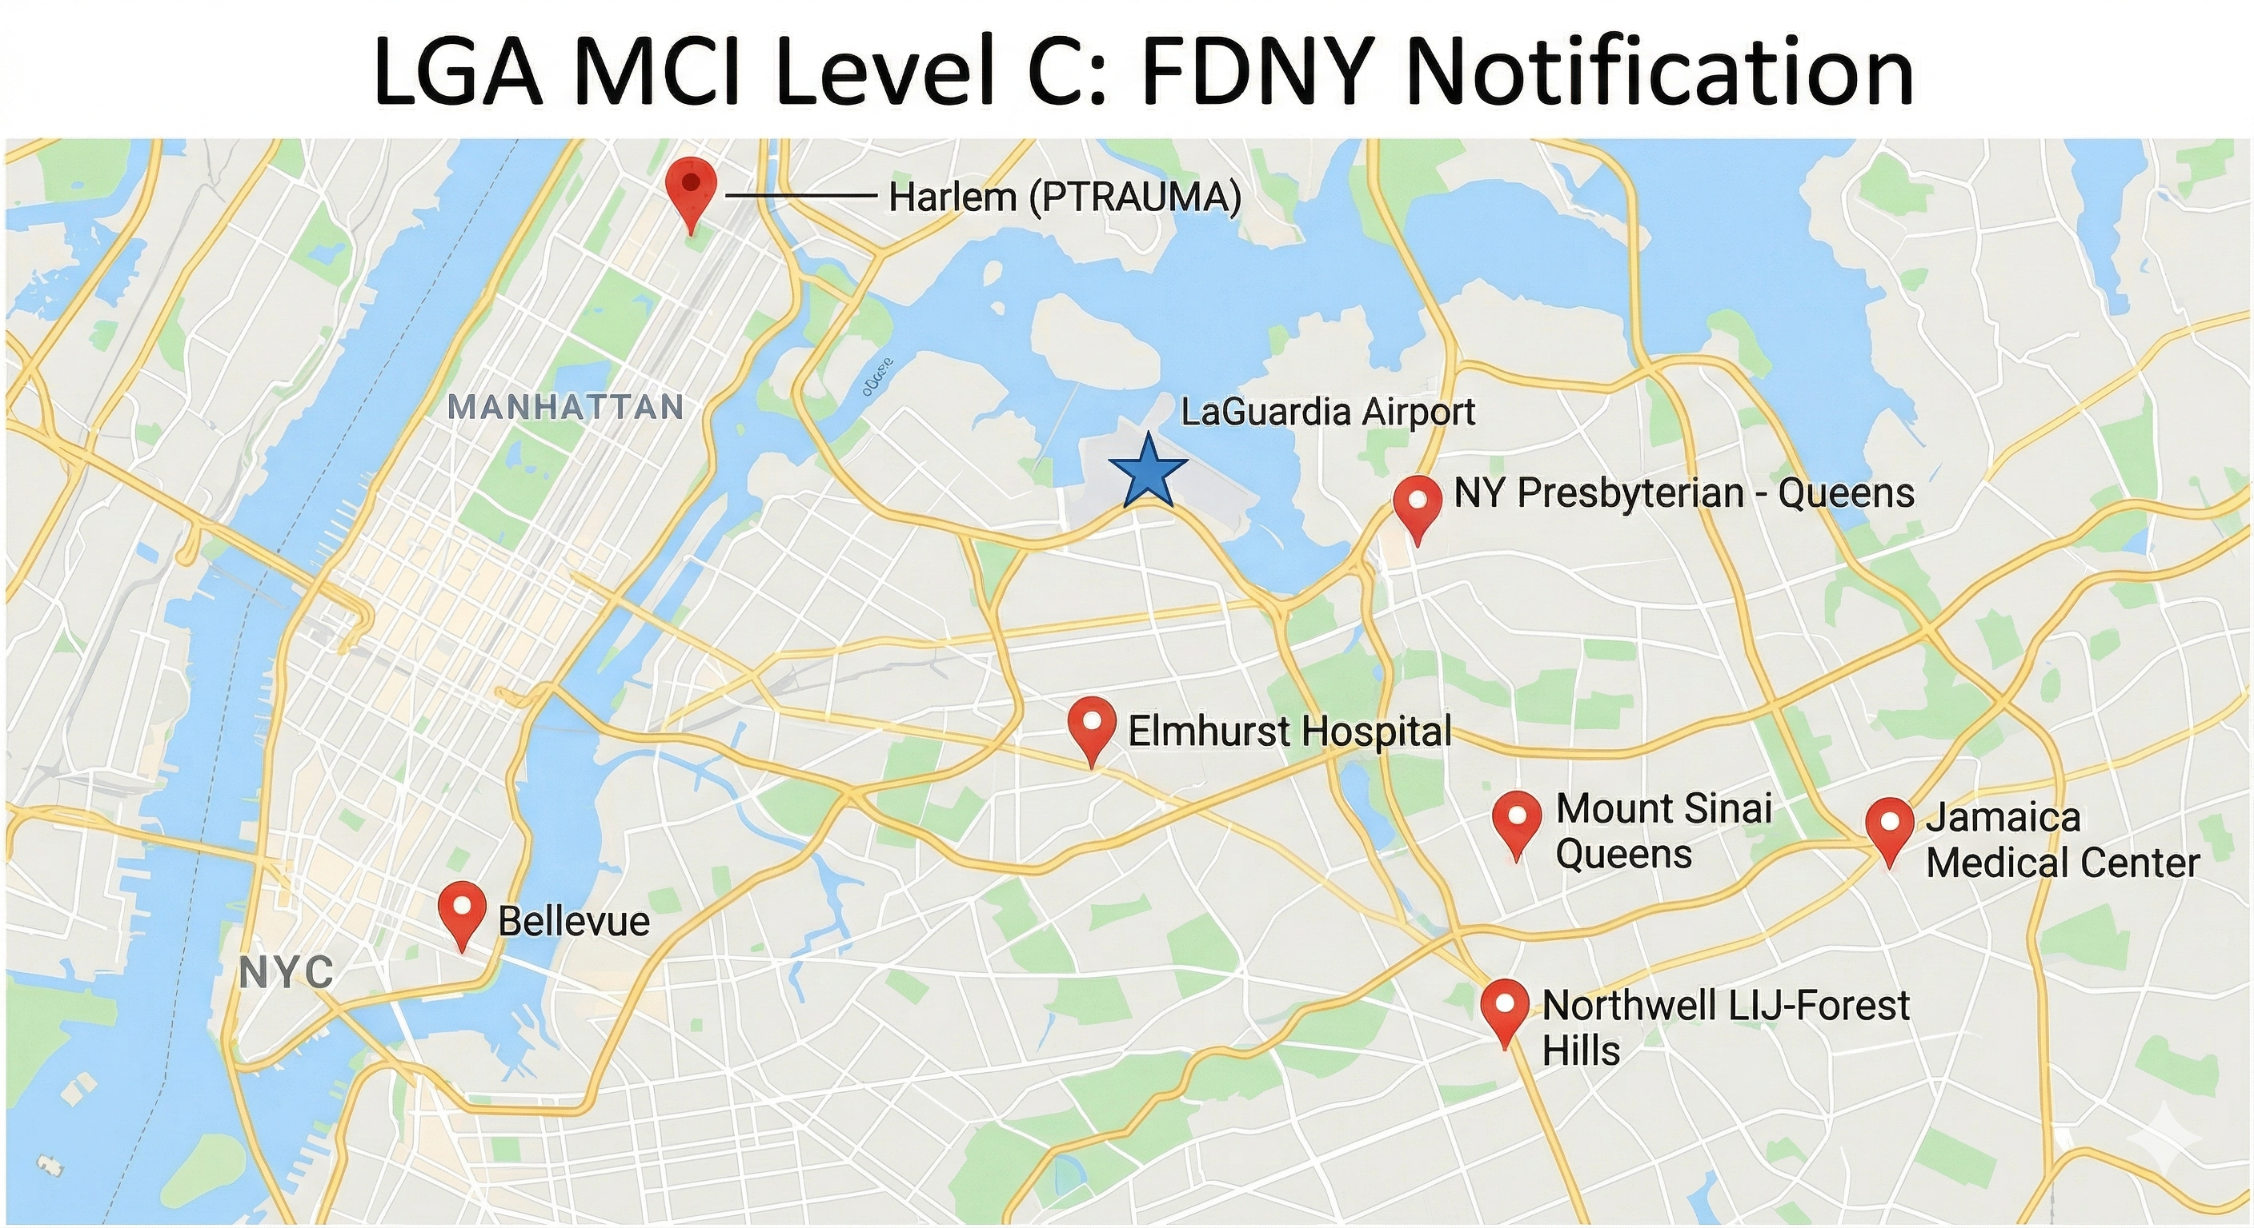

Slide 33
FDNY Patient Transfers
0 received
Total: 79 pt.
41 transferred
2 Black
4 Red
4 Yellow
22 Green
3 Family/Friends
0 received
3 Orange
3 Green
1 Orange
1 Green

Slide 34
Elmhurst Response

Slide 35
Approx. Patient Arrival Times – 27 Total
Arrival | Patient(s) | Elapsed Time
00:50 | Patient 1 | 70 mins (1h 10m)
00:55 | Patient 2 | 75 mins (1h 15m)
01:10 | Patient 3 | 90 mins (1h 30m)
01:55 | Patients 4 & 5 | 135 mins (2h 15m)
03:05 | Patients 6 to 26 (+3 family/friends) | 205 mins (3h 25m)
08:10 | Patient 27 | 510 mins (8h 30m)

Slide 36
Initial Response – 00:39 to 02:29
Incident Coordination: ED, AOD, CMO, EM, Nursing, Ancillary Staff
Patient Movement: Critical care beds
Onsite Communication: Notification to staff in-house
Role Assignment: ED staff roles
Patient Volume: Current census, expected transfers
Triage Accuracy: FDNY vs. internal triage
Registration Process: EPIC Disaster Mode, MCI Registration Kits
Resource Deployment: Stretchers, chairs, etc.

Slide 37
Response Cont. – 02:30 to 11:30
Incident Briefings: 03:15, 06:30, 08:15, 11:00
Patient Movement: Discharges, downgrades, opened unit
Additional Staffing: ED, nursing, trauma team, ancillary
Security & Access: Entrance management, media presence, patient privacy
Family Support: Coordination of family/friends

Slide 38

External Agencies & Media
Air Canada
Canadian Consulate
National Transportation Safety Board (NTSB)
NYCEM
NYC Mayor’s Office
Media Agencies

Slide 39
Lessons Learned

Slide 40
Strengths & Areas for Improvement
Strengths
Areas for Improvement
Pre-deployment of resources
Staff knowledge & command
Patient movement
Everbridge & Webex coordination
Recent Level B activation
Inter-department notification
New & changing plans
Media/external agency coordination

Slide 41
Questions?
Alexandra Lahm, MS, CEM
Associate Director, Emergency Management
lahma@nychhc.org

Slide 42
Decentralizing Resilience
A Multi-Level Crisis Management Strategy
NYC Healthcare Coalition Meeting
11 May 2026

Slide 43
Agenda
01 | Enterprise Resilience Program | 04 | Organizational Resilience
02 | Frontline Preparedness | 05 | Lessons Learned
03 | Departmental Continuity
Notes:
ERP focuses heavily on frontline and departmental continuity – feeds into existing organizational resilience efforts

Slide 44
01 | Enterprise Resilience Program

Slide 45
NYU Langone Health
47,000+
Employees
5
Hospitals
300+
Offsites
1,000+
Research
Faculty
2
Medical Schools

Slide 46
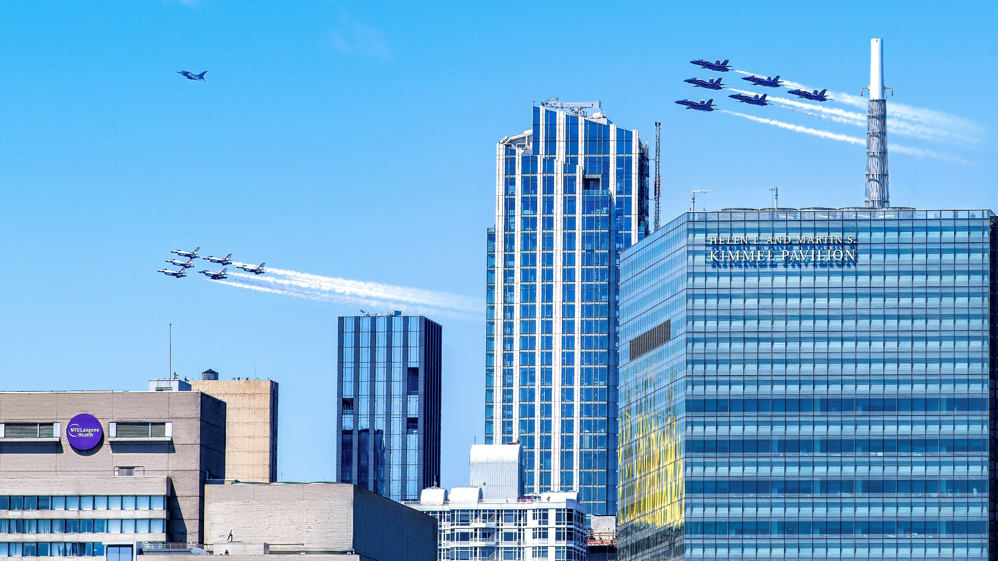
Enterprise Resilience Program Mission
Empower managers and staff to take action, improve outcomes, and shorten timelines to restoration during a disruption to essential services by equipping them with crisis management skills, business continuity plans, and communication tools.

Slide 47




Enterprise Resilience Program
Crisis Management Drills
Business Continuity
Planning
Staff Notification App
Resilience
as a
Service
Notes:
Pair these components with exercises

Slide 48
02 | Frontline Preparedness

Slide 49
Crisis Management Drills
Empower Frontline Staff
Clearly define and communicate staff roles, responsibilities, and tasks, and encourage action in the face of crisis.
Reinforce Procedures and Resources
Review and ensure existing plans, procedures, and resources are understood before an emergency occurs.
Build Crisis Decision Making Muscle Memory
Immerse staff in simulated emergencies and work through key actions in a controlled environment.

Slide 50
Distribution Format: Clinical Units
Monthly Topics
Unit Facilitators
Scenario varies by month, mandated by CMO
Facilitated by Nurse Manager or Medical Director
HRO Huddles
5-10 Minutes
Held during weekly staff or unit huddles
Conduct is brief and discussion based

Slide 51
Scenario Library
Prolonged EPIC Downtime
Active Shooter
Earthquake
Fire Response
Cyber Security
Infant & Pediatric Abduction
Hurricane Season:
Stay Team
Power Failure
Disruptive Behavior
Patient Elopement
Hurricane Season: Personal Preparedness
Heat Failure /
Patient Evacuation
Violent Visitor
Extreme Heat
Winter Weather
Med Sled Assisted Patient Evacuation
Concealed Carry
Tornado
Water Intrusion
No Bed Availability

Slide 52
03 | Departmental Continuity
Notes:
All departments (beyond just clinical units) are welcome to enroll in our broader resilience programs
Oriented to additional resources and opportunities
First thing is to begin work on a departmental BC plan
Veoci

Slide 53
Business Continuity Planning
Essential Services
operations, functions, or services that must be performed continuously or resumed quickly following a disruption
Dependencies
internal departments, external vendors, facilities, technology/software, specialized equipment, essential records, and utilities
Continuity Strategies
downtime procedures, curtailment/relocation of services, service suspension
Emergency Roles
orders of succession, delegations of authority
Team Members
departmental notification groups for crisis communication
Key Contacts
important phones numbers for departments or services, distribution lists, etc.
Notes:
Mention handbook

Slide 54
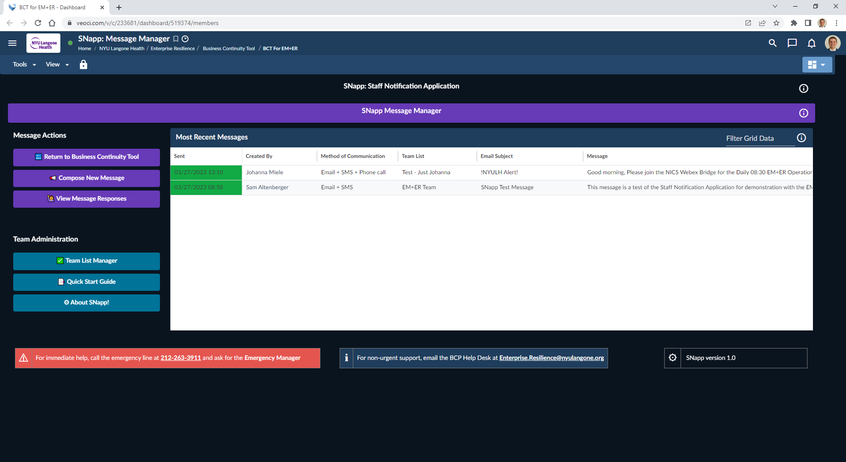
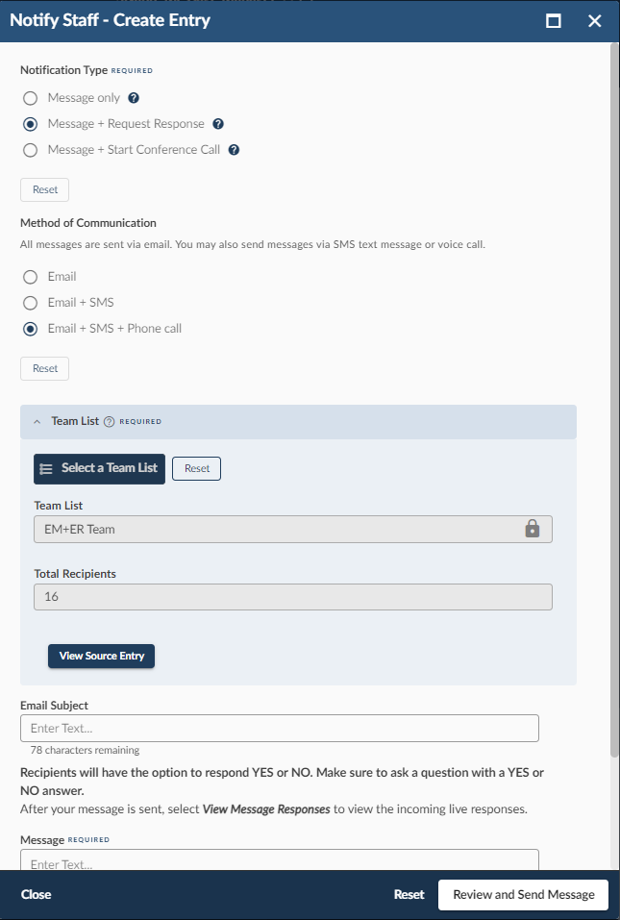
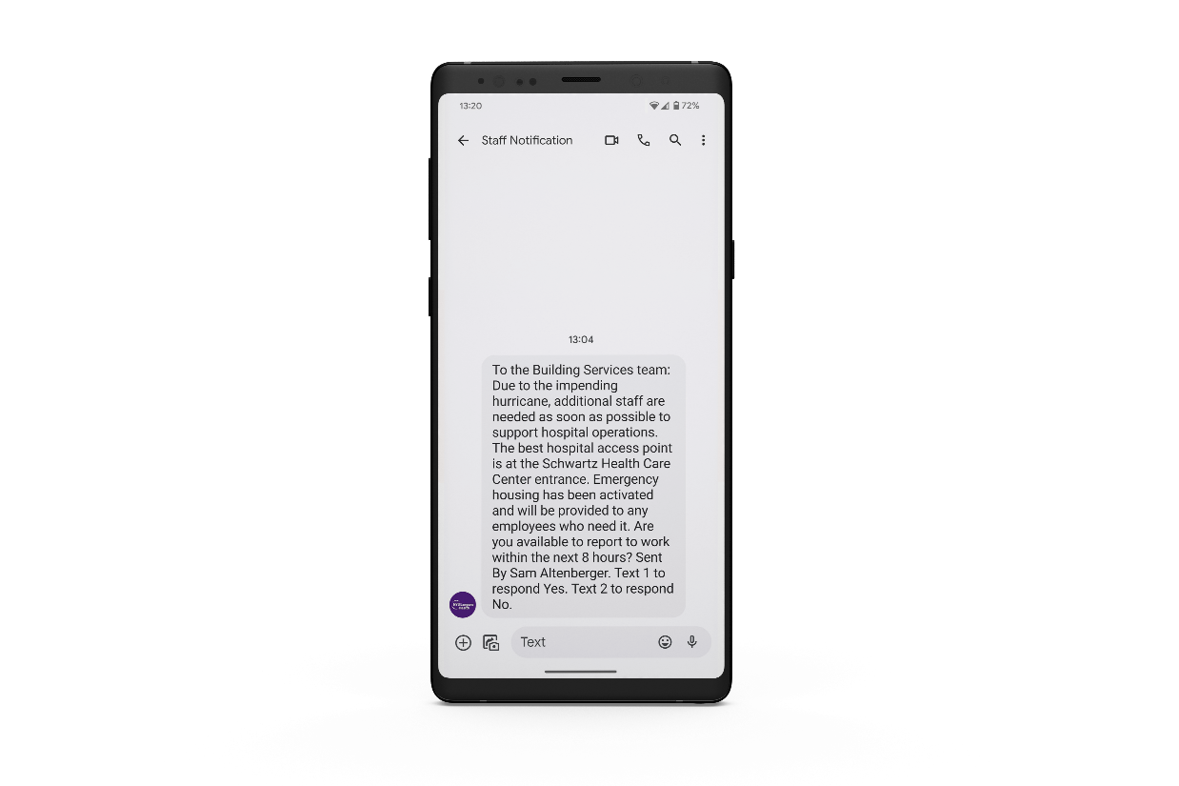
Staff Notification App for Crisis Communications
Send emails, phone calls, and text messages
Easily activate team conference calls
Request a response functionality

Slide 55

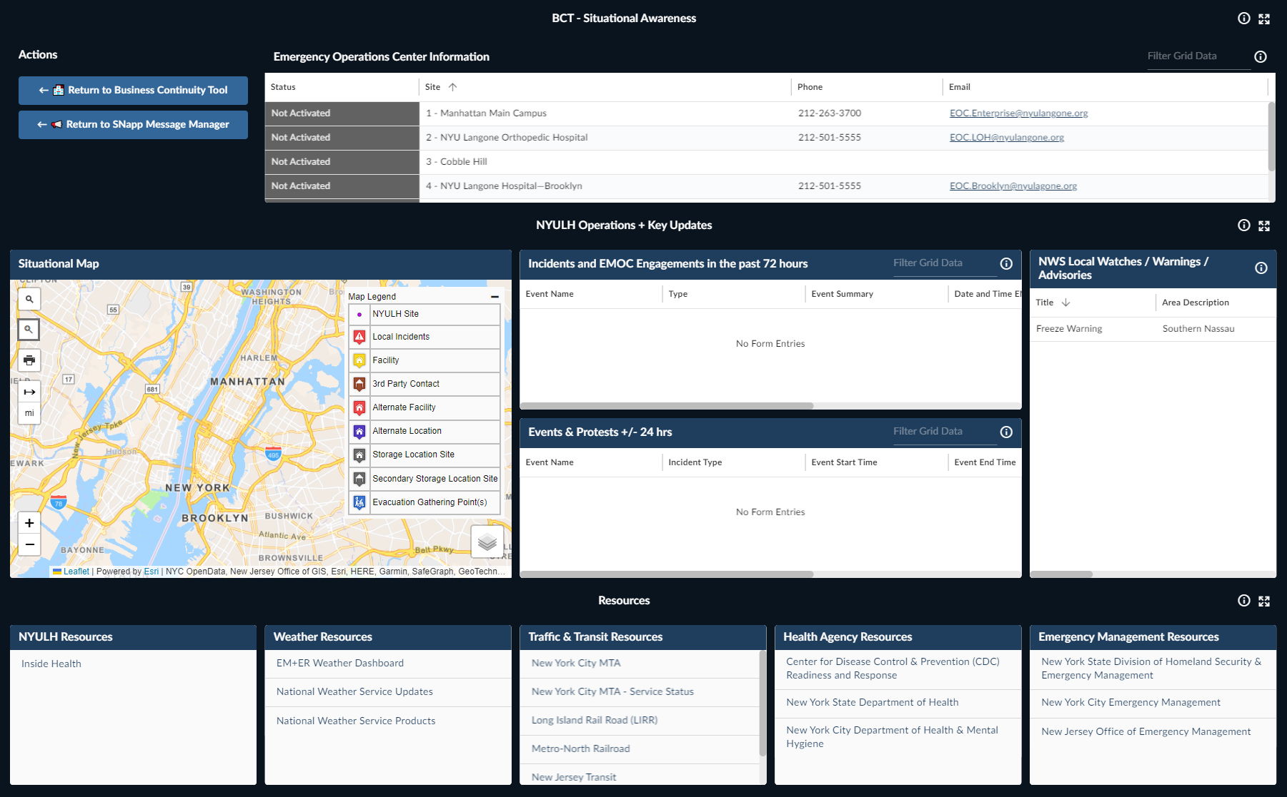
Real-Time Situational Awareness
Notes:
Additional resources: handbook, drills focused on continuity and SNapp

Slide 56
Resilience as a Service
Facilitated Continuity
Planning
Departmental Resilience Initiatives
Functional and Tabletop Exercises
Crisis Management
Training
Notes:
Finance Business Continuity FE and TTX​
Capacity Command Center Relocation FE​

Slide 57
04 | Organizational Resilience

Slide 58
Immersive Simulations for Enterprise Leadership
Tabletop exercises catered to executive leadership and designed to stress-test enterprise continuity strategies
Widespread IT Disruption
Prolonged Power Outage
Supply Chain Disruption
Union Strike Planning
Global Pandemic
Major Facility Loss
Notes:
Exercises focused on crisis decision making at the highest level
2-in-1: create versions for departmental leadership to engage with their staff
For largest enterprise exercise, we find a way to engage other levels of the organization
Mention future goal of establishing a higher-level Resilience Council

Slide 59
05 | Lessons Learned

Slide 60
Enterprise Resilience Program Timeline
2020
2022
2024
CMD concept development following unexpected incident
Business Continuity Pilot and online tool refinement
Formal rollout of Business Continuity, SNapp, and Resilience as a Service programs
CMD launch across inpatient hospitals;
Executive roadshow for broader Business Continuity effort
CMD expansion to ambulatory locations and onboarded hospital
CMD expansion to non-clinical departments;
Ongoing rollout of BCT and SNapp to critical departments
2021
2023
2025

Slide 61
Current State
1,600+
98
470+
Frontline Staff Trained Monthly
Departments Onboarded
Departmental Leaders Engaged

Slide 62
Lessons Learned
Quick Wins: Leverage CMD-like resources focused on key hazards for scalable training
Build Buy-In: Demonstrate proof of concept and programmatic value to executive leadership
Don’t Start from Scratch: Collaborate with internal SMEs and leverage existing resources
Scale Intentionally: Focus bandwidth for resilience efforts on most critical services
Notes:
Quick Win: develop CMDs for top 5 hazards in HVA or top 5 things you get requests for training for
Incorate this into other deprtmetns efforts (for example cyber security month partner with IT department to share these)
Demonstrate value to get leadership buy in
Identify champions in leadership
Leaverage experts and SMEs in their organization
Scale realistically with critical departments for ERP (don't expand too fast, expand in a targeted and intentional way)

Slide 63
Thank You!
Samia McEachin
Manager, Emergency Management + Enterprise Resilience
samia.mceachin@nyulangone.org

Slide 64
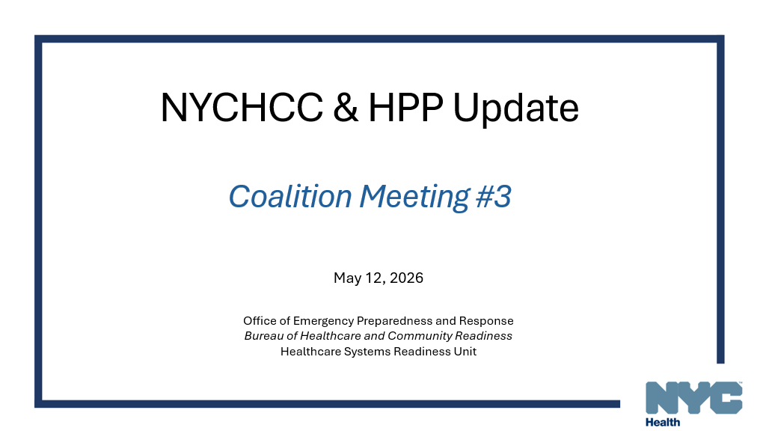

Slide 65
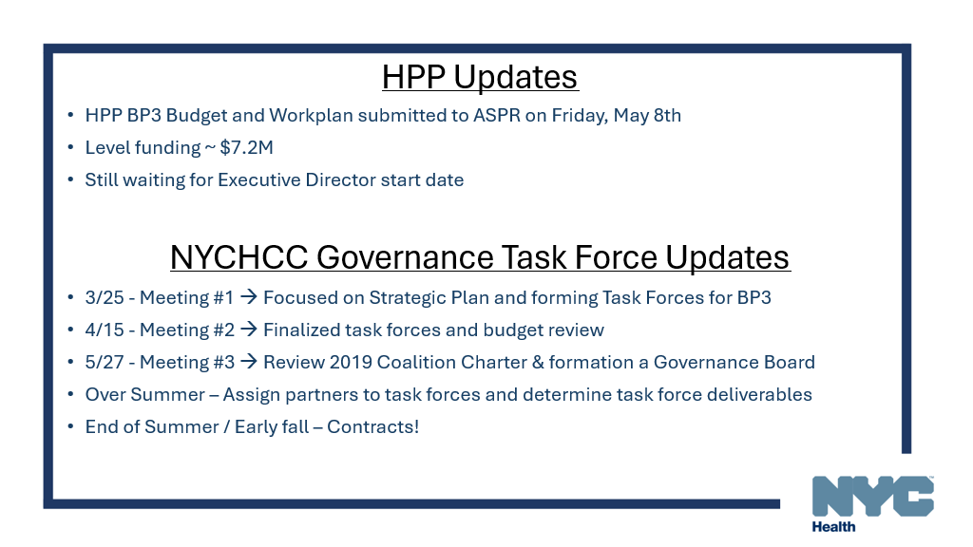

Slide 66
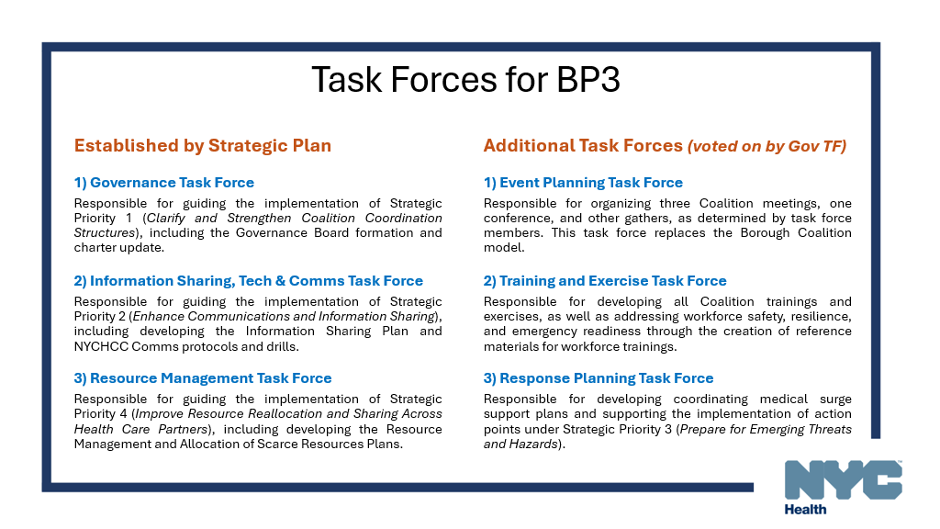

Slide 67
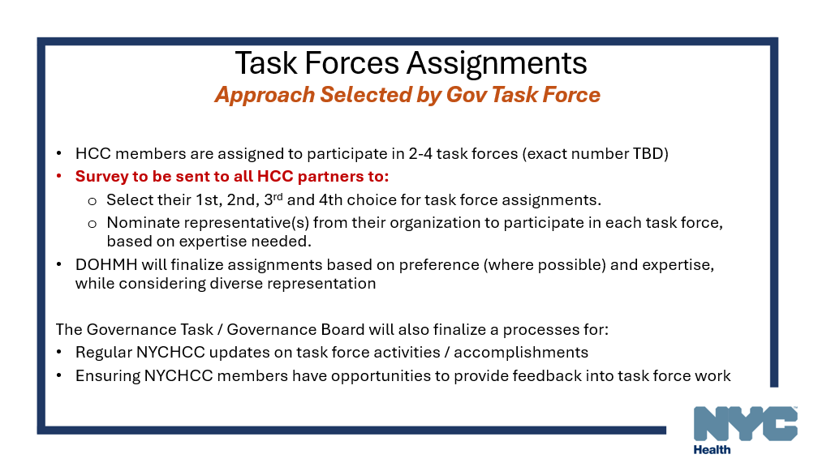

Slide 68
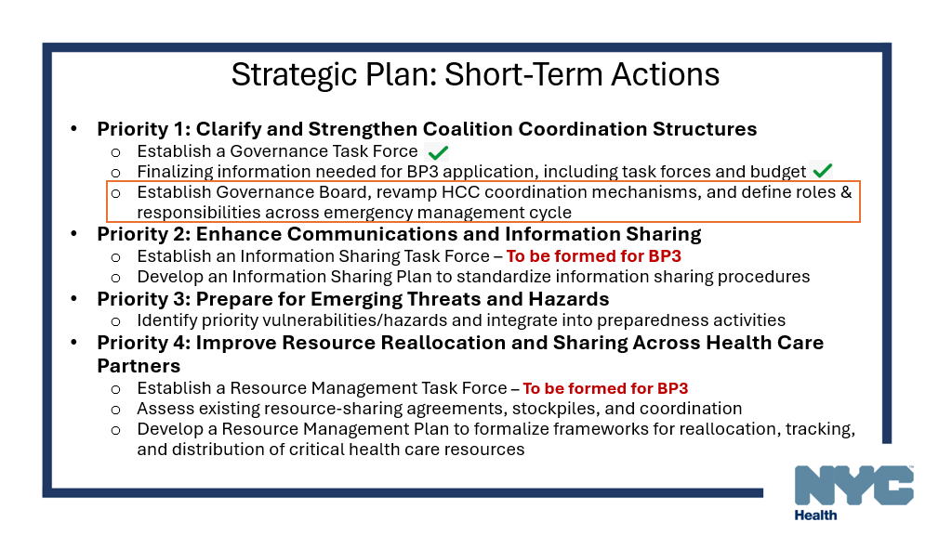

Slide 69
FIFA Updates
May 11, 2026

Slide 70
Agenda
Activities and Events
  Fan Festivals
  Transportation
  July 4 / International Naval Review / Sail 250
Health Resources
GNYHA Resources

Slide 71
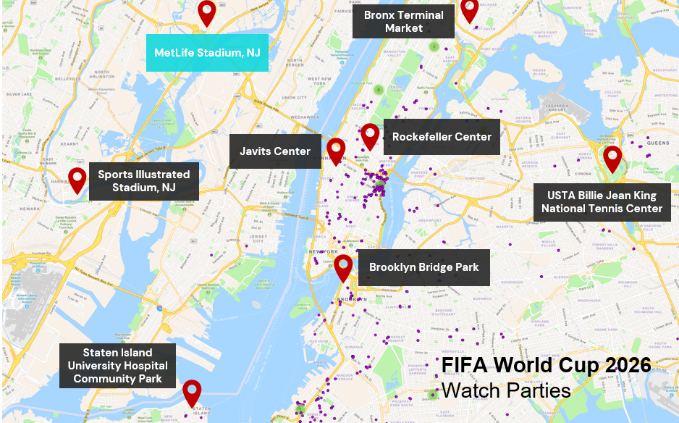
Fan Venues
Newly Announced
Sports Illustrated Stadium, NJ
  May 30: Ecuador vs Saudi Arabia
  June 6: Scotland vs Boliva
  June 7: Morocco vs Norway
Bronx Terminal Market, NYC
Courtesy of NYU Langone

Slide 72

FIFA-sponsored Fanfests in New York and New Jersey
Dates | Location | Venue Name
June 11– July 19 | Harrison, NJ | Sports Illustrated Stadium
June 11-27 | Queens, NY | USTA Billie Jean King National Tennis Center - NYNJ World Cup 26 Queens Group Stage HQ
June 13-July 19 | Brooklyn, NY | Brooklyn Fan Zone – Brooklyn Bridge Park
June 13-14 | Bronx, NY | Bronx Terminal Market - NYNJ World Cup 26 Bronx Fan Zone
June 29-July 2 | Staten Island, NY | SIUH Community Park - NYNJ World Cup Staten Island Fan Zone
July 6-19 | Manhattan, NY | Rockefeller Center - NYNJ World Cup 26 & Telemundo Fan Village at Rockefeller Center
June 12 | Stony Brook, NY | Stony Brook University Watch Party
July 19 | Valhalla, NY | Kensico Dam Plaza Watch Party

Slide 73
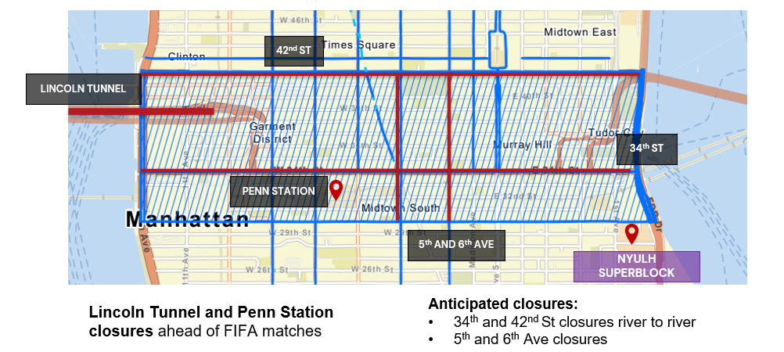
Transportation Impacts
Courtesy of NYU Langone

Slide 74
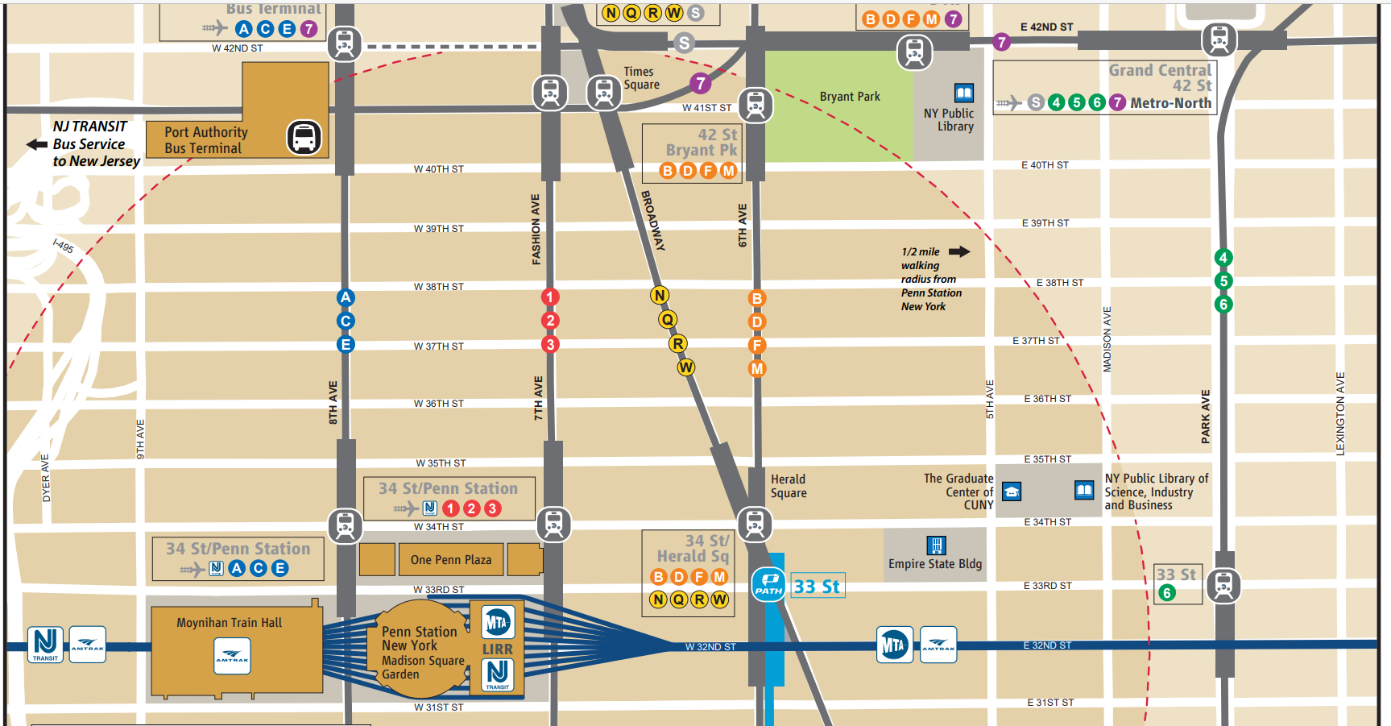

Game Day Transportation Locations
NJ Transit Rail
Rail service 4 hours before the scheduled match time
  Boarding Zone “A” (Red) at 32nd Street & 6th Avenue
  Boarding Zone “B” (Blue) at 33rd Street & 7th Avenue
Shuttle bus service
  Blue line from Port Authority Bus Terminal
  Green line from Midtown East
Shuttle bus
Train boarding
https://www.mta.info/world-cup-2026-new-york-new-jersey
Getting to NYNJ Stadium - New Jersey Transit World Cup
https://www.njtransit.com/press-releases/fifa-world-cup-2026tm-new-york-new-jersey-host-committee-and-nj-transit-announce

Slide 75
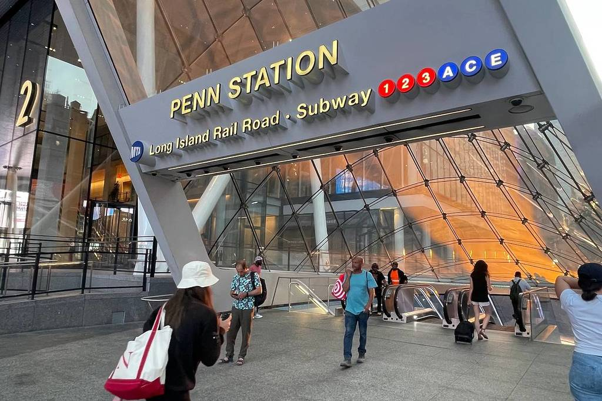
MTA Subways, Buses and Rail Services
Buses: significant changes in Midtown Manhattan on World Cup match days
  Between 34th Street and 59th Street from river to river
  Diversions, skipped stops, reroutes, and cancellations
Long Island Rail Road and subways:
  Normal operations via New York Penn Station
  Expect crowds
Source: Metropolitan Transportation Authority

Slide 76
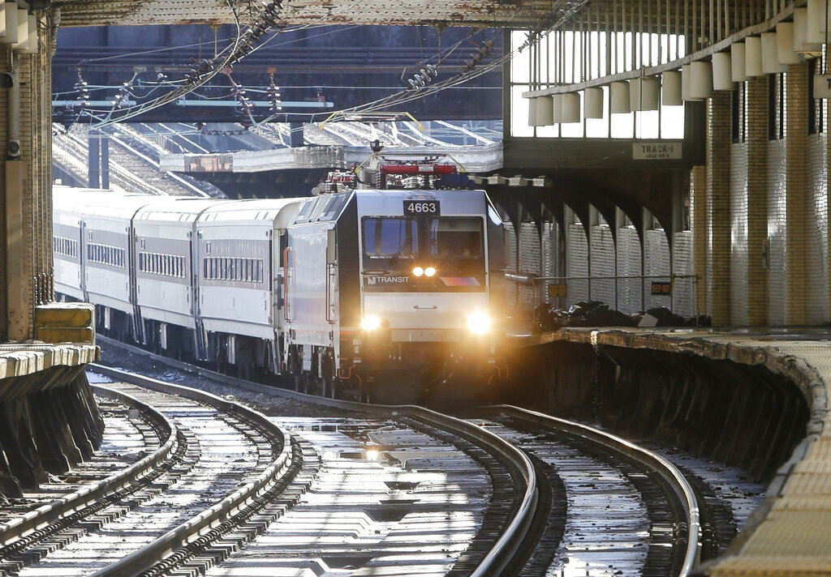
New Jersey Transit
Pre-match: 4 hours before start
  Inbound trains to NY Penn
  Only FIFA from Secaucus
  Cross honor NJT at PATH for Hoboken and Newark Penn
Post-match: 3 hours after end
  NYC-bound trains end at Newark
  Transfer to PATH
  NY Penn to NJ will be open
NJ Transit FIFA dedicated website

Slide 77

US Navy Briefing on July Events
Thursday, May 14, from 2:00 to 3:00 p.m.
  GNYHA offices (555 W 57th Street) and Zoom
Navy SMEs will discuss:
  Protocols for providing health care services to injured service members
  Applicable benefits,
  Role of US Navy Fleet Liaisons
  Medical Command Cell at Javits Center during the event
  Registration

Slide 78
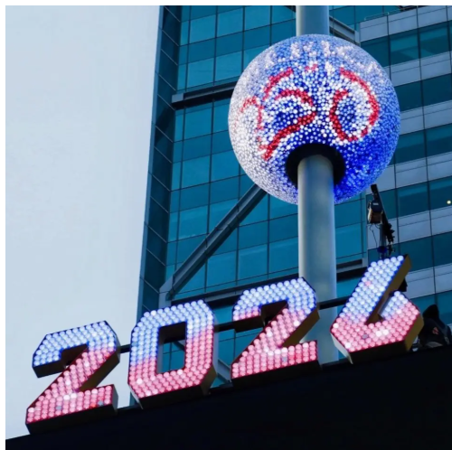
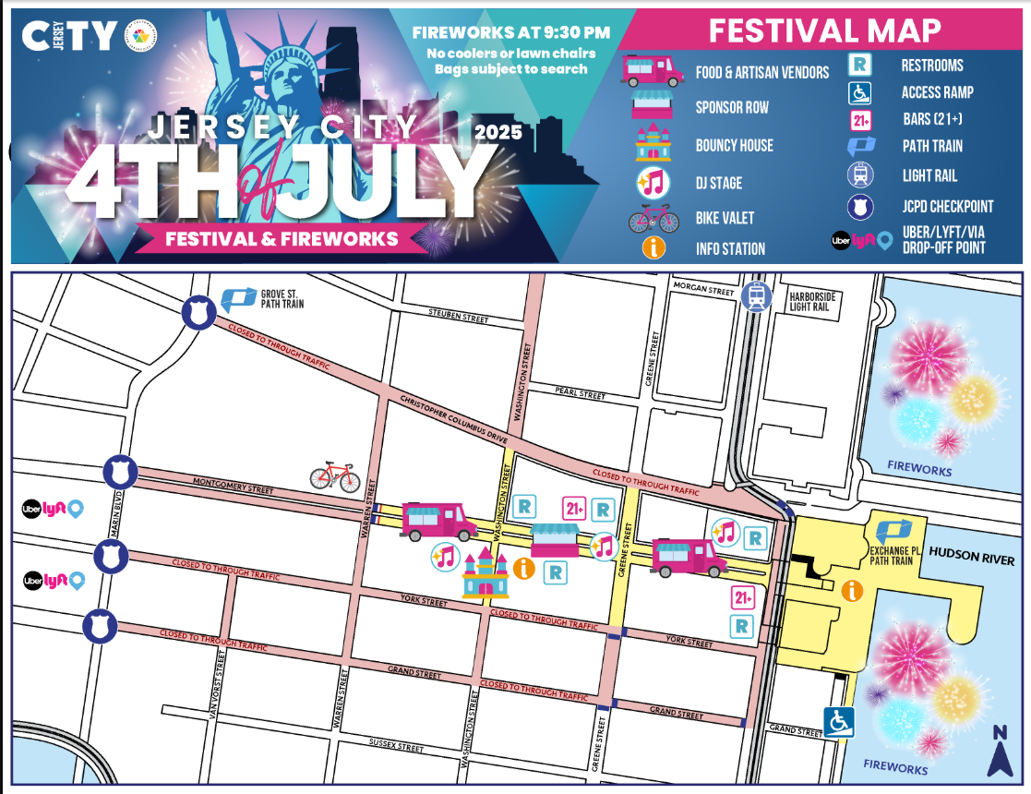
July 4th Events
July 3rd Ball Drop Times Square
  Private event
  Part of 8 ball drops in each US time zone
Fireworks
  NYC
    9:00 pm East River / Brooklyn Bridge Park
    9:30 pm Hudson River
  Jersey City
    9:30 pm Hudson River at Exchange Place
https://america250.org/news/america250-announces-historic-giving-4th-broadcast-benefit-show-with-eight-ball-drop-celebrations-to-mark-midnight-in-each-american-time-zone/
https://freedomandfireworks.com/wp-content/uploads/2025/06/2025-MAP-JULY-4-FINAL.png

Slide 79
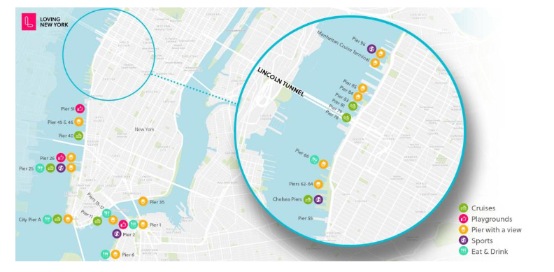
Sail250 Docking and Public Viewing Areas
Manhattan
  Governors Island (July 4)
  Terminal – Pier 88, Pier 90, Pier 92
  Intrepid Pier 86
  South Street Seaport Pier 36
  Harlem Pier
  Midtown 39th St. Pier
  Battery Park Pier
  Wall Street Pier
Staten Island
  Bay St (SI Ferry Terminal)
  Homeport Pier
Brooklyn
  Brooklyn Pier 4 (Brooklyn Army Terminal)
  Brooklyn Bridge Park
Courtesy of NYC Emergency Management

Slide 80
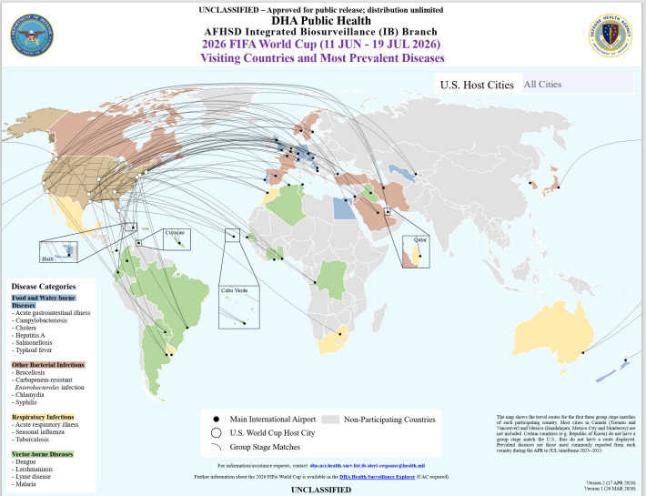
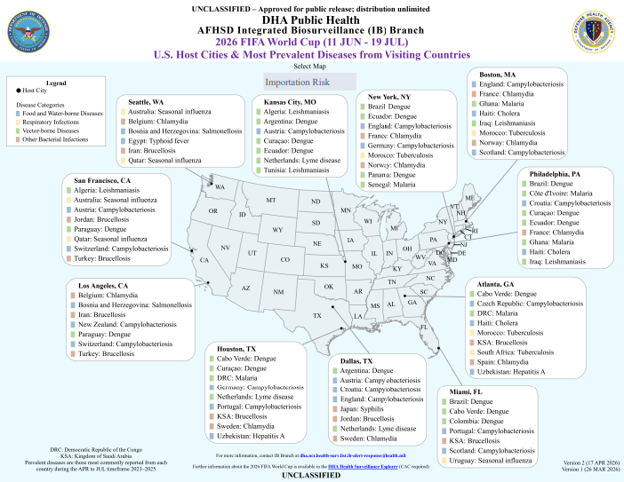
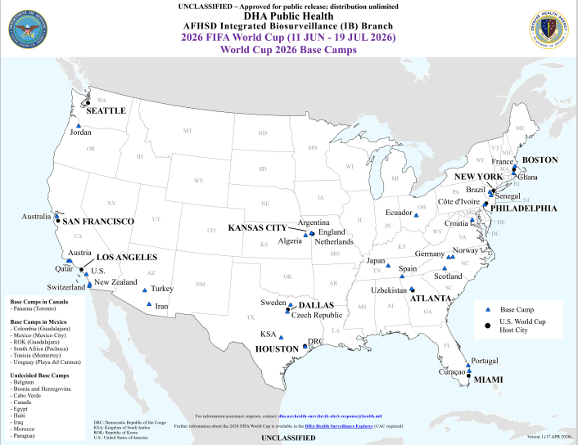
Defense Health Agency: Public Health Resources
Briefing document on Surveillance Preparedness
Maps
  Visiting countries and most prevalent diseases
  Disease importation risks from visiting countries
  Team base camps in relation to host cities
DHA World Cup Health Surveillance Resources – GNYHA

Slide 81



GNYHA Summer Event Preparedness
Supporting hospitals in NJ & NYC in close coordination with
NYC Emergency Management and NJ Health & UASI Group
Exercises & Summits
NYC Annual MRSE Exercise
In-Person Symposiums
Trauma Care
Mass Decontamination
Burn Surge
Updates & Briefings
Briefings to the GNYHA Board and EM meetings
FIFA World Cup Digest Emails
Resources on GNYHA’s Website
Sit Stat Risk Alerts
Opt-in risk alert system
via email and text
Powered by Everbridge’s NC4 Service

Slide 82



Tools & Resources
GNYHA’s Sit Stat System
GNYHA Website & World Cup Digest Emails

Slide 83




Sit Stat FIFA Location Alerts
Email and text alerts
Active notifications during scheduled events
Specific to FIFA locations
Risk categories including
  Crime
  Fire
  Hazmat
  Civil Unrest
  Transportation
Sign up here or use QR code

Slide 84
Thank you
Andrew Dahl
Vice President, Emergency Preparedness and Response
Phone: 212-258-5314
Email: adahl@gnyha.org
Lisa Fenger
Assistant Director, Emergency Preparedness and Response
Phone: 212-506-5432
Email: lfenger@gnyha.org
Nicole Ziogas
Assistant Director, Emergency Preparedness and Response
Phone: 212-554-7728
Email: nziogas@gnyha.org
Notes:
Thank you to the team at GNYHA

Slide 85

IT Disruption
Table Top Exercise
Central Office Emergency Management
Presented by:
Tomas Jimenez-Stuard
Assistant Director
COEM Training and Development

Slide 86
Exercise Overview
Thursday April 9th 2026; 2-hours
Participants: 11 H+H Acute Facilities
Planning Team: COEM, System Downtime Committee, Facility EPCs
Outputs: Evaluation Guides, Participant Feedback/Evaluation Forms
Module 1
Initial Response
Objectives:
-Recognition
-Escalation
Module 2
Coordinated Response
Objectives:
-Recognition
-Escalation
Module 3
Operational Continuity
Objectives:
-Managing Cascading Impacts
-System Coordination

Slide 87
Evaluation Summary
Performed without Challenges (P;4.0) > Performed with Some Challenges (S;3.0) >
Performed with Major Challenges (M; 2.0) > Unable to be Performed (U;1.0)
Module 1: Recognition and Initial Response
  Average Score: 3.8 (High P / S Mix)
Module 2: Incident Command and Coordination
  Average Score: 3.8 (Mostly P)
Module 3: Operational Adaptation and System Support
  Average Score: 3.5 (Variable P / S / M)
Overall Drill Evaluation: 3.7 (Mostly S / P)

Slide 88
Key Findings: Core Strengths
Strong Incident Command Activation: Most facilities (Metropolitan, South Brooklyn, Jacobi) demonstrated a clear, rapid transition to the Hospital Incident Command System (HICS) with established roles for leadership
Redundant Communication Channels: Teams effectively utilized multiple tools for internal alerting, including Everbridge, Alertus, Webex, and physical "Badge Buddies" to ensure staff awareness
Night Shift Proficiency: Several reports (Elmhurst, Queens) noted that night shift staff are often more comfortable with downtime procedures due to frequent system maintenance windows

Slide 89
Key Findings: Improvement Opportunities
Staff Knowledge Gaps
  A "generational gap" was identified at Metropolitan, where younger staff felt panicked by paper workflows. Elmhurst and South Brooklyn noted that staff outside the ED often lacked training on specific downtime forms
Ancillary Department Integration
  Labs and Radiology often had the highest friction. Elmhurst rated Module 3 as "Major Challenges (M)" because these departments were not present, and North Central Bronx struggled with missing pharmacy/lab representatives
Downtime Data Infrastructure
  Reports from South Brooklyn and Metropolitan highlighted that blackout phone directories and clinical checklists were outdated or missing in certain moved departments

Slide 90
Key Findings: Follow-up
Policy / Guidance Refinement
  Clear Trigger- Policies need to be more explicit about the exact "trigger" or duration of a glitch before a unit should independently activate paper charting vs. waiting for a facility-wide Command Center directive
  Back-Entry Standards- There is a request for a system-wide training video or "Downtime Super User" program to ensure clinical areas (especially Ambulatory and Med/Surg) are as proficient as the ED
Standardizing Training Materials
  There is a request for a system-wide training video or "Downtime Super User" program to ensure clinical areas (especially Ambulatory and Med/Surg) are as proficient as the ED
Technical Resource Audit
  Facilities must update and label all blackout phone directories and audit the volume of downtime forms (e.g., ensuring a 1-week supply is physically on-hand)

Slide 91


Participant Feedback

Slide 92
IT Disruption
Table Top Exercise
Thank you!
Presented by:
Tomas Jimenez-Stuard
tomas.jimenez@nychhc.org

Slide 93
Northwell Health
Long Island Jewish Medical Center
Preparing for a Successful Joint Commission Survey

Slide 94


Document Preparation and Review
LIJMC Campus Emergency Management completed a comprehensive review and re-write of all regulatory documents and binders to ensure survey-readiness for the Joint Commission based on 2026 standards.
Binders were completely redone all with new consistent formatting
Updated plans were reviewed with the Emergency Management Committee as part of the first meetings in 2026.
Joint Commission Crosswalk

Slide 95

Training and Education
“Stay Safe” Training
  Active Shooter
  WPV
  Emergency Management
  Safety
CDP Led HERT Course
E-Finds Training
Stair Chair/Med Sled
ICS Training
Northwell MARO Training Center
Environment of Care Rounds

Slide 96




Emergency Management Equipment and Inventory

Slide 97


Preparing for the EM Session – Presentation
Winter Storms Fern and Hernando
January/February
2026
On 1/23/2026, we were struck by a major winter storm (Fern) that brought 8-18 inches of snow, severe cold and
widespread disruptions to over 30 U.S. States and parts of Canada.
On 2/22/2026, we were struck again by a major winter storm (Hernando) that brought 16-24 inches of snow, severe
cold and widespread disruptions across the Northeastern United States.

Slide 98
Preparing for the EM Session - Involving Key Stakeholders
Mock EM Sessions completed with key stakeholders. Many may be participating in a session for the first time.
Document distribution ahead of an anticipated survey is key
  Prep with key stakeholders may help ensure a smooth, collaborative conversation during the session
Northwell System Collaboration

Slide 99


NYC Health Survey of Radiological Bioassay Capability
May 12, 2026
NYU Langone Medical Center
Mark L. Maiello, PhD
NYC Health – Office of Emergency Preparedness & Response, CBRN Unit
mmaiello@health.nyc.gov

Slide 100
Purpose of the Survey
The purpose was to gauge the respondents’ capability to perform an analysis of biological samples from patients (e.g., urine) for internalized radioactivity….

Slide 101
Presentation
Review responses to 4 of the 13 questions to illustrate the bioassay capability of the respondents.
Explain what we face if bioassay had to be done for clinical decision-making.
Indicate further assistance that the respondents requested.

Slide 102
Respondents (100% Completed Survey Only)
NETWORK | HOSPITAL
Episcopal health services | St Episcopal hospital
Independent | University Hospital at Downstate
Independent | Memorial Sloan Kettering Cancer Center
Independent | St. Barnabas Hospital
Independent | Mount Sinai Hospital
Northwell Health | Long Island Jewish Forest Hills
Independent | Unknown
Maimonides Health | Maimonides Medical Center/Maimonides Midwood Community Hospital
New York-Presbyterian | New York-Presbyterian
NYU Langone Health | NYU Langone Medical Center
One Brooklyn Health | Brookdale Hospital
One Brooklyn Health | Interfaith Medical Center and Brookdale Medical Center
Independent | Hospital for Special Surgery
Independent | Unknown
WHMC | Wyckoff Heights Medical Center
Montefiore Health System | Montefiore Medical Center

Slide 103
Q4: If you were asked to analyze a bioassay sample from a patient for quantitative assessment of internal radioactivity, what sample would you prefer?
Answered: 16 Skipped: 10
25.0% | 4
0.0% | 0
12.5% | 2
37.5% | 6
25.0% | 4
0.0% | 0

Slide 104
Q5: If you had to analyze a patient's bioassay sample for a quantitative assessment of internal radioactivity, what device/procedure would you use?
Answered: 16 Skipped: 10
18.8% | 3
0.0% | 0
31.2% | 5
0.0% | 0
25.0% | 4
12.5% | 2
12.5% | 2

Slide 105
Q7: If you responded, "Radiation Safety Officer's liquid scintillation counter" or "Another liquid scintillation counter" please indicate the manufacturer here:
Answered: 16 Skipped: 10
6.2% | 1
6.2% | 1
6.2% | 1
6.2% | 1
6.2% | 1
68.8% | 11
One each at Columbia and Weill-Cornell

Slide 106
Q9: Does your liquid scintillation counter have the capability to rapidly quantify a bioassay result for a radioisotope other than H-3 and C-14 without extensive re-calibration using standards?
Answered: 16 Skipped: 10
0.0% | 0
37.5% | 6
62.5% | 10
0.0% | 0
0.0% | 0

Slide 107
The State of Bioassay
There are only 2 hospital based liquid scintillation counters in NYC - that we know of - that can do a rad-bioassay rapidly (without calibration).
Unless there were an official waiver, the results could not be used for clinical decision-making under the federal and state regulations for Clinical Laboratory Improvement Amendments (the CLIA regulations).
There is only one U.S. commercial laboratory that is CLIA-accredited for radiological bioassay: General Engineering Laboratories (GEL) in Charleston, SC.
  Increases the time to obtain results (packaging, shipping, analysis)
  Requires financing

Slide 108
Q13: How can the NYC Department of Health assist your planning efforts for a radiological emergency? Check all that apply.
Answered: 16 Skipped: 10
68.8% | 11
87.5% | 14
68.9% | 11
75.0% | 12
25.0% | 4

Slide 109
How can the NYC Department of Health assist your planning efforts for a radiological emergency?
Answered: 3 Skipped: 13
“If possible, provide human resource[s] to assist in case of emergency.”
“Any assistance would be helpful as we are not as versed nor do we have the necessary assays or equipment to test for radioactive events.”
“We need to have [a] center for bioassay for NYC so that other hospitals could send their samples to be analyzed in [a] specific place and [to] minimize cost.”

